Slide 1
Lateralization quotient and hand users in clinical scales of BD
14th May 2026

Slide 2
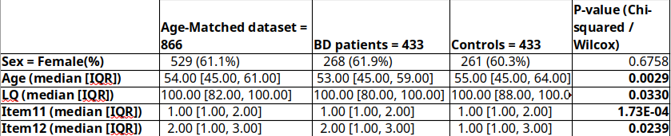
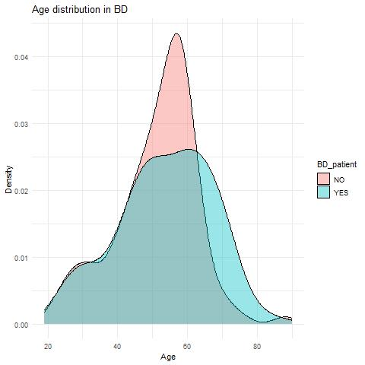
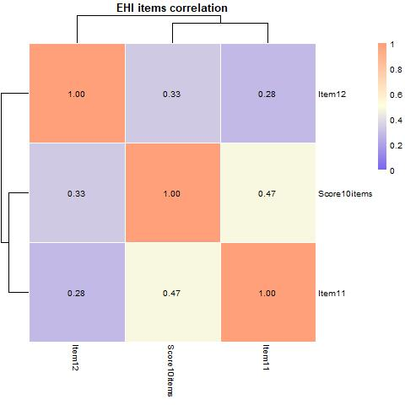
Previously…
Different distribution in Age, LQ, preferred foot and eye. Weak correlation between eye/foot to handedness.

Slide 3
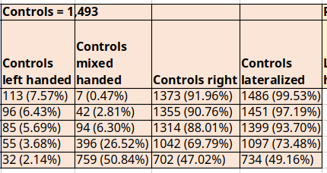
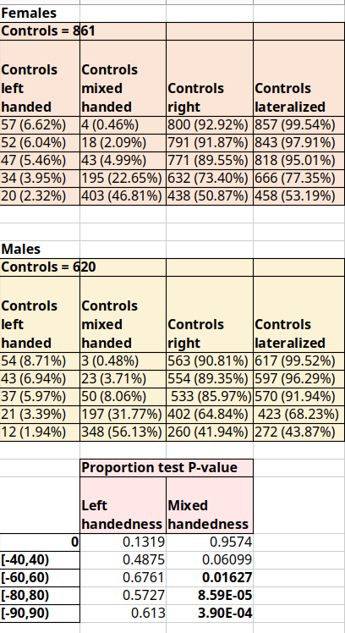
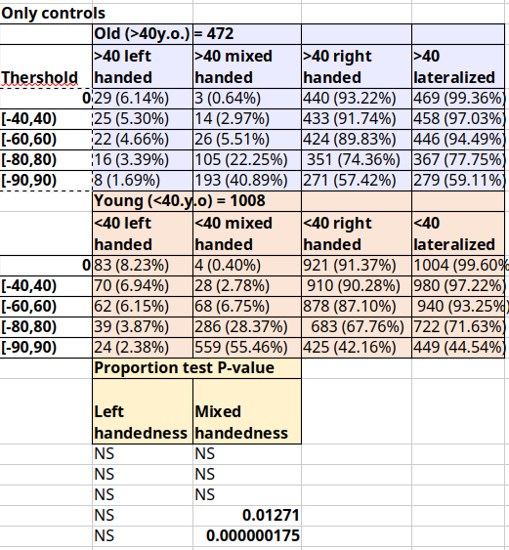
Regarding our control population
Previously…
Proportions as expected for Spanish population (validation through external data ongoing).
Sex differences, and age differences, in mixed handedness.

Slide 4
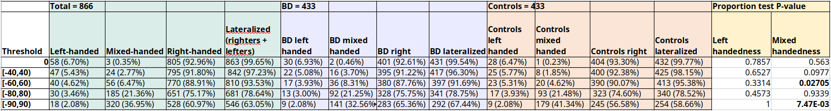
Previously…
Prevalence of hand-use groups between BD and non-BD
Age-matched control group. Trend in lateralized/non-lateralized at cutoff=60, significant at cutoff=90

Slide 5
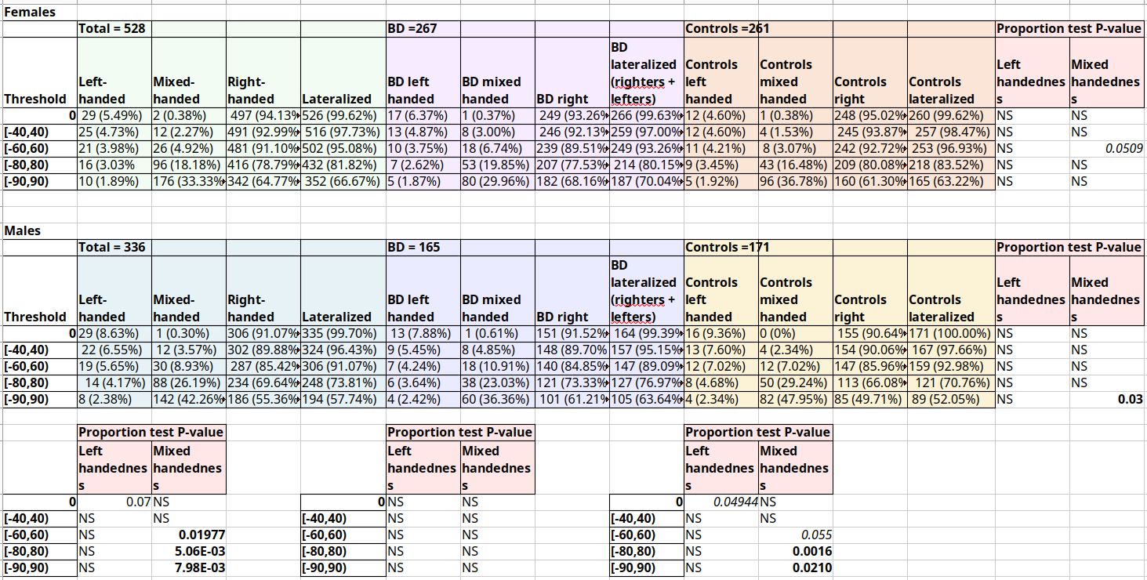
Previously…
Sex differences in handedness patterns are not present in BD group

Slide 6
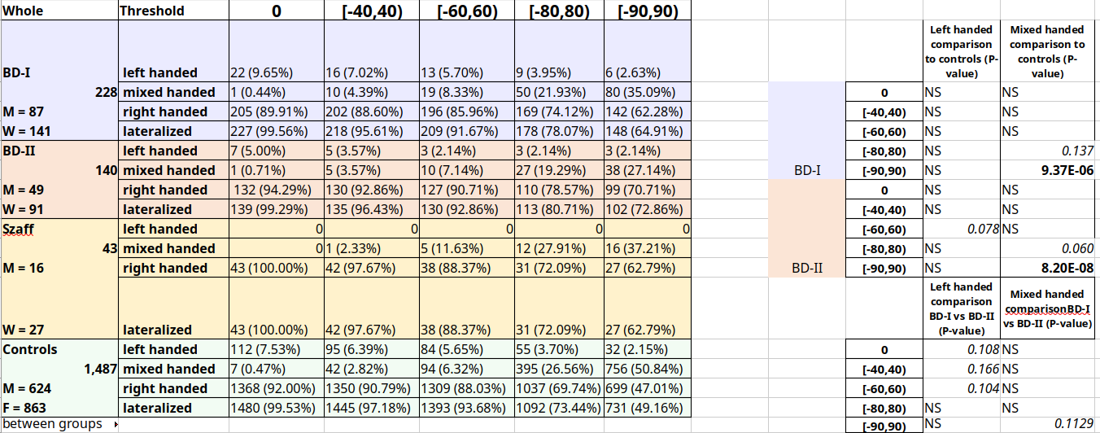
Previously…
Only suggestive trends for BD subtypes differences
Yet to be updated with age-matched controls

Slide 7
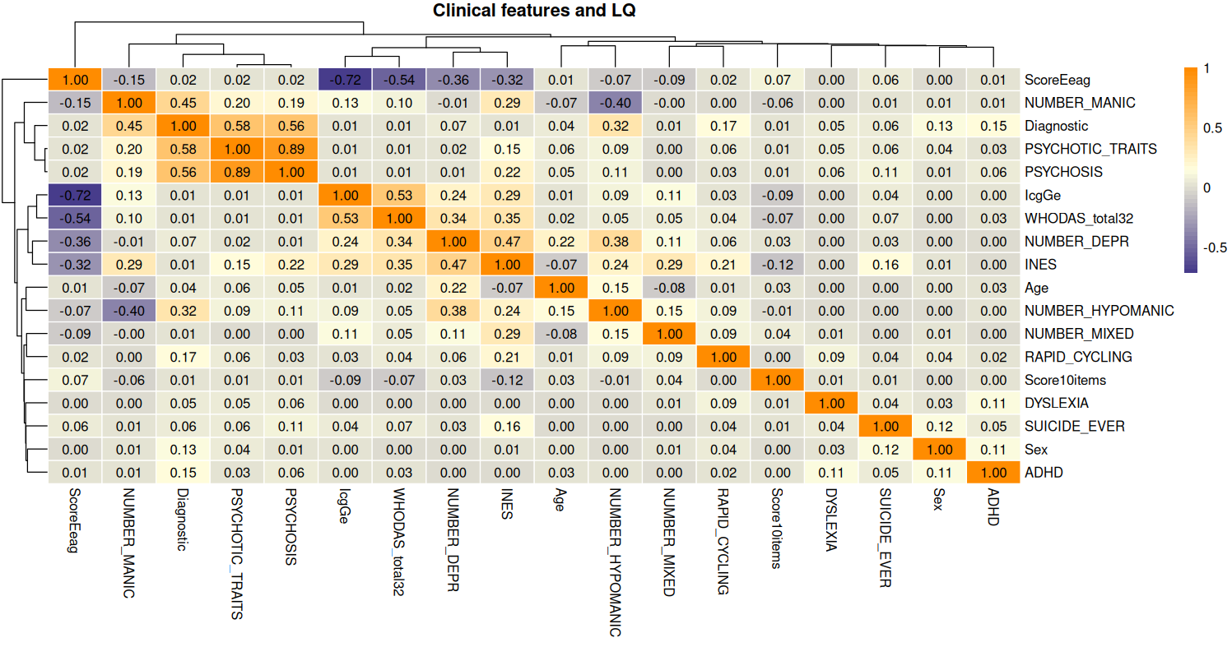
Correlation of clinical features and scales to LQ
Traits, comorbidities and number of events are too sparse to represent any clinical change by themselves.
Aggregation by Index of Number of Events and Severity (INES) leverages their signal.
Score10items = Lateralization quotient based on Edinburgh Handedness Inventory; IcgGe = Clinical Global Impression; WHODAS_score32 = World Health Organization Disability Assessment Schedule; ScoreEeag = Global Assessment of Functioning

Slide 8
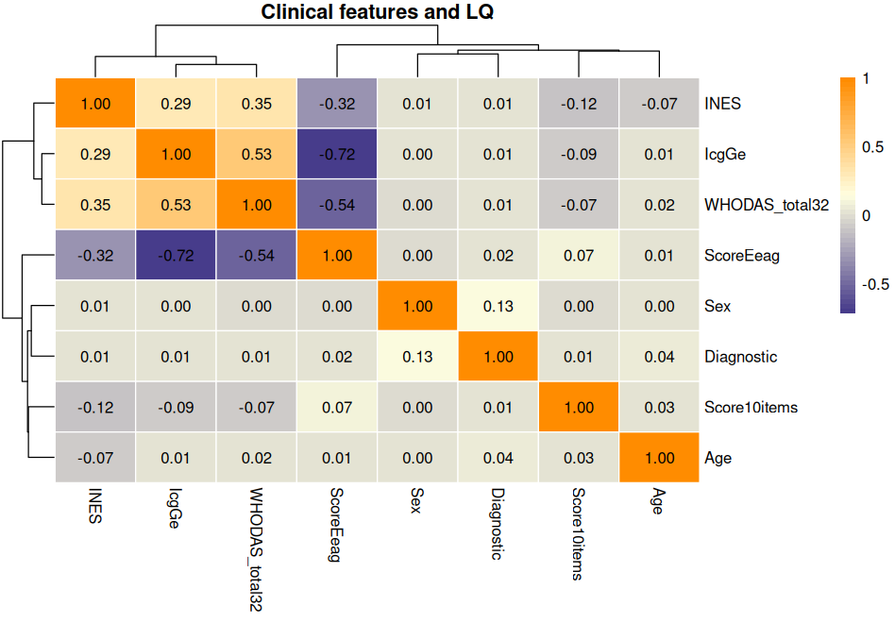
Correlation of scales and LQ (zoom in)
Modest but consistent signal between LQ and clinical scales (>7%).
High correlation of scales between one another, but answer to different pathology dimensions.

Slide 9
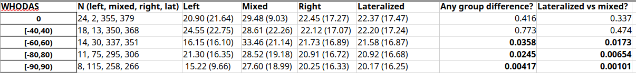
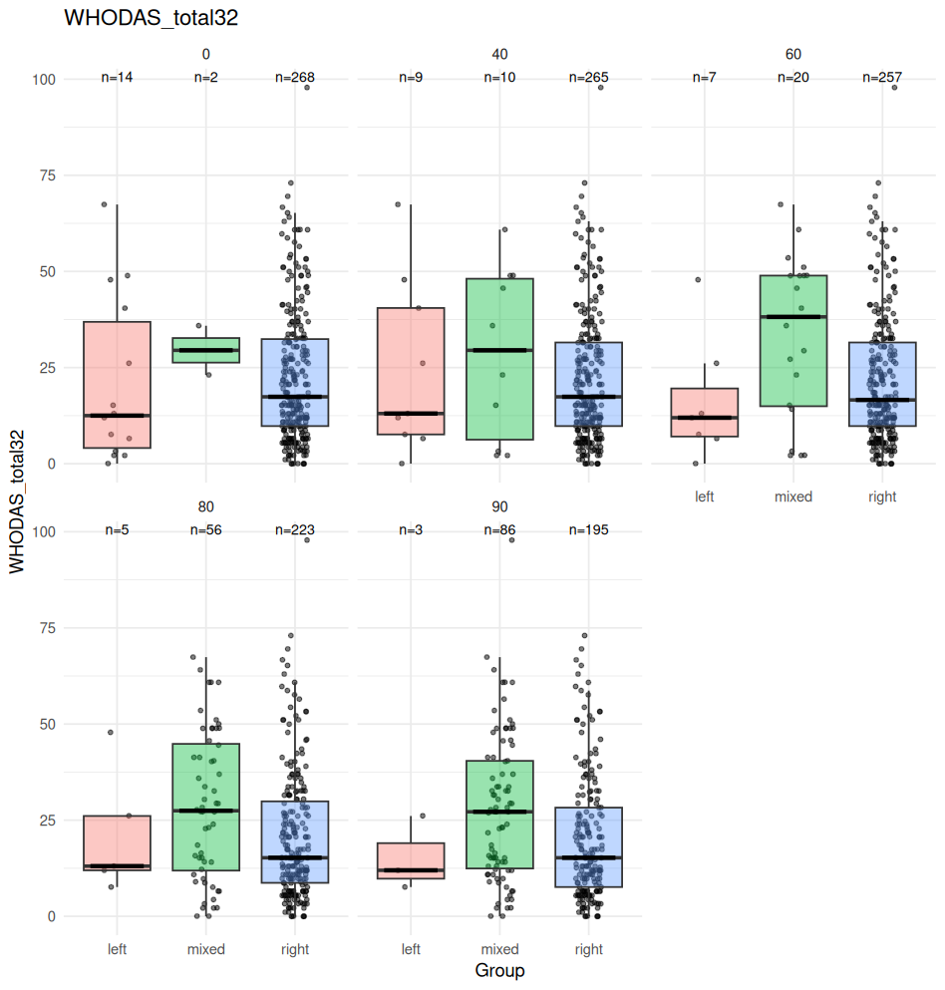
LQ and WHODAS (Disability assessment)

Slide 10
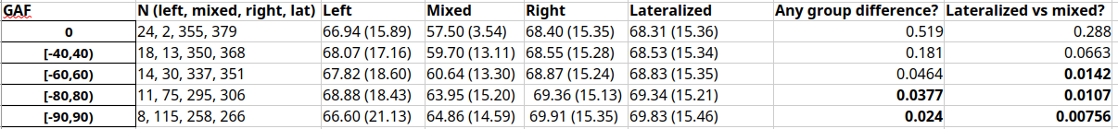
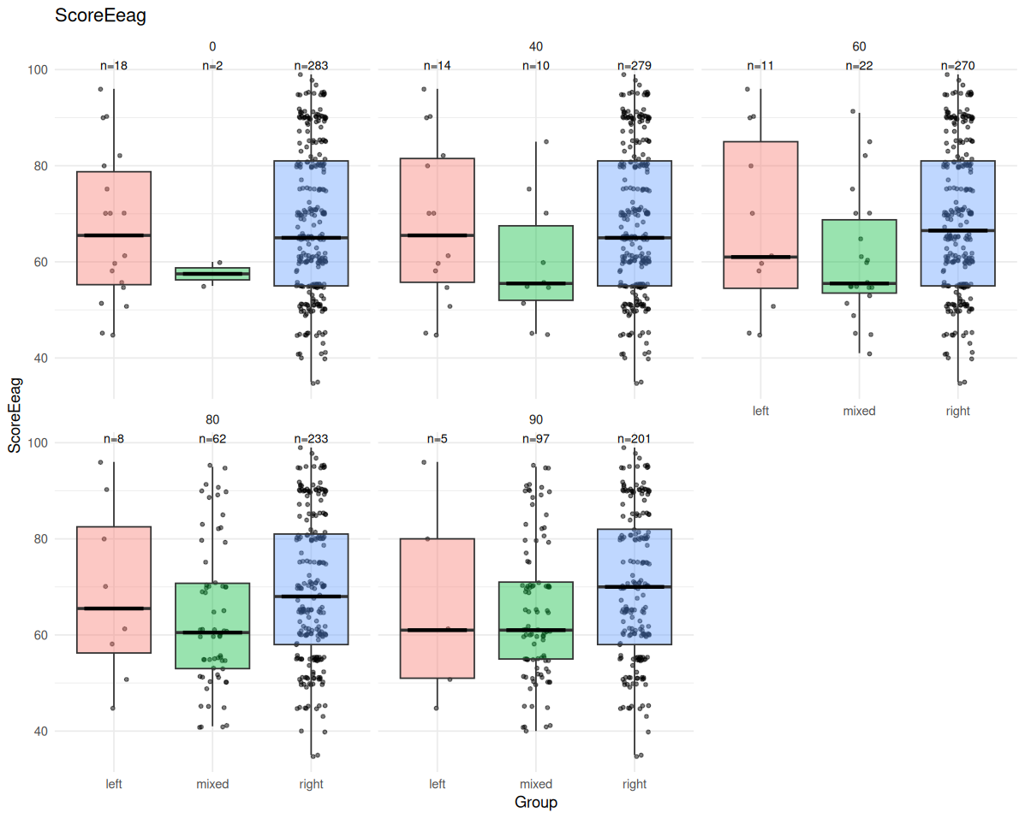
LQ and GAF (functioning)

Slide 11
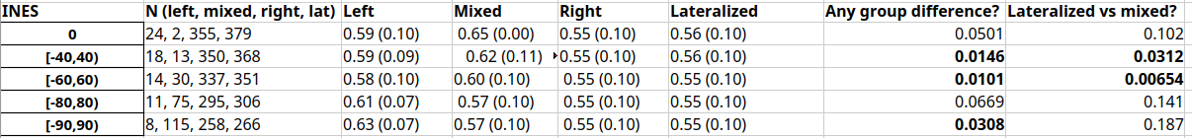
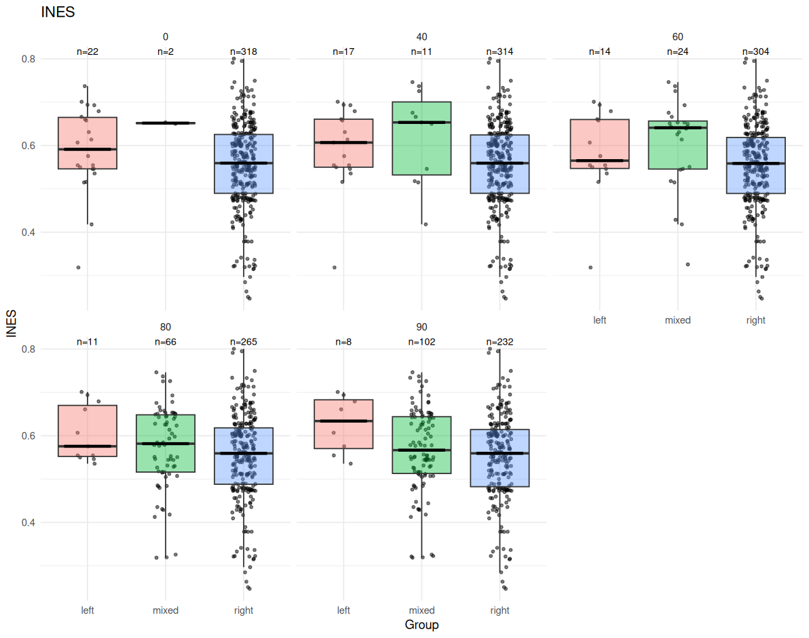
LQ and INES (severity over years of disease)

Slide 12
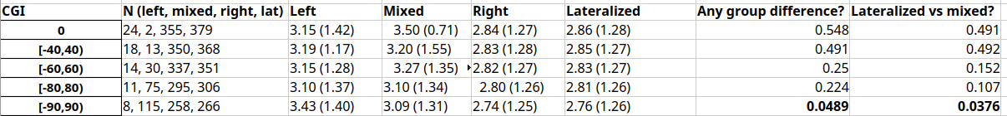
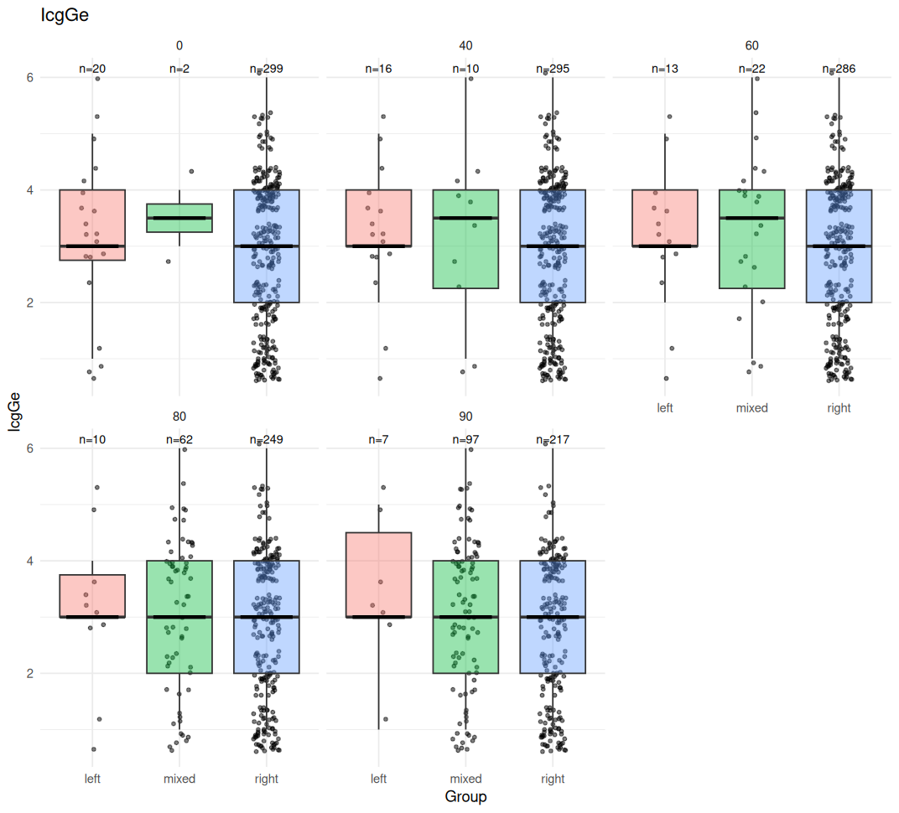
LQ and CGI

Slide 13
In summary
Mixed-handed group, when the cutoff for mixed-handed is set to 60 or above, present higher scores on WHODAS (disability) and lower in GAF (functioning).
INES scores differ in lateralized vs non-lateralized comparison only when a “stringent” cutoff for mixed handedness is considered (40 and 60). There is a trend in higher INES in left-hand users when cutoff is set to 90*.
CGI scores are slightly higher in the 7 ** left-handed individuals that remain when the cutoff for hand use is set to 90, and higher for mixed-handed indivs than for controls*.
* for those statistical comparisons I have yet to do
** I have to correct the table numbers. Now, it is the absolute BD patients that we have in that group, but not all of them have info for all the scales. The actual number is in the boxplots

