Slide 1


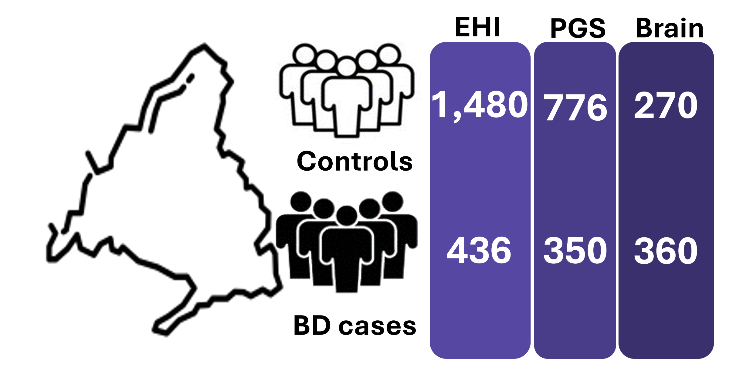




Atypical handedness as a marker of altered brain lateralization: genetic and clinical study in bipolar disorder
Inés García-Ortiz¹, Lucía Albarracín García^{2,3,4,5,6,7}, Elisabet Madridejos Palomares^{3,4}, Miriam Martínez-Jiménez¹, Rosa Ana Bello Sousa⁴, Inés Carpio-López¹, Sergio Sánchez-Alonso⁴, Sergio Benavente López⁵, Raquel Álvarez García⁶, Laura Jiménez Muñoz^{3,4,5}, Ezequiel Di Stasio⁷, Carlos López de la Hoz¹, Raúl Somavilla Cabrero¹, Noelia Borge García¹, Rebeca Jiménez⁸, Marta Bermejo Bermejo⁸, Janice Fullerton^{9,10}, Enrique Baca García^{3,4,5,6,7,11,12,13}, Silvia Paracchini¹⁴, Claudio Toma^{1,15}
¹Centro de Biología Molecular Severo Ochoa (CBMSO), UAM/CSIC, Madrid, Spain; ²School of Psychology, Universidad Alfonso X el Sabio, Madrid, Spain; ³Instituto de Investigación Sanitaria Fundación Jiménez Díaz, Madrid, Spain; ⁴ Department of Psychiatry, Hospital Universitario Fundacion Jiménez Díaz, Madrid, Spain.; ⁵Department of Psychiatry, Hospital Universitario Infanta Elena, Valdemoro, Madrid, Spain; ⁶Department of Psychiatry, Hospital Universitario Rey Juan Carlos, Mostoles, Madrid, Spain; ⁷Department of Psychiatry, Hospital General de Villalba, Madrid, Spain; ⁸Departament of Occupational Medicine and Work Health, Consejo Superior de Investigaciones Científicas (CSIC), Madrid, Spain; ⁹Neuroscience Research Australia, Sydney, NSW, Australia; ¹⁰School of Biomedical Sciences, University of New South Wales, Sydney, NSW, Australia; ¹¹Department of Psychiatry, Universidad Autónoma de Madrid, Madrid, Spain; ¹²CIBERSAM (Centro de Investigación Biomédica en Red Salud Mental), Instituto de Salud Carlos III, Madrid, Spain; ¹³Universidad Católica del Maule, Talca, Chile; ¹⁴School of Medicine, University of St Andrews, St Andrews, UK; ¹⁵School of Clinical Medicine, Discipline of Psychiatry and Mental Health, University of New South Wales, Sydney, NSW, Australia
1
Introduction
Objectives
Handedness is associated with brain asymmetries. The prevalence of non-right-handedness (NRH) is estimated at 18% in the general population. NRH has been reported at higher rates in psychiatric conditions like schizophrenia (SCZ), in concordance with altered patterns of brain asymmetries. Studies of NRH in bipolar disorder (BD) are limited, and frequently rely on small cohorts or lack of deep phenotypic data.
Estimate the prevalence of NRH in BD, and across subtypes and clinical features
Evaluate polygenic score (PGS) for handedness, schizophrenia and BD across diagnostics and handedness groups
Identify differential gene expression associated with handedness in brain-imputed transcriptomic data
2
Methods
The MadManic cohort was used to select individuals with Edinburgh Handedness Inventory (EHI) (Fig.1). Threshold for NRH was set on 60 on the lateralization quotient (LQ). Polygenic score (PGS) was computed in 1,126 individuals over BD GWAS (N = 840,309) and handedness GWAS (N = 1,766,671). BrainGenie was used to impute brain expression from blood RNAseq data of 630 individuals.
3
Prevalence
Controls (N=1,480)
3
Polygenic Scores
3
Brain expression
3
Discussion
References
Colbert, S.M.C. et al. Defining suicidality phenotypes for genetic studies: perspectives of the PGC Suicide Working Group. Mol Psychiatry 30, 6144–6154 (2025). https://doi.org/10.1038/s41380-025-03271-y
Colbert, S.M.C. et al. Genome-wide association studies identify 77 loci for suicidality and provide novel biological insights. medRxiv (2025). https://doi.org/10.1101/2025.10.22.25338076
Grants PID2020-114996RB-I00, CNS2022-135318, PID2023-149154OB-I00

