Slide 1
Laterality Project: updates
8th May 2026

Slide 2
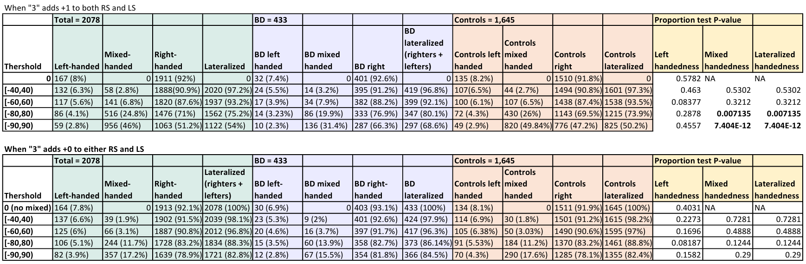
Prevalence comparison (preliminar, week 1)
RS -> Right Score
LS -> Left Score
RS - LS
RS + LS
= LQ
We decide to go for this and think about how to distinguished between inconsistent hand users and ambidextrous by thinking another approach.

Slide 3
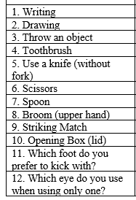
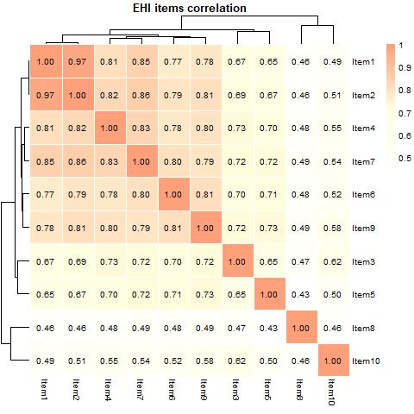
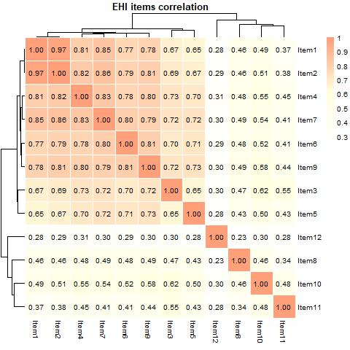
Correlation EHI items
Item1 -> writing; Item2 -> drawing.
Less correlated -> Item8, upper hand using broom.
Open box lid presents more correlation to preferred foot than to other hand ítems.
Preferred eye has the least correlation to the rest of the items

Slide 4
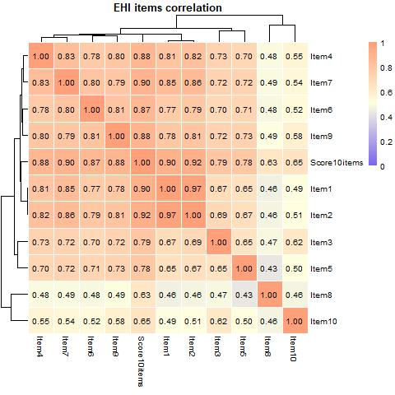
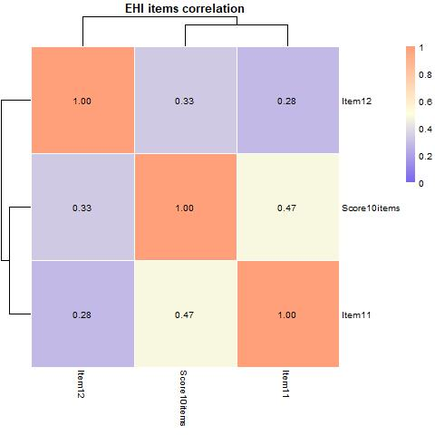
Correlation with LQ

Slide 5
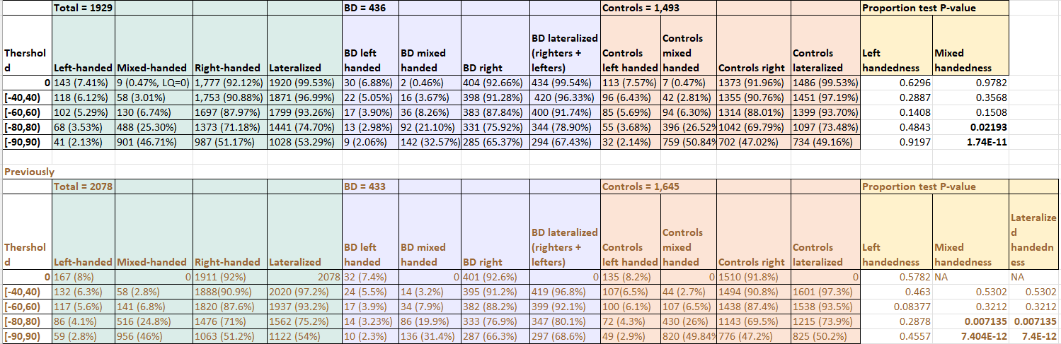
Prevalence comparison (after 1st lab meeting )
Very, very similar

Slide 6
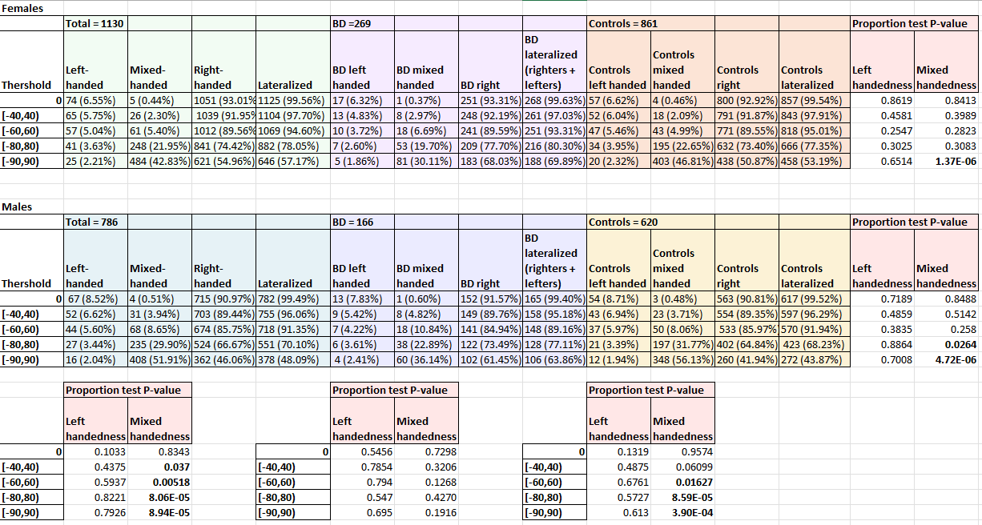
What happens with sex
Expected diff between males and females. If considering non-right-handedness (left+mixed) would still be there

Slide 7
What happens with sex
No differences between males and females in BD

Slide 8
What happens with sex
More differences in mixed handedness in males when comparing BD and controls, but still some in females

Slide 9
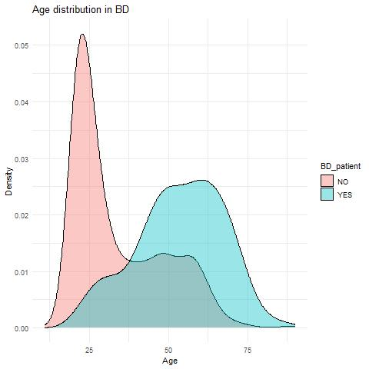
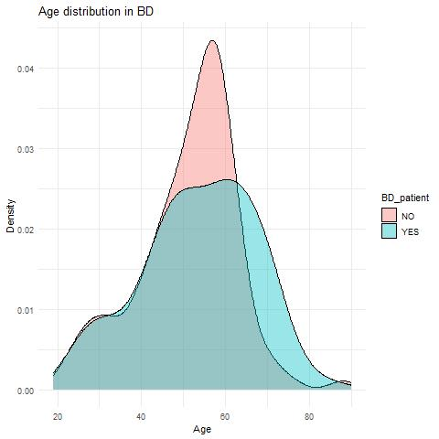


Integrating age
Wild difference in age distribution between cases and controls.
436 BD, 1,493 controls
433 BD, 433 controls

Slide 10
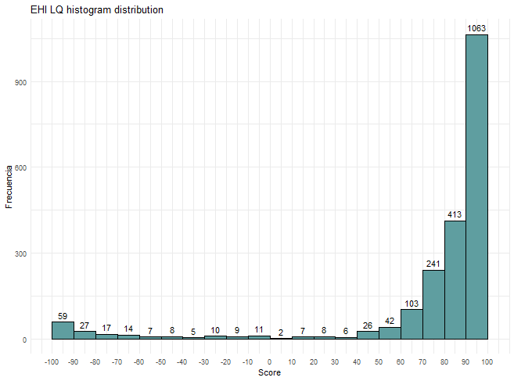
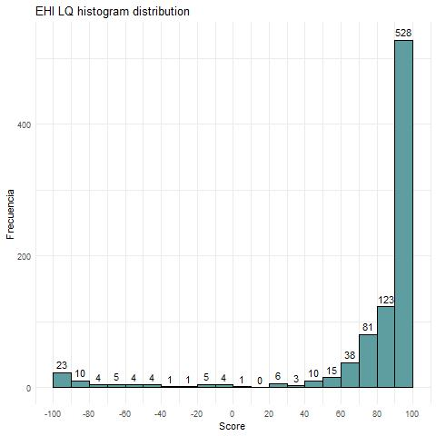
LQ dist in all
Unbalanced
Balanced

Slide 11
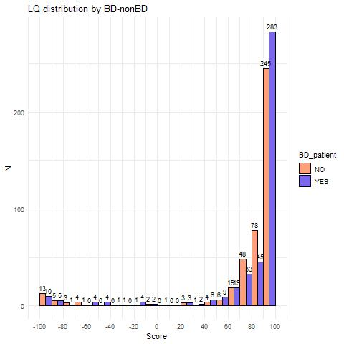
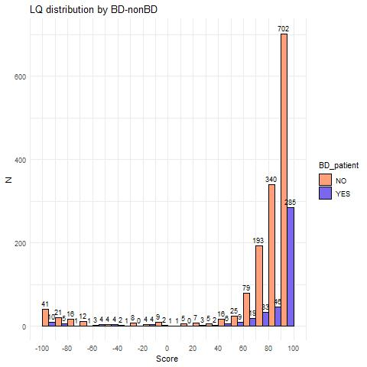
LQ dist by BD
Unbalanced
Balanced

Slide 12
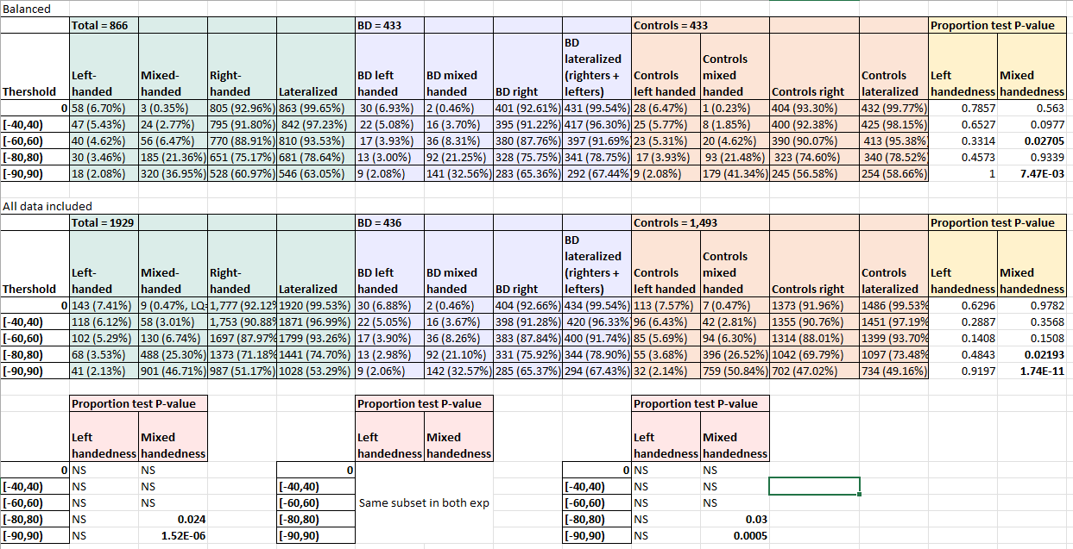
Comparison with previous data
There is more mixed handedness among younger people.
Proper effect should be calculated over oldies vs youngies. In this cases, the comparison is oldies vs all sample, which is not correct for sharing

Slide 13
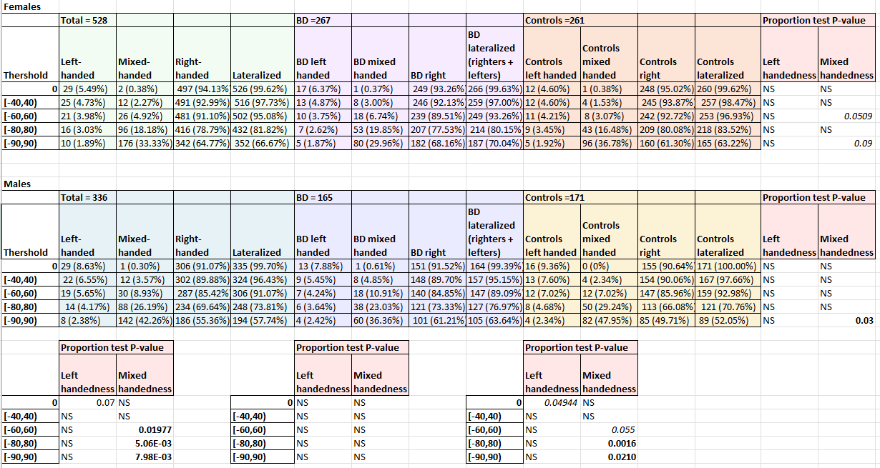
Stratification by sex
Similar patterns as with unbalanced data, but subtler.
Interesting how, in left handers when thr = 0, % of females is 5.49% and males is 8.63%. When BD are removed, males reach 9.36% of left handedness

