Slide 1
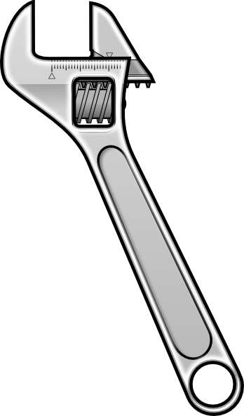
A wrench is used to loosen a tight bolt as shown. Which force will be the most effective?
D
B
C
A

Slide 2
A wrench is used to loosen a tight bolt as shown. Which force will be the most effective?
D
B
C
A

Slide 3
Given that torque, τ=rF┴, rank the effectiveness of the 3 forces from greatest to least.
C=5N
B=4N
A > B > C
C > B > A
A = B = C
B > A = C
A=3N
3cm
4cm
5cm

Slide 4
Given that torque, τ=rF┴, rank the effectiveness of the 3 forces from greatest to least.
C=5N
B=4N
A > B > C
C > B > A
A = B = C
B > A = C
A=3N
3cm
4cm
5cm

Slide 5
Given that torque, τ=rF┴, rank the effectiveness of the 3 forces from greatest to least.
B=5N
C=8N
15º
20º
A > B > C
C > B > A
A = B = C
B > A = C
40º
A=4N
3cm
4cm
5cm

Slide 6
Given that torque, τ=rF┴, rank the effectiveness of the 3 forces from greatest to least.
B=5N
C=8N
15º
20º
A > B > C
C > B > A
A = B = C
B > A = C
40º
A=4N
3cm
4cm
5cm

