Slide 1
Version Control and Agile Development
What and Why?

Slide 2
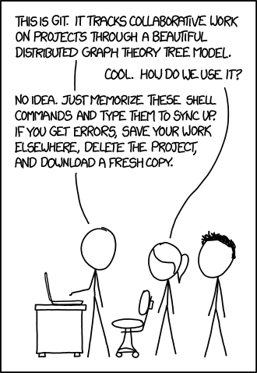
What?
A project storage system where either the most recent version or the most agreed upon version of the project can exist.
Can be remote or local
Can be centralized or distributed

Slide 3
Why?
Version control, regardless of type, allows a team to have a version of the project independent of their local copies.
Allows a team to designate a single source of truth, that is an agreed upon state that other developers can continue their work from
Allows individual developers to work without worrying about working on the same file(s) at the same time
…at least until it is submitted to the version control system

Slide 4

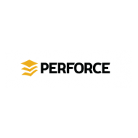

Centralized Version Control
The system has the entire change history while the individual developers only have a single copy of the work, the last copy they pulled from the system
Committing (submitting a change) is applied directly to the system
The concept of “single source of truth” is enforced by the system and not the team
Examples: Subversion (SVN), Perforce, Concurrent Versions System (CVS)

Slide 5
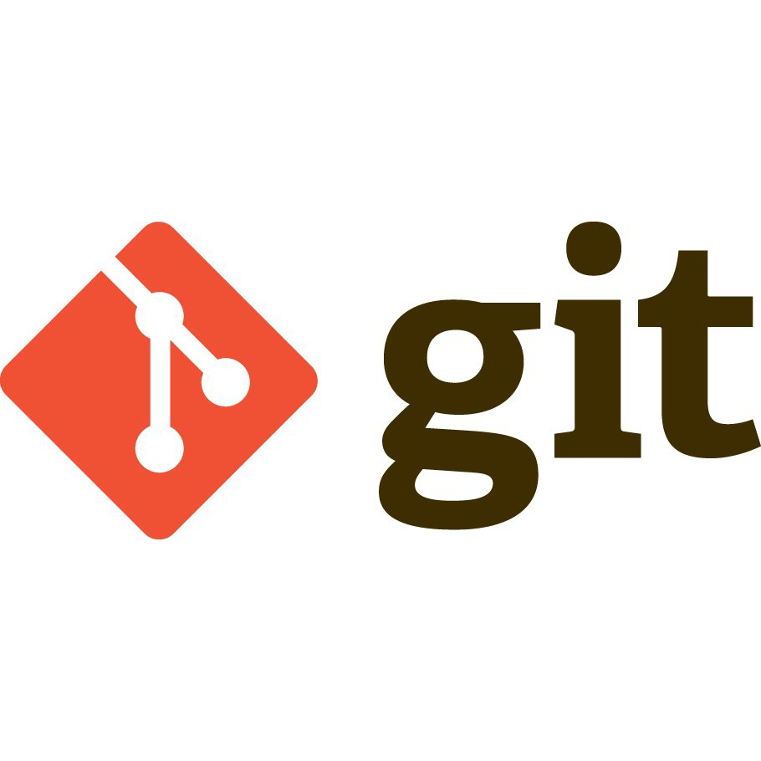

Decentralized Version Control
Each individual developer has a copy of the entire change history for them to work on
Committing is applied to your personal copy of the change history
Pushing is what applies your changes to the system
The “single source of truth” can be decided on by the team, it is not strictly enforced
Examples:

Slide 6

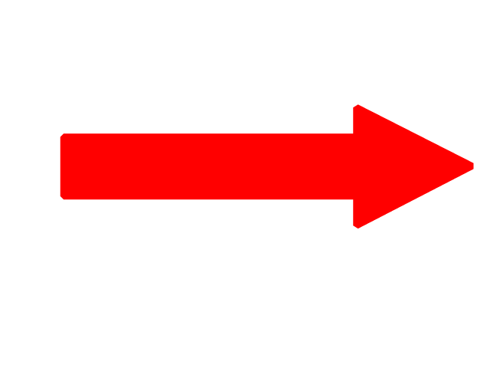
Repositories
GitHub is a service that hosts Git repositories on the web. Git, created by Linus Torvalds, is the core functionality behind Github. A repository is essentially a storage unit for a project that allows you to track versions of your files. Take this video project for example:
Version 1.0 Version 2.0 Version 2.1 Version 2.2
Original File Cut out all unwanted parts Added transitions Special Effects

Slide 7
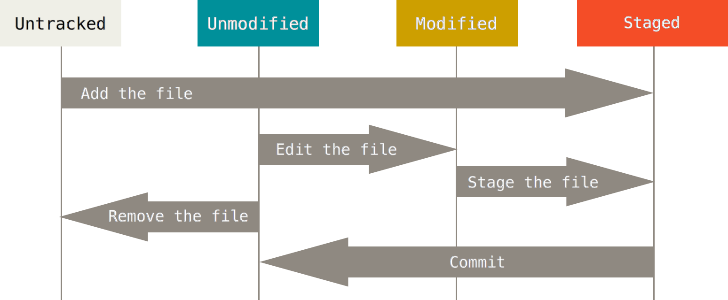
Basic Workflow

Slide 8
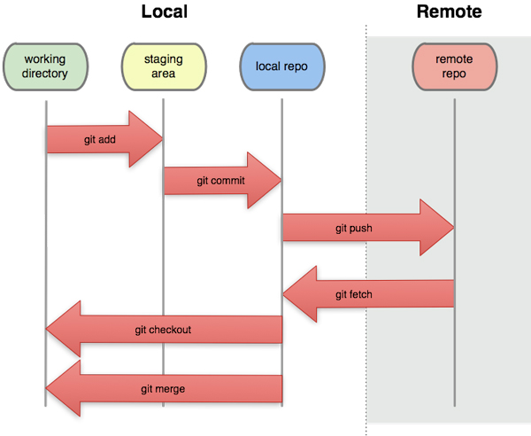
Example With Git
Most common commands:
clone - download repo
add - stage files
commit - commit files
push - push commits to remote
fetch - updates local repo
branch - create new branch
checkout - change current branch
merge - try to combine changes
pull - fetch and merge

Slide 9
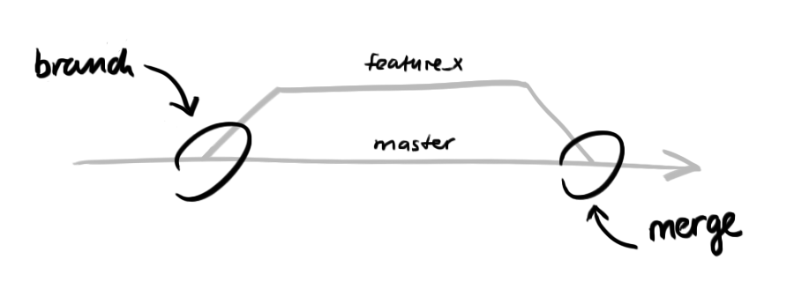
Merge Conflicts
Merge conflicts occur in either type of version control.
They happen when two developers have worked on the same code.
The system needs to figure out which is the version that should be treated as canon
There are automatic ways to resolve the conflict, but in many cases it requires manual intervention from one or more of the developers

Slide 10
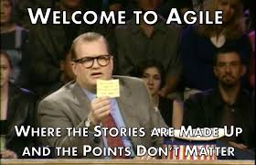

Slide 11
What is agile?
A product development scheme based on Japanese automakers work methodology
The “sprint” concept, short units of work that typically are chosen to last a week
”Stand Up” a daily meeting to discuss progress that was made the prior day
Many different types of agile
Kanban
Pivotal
Scrum
XP (Extreme Programming)

Slide 12
Tools to help with agile
Trello
Cards with tasks
Heavily customizable for individual workflow
Pivotal Tracker
More structured
Built to facilitate the pivotal method
Can be used for any alternate agile method
Asana, Taiga, Agile Zen, etc

Slide 13
How does agile fit in here.
Your project will have weekly components that are due.
This is supposed to shadow the sprint concept
As discussed random teams will be selected each class to present to shadow the stand up concept

Slide 14
For more information on agile.
https://www.tutorialspoint.com/agile/agile_primer.htm

