Slide 1
Bitcoin overview
Joseph Bonneau

Slide 2
Recall: Cryptographic Hash Functions
Input: data of any length. Output is fixed length.
Easy to compute h(x). Infeasible to get x, given h(x).
Given x, infeasible to find y such that h(x) = h(y). Weak collision property.
Infeasible to find any pair x and y such that h(x) = h(y). Strong collision property.
If we know H(x) = H(y) we assume that x = y.
Instead of storing x, store H(x)
Can fetch x from untrusted source and verify H(x)

Slide 3
Key idea:
Take any pointer-based data structure
Replace pointers with cryptographic hashes
We now have an authenticated data structure

Slide 4
Hash pointers
H( )
(data)

Slide 5
Blockchain: Linked list with hash pointers
H( )
prev: H( )
prev: H( )
prev: H( )
data
data
data
use case: tamper-evident log

Slide 6
Modifications to any block will propagate forever
H( )
prev: H( )
prev: H( )
prev: H( )
data
data
data

Slide 7
Modifications to any block will propagate forever
H( )
prev: H( )
prev: H( )
prev: H( )
data
data
data

Slide 8
Fact:
chains with same hash, different data → collision
prev: H( )
prev: H( )
prev: H( )
data
data
data
x
prev: H( )
prev: H( )
prev: H( )
data
data
data

Slide 9
Merkle tree: binary tree with hash pointers
H( ) H( )
H( ) H( )
H( ) H( )
H( ) H( )
H( ) H( )
H( ) H( )
H( ) H( )
(data)
(data)
(data)
(data)
(data)
(data)
(data)
(data)

Slide 10
proving membership in a Merkle tree
H( ) H( )
H( ) H( )
H( ) H( )
H( ) H( )
H( ) H( )
show O(log n) neighbors
(data)
(data)

Slide 11
Simple cryptocurrencies

Slide 12
Obvious approach
Use public keys as addresses
Sign to authorize transfer to new address
New coins created [somehow]

Slide 13

GoofyCoin

Slide 14
Goofy can create new coins
New coins belong to me.
signed by pk_{Goofy}
CreateCoin [uniqueCoinID]

Slide 15
A coin’s owner can spend it.
I’m paying Alice
signed by pk_{Goofy}
Pay to pk_{Alice} : H( )
signed by pk_{Goofy}
CreateCoin [uniqueCoinID]

Slide 16

The recipient can pass on the coin again.
signed by pk_{Alice}
I’m paying Bob
Pay to pk_{Bob} : H( )
signed by pk_{Goofy}
Pay to pk_{Alice} : H( )
signed by pk_{Goofy}
CreateCoin [uniqueCoinID]

Slide 17
double-spending attack
signed by pk_{Alice}
signed by pk_{Alice}
Pay to pk_{Bob} : H( )
Pay to pk_{Carol}: H( )
signed by pk_{Goofy}
Pay to pk_{Alice} : H( )
signed by pk_{Goofy}
CreateCoin [uniqueCoinID]

Slide 18
Double-spends must be prevented
X₂ = Sign_{Alice}(Transfer X₁ to Bob)
Bob
X₁ = Sign_{Bank}(Transfer X₀ to Alice)
Alice
BANK
X’₂ = Sign_{Alice}(Transfer X₁ to Carol)
Carol

Slide 19
Historical approach: talk to the issuer
X₂ = Sign_{Alice}(Transfer X₁ to Bob)
X₁ = Sign_{Bank}(Transfer X₀ to Alice)
Bob
Alice
BANK
Has X₁ been spent yet?
X₁

Slide 20
Bitcoin’s approach: global ledger
Transfer X₁ Issuer→Bob, Sign_{Issuer}
Transfer X₁ Alice→Bob, Sign_{Alice}
Transfer X₁ Bob→Carol, Sign_{Bob}
...
time

Slide 21
Bitcoin’s approach: global ledger
Transfer X₁ Issuer→Bob, Sign_{Issuer}
Transfer X₁ Alice→Bob, Sign_{Alice}
Transfer X₁ Bob→Carol, Sign_{Bob}
Transfer X₁ Alice→David, Sign_{Alice}
clearly invalid!
time

Slide 22
Ledger implementation: blockchain
Globally tracked
H( )
prev: H( )
prev: H( )
prev: H( )
transID: 71
transID: 72
transID: 73
Transfer X₁
Alice→Bob
Transfer X₁
Bob→Carol
Transfer X₁
Carol→Dave
“The Blockchain”

Slide 23
Transaction semantics

Slide 24
Bitcoin is transaction-based
There are no “accounts”
Transactions destroy old “coins”, create new ones
Sum of new coins ≤ sum of old coins
outputs ≤ inputs

Slide 25
A transaction-based ledger (Bitcoin)
time
Create: #1 to Alice (25 coins)
Input: #1
Output: #2 to Bob (17), #3 to Alice (8)
SIGNED(ALICE)
Input: #2
Output: #4 to Charlie (8), #5 to Bob (9)
SIGNED(BOB)
Input: #3
Output: #6 to David (6), #7 to Alice (2)
SIGNED(ALICE)
Notes:
This is called a “change address”

Slide 26
A transaction-based ledger (Bitcoin)
time
Create: #1 to Alice (25 coins)
A change address
Input: #1
Output: #2 to Bob (17), #3 to Alice (8)
SIGNED(ALICE)
Input: #2
Output: #4 to Charlie (8), #5 to Bob (9)
SIGNED(BOB)
Input: #3
Output: #6 to David (16), #7 to Alice (2)
SIGNED(ALICE)
Notes:
This is called a “change address”

Slide 27
A transaction-based ledger (Bitcoin)
time
Create: #1 to Alice (25 coins)
Input: #1
Output: #2 to Bob (17), #3 to Alice (8)
SIGNED(ALICE)
follow the
hash pointers
Input: #2
Output: #4 to Charlie (8), #5 to Bob (9)
SIGNED(BOB)
Input: #3
Output: #6 to David (6), #7 to Alice (2)
SIGNED(ALICE)
is this valid?
Notes:
This is called a “change address”

Slide 28
Merging value
time
Input: #1
Output: #2 to Bob (17), #3 to Alice (8)
SIGNED(ALICE)
...
Input: #3
Output: #4 to Charlie (6), #5 to Bob (2)
SIGNED(CHARLIE)
...
Input: #2, #5
Output: #6 to Bob (19)
SIGNED(BOB)

Slide 29
Joint payments
time
Input: #1
Output: #2 to Bob (17), #3 to Alice (8)
SIGNED(ALICE)
...
Input: #2
Output: #4 to Charlie (8), #5 to Bob (9)
SIGNED(CHARLIE)
...
Input: #2, #4
Output: #6 to Bob (26)
SIGNED(BOB), SIGNED(CHARLIE)
two signatures!

Slide 30

Centralized ledger (ScroogeCoin)

Slide 31

Scrooge publishes ledger of all transactions
(a blockchain, signed by Scrooge)
signed by pk_{Scrooge}
H( )
prev: H( )
prev: H( )
prev: H( )
trans
trans
trans
Merkle tree of transactions in each block

Slide 32
Don’t worry, I’m honest.
What if Scrooge is malicious?

Slide 33
Forking
prev: H( )
transID: z
signed by pk_{Scrooge}
input:
x[0]
Output:
0: 45.3➝a
H( )
prev: H( )
prev: H( )
transID: x
transID: y
input:
w[0]
Output:
0: 45.3
prev: H( )
signed by pk_{Scrooge}
transID: z’
H( )
input:
x[0]
Output:
0: 45.3➝b
double-spending attack

Slide 34
Other Scrooge problems
Blacklist addresses
Demand transaction fees
Go offline
Get hacked

Slide 35
Decentralization
Can we avoid vulnerability to misbehavior by one entity?

Slide 36
A decentralized ledger: Bitcoin

Slide 37
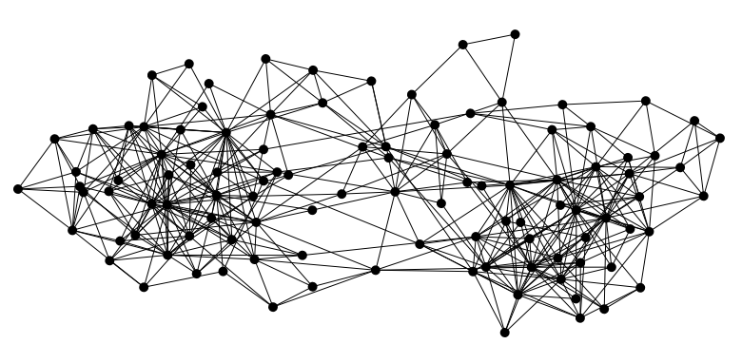

Bitcoin is a peer-to-peer system
When Alice wants to pay Bob: she broadcasts the transaction to all Bitcoin nodes
signed by Alice
Pay to pk_{Bob} : H( )
All nodes must agree on a sequence of transactions

Slide 38
Bitcoin consensus (simplified)
Transactions are broadcast to all nodes
In each round a random* node signs a block of new transactions, including the hash of the previous block
Other nodes accept the block if all transactions are valid
Invalid blocks are ignored, next node repeats this block
Longest chain is considered canonical
Leads to a valid canonical chain with “honest majority”

Slide 39
What can a malicious node do?
signed by A
C_{A} → B
Pay to pk_{B} : H( )
Notes:
Can’t create new transactions from someone else’s address, or modify them.
Suppressing tx’s is only a minor annoyance.

Slide 40
What can a malicious node do?
signed by A
C_{A} → B
Pay to pk_{B} : H( )
Double-spend
signed by A
C_{A} → A’
Pay to pk_{A’} : H( )
Honest nodes will extend the longest valid branch
Notes:
Can’t create new transactions from someone else’s address, or modify them.
Suppressing tx’s is only a minor annoyance.

Slide 41
From a merchant’s point of view
1 confirmation
3 confirmations
C_{A} → B
Double-spend probability decreases exponentially with # of confirmations
Most common heuristic: 6 confirmations
C_{A} → A’
double-spend attempt
Hear about C_{A} → B transaction
0 confirmations

Slide 42
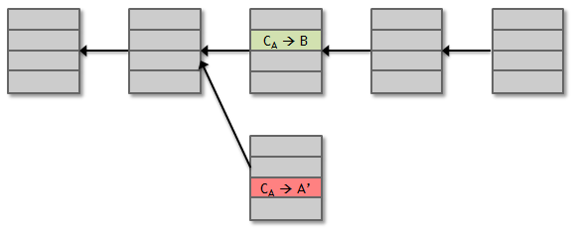
Basic properties
Protection against invalid transactions is cryptographic
Protection against double-spending relies on consensus
You’re never 100% sure a transaction is in the blockchain

Slide 43

Honest majority of whom?
Recall: addresses can be freely created

Slide 44
Solution: “vote” by CPU power
Bitcoin mining puzzle:
Given previous block prev, new block curr:
Find n such that H(prev|curr|n) < 2^{256-d}
d is a difficulty parameter
First solution wins

Slide 45
Miners are rewarded for solutions
Creator of block gets to
include special coin-creation transaction in the block
choose recipient address of this transaction
“Block reward” currently 25 BTC, halves every 4 years
Transaction fees also kept
Rewarded only if block is on eventual consensus branch!

Slide 46
Recap
Bitcoins created by special mining transactions
Bitcoins owned by public keys (addresses)
Bitcoin transfers authorized by digital signatures
Blockchain records all transfers, prevents double spends
Miners extend blockchain by solving proof of work
Miners rewarded by creating new bitcoins

