Slide 1
The Backend
Not so shiny, but definitely useful.

Slide 2
How do companies/organizations build solutions that implement their business logic and interact with feature rich websites/webapps?

Slide 3
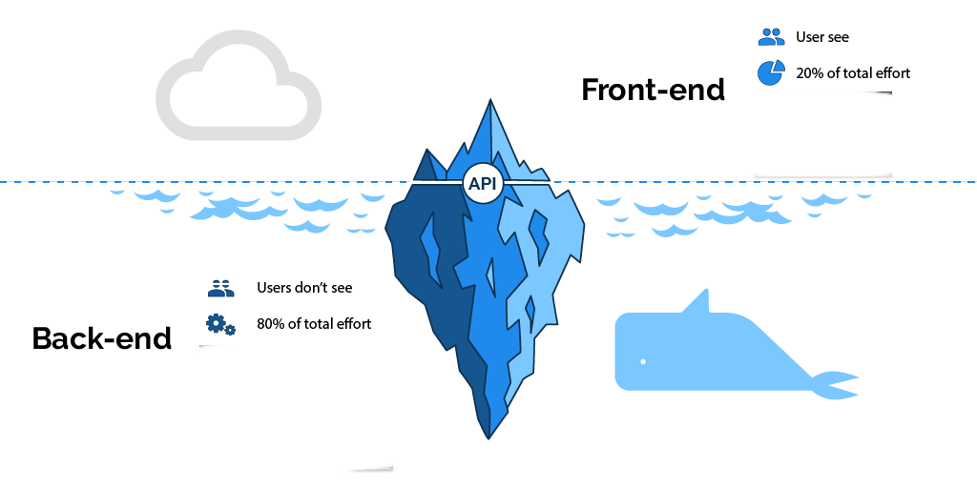
What is the backend?
The heavy lifter
Handles complex routines
Database Connections (Next Week)
The Authenticator (Never trust the client)
Sessions and client connection management
“Cookies”
Ideally Client agnostic
Any language can be used to make front-end
…There are exceptions to this which we will not cover
All the “business logic”
Business logic is(are) the structure/operations you would need to run your business/project if you had not involved (modern)technology and used pen and paper instead
The backend should be a representative model of this

Slide 4
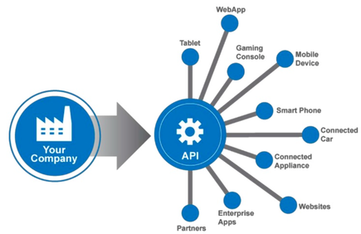
The API
Application Programming Interface
Web APIs are a very common way to build a backend
The technical specification of how developers (clients) should interact with your backend
HTTP
The language the internet uses to talk with
POST, PUT, GET, OPTION, DELETE
Example Response Codes
200 Ok
401 Unauthorized
500 Internal Error

Slide 5
The API - Cont
REST
Representational State Transfer
One of the most popular paradigms for API design
Many different ways to implement the paradigm
All interactions with the backend modify some resource
Ex. I create a User, then I update the User with a profile picture, the User is the resource.
CRUD
Create Read Update Delete
One of the most basic API structures
You will implement this for the upcoming week of Project 1

Slide 6
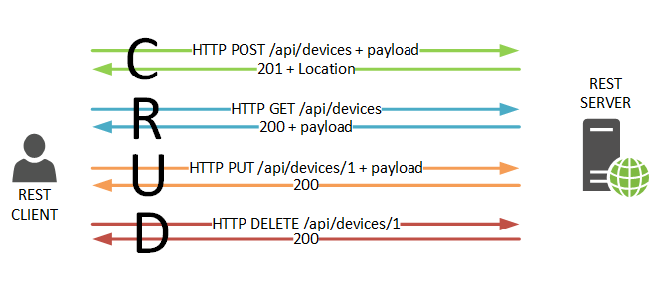
Designing your API
Think CRUD
We will have you this week implement these “Routes”
POST /Todo/create
GET /Todo/read
PUT /Todo/update
DELETE /Todo/delete
One more thing you will implement is a simple login.
POST /login
Note the RESTful-ness of the naming
The resource comes before the action being applied to the resource

Slide 7
API Creation with Python
(Flask Library)

Slide 8
What are we going to make.
There are 170 some odd students in the class and I am going to make simple backend to add and remove them from a list via api request.
Why?
This is somewhat similar to the work you and your team will have to accomplish this week.
You do not need to follow along with your laptop, these slides will be posted as a resource.

Slide 9
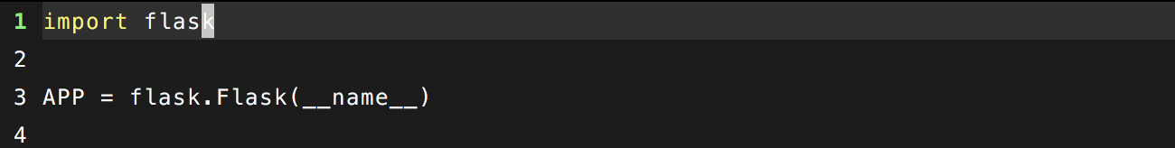
Installing Flask and Basic Setup
Note: I personally use python3, depending on your system you may be using python2. The differences should be minimal.
Mac/Linux users can do this in their terminal, windows users through the VM we asked you to download
“pip install flask”
pip is the python package manager for installing libraries
Setup:

Slide 10
Creating a couple Routes
Remember both REST and CRUD?
Well we will want to define our resources and the operations we will use to act on those routes.
/Classmates/add
/Classmates/remove
/Classmates/get
/login

Slide 11
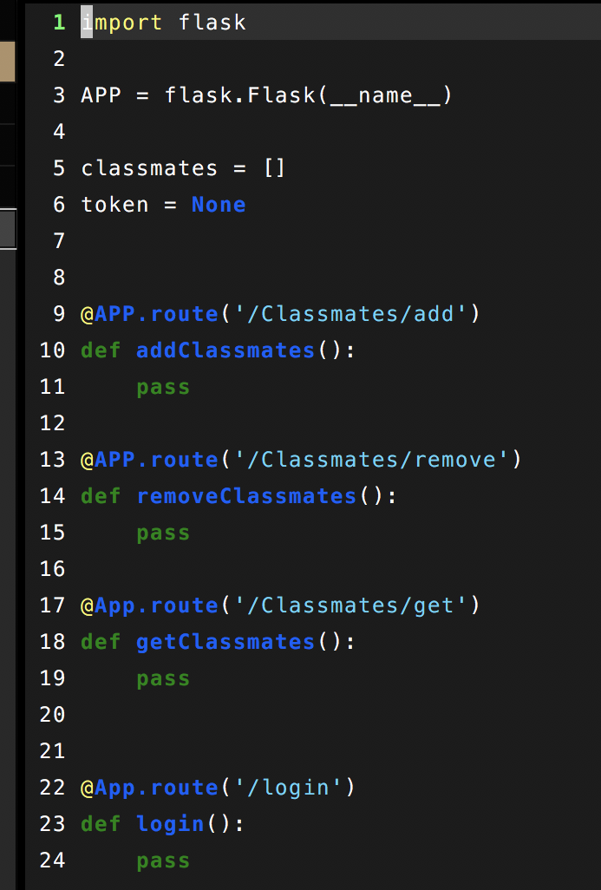
The Route Code
This is the skeleton
Note the @APP “decorator”
Decorators are little snippets of code that modify the behavior of a function or class in python
Look at line 3, it can be named anything as it is returned from flask itself
Just know that that this is how you will define your routes

Slide 12
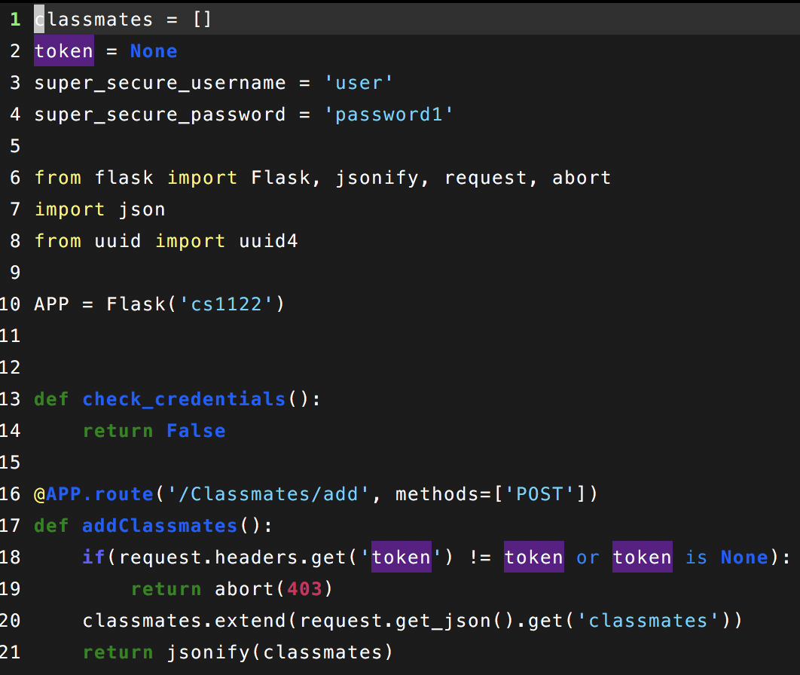
Making the routes work
Note the “methods” keyword
Flask defaults to “GET”
You must explicitly set other methods
In this case Post and later Delete
“request”
is how you access data sent by the client on the backend
“abort”
Is how you send response codes other than 200.

Slide 13
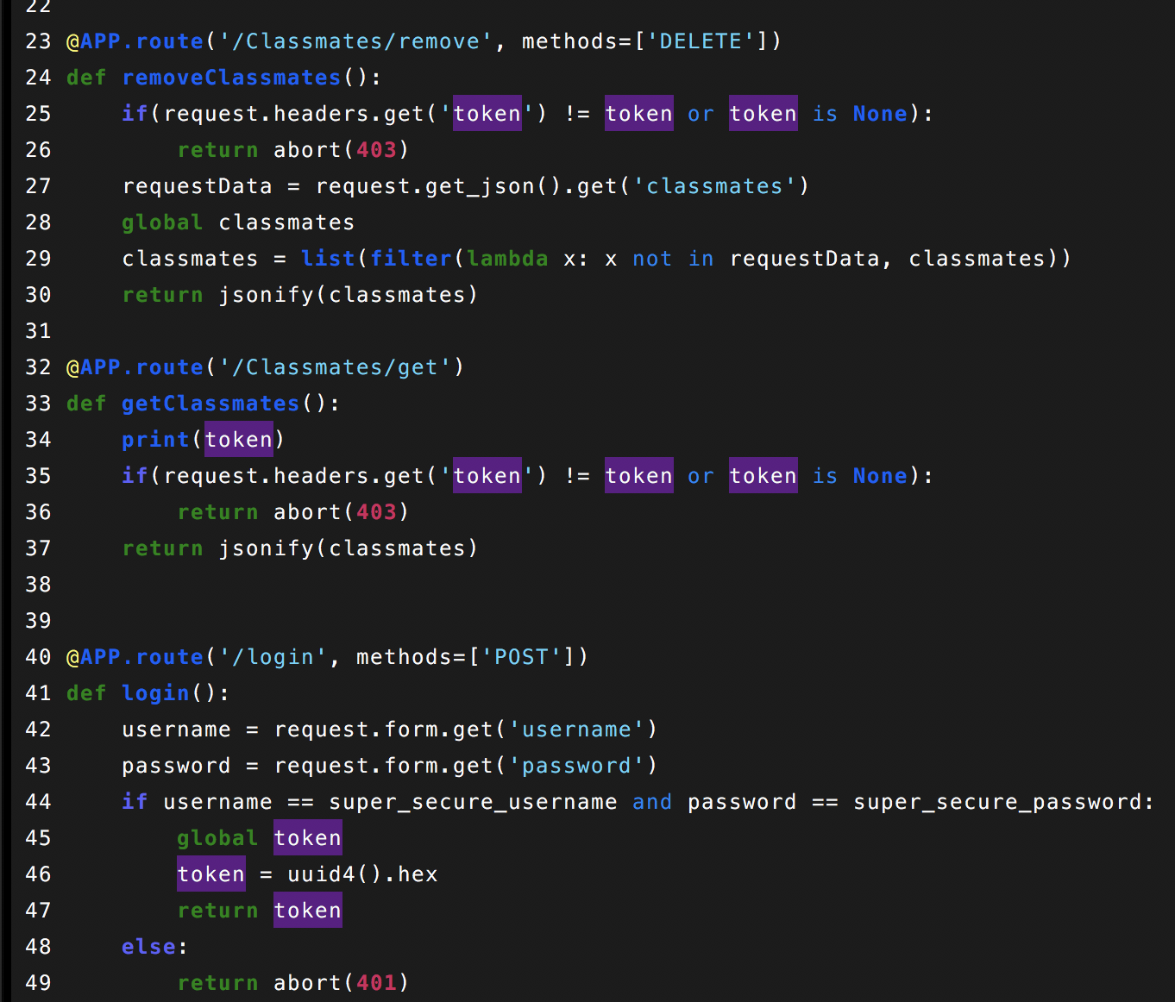
Making the routes work - cont.
Note line 32 I did not specify a method
Flask defaults to get
Login is very simple basic auth
Read a username and password from the request
There are better ways to do this
Codes 401 and 403
401 - Unauthorized
403 - Forbidden

