Slide 1

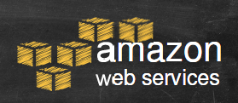
Original Author: Shadi Khalifa
( Heavily Modified for CS1122)
Database Systems Laboratory (DSL)
khalifa@cs.queensu.ca

Slide 2
Who is Amazon !!
American international multibillion dollar electronic commerce company with headquarters in Seattle, Washington, USA.
started in 1995 by Jeff Bezos as an online bookstore.
but soon diversified, selling DVDs, VHSs, CDs, video and MP3 downloads/streaming, software, video games, electronics, apparel, furniture, food, toys, and jewelry.
The company also produces consumer electronics: Kindle e-book reader and the Kindle Fire tablet computer.
In 2006, Amazon officially launched the Amazon Web Services (AWS) to became a major provider of cloud computing services.

Slide 3
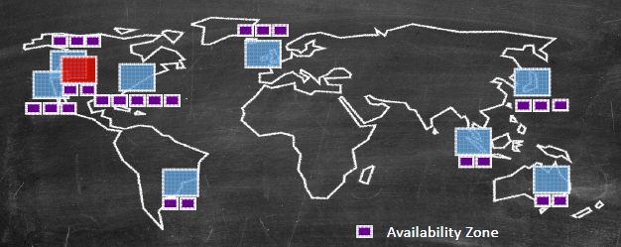

What is Amazon Web Services ?
Amazon Web Services (AWS) is a collection of remote computing services (web services) that together make up a cloud computing platform, offered over the Internet by Amazon.com.
Website: http://aws.amazon.com
AWS is located in 9 geographical 'Regions‘. Each Region is wholly contained within a single country and all of its data and services stay within the designated Region.
Each Region has multiple 'Availability Zones', which are distinct data centers providing AWS services. Availability Zones are isolated from each other to prevent outages from spreading between Zones. However, Several services operate across Availability Zones (e.g. S3, DynamoDB).

Slide 4


Amazon Elastic Compute Cloud (EC2)
Infrastructure
Services
A web service that provides resizable compute capacity in the cloud.
EC2 allows creating Virtual Machines (VM) on-demand. Pre-configured templated Amazon Machine Image (AMI) can be used get running immediately. Creating and sharing your own AMI is also possible via the AWS Marketplace.
Auto Scaling allows automatically scale of the capacity up seamlessly during demand spikes to maintain performance, and scales down during demand lulls to minimize costs.

Slide 5
EC2
Elastic Load Balancing automatically distributes incoming application traffic across multiple Amazon EC2 instances.
Provide tools to build failure resilient applications by launching application instances in separate Availability Zones.
Pay only for resources actually consume, instance-hours.
VM Import/Export enables you to easily import virtual machine images from your existing environment to Amazon EC2 instances and export them back at any time.

Slide 6
Ec2 Instances
Infrastructure
Services
Micro instances (t1.micro):
Micro Instance 613 MiB of memory, up to 2 ECUs (for short periodic bursts), EBS storage only, 32-bit or 64-bit platform.
Standard Instances provide customers with a balanced set of resources and a low cost platform.
M1 Small Instance (Default) 1.7 GiB of memory, 1 EC2 Compute Unit (1 virtual core with 1 EC2 Compute Unit), 160 GB of local instance storage, 32-bit or 64-bit platform
M1 Medium Instance 3.75 GiB of memory, 2 EC2 Compute Units (1 virtual core with 2 EC2 Compute Units each), 410 GB of local instance storage, 32-bit or 64-bit platform
M1 Large Instance 7.5 GiB of memory, 4 EC2 Compute Units (2 virtual cores with 2 EC2 Compute Units each), 850 GB of local instance storage, 64-bit platform
Amazon also offers: High Performance Instances with much greater computational, memory, or storage capabilities depending on your needs.
One EC2 Compute Unit (ECU) provides the equivalent CPU capacity of a 1.0-1.2 GHz 2007 Opteron or 2007 Xeon processor.

Slide 7
EC2 Payment methods
Infrastructure
Services
On-Demand Instances let you pay for compute capacity by the hour with no long-term commitments.
Reserved Instances give you the option to make a low, one-time payment for each instance you want to reserve and in turn receive a significant discount on the hourly charge for that instance.
Spot Instances allow customers to bid on unused Amazon EC2 capacity and run those instances for as long as their bid exceeds the current Spot Price.

Slide 8

Amazon Simple Storage Service (S3)
Infrastructure
Services
Amazon S3 provides a simple web services interface that can be used to store and retrieve any amount of data, at any time, from anywhere on the web.
Write, read, and delete objects containing from 1 byte to 5 terabytes of data each. The number of objects you can store is unlimited.
Each object is stored in a bucket and retrieved via a unique, developer-assigned key.
A bucket can be stored in one of several Regions.
You can choose a Region to optimize for latency, minimize costs, or address regulatory requirements.
Objects stored in a Region never leave the Region unless you transfer them out.

Slide 9
S3
Authentication mechanisms are provided to ensure that data is kept secure from unauthorized access.
Objects can be made private or public, and rights can be granted to specific users.
S3 charges based on per GB-month AND per I/O requests AND per data modification requests.

Slide 10


Amazon Relational Database Service (RDS)
Platform Services
Amazon RDS is a web service that makes it easy to set up, operate, and scale a relational database in the cloud.
Amazon RDS gives access to the capabilities of a familiar MySQL, Oracle or Microsoft SQL Server database engine.
Code, applications, and tools already used with existing databases can be used with RDS.
Amazon RDS automatically patches the database software and backs up the database, storing the backups for a user-defined retention period and enabling point-in-time recovery.

Slide 11
RDS
Amazon RDS provides scaling the compute resources or storage capacity associated with the Database Instance.
Pay only for the resources actually consumed, based on the DB Instance hours consumed, database storage, backup storage, and data transfer.
On-Demand DB Instances let you pay for compute capacity by the hour with no long-term commitments.
Reserved DB Instances give the option to make a low, one-time payment for each DB Instance and in turn receive a significant discount on the hourly usage charge for that DB Instance.

Slide 12

AWS Free Usage Tier
http://aws.amazon.com/free/

