Slide 1
Tips for Cleaner Code
CS1122 Lecture 6

Slide 2
Why is clean code important?
People will read your code significantly more times than you imagine.
Even if you are the only person working on your code, assume that if you don’t make it clean you will have no idea what you were doing when you come back to the code later on.

Slide 3
Why is clean code important?
When you are working on a project that lasts a long time, the amount of code can grow very large.
It may make it easier to expose bugs in the code.

Slide 4
General Tips
Have others review your code.
In most companies this is a mandatory step before your work is considered finished.
Be verbose.
More descriptive is almost always better than vague.

Slide 5
General Tips
Try to understand that other people reading your code may have a very different coding style from you.
In-fact I can almost guarantee that is going to be true.

Slide 6
3 Simple Things You Can Do To have Cleaner Code

Slide 7
“DRY” out your code.
DRY: Don’t Repeat Yourself
If you find yourself writing the same logic over and over, maybe consolidate it into a single function.
Now if a bug exists in that code you only have to fix it once.

Slide 8
Example:
Wet Code

Slide 9
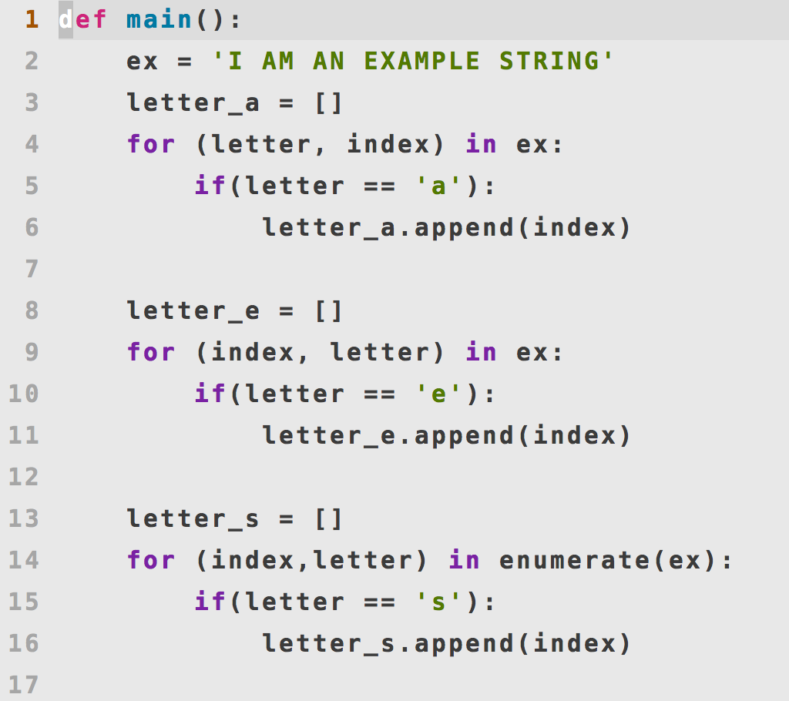

Slide 10
Example:
“Dry”ed Code

Slide 11
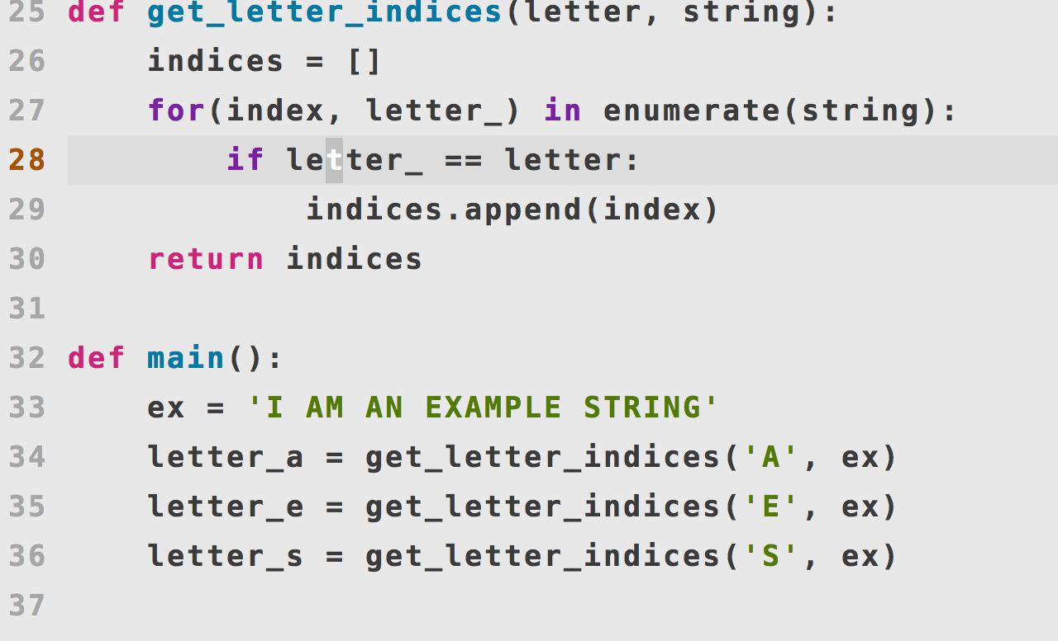

Slide 12
Break Up Overly Long Code
Sometimes breaking up a longer function that has clear subroutines is the best thing to do.
Through naming your subroutines you may be able to quickly convey what your algorithm is attempting to do.

Slide 13
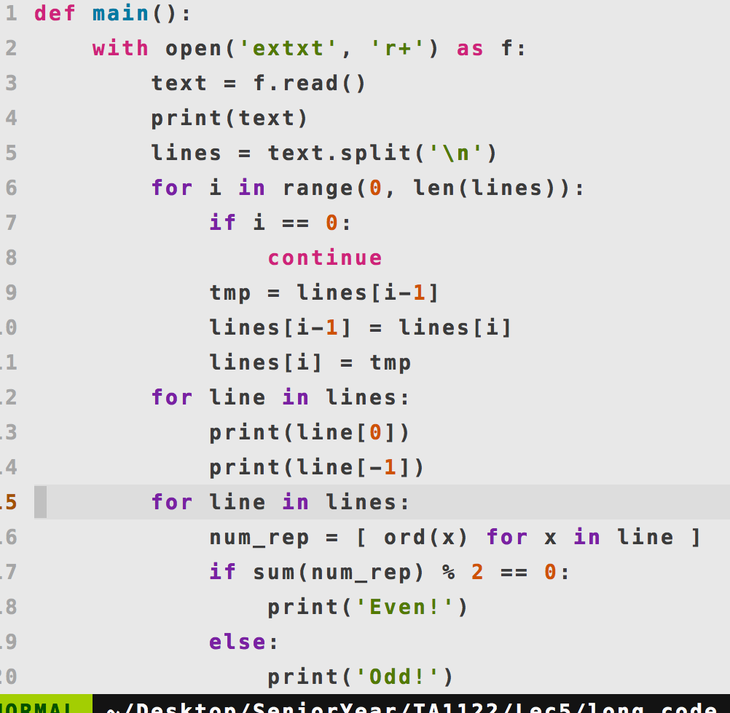

Slide 14
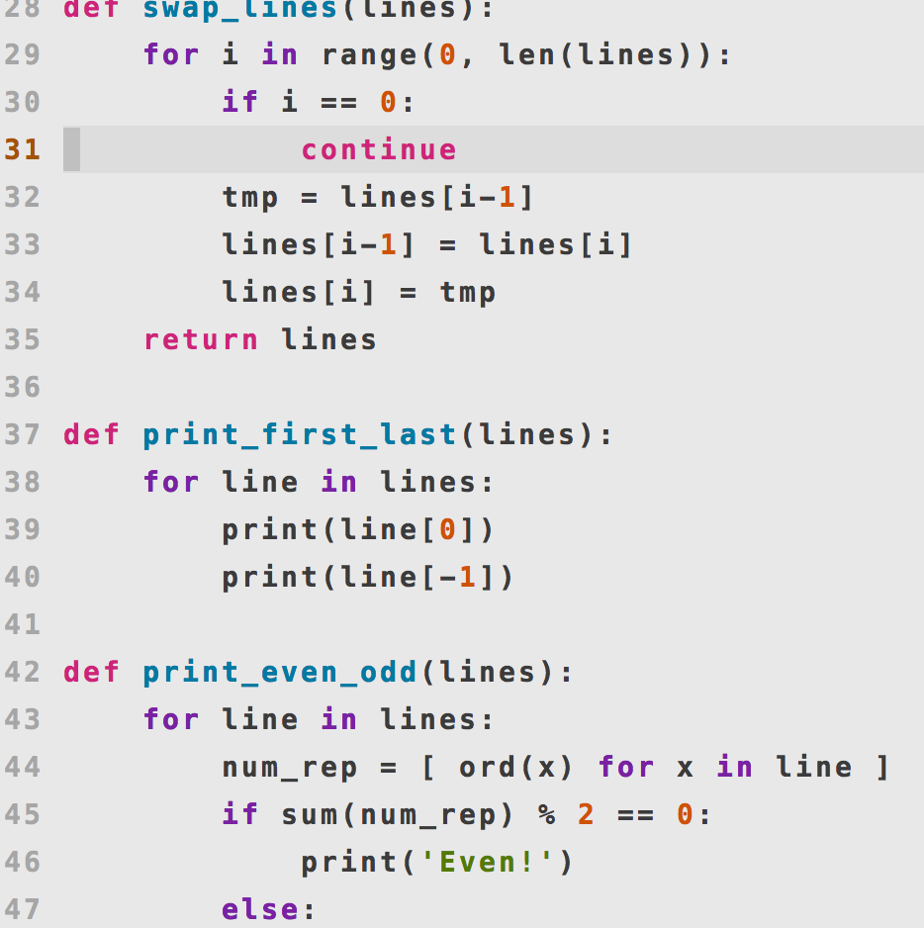

Slide 15
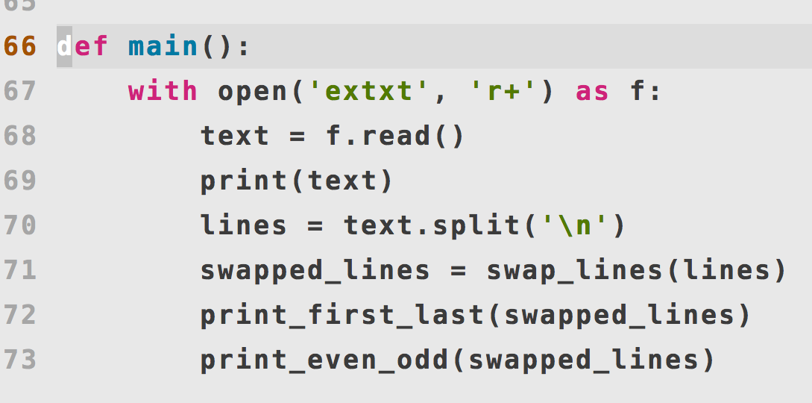

Slide 16
Name your functions and variables clearly.
Stated earlier people will read your code very often.
If your names are one letter or don’t convey what your function accomplishes this makes it harder for the people reading your code.

Slide 17
Example:
Huh?

Slide 18
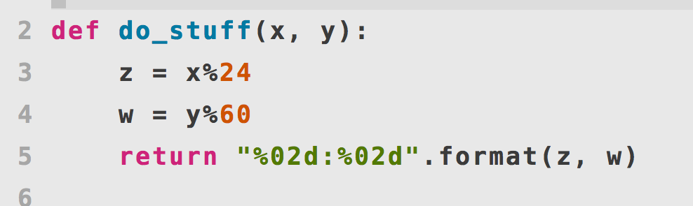

Slide 19
Example:
Ohhh

Slide 20
