Slide 1
Cryptography

Slide 2
Data Encryption
Encryption is the process of encoding a message such that its meaning is not obvious.
Decryption is the reverse process, ie, transforming an encrypted message to its original form.
We denote plaintext by P and ciphertext by C.
C = E(P), P = D(C) and P = D(E(P)), where E() is the encryption function (algorithm) and D() the decryption function.
Plaintext
Ciphertext
Plaintext
Encryption
Decryption
2

Slide 3
Kerckhoff’s Principle
How do you prevent and eavesdropper from computing P, given C?
  Keep the encryption algorithm E() secret.
    BAD IDEA!!
  Choose E() (and corresponding D()) from a large collection, based on secret key.
    GOOD IDEA!! Kerckhoff’s principle.
C = E(K, P) and P = D(K, C)
Secret Key
Plaintext
Ciphertext
Plaintext
Encryption
Decryption

Slide 4



Friends and enemies: Alice, Bob, Trudy
well-known in network security world
Bob, Alice (lovers!) want to communicate “securely”
Trudy (intruder) may intercept, delete, add messages
Alice
Bob
channel
data, control messages
secure
sender
secure
receiver
data
data
Trudy

Slide 5
Who might Bob, Alice be?
… well, real-life Bobs and Alices!
Web browser/server for electronic transactions (e.g., on-line purchases)
on-line banking client/server
DNS servers
routers exchanging routing table updates

Slide 6
Symmetric and Asymmetric Cryptosystems
Just by changing key we have different encryptions of one plaintext.
If the encryption key and the decryption key are the same then we have a symmetric encryption scheme (also private key, one-key).
If the encryption key and the decryption key are different then we have an asymmetric encryption scheme (also public key, two-key).

Slide 7
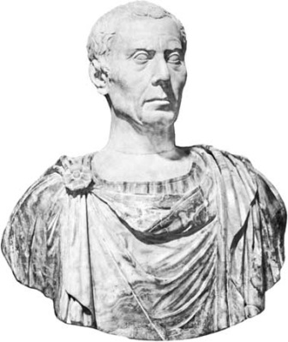
Caesar Cipher?
Encrypt messages using a very simple algorithm, which could be easily decrypted if you know the key.
Take each letter of the alphabet and replace it with a letter a certain distance away from that letter. At the end, wrap back around to the beginning.
Example with a shift of 3:
I’m so sneaky!
A | B | C | D | E | F | G | H | I | J | K | L | M | N | O | P | Q | R | S | T | U | V | W | X | Y | Z
D | E | F | G | H | I | J | K | L | M | N | O | P | Q | R | S | T | U | V | W | X | Y | Z | A | B | C
H | e | l | l | o | I | l | o | v | e | y | o | u | w | o | n | t | y | o | u | t | e | l | l | m | e
k | h | o | o | r | l | o | r | y | h | b | r | x | t | r | q | w | b | y | z | w | h | o | o | p | f

Slide 8
Cryptanalysis
A cryptosystem had to be secure against the following kinds of attacks:
  Ciphertext only attack.
  Known plaintext attack.
  Chosen plaintext attack.
  Adaptive chosen plaintext attack.
  Chosen ciphertext attack.
  Chosen key attack.
Of course there is one attack against which no cryptosystem can offer protection – rubber hose attack.
6

Slide 9
Brute Force Attacks.
Since the key space is finite, given a ciphertext a cryptanalyst can try and check all possible keys.
For above to be not feasible, key space should be large!!
  How large? How about 2⁵⁶?
Large enough to make it impractical for an adversary. But what is impractical today, may not be so tomorrow.
In practice, for a “good” cryptosystem, the only possible attack should be the brute force attack, which should be impractical into the foreseeable future, as slong as message may have value.
7

Slide 10
Substitution Ciphers
Basic idea – substitute each block of plaintext by a different block.
If plaintext is English then
  Mona-alphabetic substitution.
  Poly-alphabetic substitution.
If plaintext is binary string then map one block of bits to another.
Plaintext: 0011010101010001 … 10100101
Ciphertext: 0100010000011100 … 00101001
This is called block encryption. Very common.
8

Slide 11

Encryption by Mono-alphabetic Substitution.
P | O | K | E | M | O | N | M | A | S | T | E | R
A | B | C | D | E | F | G | H | I | J | K | L | M | N | O | P | Q | R | S | T | U | V | W | X | Y | Z
P | O | L | Y | T | E | C | H | N | I | U | V | R | S | B | K | W | A | D | F | G | J | M | Q | X | Z
K | B | U | T | R | B | S | R | P | D | F | T | A
Key space is large 26! (How do you remember a key? See example).
However, mono-alphabetic substitution is easy to break as it preserves source first order statistics.
Large key space is necessary but not sufficient condition for security!
9

Slide 12
Poly-alphabetic Cipher – Vigenere.
Use K mono-alphabetic ciphers – E₁, E₂, … E_{k}.
In position i, of plaintext, use cipher E_{i}.
Example using Caesar ciphers …
Plaintext: helloiloveyouwontyoutellmeyourname
Key: polytechnicpolytechnicpolytechnicpoly
Ciphertext: wswjhmnv………………………………coxc
A little harder to break but trivial once you know key length!
Some well known techniques for determining key length – See text.
10

Slide 13
Encryption by Transposition
P | O | K | E | M | O | N | M | A | S | T | E | R
1 | 2 | 3 | 4 | 5 | 6 | 7 | 8 | 9 | 10 | 11 | 12 | 13
7 | 1 | 8 | 2 | 6 | 10 | 3 | 9 | 11 | 12 | 4 | 5 | 13
O | E | N | T | E | M | P | K | M | O | A | S | R
Harder to break than substitution ciphers
Preserve first order statistics
One can arrange plaintext in table and sort rows and columns.
13

Slide 14
Product Ciphers
To get improved security one can encrypt the ciphertext again.
If one uses same algorithm – super encryption. May or may not be useful. For example, super-encryption with Caesar cipher is as good as single encryption!
If one uses different algorithms – product cipher.
Product ciphers based on sequence of substitutions and transpositions are very popular.
You will see one – DES.
14

Slide 15
DES – Data Encryption Standard
Private key. Encrypts by series of substitution and transpositions.
Worldwide standard for more than 20 years.
Has a history of controversy.
Designed by IBM (Lucifer) with later help (interference?) from NSA.
No longer considered secure for highly sensitive applications.
Replacement standard (AES) recently completed.
19

Slide 16
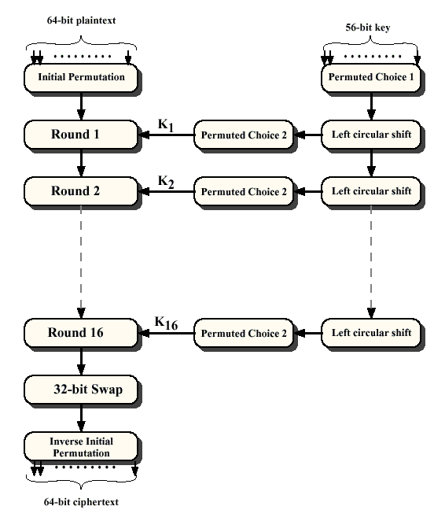
DES - Overview
20

Slide 17
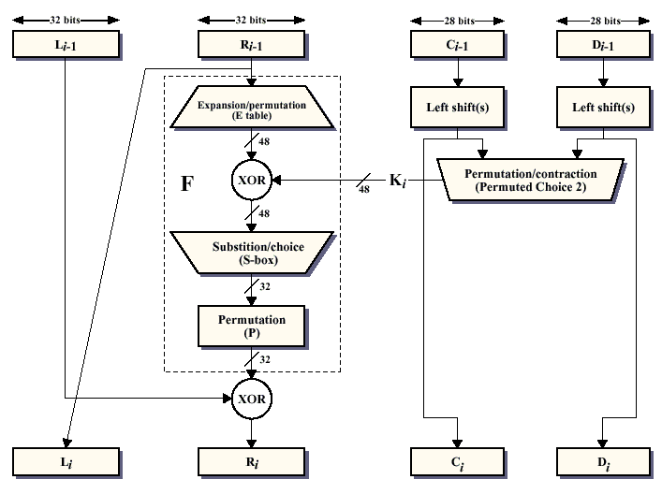
DES – Each iteration.
21

Slide 18
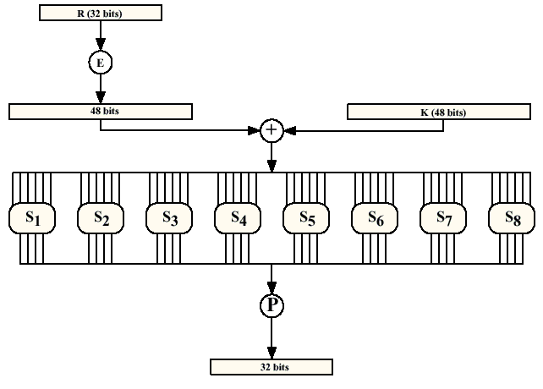
DES – Computation of F(R_{i-1},K_{i})
22

Slide 19
Computation of F:
Expansion function E:
  maps bit string of length 32 to bit string of length 48.
  Permutes bits in a fixed way and duplicates certain bits
Key schedule: each round uses a 48 bit key obtained by performing permutations, shifts, and discarding bits from the original 56 bit key. Fixed algorithm for each round
resulting 48 bit string broken into 8 6-bit strings
23

Slide 20


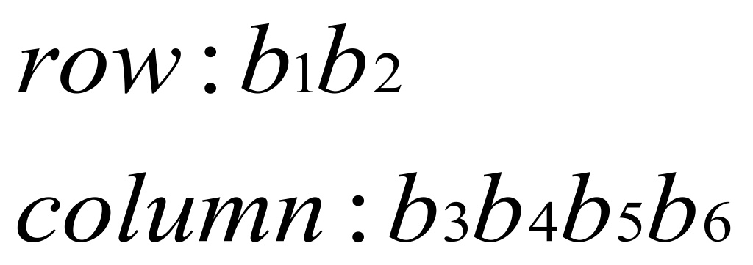
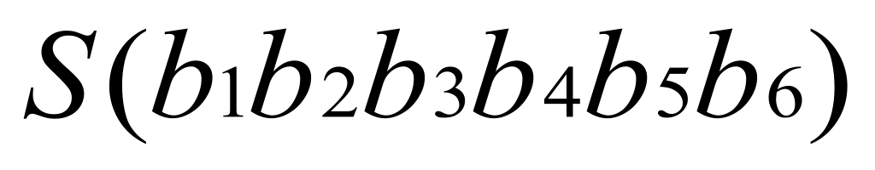
S-boxes: S1
Is the table entry from
24

Slide 21
DES Security
S-Box design not well understood (secret).
Has survived some recent sophisticated attacks (differential cryptanalysis).
Key is too short (thanks to NSA!). Hence is vulnerable to brute force attack.
1998 distributed attack took 3 months.
$1,000,000 machine will crack DES in 35 minutes – 1997 estimate. 10,000 – 2.5 days.
In 1999 EFF achieved 245 billion keys per second rate to crack in 22 hours.
34

Slide 22
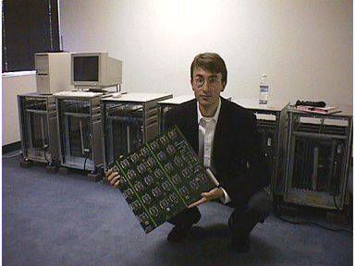
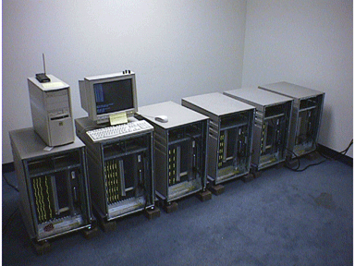
DES Cracking machine
35

Slide 23
Super-encryption.
If key length is a concern, then instead of encrypting once, encrypt twice!!
C = E_{K2}(E_{K1}(P))
P = D_{K2}(D_{K1}(C))
Does this result in a larger key space? That is a new mapping that could not have been obtained by a single key?
  With Caesar cipher – NO!
  With DES – yes!
Encrypting with multiple keys is known as super-encryption.
May not always be a good idea.
36

Slide 24
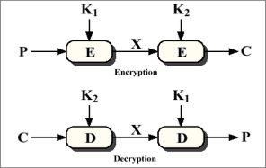
Double DES
Double DES is almost as easy to break as single DES (Needs more memory though)!
37

Slide 25
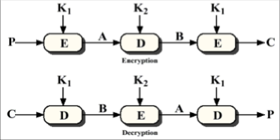
Triple DES
Triple DES (2 keys) requires 2¹¹² search. Is reasonably secure.
3 keys requires 2¹⁶⁸ .
40

Slide 26
AES History
National Institute of Science and Technology
  DES is an aging standard that no longer addresses today’s needs for strong encryption
  Triple-DES: Endorsed by NIST as today’s defacto standard
AES: The Advanced Encryption Standard
  Finalized in 2001
  Goal – To define Federal Information Processing Standard (FIPS) by selecting a new powerful encryption algorithm suitable for encrypting government documents
  AES candidate algorithms were required to be:
    Symmetric-key, supporting 128, 192, and 256 bit keys
    Royalty-Free
    Unclassified (i.e. public domain)
    Available for worldwide export
41

Slide 27
Public Key Cryptography

Slide 28
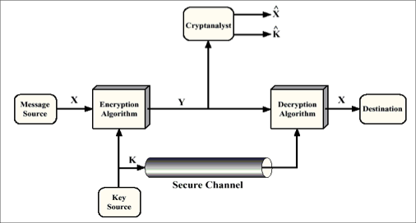
Symmetric key cryptography revisited.
Key distribution and management is a serious problem! N users – O(N²⁾ keys!
59

Slide 29

Public key cryptography
+
Bob’s public
key
K
B
-
Bob’s private
key
K
B
plaintext
message, m
encryption
algorithm
ciphertext
decryption
algorithm
plaintext
message
+
K (m)
-
+
B
m = K (K (m))
B
B

Slide 30
Public key encryption algorithms
Requirements:
.
.
+
-
1
need K ( ) and K ( ) such that
B
B
-
+
K (K (m)) = m
B
B
2
+
given public key K , it should be very difficult to compute private key K
B
-
B
RSA: Rivest, Shamir, Adelson algorithm

Slide 31
A Simple Example
Public Key
Private Key
P
O
K
E
M
O
N
Peggy
Olivia
Kathy
Erica
Mary
Olga
Nancy
7123456
6752345
2563859
6723952
9753658
7490469
7036027
P
O
K
E
M
O
N
Phone Book
Inverted Phone Book
Plaintext
Ciphertext
Plaintext
Anyone can map from plaintext to ciphertext.
Decryption easy only with inverted phone book.

Slide 32
Prerequisite: modular arithmetic
x mod n = remainder of x when divide by n
Facts:
  [(a mod n) + (b mod n)] mod n = (a+b) mod n
  [(a mod n) - (b mod n)] mod n = (a-b) mod n
  [(a mod n) * (b mod n)] mod n = (a*b) mod n
Thus
(a mod n)^{d} mod n = a^{d} mod n
Example: x=14, n=10, d=2:
(x mod n)^{d} mod n = 4² mod 10 = 6
x^{d} = 14² = 196 x^{d} mod 10 = 6

Slide 33
RSA: getting ready
A message is a bit pattern.
A bit pattern can be uniquely represented by an integer number.
Thus encrypting a message is equivalent to encrypting a number.
Example
m= 10010001 . This message is uniquely represented by the decimal number 145.
To encrypt m, we encrypt the corresponding number, which gives a new number (the cyphertext).

Slide 34
RSA: Creating public/private key pair
1. Choose two large prime numbers p, q.
(e.g., 1024 bits each)
2. Compute n = pq, z = (p-1)(q-1)
3. Choose e (with e<n) that has no common factors
with z. (e, z are “relatively prime”).
4. Choose d such that ed-1 is exactly divisible by z.
(in other words: ed mod z = 1 ).
5. Public key is (n,e). Private key is (n,d).
+
-
K
K
B
B

Slide 35
RSA: Encryption, decryption
0. Given (n,e) and (n,d) as computed above
1. To encrypt message m (<n), compute
e
c = m mod n
2. To decrypt received bit pattern, c, compute
d
m = c mod n
Magic
happens!
e
d
m = (m mod n)
mod n
c

Slide 36
RSA example:
Bob chooses p=5, q=7. Then n=35, z=24.
e=5 (so e, z relatively prime).
d=29 (so ed-1 exactly divisible by z).
Encrypting 8-bit messages.
m
e
e
bit pattern
m
c = m mod n
encrypt:
0000l000
12
24832
17
d
d
c
c
m = c mod n
decrypt:
17
481968572106750915091411825223071697
12

Slide 37
Integrity

Slide 38
RSA Based Signature
Message
Alice signs
Signed message
Bob verifies
Message
Encrypt
With
Private
key
Decrypt
With
Public
key
Hjkhrk
Hj837*
*ji8hj]
Hello, I
love you
Hello, I
love you
Alice signs message by encrypting with private key.
Bob decrypts message with Alice’s public key.
119

Slide 39
RSA signature properties
Verification: Bob knows message is from Alice. Since he decrypted it with her public key, it must have been encrypted with her private key.
Oscar needs to know Alice’s private key to modify or forge messages.
Signature cannot be attached to a different document.
However, signed message can be “replayed” unless further precautions are taken.
  “Transfer $1M from my account to Oscar’s. --Alice”
120

Slide 40

Signing With Cryptographic Hashes

Slide 41
Hash Functions

Slide 42
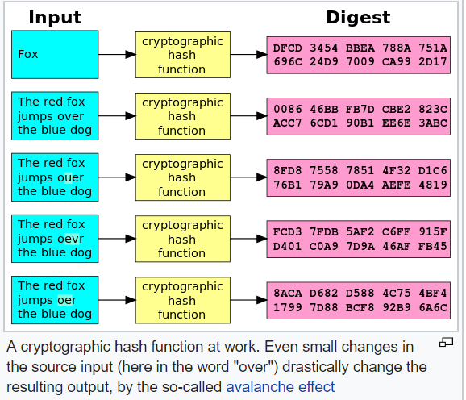

Slide 43
Hash property 1: Collision-free
Nobody can find x and y such that
x != y and H(x)=H(y)
x
H(x) = H(y)
y

Slide 44
Collisions exist ...
possible outputs
possible inputs
… but can anyone find them?

Slide 45
Brute force attack on any 256-bit hash H:
try 2¹³⁰ randomly chosen inputs
>99.8% chance that two of them will collide
This works no matter what H is
… but it takes too long to matter

Slide 46
Cryptographic Hash Functions
Requirements of cryptographic hash functions:
  Can be applied to data of any length.
  Output is fixed length.
  Relatively easy to compute h(x), given x.
  Infeasible to get x, given h(x).
  Given x, infeasible to find y such that h(x) = h(y). Weak collision property.
  Infeasible to find any pair x and y such that h(x) = h(y). Strong collision property.
124

Slide 47
MLHF – A Cryptographic Hash Function?
Consider the following hash function:
  Treat message as sequence of 32 bit words and add them together to get hash value.
Consider the message “IOU100.99BOB”.
  In hex it is 49, 4F, 55, 32, 30, 30, 2E, 39, 39, 42, 4F, 42.
  This adds to B2, C1, D2, AC.
The message “IOU900.91BOB” also has the same hash value!
A very poor cryptographic hash function.
MLHF – Memon’s Lousy Hash Function!
125

Slide 48
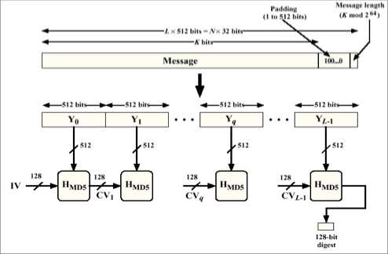
MD5 - Message Digest Algorithm
126

Slide 49
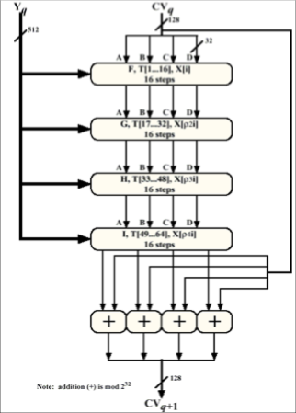
MD5 – Processing for Each Block
4 rounds for each 512 bit block
Each round uses different primitive function F, G, H and I
Buffers initialized as follows:
A : 67452301
B: EFCDAB89
C: 98BADCFE
D: 10325476
Table T[i] = 2³² x abs(sin(i))
127

Slide 50
Key Exchange

Slide 51
Key Exchange
Cryptographic primitives seen so far assume
  Alice and Bob share a secret key which is unknown to Oscar.
  Alice has a “trusted” copy of Bob’s public key.
But how does this happen in the first place?!!
Alice and Bob meet and exchange key.
Not always practical or possible.
We need key exchange protocols!
There are key distribution protocols and key agreement protocols.
140

Slide 52
Session Key Exchange With Public Keys
Alice gets Bob’s public key from KDC.
Alice generates a random session key, encrypts with Bob’s public key and sends to Bob.
Bob decrypts using his private key to get session key.
Alice and Bob exchange a challenge-response.
Above is still susceptible to man-in-the-middle attack.
143

Slide 53
Man-in-the-middle Attack
Alice send request to KDC. Mallory intercepts and sends his own public key.
Alice generates random session key and encrypts using Mallory’s (she thinks Bob’s) public key and send to Bob.
Mallory intercepts session key, decrypts, then encrypts with Bob’s public key and send to Bob.
Bob decrypts session key.
Alice and Bob use a session key to communicate that Bob knows!
144

Slide 54
Public Key Management
How do you trust a public key?
  1. Public announcement of keys.
  2. Publicly available directory.
  3. Public Key Authority.
  4. Web of Trust (PGP).
  5. Public Key Certificates.
147

Slide 55
Public Key Certificate
Public Key Certificate – Signed messages specifying a name (identity) and the corresponding public key.
Signed by whom – Certification Authority (CA), an organization that issues public key certificates.
We assume that everyone is in possession of a trusted copy of the CA’s public key.
CA could be
  Internal CA.
  Outsourced CA.
  Trusted Third-Party CA.
150

Slide 56
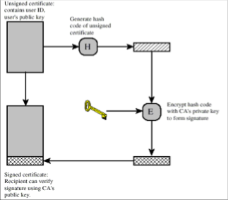
Public Key Certificate
Note: Mechanism of certification and content of certificate, will vary but at the minimum we have email verification and contains ID and Public Key.
151

Slide 57
Certificate Revocation
CA also needs some mechanism to revoke certificates
  Private key compromised.
  CA mistake in issuing certificate.
  Particular service the certificate grants access to may no longer exist.
  CA compromised.
Expiration time solves the problems only partially.
Certification Revocation Lists (CRL) – a list of every certificate that has been revoked but not expired.
  CRL’s quickly grow large!
CRL’s distributed periodically.
  What about time period between revocation and distribution of CRL?
152

Slide 58
Advantages of CA Over KDC
CA does not need to be on-line!
CA can be very simple computing device.
If CA crashes, life goes on (except CRL).
Certificates can be stored in an insecure manner!!
Compromised CA cannot decrypt messages.
Scales well.
153

Slide 59
Multiple CA’s
Certificates validating each other’s Public Key
CIA KDC
KGB KDC
Alice
Bob
How does Alice talk to Bob?
She obtains Bob’s certificate signed by KGB-KDC.
She obtains KGB-KDC’s certificate signed by CIA-KDC.
Concept can be generalized to multiple CA’s.
Helps if they are organized in a hierarchy.
154

Slide 60
Public-key Infrastructure (PKI)
Combination of digital certificates, public-key cryptography, and certificate authorities.
A typical enterprise's PKI encompasses
  issuance of digital certificates to users and servers
  end-user enrollment software
  integration with corporate certificate directories
  tools for managing, renewing, and revoking certificates; and related services and support
Verisign, RSA, Symantec – PKI providers.
Your own PKI using Microsoft certificate servers
161

