Slide 2
Experiments 2 Lab 5 Outline
  Presentation
    Using A Brief Look at Semiconductor Technology
      A comparison of CMOS and TTL technologies
    Verilog programming
  Individual work
    Understand the Vivado tool more and Verilog programming more
      Use the crypto module that has been under development
        Attach Digilent Pmod modules
        Learn about instantiating modules
        Test benches to help improve simulations for more complex modules
      Develop the DeMUX modules as your Experiment 1 project
  Accompanying PowerPoint presentation
    Verilog Description (updated)
  New handout
    Experiment 1 Design Checks
CS 2204 Fall 2019
Experiment 1 Lab 5
Page <number>

Slide 3
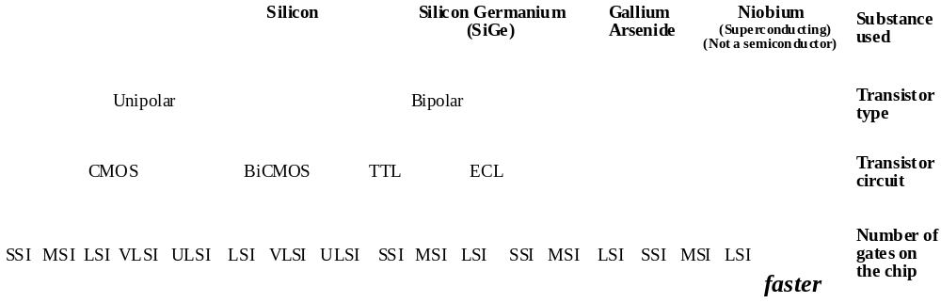
Technology of components/chips
  Complementary Metal Oxide Semiconductor (CMOS)
    Uses unipolar transistors
      Slower than Bipolar transistors
      Consume less power than Bipolar transistors
    Not straightforward to connect to TTL chips
CS 2204 Fall 2019
Experiment 1 Lab 5
Page <number>

Slide 4
Complementary Metal Oxide Semiconductor (CMOS)
  Low density commercial CMOS families, each with a different combination of speed, power, cost
    4000 (Oldest)
    74HC (High speed CMOS)
    74HCT (High speed CMOS, TTL Compatible)
    74AC (Advanced CMOS)
    74ACT (Advanced CMOS, TTL Compatible)
    74FCT (Fast CMOS, TTL Compatible)
    74FCT-T (Fast CMOS, TTL Compatible with TTL V_{OH})
  Most high-density chips
    Microprocessors, GPUs, FPGAs, DRAMs, Flash-EPROMs,..
CS 2204 Fall 2019
Experiment 1 Lab 5
Page <number>

Slide 5
Complementary Metal Oxide Semiconductor (CMOS)
  Unused gate input
    Do not leave it unconnected (floating)
      Xilinx does not allow this option !
        A No Driver warning is given by the Project Manager
?
a
a
y
b
y
b
Hi-Z value observed at the input
The gate will not work properly
CS 2204 Fall 2019
Experiment 1 Lab 5
Page <number>

Slide 6
Digital Engineering Terminology
U1
U2
a
Must be
corrected
U4
b
y
U4 input has no driver
U4 input is not connected to an output. Its input value is Hi-Z (High-Impedance) as there is infinite impedance (resistance) into the U4 input so no current can flow in
a
c
U3
CS 2204 Fall 2019
Experiment 1 Lab 5
Page <number>

Slide 7
Complementary Metal Oxide Semiconductor (CMOS)
  Unused gate input
    It can be tied to a used input
      The fan-out of the b signal may be exceeded !
a
An available 3-input AND gate used to implement a 2-input AND gate
b
y
CS 2204 Fall 2019
Experiment 1 Lab 5
Page <number>

Slide 8
Complementary Metal Oxide Semiconductor (CMOS)
  Unused gate input
    It can be connected to 1 or 0 depending on the gate type, via a pull-up resistor or pull-down resistor
a
a
b
y
b
y
Pull-up
resistor
Pull-down
resistor
+5 v
0 v
CS 2204 Fall 2019
Experiment 1 Lab 5
Page <number>

Slide 9
Complementary Metal Oxide Semiconductor (CMOS)
  Gate output
    Regular
Do not short circuit regular gate outputs
Xilinx warning message from
the Project Manager :
Multiple drivers on output y
y
CS 2204 Fall 2019
Experiment 1 Lab 5
Page <number>

Slide 10
Digital Engineering Terminology
U1
U2
a
U4
b
y
a
c
U3
Must be corrected
Multiple drivers on output y
U3 and U4 outputs are short circuited
CS 2204 Fall 2019
Experiment 1 Lab 5
Page <number>

Slide 11
Complementary Metal Oxide Semiconductor (CMOS)
  Gate output
    Tri-state outputs
      The output has three values !
        1, 0 and Hi-Z ≡ High-impedance ≡ Floating ≡ Static voltage
        There is an extra control input, Enable, to enable/disable output
        ► If disabled, the output value is Hi-Z (high-impedance)
a
y
Enable
y
b
0
Hi-Z
Operation table
1
ab
Enable
Tri-state symbol
CS 2204 Fall 2019
Experiment 1 Lab 5
Page <number>

Slide 12
Complementary Metal Oxide Semiconductor (CMOS)
  Gate output
    Tri-state outputs
      A tri-state gate can be envisioned as a regular gate with a switch at the output
Output y has three values
a
y
a
y
b
b
Enable
Enable
Regular gate
Switch closed
Switch open
0
1
Hi-Z
CS 2204 Fall 2019
Experiment 1 Lab 5
Page <number>

Slide 13
Complementary Metal Oxide Semiconductor (CMOS)
  Gate output :
    Tri-state gate outputs can be short circuited if only one gate is enabled at a time
Enable1
You can short circuit tri-state gate outputs
Tri-state outputs are often used to implement buses
y
A bus line
Enable2
CS 2204 Fall 2019
Experiment 1 Lab 5
Page <number>

Slide 14

Complementary Metal Oxide Semiconductor (CMOS)
  Gate output :
    Open-drain
      An external pull-up resistor is needed
a
y
Open-drain outputs are often used
  To drive displays and lights
  To implement buses
b
Pull-up
resistor
Open drain symbol
+5 v
CS 2204 Fall 2019
Experiment 1 Lab 5
Page <number>

Slide 15
Complementary Metal Oxide Semiconductor (CMOS)
  Gate output :
    Open-drain
      Gate outputs can be short circuited
You can short circuit open-drain gate outputs
A bus line
+5 v
+5 v
CS 2204 Fall 2019
Experiment 1 Lab 5
Page <number>

Slide 16
Technology of components/chips
  Transistor-Transistor Logic (TTL)
    Uses bipolar transistors
    Consists of two sets of families
      Commercial : 74xxxx
        Cheaper
        Widely available
      Military : 54xxxx
        Manufactured for more stringent applications
        Expensive
CS 2204 Fall 2019
Experiment 1 Lab 5
Page <number>

Slide 17
Transistor-Transistor Logic (TTL)
  Low density commercial TTL families, each with a different combination of speed, power, cost,..
    74 (Standard)
    74L (Low-power)
    74S (Schottky)
    74LS (Low-power Schottky)
    74H (High speed)
    74AS (Advanced Schottky)
    74ALS (Advanced Low-power Schottky)
    74F (Fast)
We will use it
this semester
CS 2204 Fall 2019
Experiment 1 Lab 5
Page <number>

Slide 18
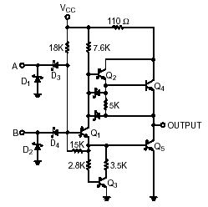
Transistor-Transistor Logic (TTL)
  Unused gate input
    It can be left unconnected (floating)
      It can be confusing
        If the designer leaves the company and a new engineer works on the circuit it can be confusing especially if the documentation is not good !
a
Implemented by an available 3-input AND gate
a
y
b
y
b
NAND
NAND gate
TTL 2-input NAND gate ON Semiconductor LS TTL Data Manual
CS 2204 Fall 2019
Experiment 1 Lab 5
Page <number>

Slide 19
Transistor-Transistor Logic (TTL)
  Unused gate input
    It can be tied to a used input
      The fan-out of the b signal can be exceeded
a
An available 3-input AND gate used to implement a 2-input AND gate
b
y
CS 2204 Fall 2019
Experiment 1 Lab 5
Page <number>

Slide 20
Transistor-Transistor Logic (TTL)
  Unused gate input
    It can be connected to 1 or 0 depending on the gate type, via a pull-up resistor or pull-down resistor
a
a
b
y
b
y
Pull-up
resistor
Pull-down
resistor
+5 v
0 v
CS 2204 Fall 2019
Experiment 1 Lab 5
Page <number>

Slide 21
Transistor-Transistor Logic (TTL)
  Gate outputs
    Totem-pole outputs
Do not short circuit totem-pole gate outputs
2-input NAND gate implementation
From ON Semiconductor LS TTL Data Manual
CS 2204 Fall 2019
Experiment 1 Lab 5
Page <number>

Slide 22
Transistor-Transistor Logic (TTL)
  Gate outputs
    Tri-state outputs
      The output has three values !
        1, 0 and Hi-Z ≡ High-impedance ≡ Floating ≡ Static voltage
        There is an extra control input, Enable, to enable/disable output
        ► If disabled, the output value is Hi-Z (high-impedance)
a
Enable
y
y
0
Hi-Z
Operation table
b
1
ab
Enable
Tri-state symbol
CS 2204 Fall 2019
Experiment 1 Lab 5
Page <number>

Slide 23
Transistor-Transistor Logic (TTL)
  Gate outputs
    Tri-state outputs
      A tri-state gate can be envisioned as a totem-pole gate with a switch at the output
Output y has three values
a
y
a
y
b
b
Enable
Enable
Totem-pole gate
Switch closed
Switch open
0
1
Hi-Z
CS 2204 Fall 2019
Experiment 1 Lab 5
Page <number>

Slide 24
Transistor-Transistor Logic (TTL)
  Gate output
    Tri-state outputs
      Outputs can be short circuited if only one gate is enabled at a time
Enable1
You can short circuit tri-state gate outputs
Tri-state outputs are often used to implement buses
A bus line
Enable2
CS 2204 Fall 2019
Experiment 1 Lab 5
Page <number>

Slide 25
Transistor-Transistor Logic (TTL)
  Gate output
    Open-collector
      An external pull-up resistor is needed
a
Open-collector outputs are often used
  To drive displays and lights
  To implement buses
y
b
Pull-up
resistor
Open collector symbol
+5 v
CS 2204 Fall 2019
Experiment 1 Lab 5
Page <number>

Slide 26
Transistor-Transistor Logic (TTL)
  Gate output
    Open-collector
      Gate outputs can be short circuited
You can short circuit open-collector gate outputs
A bus line
Open-collector outputs can be short circuited to implement buses
+5 v
+5 v
CS 2204 Fall 2019
Experiment 1 Lab 5
Page <number>

Slide 27
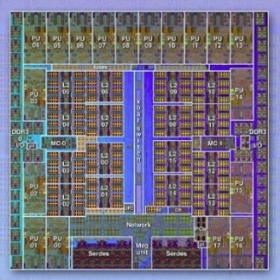
Silicon Technology Today
  Number of transistors on a chip doubles every two years
        Micron 128-Gbit Flash memory : 16 nm (16x10⁻⁹ meter)
        Samsung 128 Gbit Flash memory : 19nm (19x10⁻⁹ meter)
  Today, high density chips are CMOS chips
    Complementary Metal Oxide Semiconductor
CMOS chips
CMOS chips consume very little power
CMOS gates need less transistors
CMOS chips are sensitive to static electricity
IBM BG/Q microprocessor die with 1.47 Billion transistors
CMOS chip
You used TTL chips for your EG Digital Logic experiment
  Transistor-Transistor Logic
    TTL chips are cheaper
    TTL chips are faster than CMOS
    TTL chips consume more power
    TTL gates are larger and so we can pack less number gates on a chip
Microprocessors, DRAMs, GPUs, flash memory and FPGAs are CMOS
CS 2204 Fall 2019
Experiment 1 Lab 5
Page <number>

Slide 28
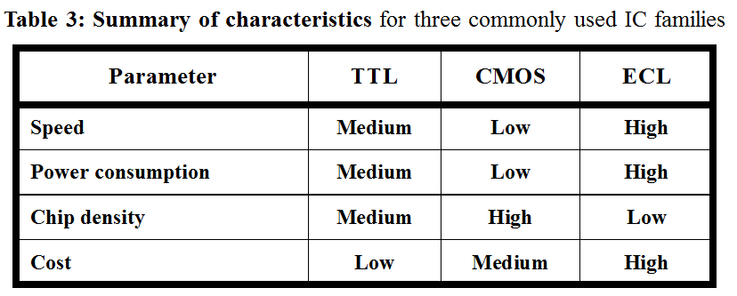
Silicon Technology Today
    A comparison of CMOS,TTL and ECL technologies
CMOS has two wins
TTL has one win
ECL has one win
CMOS is the choice for high-density chips today !
FPGA chips are CMOS
Microprocessor chips are CMOS
DRAM chips are CMOS
Flash memory chips are CMOS
GPU chips are CMOS
CS 2204 Fall 2019
Experiment 1 Lab 5
Page <number>

Slide 29
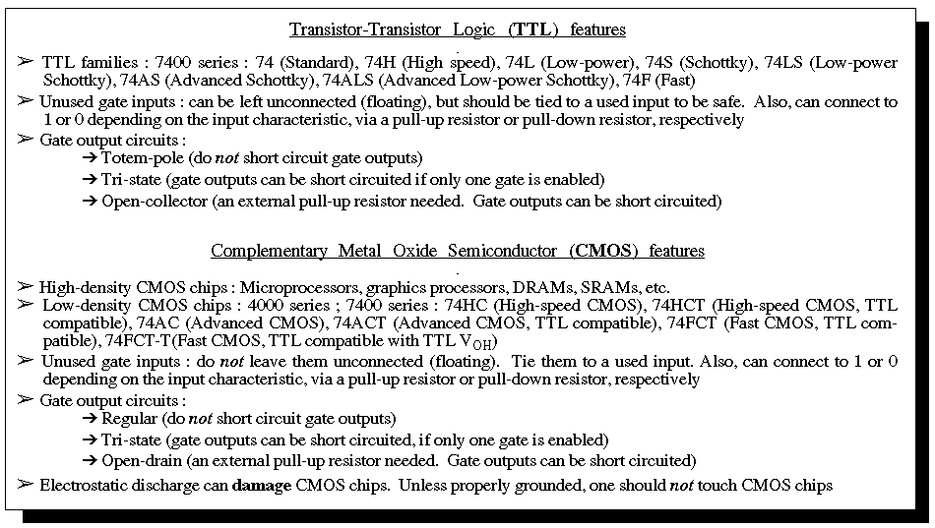
Silicon Technology Today
  A brief comparison of CMOS and TTL technologies
From : Semiconductor Technology handout
CS 2204 Fall 2019
Experiment 1 Lab 5
Page <number>

Slide 30
The Term Project
  Develop a term project so that
    You will be proud of
    You can mention it during interviews
    You will learn a lot
    You will gain a lot of knowledge that will help you
      In future semesters
      After graduation
CS 2204 Fall 2019
Experiment 1 Lab 5
Page <number>

Slide 31
Common Logic Errors
  Discovering logic errors by means of Xilinx IMPLEMENTATIONs
U2 has no Load
U2 output is not used
Must be
corrected
U1
U2
a
Must be
corrected
U4
b
y
U4 input has no driver
U4 input is not connected to an output. Its input value is Hi-Z (High-Impedance) as there is infinite impedance (resistance) into the U4 input so no current can flow in
a
c
U3
Must be corrected
Multiple drivers on output y
U3 and U4 outputs are short circuited
CS 2204 Fall 2019
Experiment 1 Lab 5
Page <number>

Slide 32
You cannot discover these errors by reading Xilinx IMPLEMENTATION messages
Common Logic Errors
  Discovering logic errors by means of simulations + playing on the board
The correct expression
Must be
corrected
a
y(a, b, c) = a.b + a.c
Input “a” is input “b” by mistake !
b
b
y(a, b, c) = a.b.(b.c)
c
U3
The incorrect
expression
Must be corrected
The OR gate is an AND gate by mistake !
CS 2204 Fall 2019
Experiment 1 Lab 5
Page <number>

Slide 33
Lessons from Previous Four Labs
  All members of the team do the project work
    If a member has problem, there are still other members to continue with the project
  Reading the handouts is needed
    Especially, to feel confident
  Working at home is needed
    Work also in the lab during Open Lab hours and other times
    Otherwise, we waste time to remember what we did the last lab
CS 2204 Fall 2019
Experiment 1 Lab 5
Page <number>

Slide 34
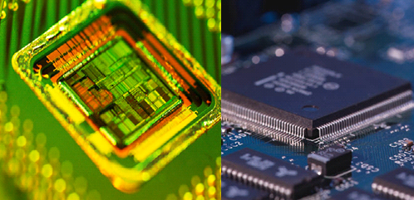
QUESTIONS ?
Make sure you have the LABS account and see the S drive
Make sure you have installed Vivado WebPACK 2018.3 on your laptop
Check the course web site all the time : NYU Classes
Organize your S drive and laptop (or your USB drive)
Create a CS2204 folder on both
Digital
Logic and
State Machine Design
CS 2204 Fall 2019
Experiment 1 Lab 5
Page <number>

Slide 35
Today’s Individual Xilinx Work (High Level Steps)
  We will experiment with developing a combinational circuit
    The Lab 2 work continues in Lab 4
      We will work on the crypto Verilog design
      We will learn the hardware development steps
        Logic Simulations
        Test benches
        Synthesis
        Implement Design (Translate + Map + Place & Route)
        Timing Simulations
        Generate Programming File
      We will learn how attach a Digilent KeyPAD module and instantiate its control program
        We will then modify the test bench program accordingly
    We will develop the 1-bit 1-to-2 DeMUX discussed in class in four different ways completely
    We will help our partners complete today’s work
    We will play the games and think about your team’s term project
    We will observe the Tetris, pong and two dash projects on the board
    We will play the Ppm game by using the Ppm Python software
      We play its four versions
Xilinx IMPLEMENTATION
CS 2204 Fall 2019
Experiment 1 Lab 5
Page <number>

Slide 36
Today’s Individual Xilinx Work (detailed steps)
  If you did not complete the work of Lab 3, complete it first
    The test bench module is added to the crypto module as a simulation source program
    Functional simulation for 400 ns are done by using the test bench program where input combinations are automatically created
    The test bench program is modified to be more descriptive by printing the value of “i” every 10 ns
    Timing simulations are done for 200ns such that longest delays are calculated
This is 1 check mark in Lab 4 !
This is 1 check mark in Lab 4 !
This is 1 check mark in Lab 4 !
Make sure you earn 4 check marks of Lab 4 !
This is 1 check mark in Lab 4 !
CS 2204 Fall 2019
Experiment 1 Lab 5
Page <number>

Slide 37
Today’s Individual Xilinx Lab Work (detailed steps)
  Source the Digilent KeyPAD module controller VHDL program to the crypto module
    Start the Xilinx Vivado software
      Double click on the Vivado 2018.3 icon on your desktop
    Click on Open Project on the left under Quick Start
      On the right hand side it will list latest projects worked on
      The crypto project is the top one shown
    Click on the crypto project
      It will open last week’s crypto project
    Double click on the crypto (crypto.v) file name under Sources to view your Verilog program from Lab 2
    Double click on crypto.xdc under Sources to view your constraints file from Lab 2
    Double click on crypto_tb.v under Sources to view your test bench file from Lab 4
CS 2204 Fall 2019
Experiment 1 Lab 5
Page <number>

Slide 38
Today’s Individual Xilinx Lab Work (detailed steps)
  Source the Digilent KeyPAD module controller VHDL program to the crypto module
    Download the following VHDL files from the NYU Classes course web site and place them in the coding folder
        PmodKEYPAD.vhd
        ➢ The PmodKEYPAD.vhd file is the VHDL program that communicates with
        the Digilent Pmod KeyPAD module
        Decoder.vhd
        ➢ The Decoder.vhd is the Decoder VHDL program used (instantiated) by
        the PmodKEYPAD program
    Click on Add Sources in the Flow Navigator window to add the two files to the crypto module
    Click Add or create design sources to add the files for crypto
    Click on Add Files on the Add or Create Design Sources window
    Select the two files on the Add Source Files window
    Click OK to add the files
    Click finish to complete the addition of the files
      You will notice that the two files are listed under Design Sources panel and above the crypto.v file
        This is because the crypto module has not instantiated the PmodKEYPAD module yet
CS 2204 Fall 2019
Experiment 1 Lab 5
Page <number>

Slide 39
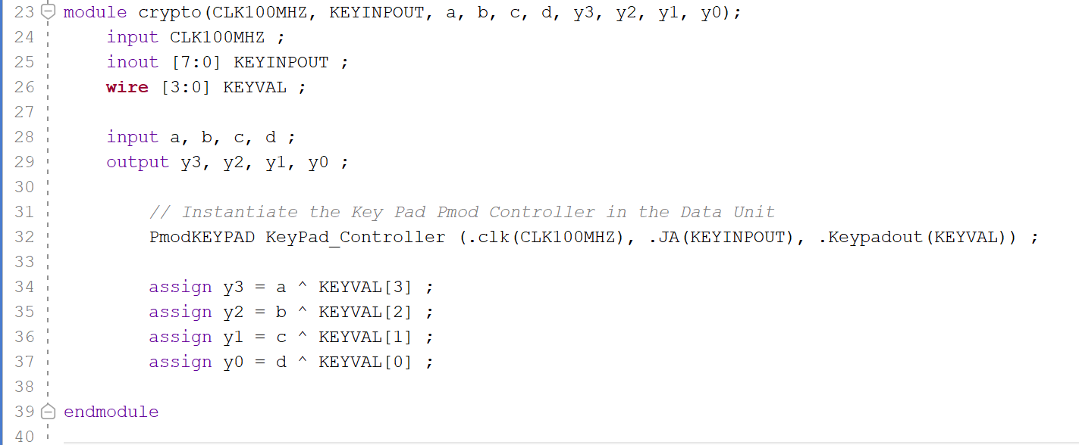
Today’s Individual Xilinx Lab Work (detailed steps)
  Modify the crypto Verilog program to instantiate the PmodKEYPAD.vhd program to use the Digilent KeyPAD Pmod
    Switch to the crypto.v program on the right hand side
    Modify the crypto.v program as shown below
      CLK100MHZ, KEYINPOUT are ports for the crypto.v module
        CLK100MHZ is a clock input at 100 MHz
        KEYINPOUT is bidirectional (inout) and has eight bits
      KEYVAL is output from the PmodKEYPAD.vhd module, but is internal to the crypto.v module and so declared as a vector of four wires
    Save the file
Declare the new ports
KEYVAL is the internal wire from the KEYPAD & has the key value
Instantiate the PmodKEYPAD module
CS 2204 Fall 2019
Experiment 1 Lab 5
Page <number>

Slide 40
Today’s Individual Xilinx Lab Work (detailed steps)
  Modify the crypto Verilog program to instantiate program to use the Digilent KeyPAD Pmod
4
(y3, y2, y1, y0
Crypto Module
4
PmodKEYPD Module
(a, b, c, d)
KEYVAL
CLK100MHZ
8
(KEYINPOUT
CS 2204 Fall 2019
Experiment 1 Lab 5
Page <number>

Slide 41
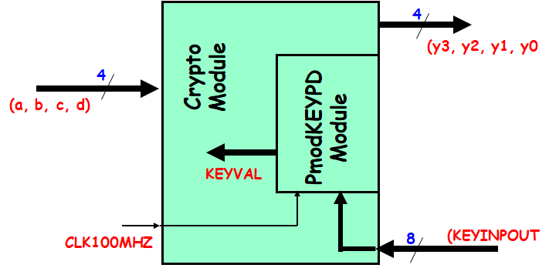
Today’s Individual Xilinx Lab Work (detailed steps)
  Modify the crypto Verilog program to instantiate program to use the Digilent KeyPAD Pmod
CS 2204 Fall 2019
Experiment 1 Lab 5
Page <number>

Slide 42
Today’s Individual Xilinx Lab Work (detailed steps)
  Modify the constraints file to attach the Digilent KeyPAD Pmod to port JA and also receive the 100 MHz clock
    Switch to the crypto.xdc constraints file on the right hand side
    Uncomment the clock input on line 7
    Place comment symbols for inputs key3 through key0 coming from switches
      Place “#” signs on lines 13 through 16
      Change their wire names to SW[3] through SW[0] so that these lines look like the original lines
    Scroll down to the area titled Pmod Header JA
    Uncomment all eight lines from 96 through 103
    Change the connected wire names to KEYINPOUT[7] through KEYINPOUT[0]
    Save the file
CS 2204 Fall 2019
Experiment 1 Lab 5
Page <number>

Slide 43
Today’s Individual Xilinx Lab Work (detailed steps)
  Source a new test bench program to use the KEYVAL lines
    Right click on the crypto_tb.v file name on the Sources panel
    Select Remove File from Project…
    Click OK on the Remove Sources warning pop up window
    Delete the test bench file in the coding folder
    Download the test bench file, crypto_tb.v, from NYU Classes course web site
    Add it a simulation source file to the project the way we did in Lab 4
CS 2204 Fall 2019
Experiment 1 Lab 5
Page <number>

Slide 44
Today’s Individual Xilinx Lab Work (detailed steps)
  Source a new test bench program to use the KEYVAL lines
    Learn from this example test bench
      The KEYVAL is declared as a vector of four bits : KEYVALtb
      There are two nested for loops to change the value of “i” and KEYVALtb separately
      The KEYVALtb value is forced and then released after 10ns
        This is required when the test bench has to assign values to internal lines
        Test bench programs are developed to assign values to input ports, not to internal wires
CS 2204 Fall 2019
Experiment 1 Lab 5
Page <number>

Slide 45
Today’s Individual Xilinx Lab Work (detailed steps)
  Follow the hardware development steps that have been studied in Lab 3 and Lab 4
    Perform logic simulations to verify that the new crypto project is correct
    Do a Xilinx IMPLEMENTATION on the project
      Synthesis
      Implement Design (Translate + Map + Place & Route)
      Generate Programming File
    Analyze the Xilinx IMPLEMENTATION results on the Project Summary panel
      62 LUTs used
      4.131 W used
      43.9 C junction temperature
    Perform timing simulations to verify that the new crypto project is correct
      Determine the longest delay when inputs are changed at 80 ns
    Apply inputs and observe outputs on the FPGA board to verify that the new crypto project is correct
This is 1 check mark in Lab 5 !
CS 2204 Fall 2019
Experiment 1 Lab 5
Page <number>

Slide 46
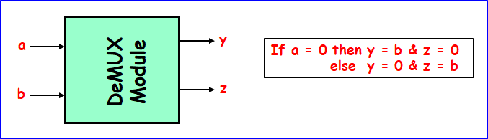
Today’s Individual Xilinx Lab Work (detailed steps)
  Develop the 1-bit 1-to-2 DeMUX studied in class such that each team member develops the DeMUX in a different way
    Decide as a team who designs DeMUX which way
      There are four possibilities of the implementation
        Use assign statements (dataflow style)
        Use an if-else statement (behavioral style)
        Use a case statement (behavioral style)
        Use a for-loop statement (behavioral style)
    Create the demux folder in the exp1 folder to contain the demux project
      Your folder structure is as follows
        S  CS2204  exp1  demux
        In order to be more informative the name of the folder can include a short name of the implementation type
        S  CS2204  exp1  demuxforloop
    Use the Verilog design source file examples to develop the Verilog module where the name of the Verilog module is demux also
      Each team member uses one of the examples
        Note that the name of the folder is demuxforloop if it is a for-loop implementation
CS 2204 Fall 2019
Experiment 1 Lab 5
Page <number>

Slide 47
Today’s Individual Xilinx Lab Work (detailed steps)
  Develop the 1-bit 1-to-2 DeMUX studied in class such that each team member develops the DeMUX in a different way
    Develop the constraints file whose name is demux.xdc
      The constraints file is developed such that
        LED15 is output “z” and LED0 is output “y”
        Push button Up (BTNU) is input “a”
        Push button down (BTND) is input “b”
      Copy the master XDC file from your S  CS2204  digilent folder
      Paste it as demux.xdc in your demuxforloop folder for example
      Edit the XDC file so that you can use the above LED lights and push buttons
    Develop the test bench file, demux_tb.v accordingly
      Add it as a simulation source file to the project the way we did in Lab 4
CS 2204 Fall 2019
Experiment 1 Lab 5
Page <number>

Slide 48
Today’s Individual Xilinx Lab Work (detailed steps)
  Develop the 1-bit 1-to-2 DeMUX studied in class such that each team member develops the DeMUX in a different way
    Complete the hardware development steps that have been studied in Lab 3 and Lab 4
      Perform logic simulations to verify that the demux project is correct
      Do a Xilinx IMPLEMENTATION on the project
        Synthesis
        Implement Design (Translate + Map + Place & Route)
        Generate Programming File
      Analyze the Xilinx IMPLEMENTATION results on the Project Summary panel to check for
        LUTs used
        Power used
        Junction temperature
      Perform timing simulations to verify that the new crypto project is correct
        Determine the longest delay when inputs are changed at a certain time
      Apply inputs and observe outputs on the FPGA board to verify that the new crypto project is correct
This is 1 check mark in Lab 5 !
CS 2204 Fall 2019
Experiment 1 Lab 5
Page <number>

Slide 49
Today’s Individual Xilinx Lab Work (detailed steps)
  Develop the other three types of the 1-bit 1-to-2 DeMUX
    Use different folder names where the type of the implementation is a part of the folder name as you did above
  When every member is at this point, decide what to do next based on how much time you have
    You can submit the team project in Lab 5
      Make sure your project follows the Experiment 1 Design Checks handout
      Fill out the Experiment 1 Design Checks handout
        Also, fill out the back of the handout
      The professor will select one member randomly
      The professor will get the soft copy of the project of the selected student
      That project will be graded by the TAs
    The team is done with Experiment 1 !
      However, they are advised to work on additional projects listed on two slides forward before they start their Experiment 2
        To learn Vivado and Verilog programming to be able to do well on the term project and on the exams
CS 2204 Fall 2019
Experiment 1 Lab 5
Page <number>

Slide 50
Today’s Individual Xilinx Lab Work (detailed steps)
  Develop the other three types of the 1-bit 1-to-2 DeMUX
    Use different folder names where the type of the implementation is a part of the folder name as you did above
  When every member is at this point, decide what to do next based on how much time you have
    You can submit the team project in Lab 6, after the professor completes his presentation
      Make sure your project follows the Experiment 1 Design Checks handout
      Fill out the Experiment 1 Design Checks handout
        Also, fill out the back of the handout
      The professor will select one member randomly
      The professor will get the soft copy of the project of the selected student
      That project will be graded by the Tas
      The last day to submit the project is during your Lab 6 session before you start Experiment 2
    Students are done with Experiment 1 !
      However, they are advised to work on additional projects listed on the next slide before they start their Experiment 2
        To learn Vivado and Verilog programming to be able to do well on the term project and on the exams
CS 2204 Fall 2019
Experiment 1 Lab 5
Page <number>

Slide 51
Today’s Individual Xilinx Lab Work (detailed steps)
  Students are advised to work on additional projects listed below to learn Vivado and Verilog programming to be able to do well on the term project and on the exams
    The DeMUX is larger for example
      A 4-bit 1-to-2 DeMUX
      A 1-bit 1-to-4 DeMUX
      An 8-bit 1-to-4 DeMUX
    The DeMUX uses the Pmod KEYPAD board
      Think which inputs the KEYPAD supplies and then develop the project
      What if you attached the KEYPAD to Pmod Header JB or JC or JD ?
    Develop MUX projects
      A 1-bit 2-to-1 MUX
      A 4-bit 2-to-1 MUX
      A 1-bit 4-to-1 MUX
      An 8-bit 4-to-1 MUX
    The MUX uses the Pmod KeyPAD board
      Think which inputs the KEYPAD supplies and then develop the project
      What if you attached the KEYPAD to Pmod Header JB or JC or JD ?
CS 2204 Fall 2019
Experiment 1 Lab 5
Page <number>

Slide 52
Today’s Individual Xilinx Lab Work (detailed steps)
  Stay in the lab and do other work to save time for the future
    Help your partners if you have a team already
    Study all the slides
    Observe the Ppm, the clock and dash projects on the board
    Play the Ppm game by using the Ppm Python software
      We play its four versions
    Do the current homework assignment
    Play the games and think about your team’s term project
    Leave the lab with teammates
CS 2204 Fall 2019
Experiment 1 Lab 5
Page <number>

Slide 53
Make sure you have the LABS account and see the S drive
Make sure you have installed Vivado WebPACK 2018.3 on your laptop
Check the course web site all the time : NYU Classes
Organize your S drive and laptop (or your USB drive)
Create a CS2204 folder on both
Digital
Logic and
State Machine Design
CS 2204 Fall 2019
Experiment 1 Lab 5
Page <number>

