Slide 2
Agenda
Introduction
VHDL Review (Page #3-19)
Modeling styles in VHDL with examples (Page #20-28)
Constructs in VHDL
  Concurrent (Page #29-48)
  Sequential (Page #49-55)
Think Hardware? (Page #56-57)
Examples of Behavioral coding (Page #58-63)
Conclusions (Page #64)
Acknowledgements
Prof. Haldun Hadimioglu
John Wakerly, Cisco Systems, Stanford University
System Design using VHDL-Charles H. Roth

Slide 3
VHDL
Revisited

Slide 4
Why HDLs?
In software everything is sequential
Sequence of statements is significant, since they are executed in that order
In hardware events are concurrent, so a software language cannot be used for describing and simulating hardware.

Slide 5
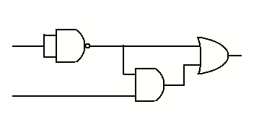
e.g.
C = (not (X) and Y) or (not (X))
1 -> 0 A 0 -> 1
X C
Y B
Different outputs with software programming languages with ‘0’ initial values
Case 1
A = not X
B = A and Y
C = A or B
Result:
C = 1
Case 2
B = A and Y
C = A or B
A = not X
Result:
C = 0
Case 3
C = A or B
A = not X
B = A and Y
Result:
C = 0

Slide 6
Features of HDLs
Concurrent Descriptions
Synchronizing mechanisms between concurrent flows
Event Scheduling
Special object types and data types
Hierarchy

Slide 7
HDL Implementation Design Cycle
DESIGN ENTRY
Schematic , VHDL, Verilog, etc.
Functional Simulation
IP cores
Static Timing Analysis
SYNTHESIS
Test insertion
Gate level simulation
LIBRARIES
Static Timing Analysis
Implementation
MAP, PLACE , ROUTE
Post layout simulation

Slide 8
Advantages of using Hardware Description Languages
Designs can be described at various levels of abstractions
Top-Down Approach and hierarchical designs for large projects
Functional Simulation Early in the Design Flow
Automatic Conversion of HDL Code to Gates
  With user level control. Consistent quality. Fast.
Early Testing of Various Design Implementations
  Due to fast synthesis, there is a scope for trying different implementations.
Design Reuse
  Technology independence, standardization, portability, ease of maintenance.
All these result in low risk, high convergence, fast time to market, more money.

Slide 9
A Brief History Of VHDL
VHDL stands for Very high speed integrated circuit Hardware Description Language
Funded by the US Department of Defense in the 80's
Originally meant for design standardisation, documentation, simulation and ease of maintenance.
Established as IEEE standard IEEE 1076 in 1987. An updated standard, IEEE 1164 was adopted in 1993. In 1996 IEEE 1076.3 became a VHDL synthesis standard.
Today VHDL is widely used across the industry for design description, simulation and synthesis.

Slide 10
About VHDL
VHDL is not case sensitive
VHDL is a free form language. You can write the whole program on a single line.
-- This is a VHDL comment
entity my_exor is -- one more comment
begin
...
end my_exor;

Slide 11
my EXOR gate
-- This is my first VHDL program
library IEEE;
use IEEE.std_logic_1164.all;
entity my_exor is
port (ip1 : in std_logic;
ip2 : in std_logic;
op1 : out std_logic
);
end my_exor;
entity declaration - describes the
boundaries of the object.
It defines the names of the ports, their
mode and their type.

Slide 12
my EXOR gate
library IEEE;
use IEEE.std_logic_1164.all;
entity my_exor is
port (ip1 : in std_logic;
ip2 : in std_logic;
op1 : out std_logic
);
end my_exor;
entity - defines the
interface.
Mode of the port :
Direction of flow.
It can be
in, out or inout

Slide 13
my EXOR gate
library IEEE;
use IEEE.std_logic_1164.all;
entity my_exor is
port (ip1 : in std_logic;
ip2 : in std_logic;
op1 : out std_logic
);
end my_exor;
entity - defines the
interface.
std_logic is the type of the
port.
Standard logic is defined
by the standard
IEEE 1164.
It is defined in the IEEE
library.
Any node of type std_logic
can take 9 different values.
‘0’ , ’1’ , ’H’ , ’L’ , ’Z’ ,
’U’ , ’X’ , ’W’ , ’-’
Mode of the port :
It can be
in, out or inout

Slide 14
my EXOR gate
Library : Collection of design
elements, type declarations, sub
programs, etc.
library IEEE;
use IEEE.std_logic_1164.all;
entity my_exor is
port (ip1 : in std_logic;
ip2 : in std_logic;
op1 : out std_logic
);
end my_exor;

Slide 15
my EXOR gate
Library : Collection of design
elements, type declarations,sub
programs, etc.
library IEEE;
use IEEE.std_logic_1164.all;
entity my_exor is
port (ip1 : in std_logic;
ip2 : in std_logic;
op1 : out std_logic
);
end my_exor;
architecture my_exor_beh of my_exor is
begin
op1 <= (ip1 and (not ip2)) or
(ip2 and (not ip1));
end my_exor_beh;
entity - defines the
interface.
std_logic is the type of the port
It is defined in the IEEE library.
Any node of type std_logic can take
9 different values.
‘0’ , ’1’ , ’H’ , ’L’ , ’Z’ , ’U’ , ’X’ , ’W’ , ’-’
Mode of the port :
It can be
in, out or inout
The architecture describes the
behaviour (function),
interconnections and the
relationship between different
inputs and outputs of the entity.

Slide 16
my EXOR gate
Library : Collection of design
elements, type declarations,
sub programs, etc.
library IEEE;
use IEEE.std_logic_1164.all;
entity my_exor is
port (ip1 : in std_logic;
ip2 : in std_logic;
op1 : out std_logic
);
end my_exor;
architecture my_exor_beh of my_exor is
begin
op1 <= (ip1 and (not ip2)) or
(ip2 and (not ip1));
end my_exor_beh;
configuration my_exor_C of my_exor is
for my_exor_beh
end for;
end my_exor_C;
entity - defines the
interface.
std_logic is the type of the port
It is defined in the IEEE library.
Any node of type std_logic can take
9 different value.
‘0’ , ’1’ , ’H’ , ’L’ , ’Z’ , ’U’ , ’X’ , ’W’ , ’-’
Mode of the port :
It can be
in, out or inout
The architecture describes the
behaviour(function), interconnections
and the relationship between different
inputsand outputs.
The configuration is optional.
It defines the entity architecture
bindings.
More about configurations later.

Slide 17
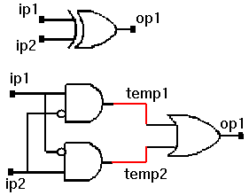
Internal connections are made using signals.
Signals are defined inside the architecture.
architecture my_exor_beh of my_exor is
signal temp1 : std_logic;
signal temp2 : std_logic;
begin
......
end my_exor_beh;

Slide 18
my EXOR with internal signals
library IEEE;
use IEEE.std_logic_1164.all;
entity my_exor is
port (ip1 : in std_logic;
ip2 : in std_logic;
op1 : out std_logic
);
end my_exor;
architecture exor_w_sig of my_exor is
signal temp1, temp2 : std_logic;
begin
temp1 <= ip1 and (not ip2);
temp2 <= ip2 and (not ip1);
op1 <= temp1 or temp2;
end exor_w_sig;
configuration my_exor_C of my_exor is
for exor_w_sig
end for;
end my_exor_C;

Slide 19
SUMMARY
Introduction to:
VHDL flow
Comments
Library declaration
Entity declaration (ports, modes, std_logic type)
Architecture
Signal declarations
Signal assignments
Component declaration and instantiation
Configuration statement

Slide 20
Design Hierarchy Levels ( Modeling Styles)
Structural
  Define explicit components and the connections between them.
Dataflow
  Most are like assigning expressions to signals
Behavioral
  Write an algorithm that describes the circuit’s output

Slide 21
Dataflow Level
Dataflow description
  The detail is less with data dependencies described, not the components and connections
  Includes “when” and “select” (case) statements

Slide 22
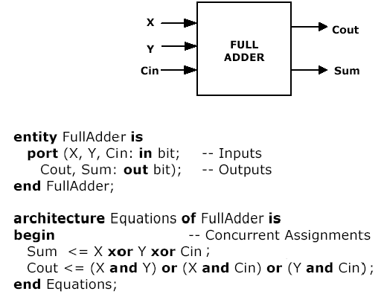
Full Adder - Data flow

Slide 23
Structural Level
A structural description is like the schematic, describing the components and their interconnections precisely
  Includes concurrent statements
    A component statement is a concurrent statement

Slide 24
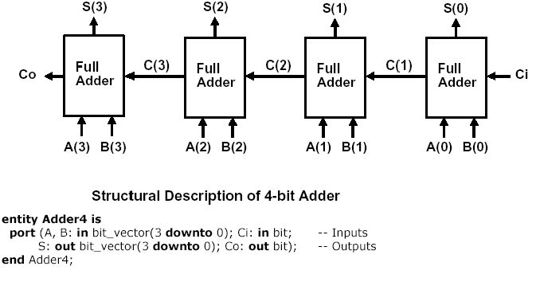
4-bit Ripple-Carry Adder - Structural Description

Slide 25
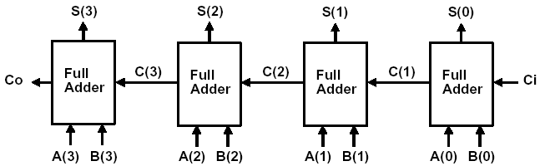
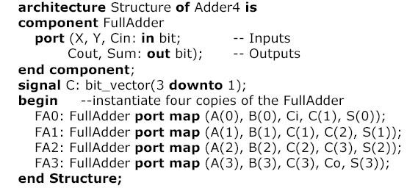
4-bit Ripple-Carry Adder - Structural Description cntd.

Slide 26
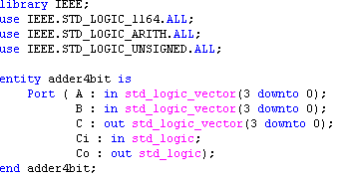
Behavioral Level
Behavioral description
  May not be synthesizable or may lead to a very large circuit
  Primarily used for simulation
  Normally uses VHDL “processes”

Slide 27
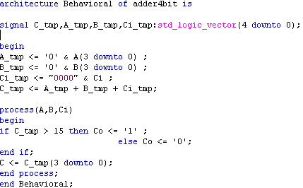

Slide 28
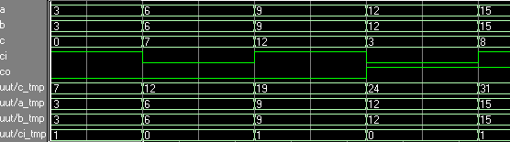
Simulation results (temp. signals also shown)
HDL Synthesis Report
Macro Statistics
# Adders/Subtractors : 2
5-bit adder : 2
# Comparators : 1
5-bit comparator greater : 1
A strong reason to think of hardware being designed, while writing VHDL behavioral code.

Slide 29
Constructs in VHDL

Slide 30
Concurrent Statements
All concurrent statements in an architecture are executed simultaneously.
Concurrent statements are used to express parallel activity as is the case with any digital circuit.
Concurrent statements are executed with no predefined order by the simulator . So the order in which the code is written does not have any effect on its function.
They can be used for behavioral and structural and data flow descriptions.

Slide 31
Concurrent statements contd.
Process is a concurrent statement in which sequential statements are allowed.
All processes in an architecture are executed simultaneously.
Concurrent statements are executed by the simulator when one of the signals in its sensitivity list changes . This is called occurrence of an ‘event’.
  eg : c <= a or b;
  is executed when either signal ‘a’ or signal ‘b’ changes.
  process(clk , reset) ...
  is executed when either ‘clk’ or ‘reset’ changes
Signals are concurrent whereas variables are sequential objects.

Slide 32
Conditional signal assignment
The ‘when‘ statement
  This type of assignment has one target but multiple condition expressions.
  This statement assigns value based on the priority of the condition.
  syntax
sig_name <= exp1 when condition1 else
exp2 when condition2 else
exp3;

Slide 33
entity my_nand is
port (a, b : in std_logic;
c : out std_logic);
end my_nand;
architecture beh of my_nand is
begin
c <= ‘0’ when a = ‘1’ and b = ‘1’ else
‘1’ ;
end beh;
entity tri_state is
port (a, en : in std_logic;
b : out std_logic);
end tri_state;
architecture beh of tri_state is
begin
b <= a when en = ‘1’ else
‘Z’;
end beh;

Slide 34
example
architecture try_A of try is
begin
  Y <= i1 when s1 = ‘0’ and s0 = ‘0’ else
  i2 when s1 = ‘0’ and s0 = ‘1’ else
  i3 when s1 = ‘1’ and s0 = ‘0’ else
  i4 when s1 = ‘1’ and s0 = ‘1’ else
  ‘0’ ;
end try_A;
Incomplete specification is not allowed

Slide 35
example
architecture when_grant of bus_grant is
signal …
begin
  data_bus <= a and b when e1 = ‘1’ else
      e or f when a = b else
      g & h when e3 = ‘1’ else
      (others => ‘Z’);
end when_grant;

Slide 36
Selective signal assignment
The with statement
This statement is similar to the case statement
syntax
with expression select
target <= expression1 when choice1
expression2 when choice2
expressionN when choiceN;
all possible choices must be enumerated
when others choice takes care of all the
remaining alternatives.

Slide 37
Difference between with and when statements
Each choice in the with statement should be unique
Compared to the ‘when’ statement, in the ‘with’ statement, choice is limited to the choices provided by the with ‘expression’, whereas for the ‘when’ statement each choice itself can be a separate expression.
The when statement is prioritized (since each choice can be a different expression, more than one condition can be true at the same time, thus necessitating a priority based assignment) whereas the with statement does not have any priority (since choices are mutually exclusive)

Slide 38
entity my_mux is
port (a, b, c, d : in std_logic;
sel0, sel1 : in std_logic;
e : out std_logic);
end my_mux;
architecture my_mux_A of my_mux is
signal sel: std_logic_vector(1 downto 0);
begin
sel <= sel1 & sel0;
with sel select
e <= a when “00”
b when “01”
c when “10”
d when others;
end my_mux_A;

Slide 39
Component Instantiation
A component represents an entity architecture pair.
Component allows hierarchical design of complex circuits.
A component instantiation statement defines a part lower in the hierarchy of the design entity in which it appears. It associates ports of the component with the signals of the entity. It assigns values to the generics of the component.
A component has to be declared in either a package or in the declaration part of the architecture prior to its instantiation.

Slide 40
Component Declaration and Instantiation
Syntax(Declaration)
component component_name
[generic list]
[port list]
end component;
Syntax(Instantiation)
label:component_name
[generic map]
port map;

Slide 41
entity my_and is
port( a : in std_logic;
b : in std_logic;
c : out std_logic);
end my_and;
architecture my_and_A of my_and is
component and2
generic (tpd: time := 2 ns);
port (x : in std_logic;
y : in std_logic;
z : out std_logic);
end component;
signal temp : std_logic;
begin
c <= temp;
-- component instantiation here
end my_and_A;
U1: my_and
generic map (tpd => 5 ns)
port map (x => a,
y => b,
z => temp);
U2: my_and
generic map (tpd => 2 ns)
port map (x => a,
y => b,
z => temp);

Slide 42
architecture exor_A of exor is
component my_or
port (a : in std_logic;
b : in std_logic;
y : out std_logic
);
end component;
component my_and
port (a : in std_logic;
b : in std_logic;
y : out std_logic
);
end component;
signal a_n, b_n : std_logic;
signal y1, y2, y3 : std_logic;
begin
. . . . .
end exor_A;
u1 : my_or
port map (y2,
y3,
y1);
u2 : my_and
port map (a_n,
b,
y2);
u3 : my_and
port map (a,
b_n,
y3);
a_n <= not a ;
b_n <= not b ;

Slide 43
Component Instantiation contd.
  Positional association
  Named Association
U1: my_and
generic map(5 ns)
port map(a, b, temp);
U1:my_and
generic map (tpd => 5 ns)
port map (x => a,
y => b,
z => temp);
The formal and the actual can have the same name

Slide 44
Component Instantiation contd.
Named association is preferred because it makes the code more readable and pins can be specified in any order whereas in positional association order should be maintained as defined in the component and all the pins need to be connected .
Multiple instantiation of the same component should have different labels.

Slide 45
Process statement
The process statement is a concurrent statement , which delineates a part of an architecture where sequential statements are executed.
Syntax
label: process [(sensitivity list )]
declarations
begin
sequential statements
end process;

Slide 46
Process statement
All processes in an architecture are executed concurrently with all other concurrent statements.
Process is synchronized with the other concurrent statements using the sensitivity list or a wait statement.
Process should either have sensitivity list or an explicit wait statement. Both should not be present in the same process statement.
The order of execution of statements is the order in which the statements appear in the process
All the statements in the process are executed continuously in a loop .

Slide 47
Process contd.
The simulator runs a process when any one of the signals in the sensitivity list changes. For a wait statement, the simulator executes the process after the wait is over.
The simulator takes 0 simulation time to execute all the statements in the process. (provided there is no wait)

Slide 48
process
begin
if (reset = ‘1’) then
A <= ‘0’ ;
elsif (clk’event and clk = ‘1’) then
A <= ‘B’;
end if;
wait on reset, clk;
end process;
process (clk,reset)
begin
if (reset = ‘1’) then
A <= ‘0’;
elsif (clk’event and clk = ‘1’) then
A <= ‘B’;
end if;
end process;

Slide 49
Sequential Statements
Sequential statements are statements which are analyzed serially one after the other. The final output depends on the order of the statements, unlike concurrent statements where the order is inconsequential.
Sequential statements are allowed only inside process and subprograms (function and procedure)
Process and subprograms can have only sequential statements within them.
Only sequential statements can use variables.
The Process statement is the primary concurrent VHDL statement used to describe sequential behaviour.

Slide 50
Sequential Statements contd.
Sequential statements can be used to generate
  Combinational logic
  Sequential logic
Clocked process
  It is easily possible to infer flip-flops using if statements and ‘event attribute.
Combinatorial process
  generates purely combinatorial logic.
  All the inputs must be present in the sensitivity list. Otherwise the simulation and synthesis results will not match.

Slide 51
The if statement
Syntax
if condition1 then
statements
[elsif condition2 then
statements]
[else
statements]
end if;
An if statement selects one or none of a sequence of events to execute . The choice depends on one or more conditions.
Priority

Slide 52
The if statement contd.
if (sel = “00”) then
o <= a;
elsif sel = “01” then
x <= b;
elsif (color = red) then
y <= c;
else
o <= d;
end if;
if sel = ‘1’ then
c <= a;
else
c <= b;
end if;
If statements can be nested.
If statement generates a priority structure
If corresponds to when else concurrent statement.

Slide 53
The case statement - syntax
case expression is
when choice 1 =>
statements
when choice 3 to 5 =>
statements
when choice 8 downto 6 =>
statements
when choice 9 | 13 | 17 =>
statements
when others =>
statements
end case;

Slide 54
The case statement
The case statement selects, for execution one of a number of alternative sequences of statements .
Corresponds to with select in concurrent statements .
Case statement does not result in prioritized logic structure unlike the if statement.

Slide 55
The case statement contd.
process(sel, a, b, c, d)
begin
case sel is
when “00” =>
dout <= a;
when “01” =>
dout <= b;
when “10” =>
dout <= c;
when “11” =>
dout <= d;
when others =>
null;
end case;
end process;
process (count)
begin
case count is
when 0 =>
dout <= “00”;
when 1 to 15 =>
dout <= “01”;
when 16 to 255 =>
dout <= “10”;
when others =>
null;
end case;
end process;

Slide 56
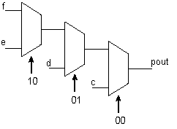
Think Hardware! (Mutually exclusive conditions)
myif_pro: process (s, c, d, e, f)
begin
if s = "00" then
pout <= c;
elsif s = "01" then
pout <= d;
elsif s = "10" then
pout <= e;
else
pout <= f;
end if;
end process myif_pro;
This priority is useful for timings.

Slide 57
Think Hardware! Use a case for mutually exclusive things
mycase_pro: process (s, c, d, e, f)
begin
case s is
when "00" =>
pout <= c;
when "01" =>
pout <= d;
when "10" =>
pout <= e;
when others =>
pout <= f;
end if;
end process mycase_pro;
C
D
POUT
E
F
S
There is no priority with case.

Slide 58
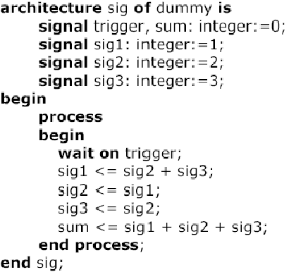
BEHAVIORAL ( Processes using signals)
Sig1 = 2 + 3 = 5
Sig2 = 1
Sig3 = 2
Sum = 1 + 2 + 3 = 6

Slide 59
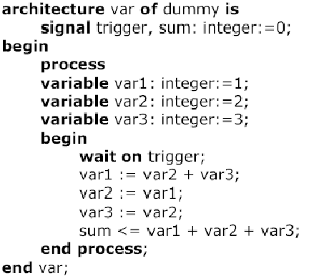
BEHAVIORAL ( Processes using Variables)
var1 = 2 + 3 = 5
var2 = 5
var3 = 5
Sum = 5 + 5 + 5 = 15

Slide 60
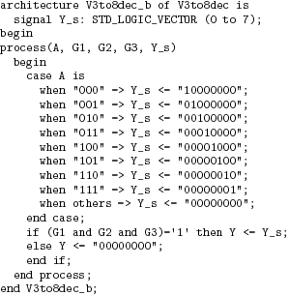
Behavioral Description of a 3-to-8 Decoder
Except for different
syntax, approach is
not all that different
from the dataflow
version

Slide 61
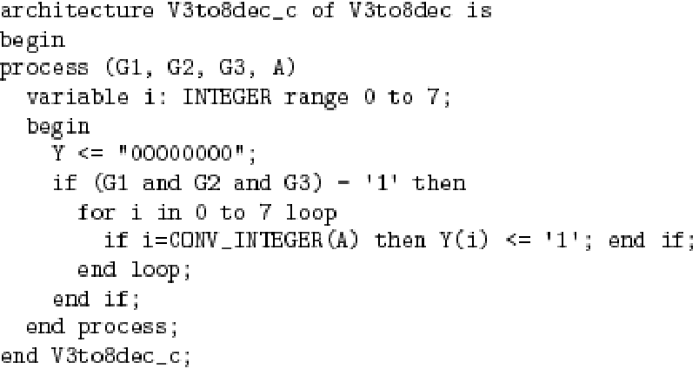
A Different Behavioral Description of a 3-to-8 Decoder
May not be synthesizable,
or may have a slow or inefficient realization.
But just fine for simulation and verification.

Slide 62
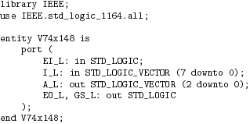
74x148 behavioral description
(8 to 3 line cascadable Priority Encoder)

Slide 63
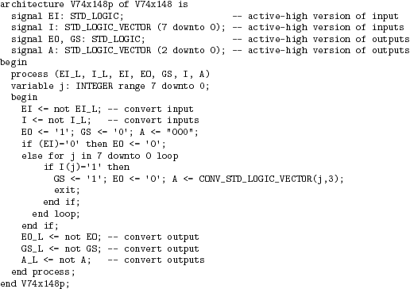
--EI - Enable I/P
--EO - O/P Enable
--I - I/P(data to be encoded)
--A - O/P
type conversion

Slide 64
CONCLUSION
Many VHDL constructs, although useful for simulation and other stages in the design process, are not relevant to synthesis. A sub-set of VHDL only can be used for synthesis.
A construct may be fully supported, ignored, or unsupported.
Ignored means that the construct will be allowed in the VHDL file but will be ignored by the synthesis tool.
Unsupported means that the construct is not allowed and the code will not be accepted for synthesis.
See the documentation of tools for exact details.

