Slide 1
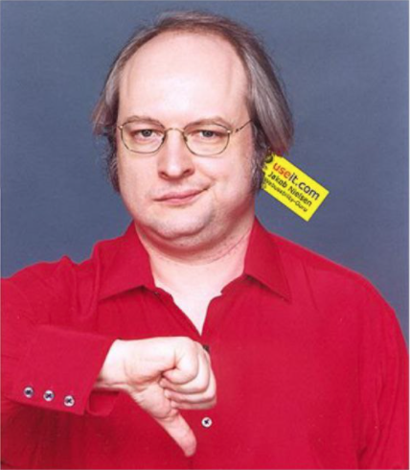
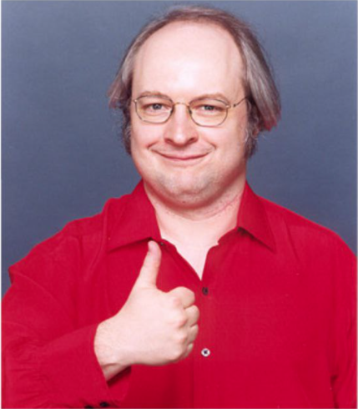
Sample Size:
0
% Samples <=5:
0
Usability Tests:
0

Slide 2
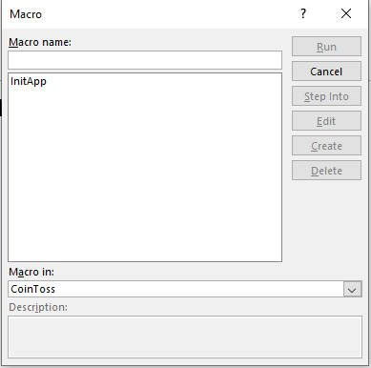
Instructions
After you open PPT, press Alt+F8
Double-click on “InitApp”
Then press F5

