Slide 1
Coffee Project
Applied Data Science Capstone
IBM Data Science Profissional Certificate

Slide 2
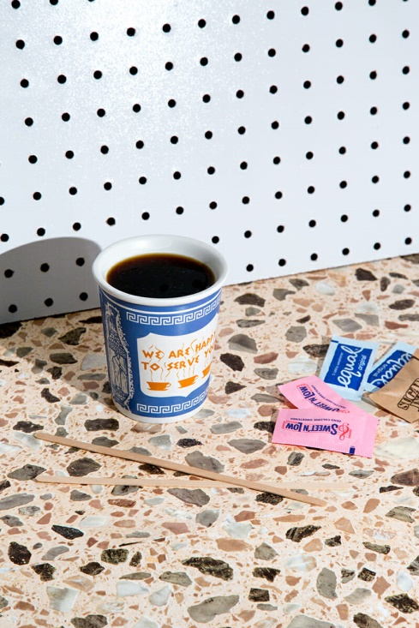
Introduction
Toronto is the fourth largest city in North America and the (multi)cultural centre of Canada. The city has become an incredibly diverse melting pot for food and drink culture driven by individuals inspired to share their traditions and ideas. But in a city that prides itself on its eclectic offerings, there is one industry that has been a bit late to the party: coffee.

Slide 3
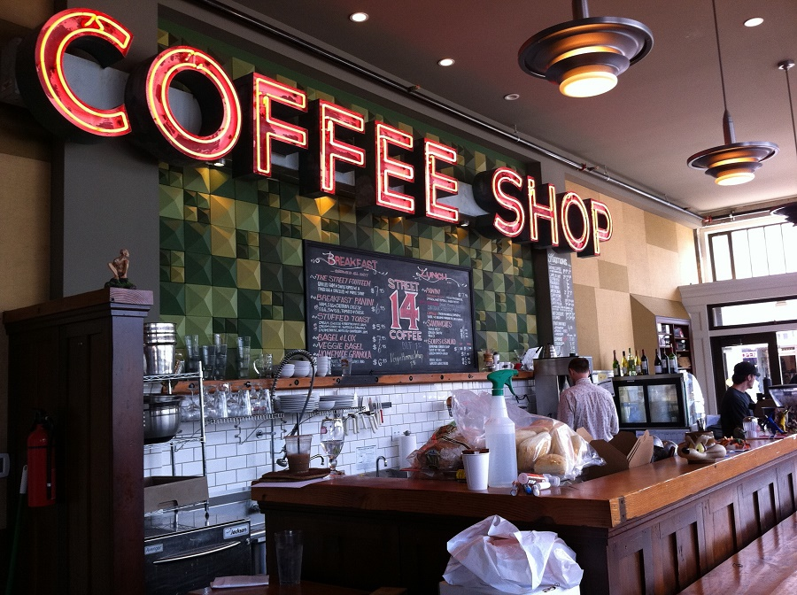
Business Problem
This project aims to target people who are passionate about having coffee to find the best establishments in the city of Toronto and for those who are interested in opening a coffee shop know the best regions to open your business.

Slide 4
Stakeholders’ Questions
What is the best location in Toronto for have a coffee?
Which areas have potential Coffee Shop Market?
Which areas lack Coffee Shops?
Which is the best borough to stay if I want have a coffee?
Which is the best Coffee Shop in Toronto?
Which Coffee Shop is rated highest in Toronto?

Slide 5
Data
Toronto data that contains list of Boroughs, Neighborhoods.
We will web scraping the Toronto data from Wikipedia.
Coffee Shop in each neighborhood of Toronto.
By using Foursquare API as its prime data gathering source as it has a database of millions of places.
GeoSpace data
By using this geo space data we will get the Toronto Borough boundaries that will help us visualize choropleth map.

Slide 6
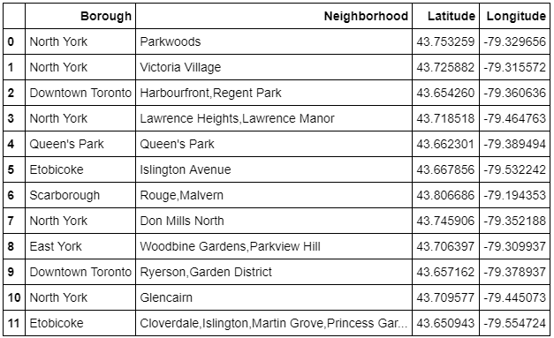
Data Cleansing
The Data scraped is combined in one table:

Slide 7
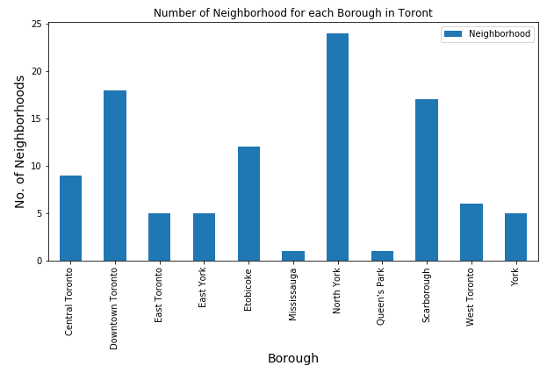
Feature Selection
After the data cleaning, the data frame has 11 boroughs and 103 neighborhoods in the city of Toronto. Making a bar chart we can visualize the differences of each neighborhood and the number of Coffee Shops.

Slide 8
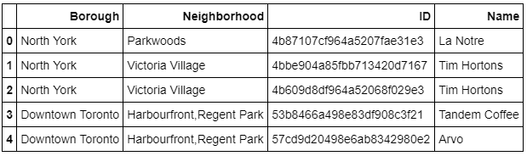
Filtering Coffee Shops
We prepared a neighborhood list that contains Coffee Shops with the second function describe above. We created a table with name of the Coffee Shops and the unique id.

Slide 9
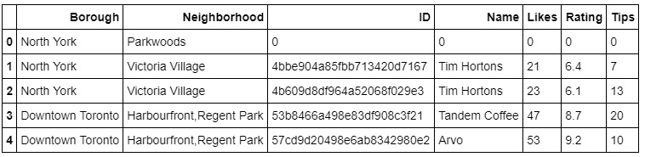
Filtering Coffee Shops
we created also a table that contains names, id, number of likes, rating and tips.

Slide 10
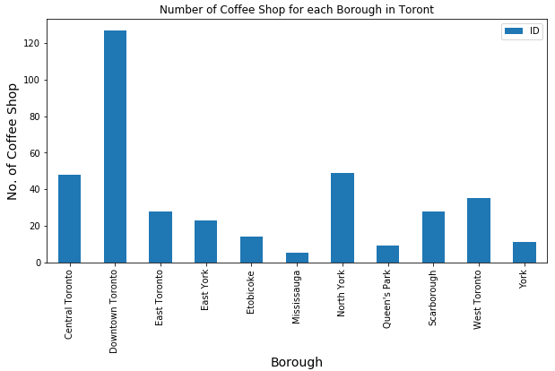
Analysing the Data
With both tables we create different analyzes so we can discriminate and answer the questions described in the Business Problem section.
The first was determinate the number of Coffee Shops for each borough and neighborhood in Toronto city.

Slide 11
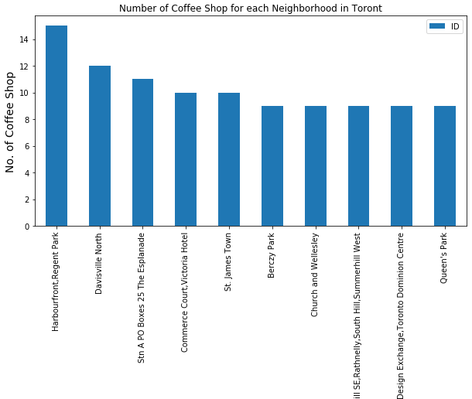
Analysing the Data

Slide 12
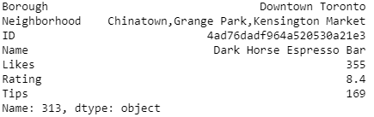
Analysing the Data
Further analysis is to know which Coffee shop that has the maximum rating and the maximum number of likes and tips.
Coffee shops with maximum likes:

Slide 13
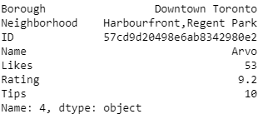
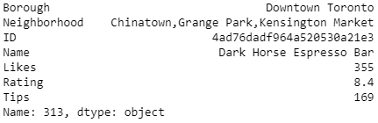
Analysing the Data
Coffee shops with maximum Rating:
Coffee shops with maximum Tips:

Slide 14
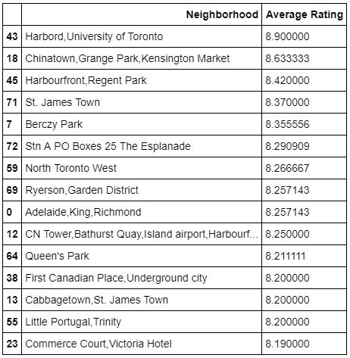
Analysing the Data
The next analysis is to know average rating of each neighborhood and borough.
For this we create a table with the average rating and then make a bar chart.

Slide 15
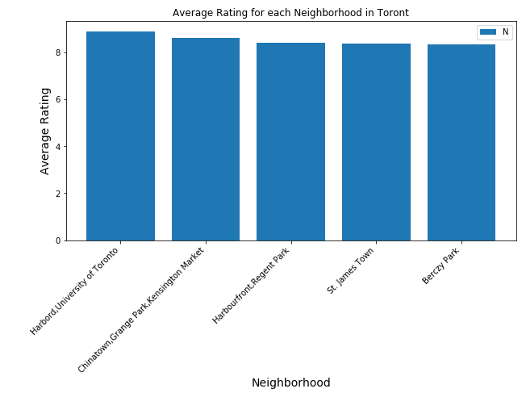
Analysing the Data

Slide 16
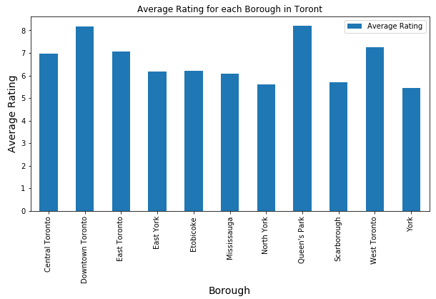
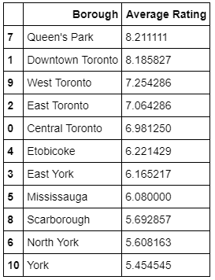
Analysing the Data
Similarly, we created a table with boroughs and their respective average rating. And then we make another bar chart.

Slide 17
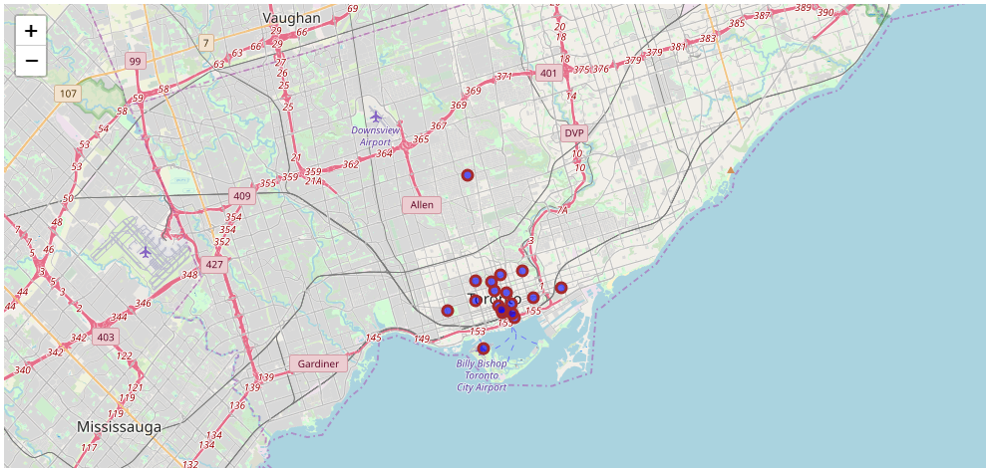
Creating Maps
The ultimate goal of our project is to build maps that can help analyze coffee shops in Toronto. And the first one of them we built to show the coffee shops in each neighborhood with an average rating above 8.0.

Slide 18
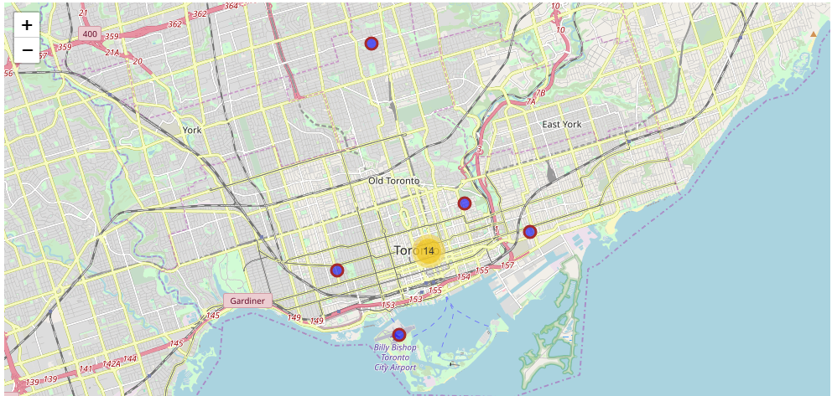
Analysing the Data
With plugins:

Slide 19
Conclusion
What is the best location in Toronto for have a coffee?
The Adelaide, King, Richmond and Berczy Park are some of the best neighborhoods for have a coffee in Toronto.
2. Which areas have potential Coffee Shop Market?
Queen’s Park is the best borough for have a coffee. The average rating for this borough is around 8.21.

Slide 20
Conclusion
3. Which areas lack Coffee Shops?
The area that lacks good Coffee Shops is York with an average rating of 5.45.
4. Which is the best borough to stay if I want have a coffee?
For this matter, we need to do additional analysis that encompasses other features to make a better decision. These analyzes are complementary goals for this project. But answering the question with the data in hand, the best neighborhood is the one with the highest average rating, hence Queen's park.

Slide 21
Conclusion
5. Which is the best Coffee Shop in Toronto?
This question we will answer based on maximum likes, hence Dark Horse Espresso Bar.
6. Which Coffee Shop is rated highest in Toronto?
The Coffee Shop in Toronto with the highest rating is Arvo.

Slide 22
**THANKS**

