Slide 1
UL Accreditations Module IQA Audit Database
User Guide
Rev 1.0
Date 2/29/2012
Author Christopher Nicastro
Approver Denise Echols

Slide 2
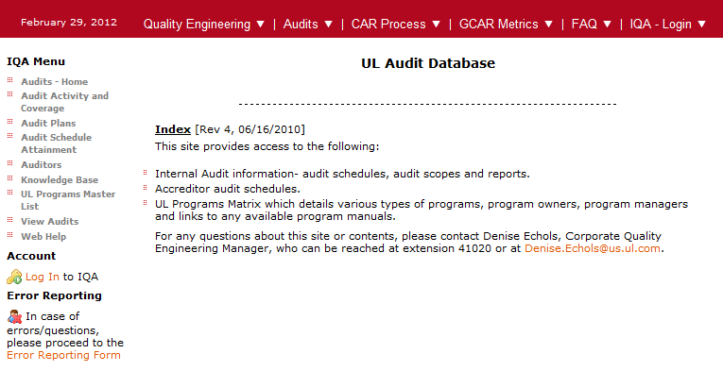
Accessing UL Accreditations Module
Log In to IQA Audit Database

Slide 3
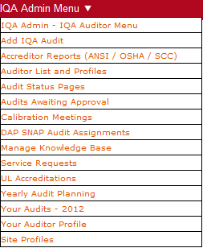
Accessing UL Accreditations Module
Select “UL Accreditations” from IQA Admin Menu:
Note – Depending on your access level, the items listed on the IQA Admin Menu may vary.

Slide 4
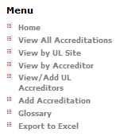
Accessing UL Accreditations Module
UL Accreditations Menu
View Accreditations by: Site, Accreditor, or view all
Add new accreditations
Edit Accreditations
View explanation of the terms used (Glossary)
Export all Accreditation Details to Excel

Slide 5
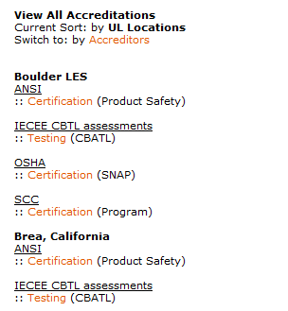
Viewing Accreditations
Find and View Accreditations
View All Accreditations - You will see a list of all accreditations sorted by UL Location Name, then by Accreditor. Under the Accreditor, the type of Accreditation is listed, as well as the specific type/scope.
Sorting All Accreditations by Accreditor or UL Location - You can switch the sorting of this view by selecting the “Switch to: Accreditors” link in the screenshot below. The default sort is by UL Location.
Accreditation Details - Select the accreditation type (orange text) to view the accreditation details.

Slide 6
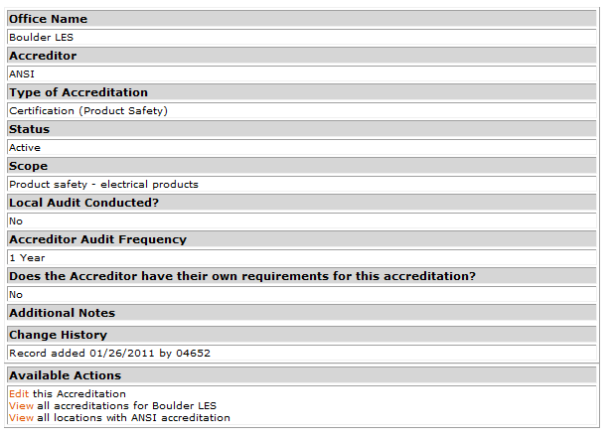
Viewing Accreditation Details
Available Actions:
Edit Accreditation Details
View other Accreditations for this location
View other Accreditations for this accreditor

Slide 7
Viewing Accreditation Details
Accreditation Details – Fields Included
Office Name
Accreditor Name
Type of Accreditation
Certification, Inspection, Testing, Other
Secondary type (in parenthesis) is the Specific Audit Type or a short explanation of the Scope or Program
Status – Active, Inactive, Suspended
Scope of Accreditation – either short explanation or a link to the scope on the Accreditor’s website. Please do not copy and paste the scope from the Accreditors website!
Local Audit Conducted (by Regional Quality Staff)
Accreditor Audit Frequency - How often does the Accreditation get audited by the Accreditor?
Does the Accreditor have their own requirements for this accreditation? (Yes/No)
Additional Notes – can include link to Accreditor Requirements (if applicable)
Change History – history of change made by IQA Audit Database Users

Slide 8
Viewing Accreditations – Other Views
View by UL Site – Requires you to select the Region, Sub Region and Office Name from a set of drop down boxes. The output is the Accreditations for the UL Location selected.
View by Accreditor – Requires you to select an Accreditor. The output is the UL Locations that have Accreditations for that Accreditor.
View/Add UL Accreditors – Shows a list of Accreditors. Is an Accreditor missing from the list? You can add it here.
Add Accreditations – Is an Accreditation missing? You can add it here using the same form to edit an existing Accreditation.
Glossary – Defines the terms used in this module.
Export to Excel – Opens an Excel file with all Accreditation Details for all UL Locations

Slide 9
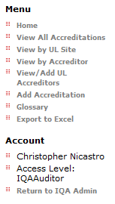
UL Accreditations Module - Exiting
How do I leave this module and get back to the IQA Admin Menu?
Select “Return to IQA Admin” as shown in the screenshot below and you will be returned to the page you see when you first log in to IQA Admin.

Slide 10
UL Accreditations - Warning
Loading the Add/Edit Accreditation page is VERY SLOW. Help!
Please be patient. The form is slow and takes several seconds to load. It works!

Slide 11
Revision History
2/29/2012 Rev 1.0 - Document Created
2/29/2012 Rev 1.0 - Approved by Denise Echols (see attached file)
Double Click Icon to Open →

Slide 12
Please contact Chris Nicastro for questions or comments.

