Slide 1
Corporate Quality Engineering Presentation for May 2013 CAR Calibration Meetings
Questions or comments, please contact Denise Echols, x41020
Prepared May 7,2013

Slide 2
Agenda
ISO/IEC 17065
ISO 17065:2012 vs. Guide 65
QMS Updates
Corporate IQA Next Steps
Expectation of CAR/Local Quality Members

Slide 3
ISO 17065:2012 vs. Guide 65 QMS Updates Corporate IQA Next Steps Expectation of Local Quality Teams EHS Audit
ISO 17065:2012 vs. Guide 65
Gap Analysis for UL Mark Program
Gap Analysis for VS Energy Efficiency
ISO 17065- Specific Program/Accreditor Information
INMETRO
PAL: MHLW notification – “17065 shall be applied from February 1, 2013 but a previous practice can be used until October 31, 2013”. Updated documentation scheduled for end of September 2013 completion.
ANSI: ANSI will begin auditing against 17065 in July 2014. That means any new processes, records, etc. needed for 17065 compliance will need to be implemented by July 2014.

Slide 4
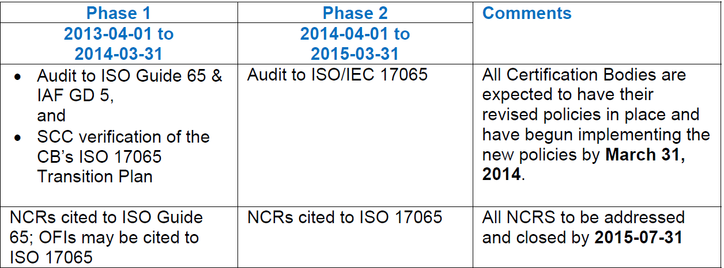
ISO 17065:2012 vs. Guide 65 QMS Updates Corporate IQA Next Steps Expectation of Local Quality Teams EHS Audit
SCC:
The SCC will cease accreditation to ISO Guide 65 and IAF GD5 after August 15th, 2015. Any Certification body that does not comply with the above-described transition requirements by August 15th, 2015 will be subject to suspension of their CBAP accreditation. Certification bodies must transition as stated because all certificates to ISO Guide 65 will be invalid as of September 15, 2015.

Slide 5
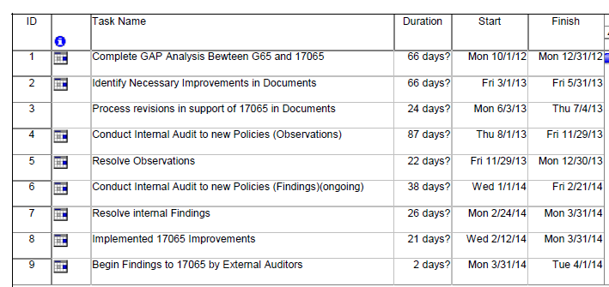
ISO 17065:2012 vs. Guide 65 QMS Updates Corporate IQA Next Steps Expectation of Local Quality Teams EHS Audit
UL Mark (draft plan- see slide 3 for gap analysis)

Slide 6
ISO 17065:2012 vs. Guide 65 QMS Updates Corporate IQA Next Steps Expectation of Local Quality Teams EHS Audit
VS - Energy Efficiency Certification
Gap analysis has been developed
Must meet timeframe requirements set by SCC as shown on slide number 4

Slide 7
UK Certification Office Programs
ISO 17065:2012 vs. Guide 65 QMS Updates Corporate IQA Next Steps Expectation of Local Quality Teams EHS Audit
Program
Notified Bodies - The relevant Directive(s)/Regulation(s) and …. | Primary (1) | + relevant elements of | EA 2/17
Construction Products Directive | ISO 17065 | ISO 17020 | √
Marine Equipment Directive | ISO 17065 | ISO 17020 | √
Personal Protective Equipment Directive | ISO 17065 | ISO 17020 | √
Low Voltage Directive | ISO 17065 | URN 00/800 | √
Medical Notified Body | MHRA GN6 | - | -
Other Programs
Accredited EN evaluations (ITE) | ISO 17025 | - | -
Microgeneration Certification Scheme | ISO 17065 | - | -

Slide 8
UK Certification Office Programs
ISO 17065:2012 vs. Guide 65 QMS Updates Corporate IQA Next Steps Expectation of Local Quality Teams EHS Audit
EN45011:1998 transitioning to ISO 17065:2012
From 2014 assessment year (a/y) for external assessments
September 2015 deadline for transition
For Notified Bodies
- ‘Accreditation for Notification’ - EU Regulation 765-08 from 2013 a/y for external assessments, which means……
‘System 1 +’
‘1’ = Primary Std. for Accreditation e.g. ISO 17065:2012 from a/y 2014
‘+’ = the relevant elements of supporting Standards e.g. ISO 17020
EA 2/17 - EA Guidance on the horizontal requirements for the accreditation of conformity assessment bodies for notification purposes

Slide 9
UK Certification Office Programs -Exceptions and Notes
Medical Notified Body:
- Requirement remains MHRA Guidance Note 6 + related guidance
- Moving to Regulations from Directives (Timescale 3-5 years)
- Regulations mandatory in all EU Member States
- Regulations are envisaged to be self-contained in terms of requirements
Low Voltage Directive Notified Body:
- Moved to EN45011/ISO 17065 base from ISO 17025
Product Certification Accreditation (EN45011/ISO17065)
Umbrella for Notified Bodies ‘Accreditation for Notification’
Transition timing as previous slide
Likely to be utilised for other areas
ISO 17065 compliance will be increasingly important for us

Slide 10
ISO 17065:2012 vs. Guide 65
QMS Updates Corporate IQA Next Steps
Expectation of Local Quality Teams
EHS Audit
ISO 17065- QMS Updates
UL Mark: A new UL LLC CB Manual will need to be written, which will directly address all ISO/IEC 17065 clauses, and serve as a pointer document to all the SOPs; this is similar to the role the UL Mark Program Policy Manual serves today.
A new UL Mark Scheme document will also need to be created; this new document will incorporate the portions of the existing UL Mark policy documents that do not go into the UL LLC CB Manual. It’s anticipated that it will replace 00-CE-P0001, 00-CE-P0004, and 00-CE-P0005.
Rod Morton managing above UL Mark document updates.
VS Energy Efficiency: Documents to be updated have been identified; expect updates to be completed and published by end of 1Q2014. See gap analysis. Plan managed by Stephen Jeong.

Slide 11
ISO 17065- QMS Updates
ISO 17065:2012 vs. Guide 65
QMS Updates Corporate IQA Next Steps
Expectation of Local Quality Teams
EHS Audit
UK Certification Office Programs:
Documented gap analysis:
Using International Program Policy framework (00-IC-P0035*)
All Program Polices will supplement 00-IC-P0035*
Document updates ready for assessment year 2014
* Or its replacement
Contact Karl Harland for more information.

Slide 12
ISO 17065:2012 vs. Guide 65
QMS Updates
Corporate IQA Next Steps
Expectation of Local Quality Teams
EHS Audit
Corporate IQA Next Steps
Support program transitions as requested/planned
Continue Corporate Auditor calibration on requirements
ISO 17065 audits begin 2014 in compliance with transition plans (generate observations)
PAL audits for compliance 2013
Sept 2015 or before depending on program requirements - expect all audits to ISO 17065 (generate findings)
Exception may be AECO Program
Provide input to quality staff on any training materials, etc.
Work with RQMs to arrange ISO 17065 Q&A training sessions with Keith Mowry

Slide 13
ISO 17065:2012 vs. Guide 65
QMS Updates
Corporate IQA Next Steps
Expectation of Local Quality Teams
EHS Audit
Corporate IQA Next Steps
Working on training to update CAR ADMs on ISO 17065
Completion dependent on publication of QMS updates
Completion –TBD
Will prepare ISO 17065 auditor training material
Completion dependent on publication of QMS updates
Corp Auditor ISO 17065 knowledge effectiveness
Will advise when material is available
Completion –TBD

Slide 14
ISO 17065:2012 vs. Guide 65
QMS Updates
Corporate IQA Next Steps
Expectation of Local Quality Teams
Expectation of CAR/Local Quality Members
Read ISO 17065 and differences from Guide 65
GAP Analysis can be used
Review ISO 17065 Training Modules from Keith Mowry
Review Training Materials from ISO CASCO
Also has a Guide 65 to ISO 17065 difference listing
Prepare questions for Q&A session with Keith Mowry
RQMs coordinate so that one list can be submitted to Keith before session

Slide 15
Questions?

