Slide 1
CAR Administrator Calibration 1st Quarter 2011
February 23, 2011, Initial Release

Slide 2
Topics
CAR Process Document Updates
CAR Verifications
Observation CARs
Using GCAR Metrics

Slide 3
CAR Process Document Updates

Slide 4
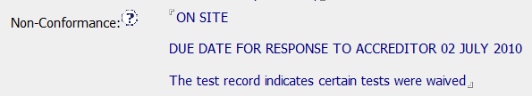
CAR Process Document Updates
Accreditor CARs
The CAR Initiator must specify the Accreditor response due date in the CAR.
This identifies the Accreditor due date that we must meet.
The CAR response must be completed and approved prior to this due date.
Include the Accreditor due date in either the Non-Conformance or Attachments/Comments area.

Slide 5
CAR Process Document Updates
Observation CARs
Removed the option of verifying an Observation CAR as ineffective.
Observation CARs are closed when the objective evidence has been satisfactorily addressed.
The last milestone of an Observation CAR is not accepted if the implementation is not effective.
REMINDER: Always immediately verify Observation CARs as effective as soon as you close them.

Slide 6
CAR Verifications

Slide 7
CAR Verifications
Observation CARs
Verify Observation CARs at the same time you accept and close the final milestone.
Approve the final milestone.
As soon as you approve the final milestone, open the CAR and verify it as effective.

Slide 8
CAR Verifications
Finding CARs
Verify Finding CARs as soon as possible after CAR closure.
The goal is to verify Finding CARs within 6 months of closure at the latest.

Slide 9
CAR Verifications
Finding CARs, cont.
When verifying a Finding CAR:
If more information is needed to support verification and it cannot be provided within 48 hours:
Move the CAR back in state to “Awaiting Implementation”.
Once the information has been provided, close the CAR and verify it as either effective or ineffective.

Slide 10
CAR Verifications
Finding CARs, cont.
When verifying a Finding CAR:
If no samples are available for review within 6 months of CAR closure (e.g., no additional projects completed, an individual is no longer active in a category, etc.):
Make sure that the corrective action has been addressed in the milestones.
Verify the CAR based upon the information contained in the closed milestones.
Note in the verification evidence how the CAR was verified and that no new samples were available.

Slide 11
Observation CARs

Slide 12
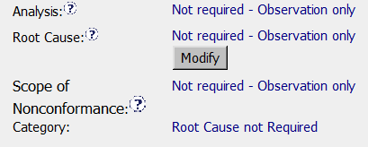
Observation CARs
The Root Cause “Category” for Observation CARs is always “Root Cause not Required”.
Root cause analysis is not required for Observation CARs.
Metrics for the “Category” field recognize “Root Cause not Required” as Observations.

Slide 13
Observation CARs
Corrective actions for Observation CARs should only fix the problem found.
Other actions beyond fixing the problem cause CARs to remain open for extended periods of time.
CAR owners are encouraged to go beyond the fixing the problem, but this must be done outside the CAR system.

Slide 14
Using GCAR Metrics

Slide 15
Questions???

Slide 16
Revision History
Initial Release, February 23, 2011

