Slide 1
CAR Administrator Calibration
IMPORTANT
During the call, DO NOT use HOLD because the music will interrupt the call. Use MUTE.
February 28, 2012
For questions or comments, please contact Cheryl Allison

Slide 2
Topics
Reminder: Add Process Owners and Program Owners as Optional Recipients on CARs
Update: Requirements for Published Documents in CAR milestones
CAR Review Trends: Scope of Nonconformance
Communication Forum Status
Good CARs, Bad CARs

Slide 3
REMINDER: Add Process Owners and Program Owners as Optional Recipients on CARs

Slide 4
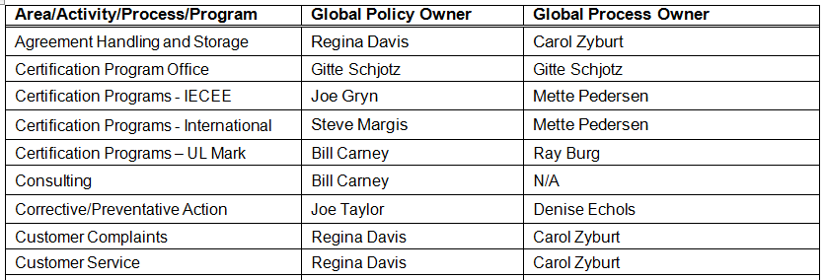
Add Process Owners and Program Owners as Optional Recipients in CARs
Process Owners
00-QA-P0031 Policy and Process Owners Matrix
.
.
.

Slide 5
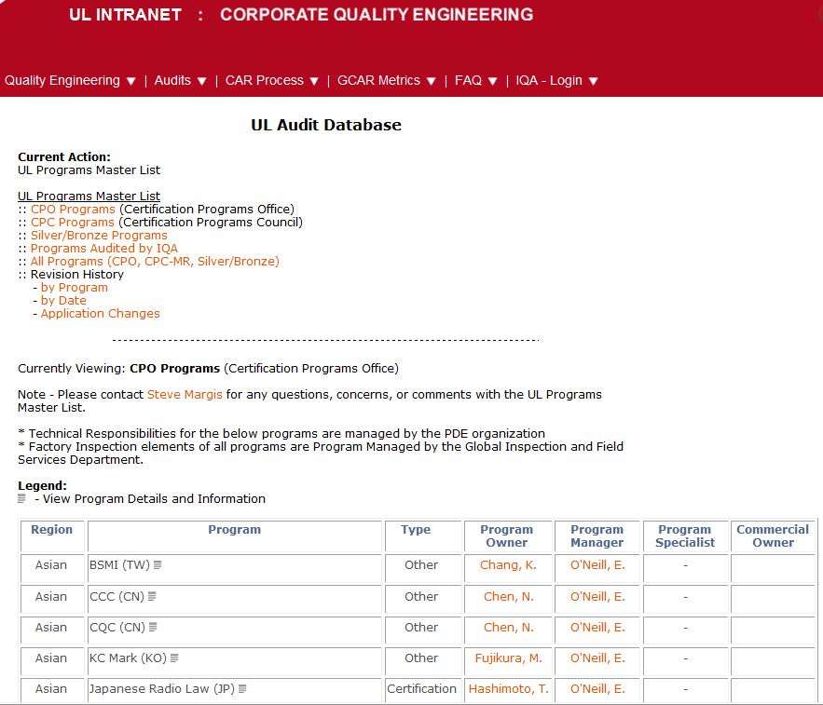
Add Process Owners and Program Owners as Optional Recipients in CARs
Program Owners
Corporate Quality Engineering Website

Slide 6
UPDATE: Requirements for Published Documents in Milestones

Slide 7
Requirements for Published Documents in Milestones
FAQ 21:
21 - What is considered when accepting the CAR Implementation? Category: CAR Admin · Every element of the corrective action plan and all milestones must have corresponding evidence of effective implementation. For example, if the corrective action plan included the creation of an audit review, then at least one of these reviews must have taken place before closing the CAR or milestone.
· For document changes, evidence that the updated document has been published must be provided. The updated, published document must also be attached in the CAR.
· There should be evidence that shows how the new process was implemented. This could include a PDF (or equivalent) of proof of training/implementation that shows names/signatures of those who attended and the topics covered. In case of online training, evidence of attendance must be captured in the CAR.
.
.
.

Slide 8
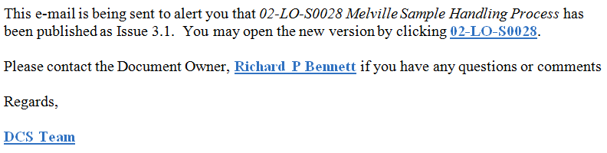
Requirements for Published Documents in Milestones
Two Requirements
Evidence that the updated document has been published
Example 1
Can be a copy of the email from KMS stating that the document has been published

Slide 9
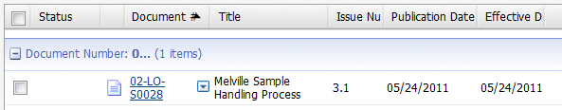
Requirements for Published Documents in Milestones
Two Requirements, cont.
Evidence that the updated document has been published
Example 2:
Can be a KMS screen print showing the new document version

Slide 10
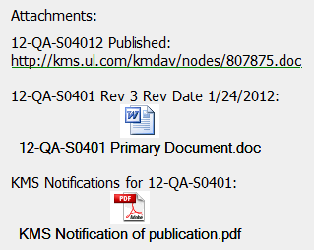
Requirements for Published Documents in Milestones
Two Requirements, cont.
The updated, published document must also be attached.

Slide 11
CAR REVIEW TRENDS: Scope of Nonconformance

Slide 12
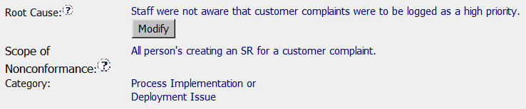
CAR Review Trends: Scope of Nonconformance
No evidence is provided to support the Scope
The Analysis must clearly show how the “Scope of Nonconformance” was determined.
“Category” is NOT “Nonconformance Category”. It is “Root Cause Category”. The labels are:
“Scope of Nonconformance” (All persons creating an SR for a cust complaint)
“Category” (Process Implementation or Deployment Issue)

Slide 13
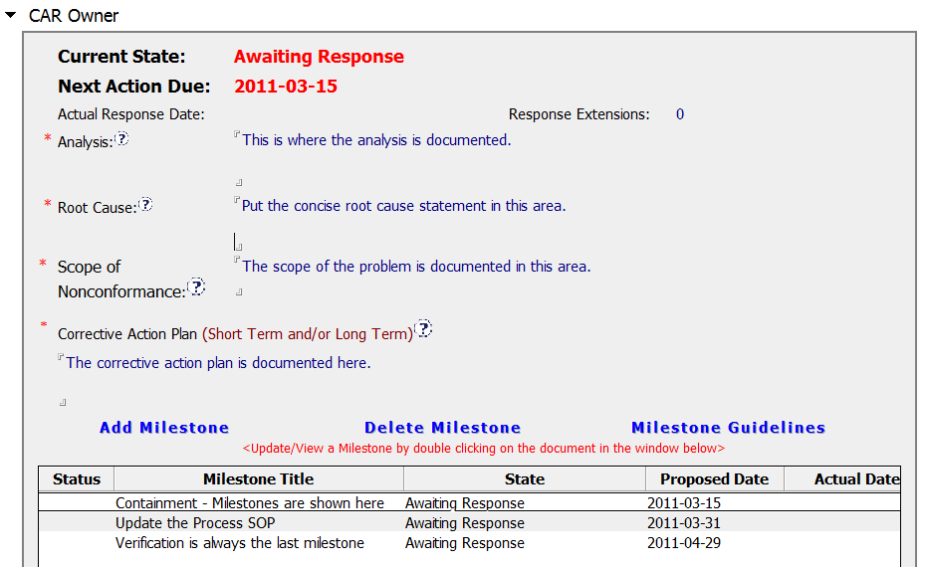
CAR Review Trends: Scope of Nonconformance
Scope of
Nonconformance
Section

Slide 14
CAR Review Trends: Scope of Nonconformance
Review FAQ #17 on the CAR website
17 – What should be included in the SCOPE of NONCONFORMANCE* section of a CAR? The Objective Evidence does not describe the entire scope of the problem, so the CAR Owner uses this section to document the results of the investigation to determine the full scope and impact of the nonconformance.
How widespread is the problem?
How was this determined?
What areas/groups/locations have the problem based on your analysis?
The Scope of Nonconformance is entered after the completion of the Root Cause Analysis.
* For Finding CARs only – does not apply to Observation CARs

Slide 15
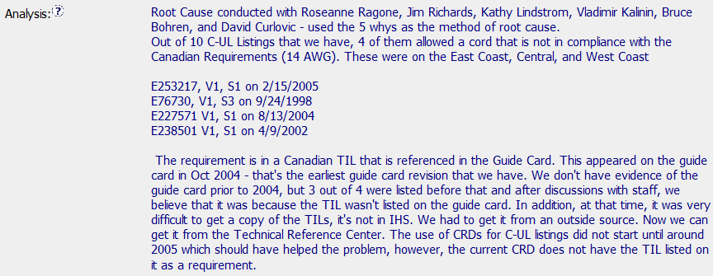
CAR Review Trends: Scope of Nonconformance
Scope of Nonconformance Example
How was
the scope
determined?
How widespread is the problem… Global? Regional? Local?

Slide 16
COMMUNICATION FORUM: Status

Slide 17
Communication Forum: Status
Team
Samantha (WonSeon) Bang – x65381 Julie Heinzinger – x55602 Paul Ip – x69582
Michelle Lee – x55600
Chris Nicastro – x41718

Slide 18
Communication Forum: Status
Background
Feedback from CAR admin process assessment
Goal - Improve communication/information sharing among CAR Admins
Easily accessible
Online collaboration
Store the discussion history
Searchable

Slide 19
Communication Forum: Status
Status
Researching use of Sharepoint
Benefits
Easy setup
Faster uploading /file sharing than KMS
Various roles (manager, user, guest) with different access levels (view, edit, etc.)
Revision history
Keywords
Other
Access via direct link or Sharepoint profile – no separate registration
Profile information in process
Creating a trial forum for CAR Admin Communication team

Slide 20
Communication Forum: Status
Next Steps
If the trial forum is successful:
Create a brief training module on how to use the forum
Expand the forum to other users
Please contact a team member if you have questions.

Slide 21
Good CARs: Bad CARs

Slide 22
Good CARs: Bad CARs
Teams and CAR Numbers for review
NA Team for meeting on March 1
Tovia Bat-Leah, Dale Hendricks, Jenni Murrill, Jim Carlisle
CAR #s: 09397047, 11399232, 11399652, 11399925
EULA and NA Team for meeting on March 2
Karl Harland, Jim Kurtz, John Carlin
CAR #s: 10398884, 11399808, 11399819, 123910094
Asia Team for meeting on March 7
Adele Fan, Tony Hsu, Peter Johnston, Paul Ip
CAR #s: 10398628, 10398706, 11398910, 11399603

Slide 23
THANK YOU.

