Slide 1
CAR Administrator Calibration
March 3, 2014
For questions or comments, please contact Cheryl Allison

Slide 2
Topics
L1 Competency
Accreditor OFI’s
Program Audited – Update to GCAR selections
Champion Conversations
CAR Reviews

Slide 3
L1 Competency

Slide 4
Accreditor OFI’s

Slide 5
Accreditor “Opportunity For Improvements”
How should you handle an OFI from an accreditor?
When the accreditor requires a response:
You must always create a CAR for an accreditor OFI when the accreditor requires a response.

Slide 6
Accreditor “Opportunity For Improvements”
How should you handle an OFI from an accreditor?
When the accreditor does not require a response:
Depending on which accreditor originated the request, the Corporate Quality Manager or the Local Quality Manager must determine whether or not to create a CAR.
Corporate Quality Manager makes determination for accreditor CARs championed by her team
LQM makes determination for other accreditor CARs

Slide 7
Accreditor “Opportunity For Improvements”
When the accreditor does not require a response:
Create a CAR when:
It is possible or likely that the issue will become a CAR in the future
The concern has arisen previously and should be investigated further

Slide 8
Accreditor “Opportunity For Improvements”
When the accreditor does not require a response:
Use your discretion whether to create a CAR when:
We have never had the issue before and it will not likely become a CAR in the future
The opportunity is not related to a requirement, but is simply an opinion or preference

Slide 9
Program Audited:
Update to GCAR Selections

Slide 10
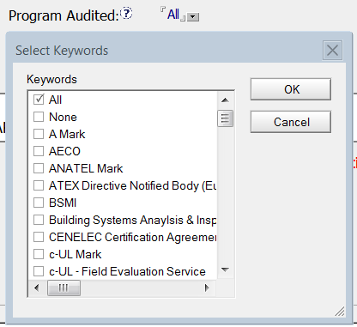
Program Audited: Update to GCAR Selections
Certain “Program Audited” options were confusing and inconsistently chosen. “All” and “None” were the most inconsistent.

Slide 11
Program Audited: Update to GCAR Selections
CAR originators had varying interpretations for what “All” meant.
Example:
One originator who selected “All” for one CAR explained, “The misidentification and handling of samples was not program specific and would apply to any program or testing service that they are engaged in.”
Only 3 programs had been audited

Slide 12
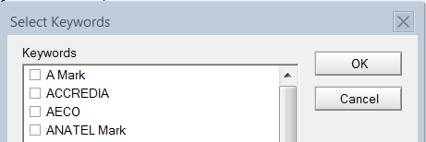

Program Audited: Update to GCAR Selections
“All” and “None” usually indicated a “process” concern and not a specific “program” concern
The selections “All” and “None” have been removed
In their place is “Process Concern”
“All” removed
“None” removed
“Process Concern”
added

Slide 13
Champion Conversations

Slide 14
Champion Conversations
GCAR “Madness”
GCAR does some pretty interesting things when you have more than one CAR open in “Edit” mode
Here is one recent experience:
“GCAR is doing strange things again. For CAR 133912443, two emails (not one, but two) came to me saying that the response was accepted, yet the CAR state is “Received Implementation”. Not only that, but the approval was today, 02/17/2014 yet the milestones do not reflect an acceptance today. See the screenshots below.”

Slide 15


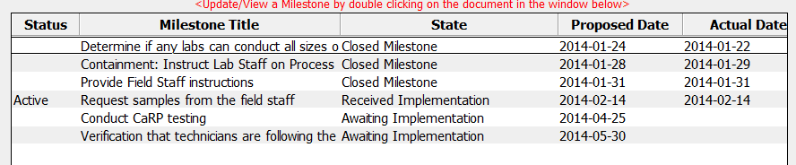
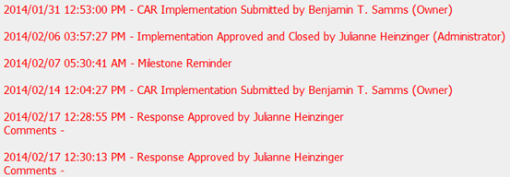
Champion Conversations
GCAR “Madness”
2 emails for
“Response
Approved”
Milestone
shows
“Received
Implementation”
History shows that
CAR state was already
past the response state

Slide 16
Champion Conversations
GCAR “Madness”
Here is what happened:
The CAR champion had two CARs open in edit mode
She approved the response for CAR “A”, but GCAR put the history item for the response acceptance in CAR “B”
GCAR then sent two emails for the response acceptance for CAR “B” instead of CAR “A” which was the correct CAR (we still don’t know why GCAR sent two emails instead of one!)
CAR “A” did have the correct state of “Response Approved”

Slide 17
Champion Conversations
GCAR “Madness”
There are other times when GCAR has captured the history of an action in CAR “C” when it should have been in CAR “D”. Both “C” and “D” were open in edit mode at the time.
What can you do?
These problems can be avoided if you have only one CAR open in edit mode at a time
It is not a requirement that you edit only one CAR at a time. But be aware that if you choose to edit multiple CARs at the same time, GCAR may go “mad”!

Slide 18
Champion Conversations
GCAR “Madness”
FAQ # 33 on the CAR website provides some of the common GCAR errors/problems, and how can they be resolved.

Slide 19
Champion Conversations
Role Play
Have you ever pondered what would be an effective way to respond to a CAR Owner’s request for an extension?
What might be a good approach when there is a concern with the request?
How might you make this a “win-win” discussion?
Let’s role play to see one possible approach given the following scenario.

Slide 20
Champion Conversations
Role Play
Scenario
The extension request is for a Finding CAR milestone
The milestone expectation is that three local documents be updated to include a records section (which is currently missing from the three documents).
This is the third extension request
The CAR owner is requesting a one month extension due to the push for revenue-generating work being the priority.
The first extension granted was for two weeks due to the CAR owner being out of the office.
The second extension was granted for one month due to the CAR owner’s workload

Slide 21
CAR Reviews

Slide 22
CAR Reviews
Teams and CAR Numbers for review
Asia Team for meeting on March 7
J. Y. Lee, Matthew Kim, Kila Yang, Ravi V, Funny Li
CAR #s: 133912279, 133912451, 133912770, 133912082
NA Team for meeting on March 3
Alan Purvey, Mark Jessen, Julianne Heinzinger
CAR #s: 133912730, 133912451, 133912654, 133911539
EULA and NA Team for meeting on March 4
Kyle Huang, Karen Fine, Mark Lavine
CAR #s: 133912730, 133912279, 133912331, 133912362

Slide 23
THANK YOU

