Slide 1
CAR Champion Calibration
March 12, 2015 – Revision 2.0
For questions or comments, please contact Cheryl Adams

Slide 2
Topics
CAR FAQ’s – Enhanced Website
CAR Champion Performance
Champion Conversations
Human Error
CAR Champions for ANSI, OSHA, SCC CARs
Observations
Findings
CAR Champion assignments
CAR Reviews

Slide 3
CAR FAQ’s:
Enhanced Website

Slide 4
CAR FAQ’s – Enhanced Website
Enhancements
Provides a more direct access path for:
CAR Owners
CAR Champions
Creating a CAR
Uses “buttons” for navigation
Displays and Hides details
More/Hide
View – goes to a new window
Links – to presentations and documents
Continues to provide numerical list of FAQ’s

Slide 5
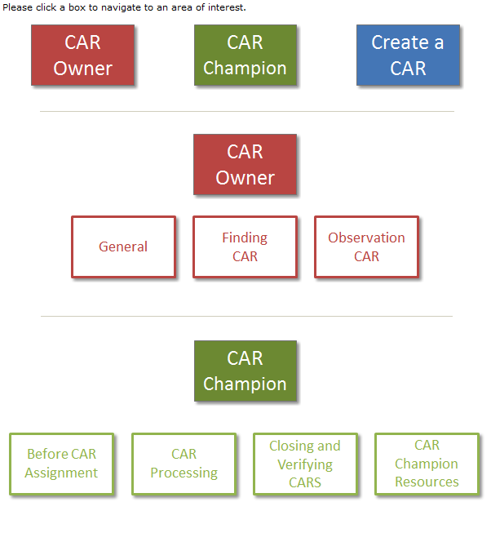
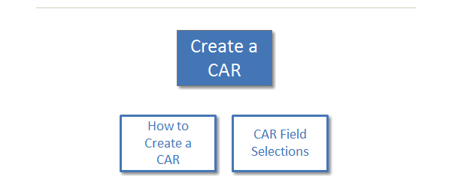

Slide 6
CAR Champion Performance

Slide 7
CAR Champion Performance
CAR Champion performance is more than
“CAR Stars”:
CAR Star
+ CAR reviews
+ CAR review team participation (calibration meetings)
+ CAR Champion training performance (new CAR
Champions)
= CAR Champion performance

Slide 8
CAR Champion Performance
CAR Champion performance expectations
CAR Star
80% of CARs meet the CAR Star requirements
CAR Reviews
90% of CARs reviewed have either minor concerns or no concerns
Major concerns include major impact items, e.g.,
Insufficient analysis
Inadequate root cause, e.g., “human error”
Missing containment or owner’s verification (finding CARs)

Slide 9
CAR Champion Performance
CAR Champion performance expectations
CAR Review Team Participation
Participate in the assigned CAR review team activity
CAR reviews include all of the required elements:
Slides with meaningful comments
Integration with CBS, UL Values, and CAR Champion areas of responsibility
CAR Champion Training Performance (new champions)
Quarterly performance reviews indicate continual, positive progression in mentoring phase of training

Slide 10
Champion Conversations

Slide 11


Champion Conversations
The return of
“Human Error”
OH NO!!!
WHY???

Slide 12

Champion Conversations
Human Error – Opportunity
143913542
143913643
143914226
143913860
143913625
143913227
143913239

Slide 13
Champion Conversations
Human Error – Opportunity
Any root cause that states "human error", "lack of resources", or "item overlooked" requires more investigation.
Why was there human error? Root cause investigation begins with an operator error.
What in the process allowed such an error to occur?
These statements must be supported by facts and data.

Slide 14
Champion Conversations
Why was I assigned as
CAR Champion for an
ANSI Observation CAR???

Slide 15
Champion Conversations
Local CAR Champions now handle ANSI, SCC and OSHA Observation CARs only!
You will receive an email notification when you are assigned to one of these accreditor observation CARs.
Please note the following important details:
These CARs will be in the “New” state.
They do not appear in your “Transitional” CARs view.
You must “submit” these CARs and then assign them to the owner.

Slide 16
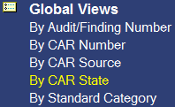
Champion Conversations
Sample email notification
CAR Champion:
Below are ANSI observation CARs in the “New” state that have recently been assigned to you as the CAR Champion. Please (1) complete and submit, and then (2) assign these CARs to owner.
Please note that “New” state CARs do not appear in your transitional CARs view.
You will not see these CARs unless you go to “Global Views” “By CAR State”.
This is your notice that CARs are awaiting your attention.

Slide 17
Champion Conversations
We still have designated CAR Champions for ANSI, SCC and OSHA Finding CARs!
We have changed the CAR Champion for ANSI, SCC and OSHA Finding CARs as follows:
The CAR Champion for the U.S. and Canada is Chris Nicastro.
The CAR Champions for EULA and Asia are Michelle Lee and Jenni Murrill.

Slide 18
Champion Conversations
Who should I assign as the
CAR Champion
for a
newly submitted CAR???

Slide 19
Champion Conversations
Remember – the CAR Champion Responsibility Matrix, located on the CAR website – shows the CAR Champion assignments.
CAR Champion Responsibility Matrix |  |  |  | March 9, 2015
Owner's Region | Owner's Subregion | Owner's Org/Function or Site Audited | Special Conditions | CAR Champion | Responsible RQM
Any | Any | Any | CAR Source = any ANSI, any OSHA, SCC (Exceptions: SCC-IB, SCC-ULC Mark, Medical Mgmt System program, Radio & TCB program) | US and Canada - Nicastro, Chris EULA and Asia - Murrill, Jenni and Lee, Michelle Exceptions **Local CAR Champions (local observations only) **SCC-IB; SCC-ULC Mark - Gunsimar Paintal **Med Mgmt System - Jenni Murrill **Radio & TCB program - Matt Marotto | Echols, Denise
Any | Any except Canada | Any except Canada | Proficiency Testing | Oates, Jim | Echols, Denise
Any | Any | Any | Auditor is IQA auditor and CAR is a Finding | IQA Auditor | Echols, Denise
Corporate | Corporate | Global IT | none | Nicastro, Chris | Echols, Denise
North America | West Coast | CAM - Camas, Washington | none | Lee, Michelle | Taylor, Joe (acting)
EULA | Brazil | SPL - Sao Paolo, Brazil | none | Navarette, Rebeca | Thelen, Horst
Asia | Japan | APX - Ise, Japan | none | Kestner, Thomas | Kestner, Thomas

Slide 20
CAR Reviews

Slide 21
CAR Reviews
Teams and CAR Numbers for review
Asia Team for meeting on March 11
Erica Qin, Simy Li, Adele Fan
CAR #s: 143913643, 143913620, 143914179, 143914008
NA Team for meeting on March 12
Jim Oates, Mark Jessen, Kathy Lindstrom, Chuck Jackson
CAR #s: 143914104, 143913620, 143914191, 143913175
EULA and NA Team for meeting on March 12
Jim Carlisle, Karen Fine, Matthew Marotto
CAR #s: 143914104, 143913643, 143914280, 143913780

Slide 22
THANK YOU

Slide 23
Rev 2.0 – Updated slide 19 to reflect updates to the CAR Champion Responsibility Matrix (March 11, 2015)

