Slide 1
CAR Champion Calibration
March 10 and 17, 2016
For questions or comments, please contact Cheryl Adams

Slide 2
Topics
Preventive Action
Champion Conversations
Owner’s Verification – Milestone Ineffective
Accreditor Finding Dilemma
Reminder
CAR Reviews

Slide 3
Preventive Action

Slide 4
Preventive Action
What is Preventive Action?
Actions taken to prevent the occurrence of and/or eliminate potential causes of nonconformities.
The nonconformity does not yet exist; there is an impending likelihood of a nonconformity developing.
Preventive Action is the same as a Preventative Action.
Note: Preventive Actions differ from a Corrective Action in that a Preventive Action prevents the occurrence of a nonconformity. For a Corrective Action a nonconformity already exists.

Slide 5
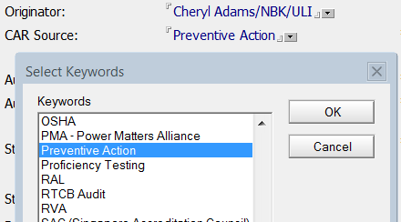
Preventive Action
Preventive Action in GCAR
00-QA-S0006, Corrective Action Request Process document is being updated to provide a framework for CAR Source “Preventive Action” in GCAR.

Slide 6
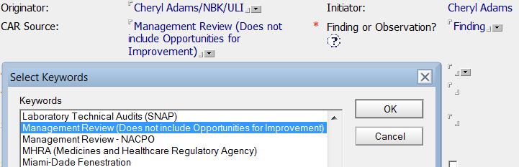
Preventive Action
Preventive Action in GCAR
Note: CAR Source “Management Review” is for actual findings from Management Review. Be sure to use “Management Review” for these CARs and not “Preventive Action”.
This distinction will help with metrics
This will show proof of PA activity in an audit

Slide 7
Preventive Action
Preventive Action in GCAR
Classification: Finding or Observation?
Preventive Action CARs may be considered findings or observations unless specified otherwise in program/process documentation.
Containment
Containment is optional unless required by program/process documentation.
Owner’s Verification (last milestone in findings)
Owner’s verification as to the effectiveness of the resolution is required for findings.

Slide 8
Preventive Action
Preventive Action in GCAR
CAR Champion’s Role
The primary role of the CAR Champion is to progress the PA CAR through to closure.
CAR Champions are not responsible for verification of milestone information.
The CAR owner’s submission of the response and milestone implementation are accepted as approval to proceed.
The CAR Champion accepts each milestone implementation without verifying details of the submission.

Slide 9
Preventive Action
Preventive Action in GCAR
Final Verification (after CAR closure)
Preventive Action CARs are to be “Closed-Verified as Effective” based on the CAR owner’s deeming the resolution effective (i.e., after closure of last milestone).
CARs are to be verified as effective immediately upon closure.
No further verification is required after CAR closure.
No further CAR Champion or Corporate Quality Engineering verification is required.

Slide 10
Preventive Action
Preventive Action in GCAR
Escalations
Preventive Actions that escalate to the Quality Assurance Director (or designee) will be sent to the Regional Quality Manager to determine if they should remain open or be force closed.

Slide 11
Champion Conversations

Slide 12

Champion Conversations
What should I do if the Owner’s Verification milestone is ineffective?
The CAR Owner has submitted the final milestone of a finding CAR.
Dilemma:
Only one of three nonconformity issues
has been resolved.
? ? ?
What’s a CAR Champion to do???!!!!

Slide 13
Champion Conversations
Owner’s Verification Milestone Ineffective – Options
Option 1: Allow more time for complete implementation of corrective actions, for example:
If there is an indication of incomplete deployment of actions (e.g., training not completed at all locations, SOP updated but not fully communicated, etc.)
If a further action has been identified that would cause the implementation to be complete
Remember to:
Add new milestones
Add a new Owner’s Verification milestone
Add comments to explain the updates

Slide 14
Champion Conversations
Owner’s Verification Milestone Ineffective – Options
Option 2: Require more analysis to determine other root cause(s), for example:
Corrective actions are fully deployed yet nonconformity is only partially fixed
Corrective actions are fully deployed yet they did not fully sustain over time
Remember to:
Update the analysis
Update the root cause statement
Add new milestones
Add a new Owner’s Verification milestone
Add detailed comments in the CAR to explain the new actions (analysis, corrective action plan)

Slide 15
Champion Conversations
Owner’s Verification Milestone Ineffective – Options
Option 3: (Consider carefully before using) – Revert the CAR back to “Awaiting Response”
All milestones are reverted back to “Awaiting Implementation”.
Manual resubmission & acceptance of all milestones would be required. Original completion dates are lost.
If the corrective actions proved to be almost totally ineffective, this might be a viable option. If so, remember to:
Document the details throughout the CAR with comments and dates
Update the analysis
Update the root cause statement
Update the corrective action plan
Add new milestones

Slide 16
Champion Conversations
What should I do if
an Accreditor issues a Finding yet only wants a fix to the Objective Evidence?
Dilemma:
The Accreditor insists that
the CAR be issued as a Finding
and not as an Observation
? ? ?
What’s a CAR Champion to do???!!!!

Slide 17
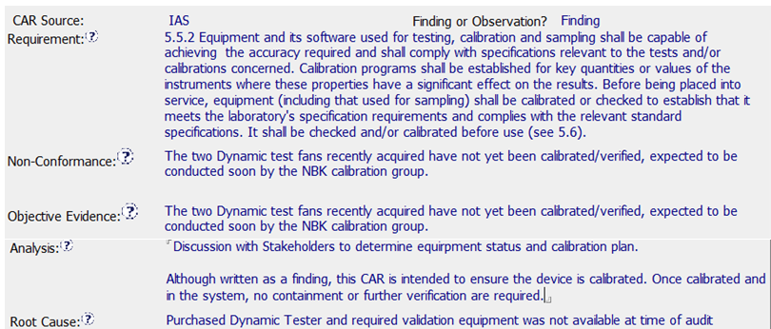
Champion Conversations
? ? ?
What should I do?

Slide 18
Champion Conversations
These Accreditor Findings are to be treated per CAR process requirements – analysis, root cause, containment, verification, etc.
Make sure the Accreditor understands how we classify CARs
Propose that they classify the CAR as an observation
If the Accreditor insists on a Finding, then we must treat it per requirements for Findings
Remember: It is okay to go above an Accreditor’s expectation

Slide 19
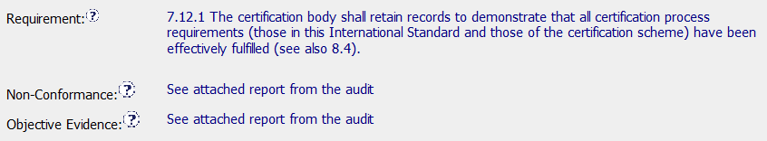
Champion Conversations
Reminder –
Please Avoid…
Be sure to enter the Non-Conformance
Be sure to enter the Objective Evidence
It is okay to reference an attachment, but key information such as the non-conformance and objective evidence must be entered.

Slide 20
CAR Reviews

Slide 21
CAR Reviews
Teams and CAR Numbers for review
Asia Team for meeting on March 17
J. Y. Lee, Hiromi Yamaoka, Paul IP
CAR #s: 153915355, 153915300, 153915575, 153915367
NA Team for meeting on March 10
Tovia Bat-Leah, Jim Oates, Gunsimar Paintal, Michelle Lee
CAR #s: 153915300, 153914936, 153915394, 153915174
EULA and NA Team for meeting on March 10
Rebeca Navarrete, Barbara Scala, John Carlin
CAR #s: 153915355, 153914936, 153915272, 153914570

Slide 22
THANK YOU

