Slide 1
CAR Administrator Calibration
July 2010
July 12, 2010, Rev. 1

Slide 2
Topics
CAR Process and Tool Redesign Project Update
CAPA System
Root Cause Statements
Comments in CAR History
CAR Metrics on the CAR Website

Slide 3
CAR Process and Tool Redesign

Slide 4
CAR Process/Tool Redesign Project
Purpose
Redesign the CAR process as needed, and select a new tool based upon requirements.
Core Team
Cheryl Allison, Denise Echols, Karl Harland, Jenni Murrill, JY Lee, John Pallanti, Rod Morton, Stephen Dokoupil
Targets
  July 31, 2010 Benchmarking Complete
  Sept 30, 2010 Process Requirements Complete
  Oct 31, 2010 Tool Requirements Complete

Slide 5
CAPA System

Slide 6



What is CAPA?
Corrective action: action to eliminate the cause of a detected nonconformity or other undesirable situation – prevents recurrence
Preventive action: action to eliminate the cause of a potential nonconformity or other undesirable potential situation – prevents occurrence
Purpose:
1) To evaluate current performance indicators and causes based
on triggers and monitoring systems that provide a view on
opportunities regarding our quality system
2) To evaluate current initiatives taken to correct and prevent
nonconformance's identified in previous boards
3) Create a sense of continuous improvement and accountability

Slide 7
CAPA Review inputs:
  IQA CARs
  Internal Audits (process / technical)
  External Audits
  External Rework
  Internal Rework
  Customer Advocacy
  Customer Service Data
Meeting expectations:
Review Corrective and Preventative Action (CAPA) report (analysis, trends, and recommendations).
Identify action items and owners

Slide 8
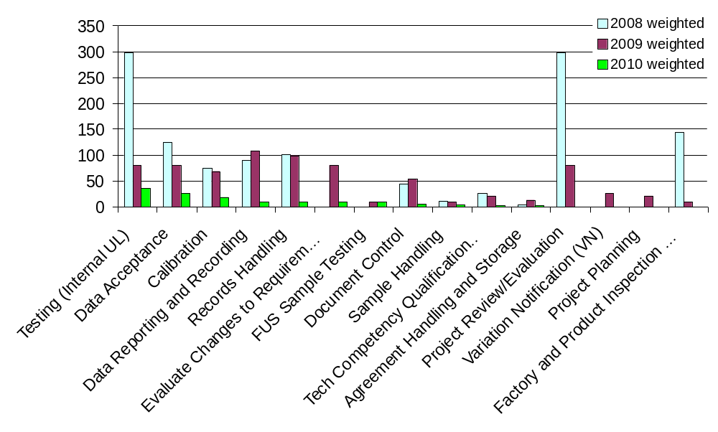
1) IQA CARs – Weighted (severity x volume)
High 9x
Medium 3x
Low 1x
Source: CAR Database
2010 pareto order

Slide 9
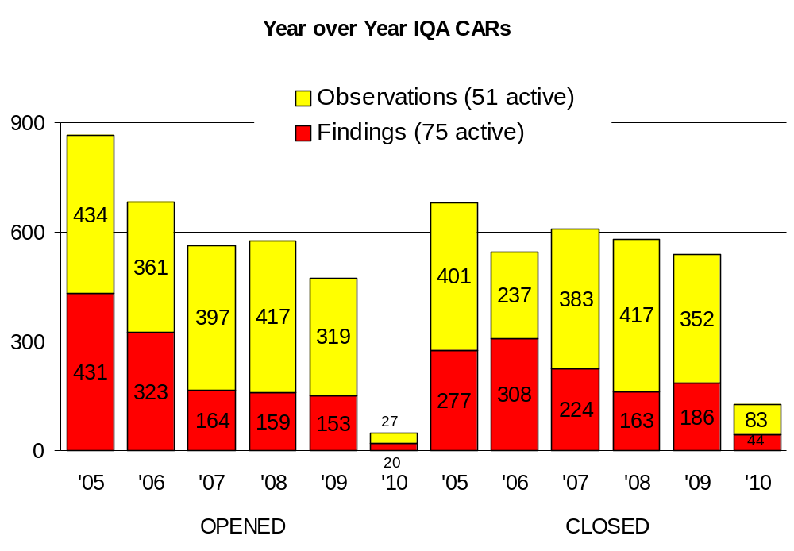
2) Internal Audits (process) – CAR Turnover
Analysis / Trend
Low number of YTD 2010 CARs since audits began in March
IQA Audits vs CARs – number of CARs is decreasing as IQA works to obtain stakeholder collaboration to resolve issues that occur across multiple region
Reduction of observation CARs through the use of PDE Work Inventory process and Service Requests
Actions Completed/Underway
CAR analysis and feedback to process owners for improvements
Direct process solutions for corrective actions (e.g., Market Surveillance to PDE Work Inventory)
Issues
Long-term solutions (initiatives) put on hold (e.g., datasheet automation, LIMS) or delayed (L1 competency 2011) – resulting in multiple repeat Accreditor findings.
Recommendations
Source: CAR Database

Slide 10
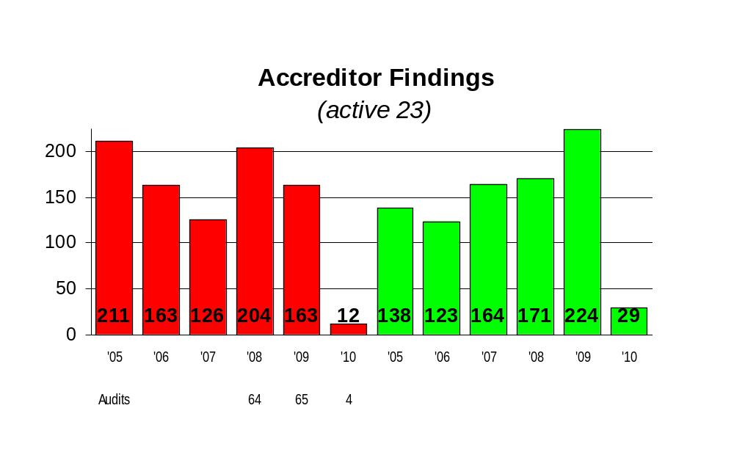

3) External Audits – Accreditor Finding Turnover (YoY thru year end 2009)
Trend / Analysis
Accreditors are documenting issues on a per site basis repeat finding
Accreditors observing year-over-year repeat findings (keep writing the same finding)
Correlation between internal and external audit findings – issues found internally that are not resolved become Accreditor findings
Actions Underway
L6S Technical Accuracy of Certifications (ID:00391)
Follow-up review and execution of missing agreements since 9-1-2009
Issues
Long-term solutions (initiatives) put on hold (e.g., datasheet automation, LIMS) or delayed (L1 competency 2011) – resulting in multiple repeat Accreditor findings.
Recommendations
Source: CAR Database

Slide 11
CAPA Questions?

Slide 12
Root Cause Statements

Slide 13
Root Cause Statement
One or two sentences summarizing what the root cause is.
There must be linkage to the non-conformance statement.

Slide 14
Root Cause Statement
“Root cause investigation BEGINS with an operator error.
  What in the process allowed an operator to make such an error?
  What fail-safe steps can we add to assure errors don't recur?“
Quote provided by James Kurtz

Slide 15
Root Causes to Further Explore
Human Error
Training
Knew the requirement but chose not to follow it
This shouldn’t be a CAR
A restatement of the problem
A statement of a symptom

Slide 16
Enhanced Root Cause Statements
Example 1
Nonconformance:
Sample #123 did not comply with corrosion cracking test requirement of UL 486e, 14A, as recorded on data sheet on 9/7/2009. No evidence of communication to client was evidenced in eCommunication regarding failure of test.
Analysis:
This nonconformance escaped detection since a new project handler received this project from a former employee who has left the company. He did not notice that previous handler did not store the letter in eCommunication. Not all information was transferred from one engineer to another.

Slide 17
Enhanced Root Cause Statements
Original Root Cause Statement:
Item overlooked
Concerns with the Original Root Cause:
“Item overlooked” is similar to “Human error”. It requires further investigation.
Need to know “why” the item was overlooked.
The analysis does not lead to the conclusion that the item was overlooked. It provides details that indicate that this was not simply something that was overlooked.

Slide 18
Enhanced Root Cause Statements
Revised Root Cause Statement:
The Project Handler made an incorrect assumption that the original PH completed all aspects of the project before it was handed over to him.
Strengths of the Revised Root Cause Statement:
Addresses “why” the item was overlooked.
Enables the CAR owner to develop a more effective plan of action – one that addresses the true cause.
Provides a reason that is consistent with the analysis.
Provides linkage to the nonconformance statement: Communication to the client was not profiled in eComm because the PH made an incorrect assumption that the original PH had already done this.

Slide 19
Enhanced Root Cause Statements
Example 2
Nonconformance:
Test record dated 6/8/2009, vol 1, section 1 specifies inaccurate rating of the UPS as 120V, 34 Amp, 8000VA. This does not match with data sheet information for testing result.
Analysis:
The project handler and reviewer failed to fulfill the requirements of 00-LC-S0258 with regards to correctly match the ratings of the datasheets to the report. The data package was completed correctly - the project handler did not transfer the correct ratings of the DUT and the reviewer did not catch this mistake. After review of projects this was an isolated occurrence.

Slide 20
Enhanced Root Cause Statements
Original Root Cause Statement:
UL does not have foolproof system to ensure that SOP requirements are always properly fulfilled. Some employees do not always follow the procedures of 00-LC-S0258.
Concerns with the Original Root Cause:
Not having a foolproof system could easily apply to many nonconformances. This does not add value to a root cause because it is too broad to be addressed in a CAR.
Need to know “why” employees do not always follow the procedure.
The analysis states that this is an isolated occurrence. This does not lead to the conclusion that there is a problem with employees not following the procedure.

Slide 21
Enhanced Root Cause Statements
Revised Root Cause Statement:
The project handler made a transcribing error and therefore did not transfer the correct ratings of the DUT, and the reviewer did not catch this mistake.
Strengths of the Revised Root Cause Statement:
More accurately states “why” the error occurred.
Enables the CAR owner to develop a more effective plan of action – one that is addressable within their organization.
Provides a reason that is consistent with the analysis.
Provides linkage to the nonconformance statement: This does not match with data sheet information for the testing result due to a transcribing error.

Slide 22
Comments in CAR History

Slide 23
Comments in CAR History
If a comment in a CAR references a meeting, discussion, email, etc., it is important to include a summary of the details in the CAR.
  Those reviewing the CAR must have enough information to understand what discussions have occurred.
  Backup CAR Admins, the CAR process owner, and others who may act upon the CAR must be able to tell what has transpired in the CAR.
  Options:
    Include the details as a part of the comment.
    Attach a summary of the discussion in the “Attachments/Comments” area of the CAR.

Slide 24

Comments in CAR History
Example of a comment that requires more detail or an attachment with the details:
2009/10/16 10:55:20 AM - Response Disapproved But Date Changed From 2009/10/29 To 2009/11/10
Reason - Sent an email to the Owner dated 10/16/2009.
For this example, you should attach the details in a document in the “Attachments/Comments” section of the CAR.

Slide 25
Comments in CAR History
Example of a detailed comment:
2009/10/16 10:55:20 AM - Response Disapproved But Date Changed From 2009/10/29 To 2009/11/10
Reason - Sent an email to the Owner dated 10/16/2009 which included the following: Please provide an explanation of what was the "miscommunication" that occurred. What is "NCB", and what is NCB's relationship to IECEE? Was the incorrect posting due to a UL error or due a non-UL entity's error? The field "Scope of Non-Conformance" is where you put the extent of the non-conformance. In other words, were there any other incorrectly listed competencies for this lab, or was it limited just to the two mentioned in the non-conformance. Remember that as part of the Corrective Action every CAR needs a Containment and a Verification, or explanations why they are not needed.
In this case, no attachment is necessary.

Slide 26
CAR Metrics on the Website

Slide 27
CAR Metrics on CAR Website
CAR Metrics will be available in July.
Various search mode options
(All CARs, Open CARs, Closed CARs, by Manager, by Program)
Data drill down search feature
(Audited Region, Site Audited, Process Impacted, Root Cause Category, Organization/Function, Standard Category, CAR Source, CAR State)
Overdue and escalation information
Export data to Excel
Save reports you create under your employee number

Slide 28
Questions?
For questions or comments, please contact Cheryl Allison, Northbrook, x43246

Slide 29
Revision History
Initial Release, July 5, 2010
Rev. 1, July 12, 2010
Changed slide 27 from “CAR metrics will be available in August” to “CAR metrics will be available in July”.

