Slide 1
CAR Administrator Calibration 2nd Quarter 2011
May 18, 2011, Revision 2
For questions or comments on the content, please contact Cheryl Allison

Slide 2
Topics
Root Cause Statement ≠ Nonconformance Statement
When the Corrective Action Changes …
Verification Milestone: What does it verify?
Extension Requests: It is ok to say “No”
Reminder

Slide 3
Root Cause Statement ≠ Nonconformance Statement

Slide 4
Root Cause Statement
Nonconformance Statement:
Root Cause Statement:
Root cause restates the nonconformance: “The test conditions were not followed / maintained”.

Slide 5
Root Cause Statement
Nonconformance Statement:
Root Cause Statement:
The Root Cause does not address:
Why the requirements for test conditions were not followed
The bottom line reason for the nonconformance

Slide 6

Root Cause Statement
Nonconformance Statement:
Root Cause Statement:
Root cause restates the nonconformance without a reason for it: There was an error made – there was indeed one VN.

Slide 7
Root Cause Statement
Nonconformance Statement:
Root Cause Statement:
The Root Cause:
Does not address that there was a Field Rep Error: Why did the problem occur?
Is equivalent to “Human Error” and therefore requires further investigation

Slide 8
Root Cause Statement
Nonconformance Statement:
Root Cause Statement:
Root cause restates the nonconformance: There was a failure to flag / comment regarding the missing MSD samples.

Slide 9
Root Cause Statement
Nonconformance Statement:
Root Cause Statement:
The Root Cause:
Does not address why there was a failure to flag the missing MSD samples.
Why was there an analyst oversight?

Slide 10
When the Corrective Action Changes …

Slide 11
Corrective Action Changes
When a Corrective Action Plan changes:
Make sure that the nonconformance and root cause are still fully addressed
Update the wording of the CAP in the CAR
Update the milestones, including the milestone expectations
Add comments for clarification

Slide 12
Corrective Action Changes
Example
Current CAP:
Revise 00-LC-P0034 para. 7.1.3 to change "equipment" to "permanently installed alcoves"
Milestone Title:
Revise 00-LC-P0034 para. 7.1.3
Action completed by CAR Owner:
Para. 8.1 of 00-LC-P0034 was revised. 7.1.3 was not revised.
What actions need to be done by the CAR Admin?

Slide 13
Corrective Action Changes
Example, cont.
Make sure that the nonconformance and root cause are still fully addressed.
Options:
More actions may be needed, including more milestones
The new action may be sufficient without more milestones
The new action may need to be rejected

Slide 14
Corrective Action Changes
Example, cont.
More actions may be needed, including more milestones
Update the CAR with the additional actions needed to fully address the nonconformance and root cause
Add new milestones as needed
Update the CAP to reflect the changes that are being made
Update the submitted milestone, including milestone expectation, to reflect what was actually done
Add clarifying comments to the CAR and milestone

Slide 15
Corrective Action Changes
Example, cont.
The new action may be sufficient without more milestones
You must ensure that the new action fully addresses the nonconformance and the root cause
Update the CAP to reflect the changes that are being made
Update the submitted milestone, including milestone expectation, to reflect what was actually done
Add clarifying comments to the CAR and milestone

Slide 16
Corrective Action Changes
Example, cont.
The new action may be need to be rejected if:
The new action does not address the CAP or the root cause
The new action creates new concerns or new nonconformances

Slide 17
Verification Milestone: What does it verify?

Slide 18
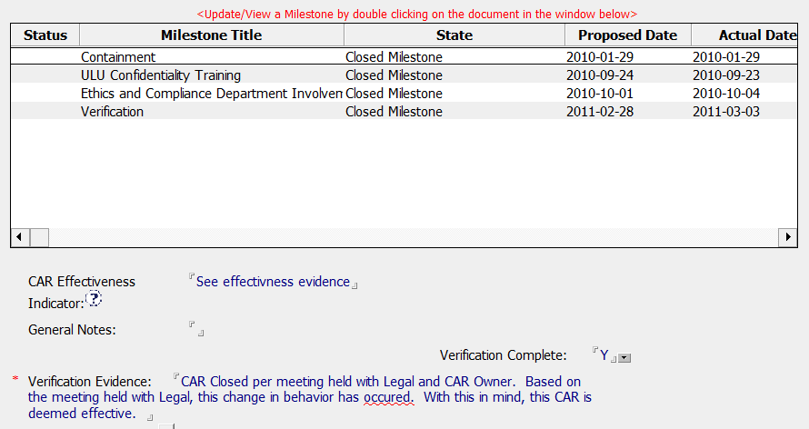
Verification Milestone
This is the Verification Milestone

Slide 19
Verification Milestone
The Verification milestone assesses the effectiveness of the entire solution implemented by the CAR Owner
Owner’s Verification of Effectiveness occurs:
In Finding CARs only – not in Observation CARs
After all corrective actions have been implemented
After all previous milestones have been verified and closed
In the last milestone of the CAR
Before the CAR is closed

Slide 20
Verification Milestone
The Verification milestone does NOT:
Contain corrective actions. Corrective actions are completed in the previous milestones.
Verify specific actions that are done in the previous milestones. Those actions were already verified before the milestones were closed. (Exception: if new samples will not be available for several months, it may be appropriate to use the previous milestones for verification.)

Slide 21
Verification Milestone
The Verification milestone verifies that the corrective actions:
Were effective in resolving the nonconformance
Addressed the root cause
Have sustained

Slide 22
Extension Requests: It is ok to say “No”

Slide 23
Extension Requests
Consider the following when asked to grant an extension:
Is containment addressed? If not, the request may be denied pending the implementation of appropriate containment.
The nature of the CAR Consider the impact of the nonconformance to safety, accreditation, etc.

Slide 24
Extension Requests, cont.
The amount of time being requested Does the time requested seem reasonable, or does it seem excessive for the task?
The reason for the request
The number of previous extensions requested and granted Does it appear that the handling of the CAR is a low priority?

Slide 25
Extension Requests, cont.
What are options for the CAR Admin when they do not agree with the request?
Reject the request, i.e., select “Disapprove Implementation Date Extension”
Require the owner to provide written approval for the extension by his/her management
Ask the CAR Process Owner for support in addressing the request
Remember: It is ok to say “No”
to a request for an extension

Slide 26
Reminder

Slide 27
Reminder
CAR Owner Training presentation is available: FAQ 15 on the CAR website

Slide 28
Questions???

Slide 29
Revision History
Initial Release, May 12, 2011
Revision 2, May 17, 2011: Added slide 18 which shows the Verification Milestone in a CAR

