Slide 1
CAR Administrator Calibration
IMPORTANT
During the call, DO NOT use HOLD because the music will interrupt the call. Use MUTE.
April 30, 2012
For questions or comments, please contact Cheryl Allison

Slide 2
Topics
Accreditor Due Dates and Response Extensions
CAPs Requiring the Commitment of Other Groups
CAR Review Trends: Analysis
Discussion: “Human Error Reduction” Article
Communication Forum Status
Good CARs, Bad CARs

Slide 3
Accreditor Due Dates and Response Extensions

Slide 4
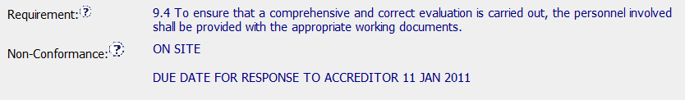
Accreditor Due Dates and Response Extensions
CAR responses must meet the Accreditor due date.
The CAR owner must provide a response prior to this date:
To ensure that the CAR Owner has time to make updates to their response after review by the CAR Admin
To ensure that the CAR response is acceptable and ready for the Accreditor by the due date

Slide 5
Accreditor Due Dates and Response Extensions
For the above CAR, the CAR response due date must be prior to 11 JAN 2011
The CAR Admin may need to change the GCAR generated due date if less time is required based upon the Accreditor due date
Extensions may NOT be granted:
Beyond the Accreditor due date (11 JAN 2011)
If there will not be time for CAR Admin review, Owner updates, and CAR Admin approval prior to the due date

Slide 6
CAPs Requiring the Commitment of Other Groups

Slide 7
CAPs Requiring the Commitment of Other Groups
Corrective action plans and milestones sometimes require a commitment from another group such as
IT
UL University
Others
Prior to accepting the CAR response:
The CAR Owner must provide written evidence that the other group agrees to the action
There must be an agreed upon completion date by the other group
Evidence of the above must be placed in the milestone

Slide 8
CAR REVIEW TRENDS: Analysis

Slide 9
CAR Review Trends: Analysis
Important details are not being captured in the Analysis. The Analysis:
Must clearly document the thought process used to determine the cause of the nonconformance
Provides a logical flow to the root cause statement
Provides enough detail so that someone who is not familiar with the CAR can easily follow the path to the root cause and corrective actions
Make sure that the CAR Owner has provided enough detail in the Analysis to accomplish the above

Slide 10
DISCUSSION: “Human Error Reduction” Article

Slide 11
COMMUNICATION FORUM: Status

Slide 12
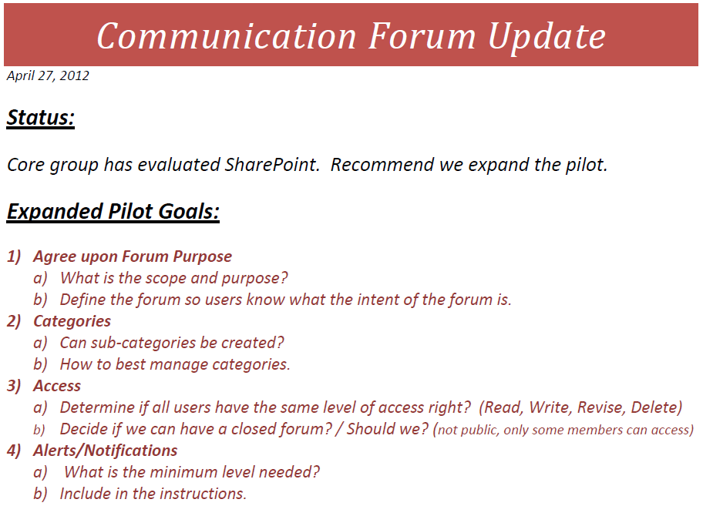

Slide 13
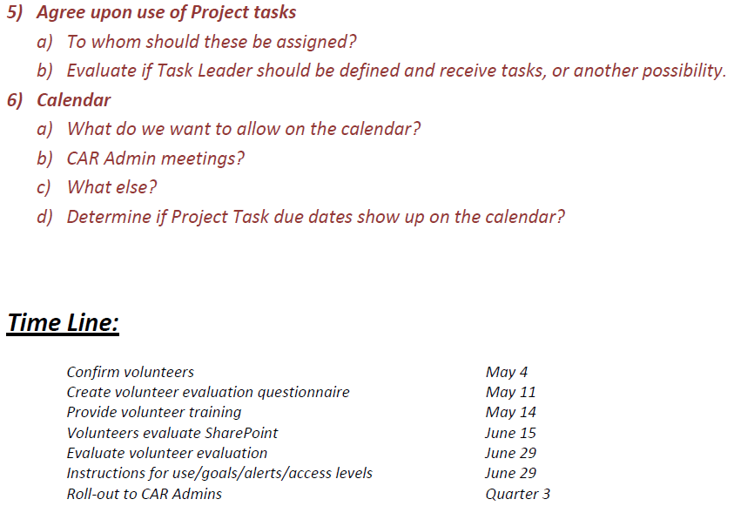

Slide 14
Team
Samantha Bang – x65381
Julie Heinzinger – x55602
Paul Ip – x69582
Michelle Lee – x55600
Chris Nicastro – x41718

Slide 15
Good CARs: Bad CARs

Slide 16
Good CARs: Bad CARs
Teams and CAR Numbers for review
NA Team for meeting on May 3
Gary Gardell, Kathy Lindstrom, Chris Nicastro, John Pallanti
CAR #s: 11399735, 11399359, 11399465, 123910107
EULA and NA Team for meeting on May 3
William Costello, Rebeca Navarrete, Dale Piechocki
CAR #s: 11398960,11399635, 11399426, 11398998
Asia Team for meeting on May 2
Thomas Kestner, J.Y. Lee, WeiBeng Leong, Simy Li
CAR #s: 11399850, 11399377, 113910033, 11399204

Slide 17
THANK YOU.

