Slide 1
CAR Champion Calibration
May 22, 2014
For questions or comments, please contact Cheryl Allison

Slide 2
Topics
Raising the Bar
Interim Verifications: Status Milestones Required
Management Path – selective changes
Root Causes
Update to GCAR selections
Owner’s Org/Function
Sector/Industry
Champion Conversations
CAR Reviews

Slide 3
Raising the Bar

Slide 4



Slide 5
Raising the Bar: Why?
Why are we Raising the Bar?
Customer/Management expectation
Complexity of the organization structure
Effective Corrective Actions
Positive Business Impact

Slide 6
Raising the Bar:
Interim Verifications

Slide 7
Raising the Bar: Interim Verifications
Why have Interim Verifications?
Issues:
Organizational direction sometimes changes during the life of a CAR, impacting the suitability of the previously determined corrective action plan
CARs are open for several months only to be found ineffective at closure
The number of CARs verified as ineffective is rising often due to these changes
There is sometimes minimal progress on corrective actions during periods of the CAR life

Slide 8
Raising the Bar: Interim Verifications
Why have Interim Verifications?
Raising the Bar:
“Interim Verification” should address:
Appropriateness of the corrective actions for the current business direction
Effectiveness of the actions that have been implemented to date
Progress/timeliness of the corrective actions
“Interim Verification” milestones are required at each 3 month interval. Therefore, a CAR may have more than one “Interim Verification” milestone.

Slide 9
Raising the Bar: Interim Verifications
Why have Interim Verifications?
Desired outcome:
Corrective actions remain appropriate for the current business direction as the CAR progresses
Concerns regarding progress of corrective actions are identified and addressed
Corrective actions are deemed effective at CAR closure
The number of CARs verified “ineffective” diminishes

Slide 10
Raising the Bar: Interim Verifications
Actions for Interim Verifications
For corrective actions taking longer than 3 months to correct, include an “Interim Verification” milestone at every 3 month interval.
Verifies that the corrective action plan is still reasonable and effective
Determines if modifications to the corrective action plan are needed
Start including the “Interim Verification” milestone for CARs that are “Awaiting Response” beginning today

Slide 11
Raising the Bar: Interim Verifications
Actions for Interim Verifications, cont.
Add “Interim Verification” milestones for existing CARs when:
An extension is requested AND
The CAR closes beyond 3 months from today
There is no need to make changes to in-process CARs that are already “Awaiting Implementation” (unless there is an extension request per the #2 above description)
On a case-by-case basis, “Interim Verification” milestones may be requested for existing CARs

Slide 12
Raising the Bar:
Management Path – Selective Changes

Slide 13
Raising the Bar: Management Path – Selective Changes
Business Unit Presidents are intentionally being added to the management escalation path (by the CAR process owner) for certain CARs
Issues:
CARs involving critical impact areas (e.g., safety, accreditation, etc.) may require higher level involvement should corrective actions become delayed
Executive involvement earlier in the CAR life will hopefully ensure that the commitment, resources and direction needed will be provided

Slide 14
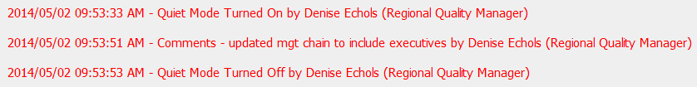
Raising the Bar: Management Path – Selective Changes
For Management Path Changes:
The CAR will include a comment in the history documenting that the change was made by the CAR process owner (or delegate)
An email will be sent to the CAR Champion notifying them of the change
Note: These changes will not impact “CAR Star” status

Slide 15
Raising the Bar:
Root Causes

Slide 16
Raising the Bar: Root Causes
Root Cause: Was not aware or misunderstood requirement or SOP
Raise the Bar:
Include in corrective action:
The mechanism to be used for future changes that are received
Determine impact

Slide 17
Raising the Bar: Root Causes
Root Cause: Was not aware or misunderstood requirement or SOP
Raise the Bar, continued:
Include process owner in the CAR analysis to help determine ways to improve communication/deployment
Could have one individual in department/team to subscribe to SOPs and let others on team know of impact to new or changed requirement
Review this during verification stages

Slide 18
Raising the Bar: Root Causes
Root Cause: No automated tools
This root cause should really be that the manual process was not effectively implemented
Raise the Bar:
Automation may not be planned, so they must implement a consistent manual solution:
Include the process owner in the CAR analysis. There may be things available to support local owners.
Benchmark with other locations (for example, with FUS Adms in other locations)

Slide 19
Raising the Bar: Root Causes
Root Cause: No automated tools
Raise the Bar, continued:
Ensure staff are trained on the local, manual process; have things in place to escalate when needed.
If CAR takes months to implement, include the 3 month verification.

Slide 20
Raising the Bar: Root Causes
Root Cause: No nonconformance - record found after audit
Raise the Bar:
We have requirements that records are to be readily retrievable. If a record cannot be located at the time of an audit, that’s an issue…
These CARs are not to be forced closed…
Include in corrective action:
Record has been located and provide copy of record
Address why the record could not be located and what action is to be taken to prevent it in future.

Slide 21
Raising the Bar: Things to consider
Include process or program owners in analysis
Benchmark with others
Communication with network of quality managers
Past CARs/Trends
Goals/objectives

Slide 22

Questions?

Slide 23
Champion Conversations
Discussion
Raising the Bar
Root Cause: Was not aware or misunderstood requirement or SOP
What might be a good approach when there is a concern with this kind of root cause?
How might you make this a “win-win” discussion?
Let’s role play to see one possible approach given the following scenario.

Slide 24
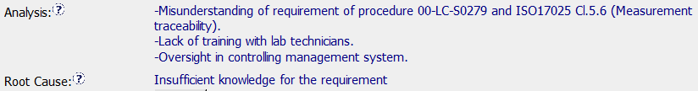
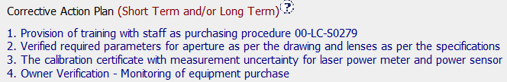
Champion Conversations
Discussion
Scenario

Slide 25
Update to GCAR Selections

Slide 26
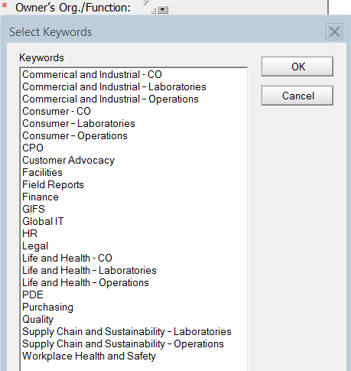
Update to GCAR Selections
New Owner’s Org/Function Selections
Updates have been made to reflect our new business unit names
Business Units
have CO, Lab
and Operations

Slide 27
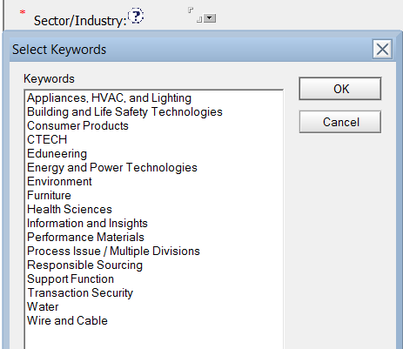
Update to GCAR Selections
Updated Sector/Industry Selections
Note the new selection “Process Issue / Multiple Divisions” to be used for concerns that cross more than one area

Slide 28
Champion Conversations

Slide 29
Champion Conversations
GCAR “Madness”
GCAR has truly gone mad with this one…
We recently had an experience where GCAR actually closed a milestone when it was
“awaiting implementation”!
The CAR owner had not submitted the implementation.
The CAR Champion had not taken any action on the CAR!

Slide 30
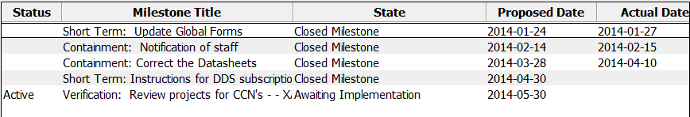
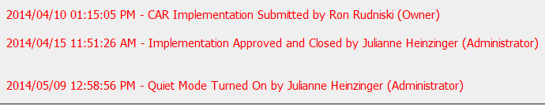
Champion Conversations
GCAR “Madness”
Note that the
“Actual Date”
is missing
Note that no
history was
captured for the
closed milestone

Slide 31
Champion Conversations
GCAR “Madness”
A Helpdesk ticket is in process for this issue
An investigation is being done to determine if other CARs have been impacted
What can you do?
There is no need for you to take any action, however…
Be aware that a missing “Actual Date” for a milestone may indicate that the implementation was never submitted
Notify Jim Oates and Cheryl Allison if this occurs

Slide 32
CAR Reviews

Slide 33
CAR Reviews
Teams and CAR Numbers for review
Asia Team for meeting on June 3
Paul Ip, Ronald Tse, Adele Fan, Simy Li, Balina Ling
CAR #s: 133912678, 143912878, 133912554, 133912151
NA Team for meeting on May 22
Mark Jessen, Jim Oates, Gunsimar Paintal, Michelle Lee
CAR #s: 133912451, 133912827, 143912878, 143913017, 133911845
EULA and NA Team for meeting on May 22
Jim Carlisle, John Carlin, Rebeca Navarrete
CAR #s: 133912678, 133912827, 133912862, 133911885

Slide 34
THANK YOU

