Slide 1
CAR Champion Calibration
June 3, 2015
For questions or comments, please contact Cheryl Adams

Slide 2
Topics
Repeat CARs
FAQ #25 Update
Standard, Edition and Date
Communication of Scope
Champion Conversations
GCAR Madness
Management Path Considerations
Root Causes
CAR Reviews

Slide 3
Repeat CARs:
Standard, Edition and Date
Communication of Scope

Slide 4
Repeat CARs
Background
Quality Initiative teams were assembled in 4th Quarter 2014 to address two global, repeat CAR concerns:
Standard, Edition and Date
CARs written due to inconsistencies found regarding the standard, edition, and/or date on datasheets, test records, or the communication of scope to the client. This does NOT include testing done to the wrong standard.
Communication of Scope
CARs regarding missing and/or erroneous communication of scope to the client.

Slide 5
Repeat CARs
FAQ #25 updated to include processing instructions for certain Repeat CARs
Standard, Edition and Date
Communication of Scope
Other Repeat CAR issues may be added in the future. Email notification will be sent as FAQ #25 is updated.

Slide 6
Champion Conversations

Slide 7
Champion Conversations
GCAR Madness
I just verified a CAR as “ineffective”.
GCAR will not let me edit the
new CAR that was created.
This is a very common occurrence. GCAR will not allow you to edit the CAR even though your name shows as Originator, Initiator and/or CAR Champion.
Notify Cheryl Adams or Jim Oates and they will implement the quick fix.
They will simply delete and then repopulate these fields: owner’s region, owner’s subregion, owner’s reporting location.

Slide 8
Champion Conversations
Management Path
Considerations
The Global Quality Director’s name
must replace the executive’s name
in the CAR’s management path.
But – Did you know…

Slide 9
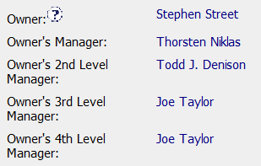
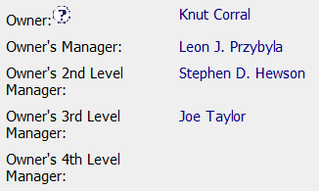
Champion Conversations
Management Path
Considerations
Joe Taylor’s name only needs to appear once if it is the last one in the path
Having his name appear two consecutive times causes the CAR to escalate to him twice which is unnecessary and delays further escalation
Avoid:
Correct:

Slide 10
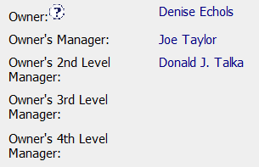
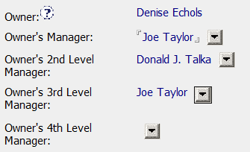
Champion Conversations
Management Path
Considerations
Joe Taylor’s name must appear in place of the executive’s name and not be left blank
This may mean that occasionally his name appears twice (but not consecutively).
Avoid:
Correct:

Slide 11
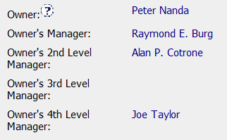
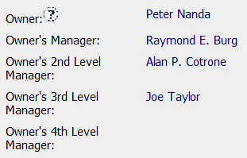
Champion Conversations
Management Path
Considerations
A name must appear immediately after the previous management name without leaving a level blank
A blank field stops escalation and immediately goes to manual escalation
Avoid:
Correct:

Slide 12
Champion Conversations
Root Causes
Assess this root cause:

Slide 13
Champion Conversations
Root Causes to further explore
Person is no longer an employee of UL
Human Error
Training
Knew the requirement but chose not to follow it
This shouldn’t be a CAR
A restatement of the problem
A statement of a symptom

Slide 14
CAR Reviews

Slide 15
CAR Reviews
Teams and CAR Numbers for review
Asia Team for meeting on June 12
Matthew Kim, Balina Ling, Tony Hsu, J. Y. Lee
CAR #s: 153914349, 143914135, 153914555, 143913949
NA Team for meeting on June 11
Chris Nicastro, Alan Purvey, Linda Ziemnick, Michelle Lee
CAR #s: 153914349, 143914252, 153914523, 143913065
EULA and NA Team for meeting on June 3
Rebeca Navarrete, Mark Lavine, Maria Carolina Bossert, Jim Kurtz
CAR #s: 143914135, 143914252, 143914149, 153914378

Slide 16
THANK YOU

