Slide 1
CAR Administrator Calibration
IMPORTANT
During the call, DO NOT use HOLD because the music will interrupt the call. Use MUTE.
September 19, 2012
For questions or comments, please contact Cheryl Allison

Slide 2
Topics
Reminders
- Management Escalation Path
- Document Control System availability during October
Being Customer-Focused: CAR Responses
CAR Responses: Today…Future
Communication Forum Status
Good CARs, Bad CARs

Slide 3
REMINDERS

Slide 4
1. Management Escalation Path
Replace Presidents of Business Units with Joe Taylor
Joe Taylor will determine the appropriate course of action and notify the President of the Business Unit as appropriate
Presidents of Business Units change over time. As of August 2012 they include:
Patrick Boyle | Stephen Wenc
Sara Greenstein | Keith Williams
Sajeev Jesudas | Hiroshi Yamaki
Ben Miller

Slide 5
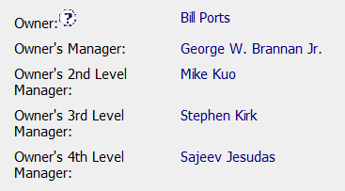
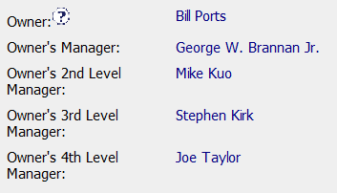
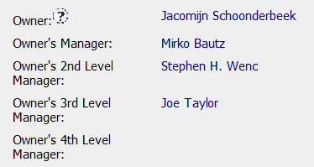
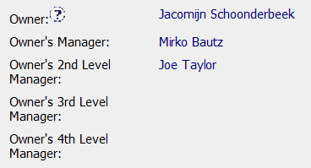
1. Management Escalation Path, cont.
Remove President’s Name:
Replace with “Joe Taylor”:
***
***
***
*** Note: Joe Taylor’s name only needs to be input one time if his is the . final name in the escalation path.

Slide 6
2. DCS Not Available in October ????????
Document Control System will not be available during transition to Sharepoint from October – November 4 ?????????????.
No requests/approvals will be accepted
You will be able to view documents
CARs having milestones due for document publication must be adjusted accordingly
Be aware of these date restrictions as you approve CARs.
Proactively review current CARs to avoid conflicts during the DCS transition period

Slide 7
BEING CUSTOMER-FOCUSED: CAR Responses

Slide 8
Being Customer-Focused: CAR Responses
CAR Responses are developed by the CAR Owner with the assistance of the CAR Admin.
This is especially important with first-time or newer CAR Owners
It helps minimize rework
It promotes better and more timely responses
What does it mean to be “Customer-Focused” with our customer – the CAR Owner?
What can we do to be “Customer-Focused”?

Slide 9
Being Customer-Focused: CAR Responses
What can we do to be “Customer-Focused”?
Share with the CAR Owner similar CARs that have been successfully implemented
Study/Know the process prior to meeting with the CAR Owner
Sit with the CAR Owner or share screens as you review and/or update the CAR
Other suggestions…

Slide 10
CAR RESPONSES: Today…Future

Slide 11
CAR Responses Today………..Future?
Today
CARs usually assigned locally
Most responses local training/communication
Long-term correction usually local in nature
Many local CARs are issued before global solution
How do we improve for future?

Slide 12
COMMUNICATION FORUM: Status

Slide 13
Team
Samantha Bang – x65381
Julie Heinzinger – x55602
Paul Ip – x69582
Michelle Lee – x55600
Chris Nicastro – x41718

Slide 14
Good CARs: Bad CARs

Slide 15
Good CARs: Bad CARs
Teams and CAR Numbers for review
Asia Team for meeting on September 18
Samantha Bang, Funny Li, Balina Ling, Catherine Qiu
CAR #s: 11399522, 11399506, 11399065, 123910414
NA Team for meeting on September 18
Bill Konigsfeld, Jim Oates, Julianne Heinzinger, Gunsimar Paintal
CAR #s: 11399769, 123910694, 123910200, 123910055
EULA and NA Team for meeting on September 19
Karen Fine, Barbara Scala, Mel Fehrenbacher, Mark Lavine
CAR #s: 123910646, 123910629, 123910102, TBD

Slide 16
THANK YOU.

