Slide 1
CAR Administrator Calibration
September 23, 2013
For questions or comments, please contact Cheryl Allison

Slide 2
Topics
Buy & Pay
Customer Focused CAR Administration
Champion Conversations
CAR Reviews

Slide 3
Buy & Pay

Slide 4
Buy & Pay Topics
Implication for CARs
Analysis
Root Cause Categories
Root Cause Statements
Optional Recipient for Buy & Pay CARs
CAR Processing Requirements FAQ

Slide 5
Buy & Pay
Implication for CARs
There are several issues resulting from the Buy & Pay transition. Be aware that:
Processes have been impacted
An Issue Log is provided on the Buy & Pay website
Issues continue to arise and continue to be addressed
There are specific CAR processing requirements for Buy & Pay related concerns

Slide 6
Buy & Pay: CAR Processing Requirements
Analysis
For Finding CARs, a thorough analysis must indicate that this is a Buy & Pay specific concern, i.e.,
The problem has already been identified and is included on the Buy & Pay Issue Log, or
The problem would not likely exist if Buy & Pay did not exist, or

Slide 7
Buy & Pay: CAR Processing Requirements
Analysis, continued
Changes resulting from the implementation of Buy & Pay either caused the problem or directly contributes to the problem. For example:
A previously automated process is now manual, and staff neglected to do something
A new process exists but not all staff have been trained

Slide 8
Buy & Pay: CAR Processing Requirements
Root Cause Categories
There are three new root cause categories for Buy & Pay (Finding CARs only)
Buy & Pay: Risk/Issue Log
Open items that are included on the Buy & Pay website, Issue Log

Slide 9
Buy & Pay: CAR Processing Requirements
Root Cause Categories
Buy & Pay: Risk/Issue Log, continued
Treat the resolution for these CARs as follows because the issue is already being addressed outside the CAR system:
Analysis should show that this is a part of an existing, identified issue, and state that the long-term resolution for the concern is being addressed outside the CAR via the Buy & Pay Issue Log.
Be sure to reference the number of the issue
Scope and Root Cause Statement should address the objective evidence presented in the CAR.

Slide 10
Buy & Pay: CAR Processing Requirements
Root Cause Categories, continued
Buy & Pay: Risk/Issue Log, continued
If:
A Buy & Pay problem persists for two months after closure on the Issue Log,
and
This results in multiple CARs,
Then:
A finding CAR will be created to readdress the issue
Global Quality Engineering will create the finding CAR when these conditions exist

Slide 11
Buy & Pay: CAR Processing Requirements
Root Cause Categories, continued
Buy & Pay: Deployment Concern
Transitional concerns that are not on the Buy & Pay Issue Log and are not new issues that should go on the Issue Log. For example:
Staff forgetting manual steps that were previously automated
Training not fully deployed
The corrective actions must address both the individual cited in the objective evidence as well as other staff in that group (determined by the scope of the nonconformance)

Slide 12
Buy & Pay: CAR Processing Requirements
Root Cause Categories, continued
Buy & Pay: New Issue
Concerns that are suitable for the Issue Log, but are not currently listed on the log
Global Quality Engineering will contact the Buy & Pay team to share this information
These concerns will likely become a part of the Buy & Pay Issue Log. Treat these CARs the same as the “Buy & Pay: Risk/Issue Log” CARs.

Slide 13
Buy & Pay: CAR Processing Requirements
Root Cause Statements
Root cause statements must begin with the title of the root cause category to facilitate metrics tracking
“Buy & Pay: Risk/Issue Log” (followed by the issue log # and title)
“Buy & Pay: Deployment Concern” (followed by the root cause statement)
“Buy & Pay: New Issue” (no additional verbiage)

Slide 14
Buy & Pay: CAR Processing Requirements
Root Cause Statements
The analysis must clearly lead to a Buy & Pay root cause category.
If the analysis does not indicate one of the three Buy & Pay areas of concern, choose a “category” other than the Buy & Pay categories

Slide 15
Buy & Pay
Optional Recipient
Carson Wang is to be an Optional Recipient for all Buy & Pay CARs

Slide 16
Buy & Pay
CAR Processing Requirements FAQ
The requirements for processing Buy & Pay related CARs are maintained on the CAR website, FAQ #25

Slide 17
CUSTOMER FOCUSED CAR ADMINISTRATION: Milestone Acceptance

Slide 18
Customer Focused CAR Administration
We will complete our exploration of what a customer focused approach to CAR Administration looks like:
CAR Assignment to Owner (previously discussed)
Response Development (previously discussed)
Milestone Acceptance
Today, we will cover “Milestone Acceptance”.

Slide 19
Customer Focused CAR Administration
Milestone Acceptance
Discussion
What does a customer focused approach
to CAR Administration look like
In the “Milestone Acceptance” phase?

Slide 20
Customer Focused CAR Administration
Milestone Acceptance
The CAR Champion monitors the GCAR milestone due dates, and works with the Owner to ensure the CAR does not go overdue.
Quick reminder call / e-mail on due date is a good practice
Any overdue milestone should result in a call (preferred approach) to the Owner to offer assistance.

Slide 21
Customer Focused CAR Administration
Milestone Acceptance
If additional objective evidence or clarification is needed,
Contact the Owner to request additional objective evidence in lieu of immediately rejecting the milestone in GCAR
Upon acceptance of each milestone,
Review the next milestone
Confirm with the Owner, as needed, that milestone deliverables and timing is still applicable

Slide 22
Champion Conversations

Slide 23
Champion Conversations
What are “Champion Conversations”?
Fellow CAR Champions sometimes share things regarding our role: items of interest, concern, or praise
Many of these items are worthy of discussion and sharing with the CAR Champion team as they may add value to our performance.
“Champion Conversations” is one forum that will be used for sharing and discussing these items.
Time permitting, the calibration meetings will include “Champion Conversations”.

Slide 24
Champion Conversations
Great Practice
CAR Champion comments saved the day during an accreditor audit!
Grateful email sent to a CAR Champion:
“Just wanted to let you know that YOU TOTALLY ROCK!! Your comments in the last milestone of this CAR helped save the day during the UKAS audit today!! Steve was having trouble locating the applicable records, but because of the detailed comments that you provided, he remembered that they are now with Janet S. THANK YOU!!!”

Slide 25
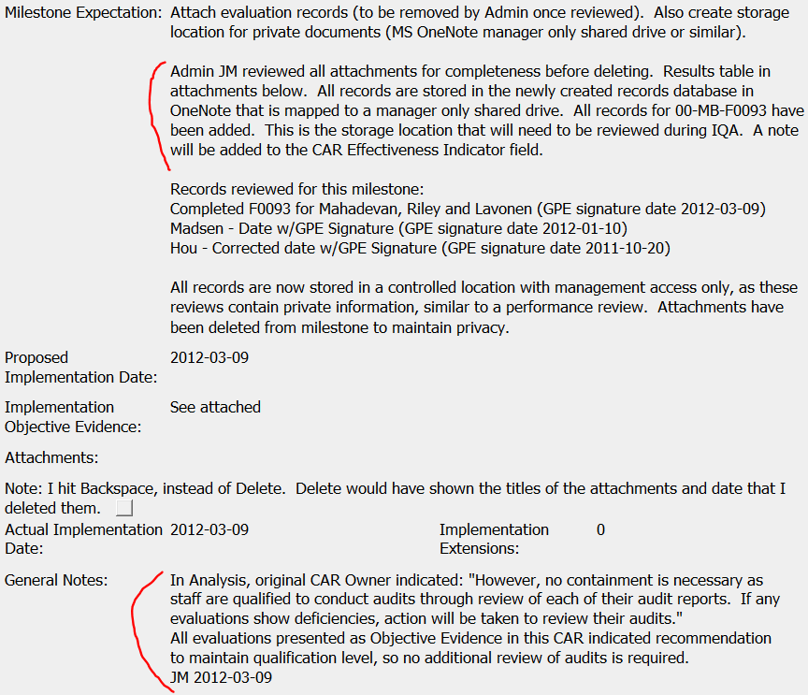
Champion Conversations

Slide 26
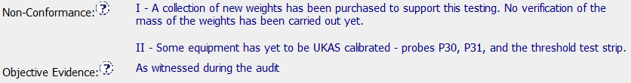

Champion Conversations
Opportunity
Objective Evidence not listed or too vague

Slide 27
Champion Conversations
Opportunity
Objective Evidence not listed or too vague
Concerns:
Leads to a poor record because it is so incomplete and imprecise
Must search for specific evidence several times:
When first reviewing the CAR
When reviewing the corrective action plan
When reviewing the milestones for completion
Anyone who reviews the CAR must search for the evidence

Slide 28
Champion Conversations
Opportunity
Objective Evidence not listed or too vague
Resolutions:
Make sure the specific details of the objective evidence are included within the objective evidence area
Use the Attachments/Comments area for supplemental information and not as the only location for the objective evidence
Ensure that the nonconformance is the statement of nonconformance and not the placeholder for the objective evidence

Slide 29
Champion Conversations
Discussion
Should you change the state of a CAR
that has gone overdue or escalated
when the Owner
is granted an extension?
Some CAR Champions reset the CAR back to an “awaiting” state after they extend a date, while others leave the state as is (overdue or escalated) with a new date.

Slide 30
Champion Conversations
Discussion
It is appropriate to change the CAR state when:
The CAR owner had previously been responsive
You anticipate that the CAR owner will continue to be responsive
It is appropriate to not change the CAR state when:
The CAR owner has consistently been late or nonresponsive to the CAR
There is a desire to continue the escalation process from where it currently is in the management chain should the CAR owner continue to be nonresponsive

Slide 31
CAR Reviews

Slide 32
CAR Reviews
Teams and CAR Numbers for review
Asia Team for meeting on September 24
Jacky Wu, Adele Fan, Funny Li, Ronald Tse, Tony Hsu
CAR #s: 133911505, 123911379, 133911678, 133911950
NA Team for meeting on September 23
Dale Hendricks, Gunsimar Paintal, Julianne Heinzinger, Chris Nicastro
CAR #s: 133911636, 133911950, 133912255, 123911154
EULA and NA Team for meeting on September 25
Mark vandeWaterlaat, Mel Fehrenbacher, Mark Lavine
CAR #s: 133911678, 133911636, 133911831, 133911497

Slide 33
THANK YOU

