Slide 1
CAR Champion Calibration
September 15, 2014
For questions or comments, please contact Cheryl Allison Adams

Slide 2
Topics
The Medusa Project
CAR Surveys
Champion Conversations
CAR Reviews

Slide 3
The Medusa Project

Slide 4
CAR Surveys

Slide 5
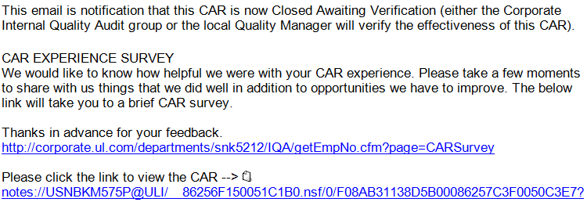
CAR Surveys
CAR Surveys will help assess CAR Owner and Owner’s Assistant experiences with CARs
Surveys are distributed in two ways:
Periodically, the survey is manually sent to a group of CAR owners
A survey link is included in the email when a CAR becomes “Closed – Awaiting Verification”

Slide 6
CAR Surveys
CAR Survey Questions
The respondent may select one of the following responses for each question:
5 – Extremely Satisfied
4 – Satisfied
3 – Neither Satisfied nor Dissatisfied
2 – Dissatisfied
1 – Extremely Dissatisfied
N/A
There is an area for comments after each question.

Slide 7
CAR Surveys
CAR Survey Questions
How satisfied were you with the communication received prior to being assigned the Corrective Action Request (CAR)?
How satisfied were you with the guidance received from the CAR Administrator/Champion during CAR response development?
How satisfied were you with the CAR Administrator's/ Champion's support through milestone implementation?
How satisfied were you with the communication from the CAR Administrator/Champion regarding overdue or escalated CARs?
How satisfied were you with the helpfulness of the CAR Website and associated FAQs?
How satisfied were you with the CAR Administrator's/ Champion's overall support?

Slide 8
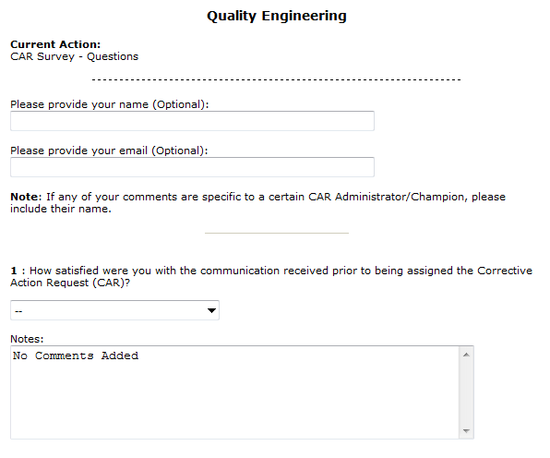
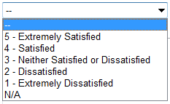
CAR Surveys

Slide 9
Champion Conversations

Slide 10
Champion Conversations
Observation or Finding???
An accreditor requires a root cause analysis
and implementation evidence. Sometimes
the CAR resolution is provided to the accreditor but other times it is not.
Should these CARs
be classified as
“Observations” or as “Findings”?

Slide 11
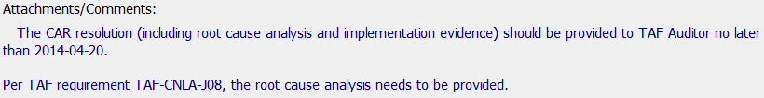
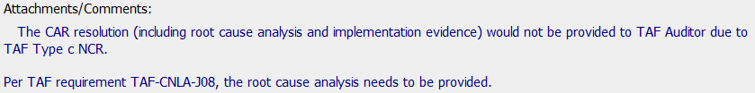
Champion Conversations
Observation or Finding???
Should these CARs
be classified as
“Observations” or as “Findings”?

Slide 12
Champion Conversations
Observation or Finding???
Should these CARs be classified as Observations or as Findings?
Whenever a root cause analysis is required, classify the CAR as a Finding.
The intent of an analysis is to discover the bottom line reason (root cause) for the nonconformance
A reasonable expectation is to address the root cause by corrective actions

Slide 13
Champion Conversations
Management Escalation Paths
CAR Champions have asked for clarification on who should be removed from the Management Escalation path:
Presidents? Sr. Vice Presidents? VP’s?

Slide 14
Champion Conversations
Management Escalation Paths
FAQ #36 on the CAR website provides a list of who to remove from the management path.
“Who are the Business Unit Presidents and other executives that are to be removed from the CAR owner’s management path and replaced by the Global Quality Director?”
“Include all executives, vice presidents and directors except for the following. Be sure to replace these names with the name of the Global Quality Director.”
See FAQ #36 for the current list of names
*** Always replace the names with “Joe Taylor” ***

Slide 15
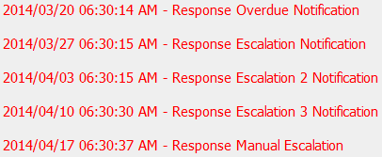

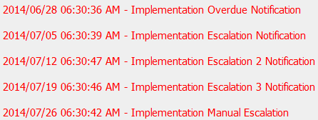
Champion Conversations
Other Escalation Concerns
The below notifications are from one CAR.
Other than lack of owner action,
What is wrong with this picture?

Slide 16
Champion Conversations
Other Escalation Concerns
Each time a CAR becomes overdue or escalates:
Contact the CAR owner
Remind them that the CAR is overdue or escalated
Offer to assist them
Remind them that they must respond before the next due date or the CAR will continue to escalate
Tell them they can request an extension, however:
They must provide a reason and a new date
The request may or may not be granted

Slide 17
Champion Conversations
Other Escalation Concerns
Each time a CAR becomes overdue or escalates:
Add a comment to the CAR indicating that you contacted the owner
Include helpful details related to the contact
Comments provide details that are helpful to Joe Taylor should the CAR go into manual escalation

Slide 18
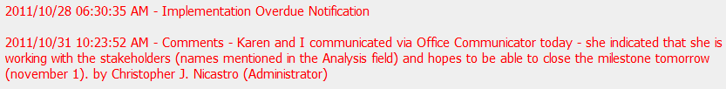
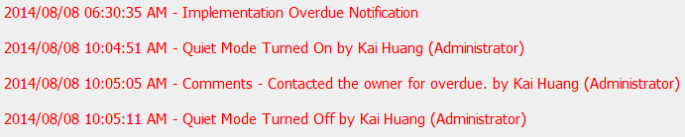
Champion Conversations
Other Escalation Concerns
Better Picture:

Slide 19
CAR Reviews

Slide 20
CAR Reviews
Teams and CAR Numbers for review
Asia Team for meeting on September 17
Tony Hsu, Erica Qin, Motomu Kawano, Samantha Bang
CAR #s: 143913471, 143912892, 143913016, 143913473
NA Team for meeting on September 15
Tovia Bat-Leah, Jeff Lietz, Kathy Lindstrom
CAR #s: 143913123, 143912892, 143913435, 143913094
EULA and NA Team for meeting on September 15
Matthew Marotto, Barbara Scala, Mel Fehrenbacher
CAR #s: 143913123, 143913471, 143913421, 133912513

Slide 21
THANK YOU

