Slide 1
CAR Champion Calibration
September 23, 24 and 28 2015
For questions or comments, please contact Cheryl Adams

Slide 2
Topics
New Project Search Tool
Closed – Awaiting Verification CARs
Champion Conversations
Management Path – Check for updates
Root Causes
CAR Reviews

Slide 3
New Project Search Tool:
Help for FAQ #25

Slide 4
New Project Search Tool
Background
Initial focus is on FAQ 25, Repeat CAR issues – currently Communication of Scope and Standard, Edition, and Date
In reaction to a local CAR for one of these issues, it became apparent there was nothing in place to
Identify all areas of Manager’s responsibility, or
Provide a uniform way of identifying specific work needing to be reviewed by Managers
Tools were made to assist with this. Both tools are located on the Quality Dashboard as Managers Workload in the IQA section.

Slide 5
New Project Search Tool
As opened, the link defaults to an ePro search tool where users are prompted to enter either:
A manager’s name (preferred)
Department number(s)
Once run, a report of all projects which could have been affected by the finding can be obtained by clicking on the Managers name in OBI.
The list of projects returned will be for the prompt date range
Date range by default is from the first of the year to the last date of the previous month

Slide 6
New Project Search Tool
The tool:
Enables auditors to quickly identify the volume of projects a Manager needs to work with to comply with FAQ 25
Enables us to attach a downloaded list of projects to the resulting CAR to help Operations deal with the issue quickly

Slide 7
New Project Search Tool
When audited staff are using FLEX instead of ePro, similar reports can be made except we can’t search the data by Manager’s name and have to rely on department numbers.
Once departments are identified, detailed list of projects can be made by clicking on the department number link in OBI.

Slide 8
New Project Search Tool
There is an additional use of the ePro report for auditors:
If they run it prior to doing an audit, they will know which YEAR-MO was most productive for a team, which is where it’s expected there could be more errors due to our heavily manual processes.
This is a point in time from where one might want to start sampling projects.

Slide 9
New Project Search Tool
If you have questions, please contact James Kurtz.

Slide 10
Closed – Awaiting Verification CARs

Slide 11
Closed – Awaiting Verification CARs
The number of CARS awaiting verification is growing:
Please verify your CARs!
Two ways to view your CARs:
View CARs “by CAR Administrator”
Create an Excel spreadsheet using GCAR Metrics to get a list of your CARs

Slide 12
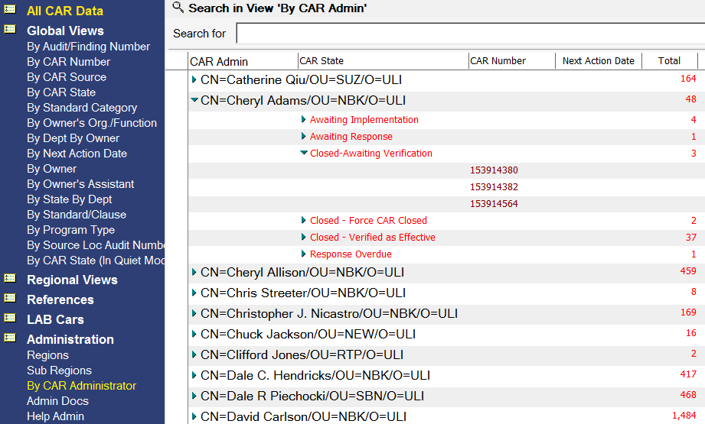
Closed – Awaiting Verification CARs
By CAR Admin:

Slide 13
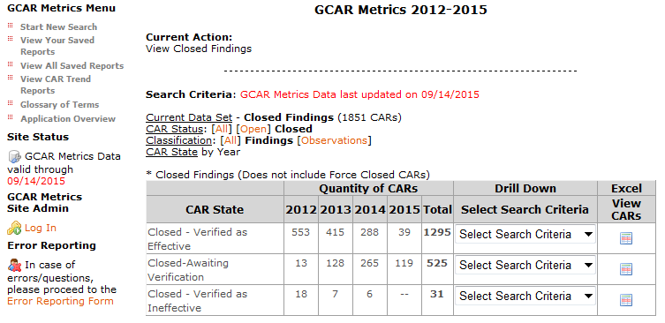
Closed – Awaiting Verification CARs
GCAR Metrics:

Slide 14
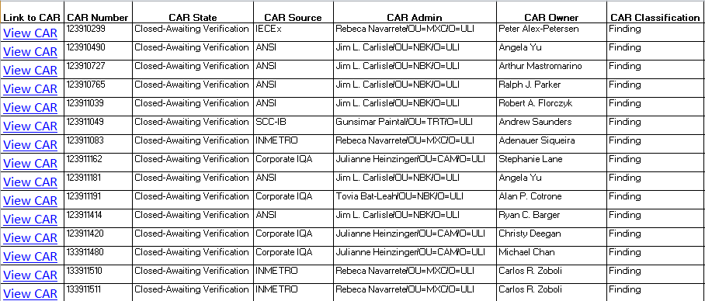
Closed – Awaiting Verification CARs
Excel Spreadsheet:

Slide 15
Champion Conversations

Slide 16
Champion Conversations
Management Path
Considerations
Organizational changes
=
Management Path changes
Did you know…

Slide 17
Champion Conversations
Management Path
Considerations
When a CAR exhausts the management escalation path, Joe Taylor will:
Contact the CAR owner and/or CAR owner’s management
Facilitate getting the CAR back on track
Notify the executives who have been removed from the management path as needed
What happens when the escalation path
is not correct/current?

Slide 18
Champion Conversations
Management Path
Considerations
Recently, a meeting was held with a CAR owner’s management to discuss 8 overdue or escalated CARs
Because the CAR owner’s management had changed, they were not aware of the escalations
They had not received the GCAR escalation notifications
What can CAR Champions do
to help prevent this from happening?

Slide 19
Champion Conversations
Management Path
Considerations
What can CAR Champions do to help ensure the management path is current?
Review the management path to ensure it is current whenever a CAR becomes overdue or escalates.
Other suggestions???

Slide 20
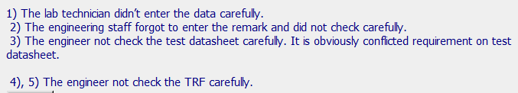
Champion Conversations
Root Causes
Assess this root cause:

Slide 21
Champion Conversations
Root Causes
Assess this root cause:

Slide 22
Champion Conversations
Root Causes
Assess this root cause:

Slide 23
Champion Conversations
Root Causes to further explore
Person is no longer an employee of UL
Human Error
Training
Knew the requirement but chose not to follow it
This shouldn’t be a CAR
A restatement of the problem
A statement of a symptom

Slide 24
CAR Reviews

Slide 25
CAR Reviews
Teams and CAR Numbers for review
Asia Team for meeting on September 25
Ravi V, Paul Ip, Thomas Kestner, Kila Yang
CAR #s: 153914559, 153914404, 153914965, 153914624
NA Team for meeting on September 28
Jeff Follett, Sarah Escosa, Gunsimar Paintal, Jenni Murrill
CAR #s: 153914559, 153914329, 153914896, 153914905
EULA and NA Team for meeting on September 23
Mel Fehrenbacher, Barbara Scala, Brian Mahoney, Paul Mouawad
CAR #s: 153914404, 153914329, 153914664, 153914685

Slide 26
THANK YOU

