Slide 1
CAR Administrator Calibration
IMPORTANT
During the call, DO NOT use HOLD because the music will interrupt the call. Use MUTE.
December 2, 2011
For questions or comments, please contact Cheryl Allison

Slide 2
Topics
Root Cause Example
CAR Admin Changes for 2012
CAR Admin Responsibility
CAR Reviews
Results: Assessment of CAR Admin Process/ Activities

Slide 3
ROOT CAUSE EXAMPLE

Slide 4
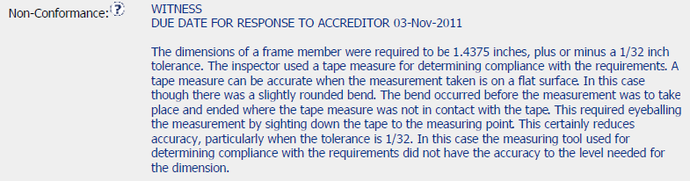
Root Cause Example
Assess the Root Cause given for this CAR:

Slide 5
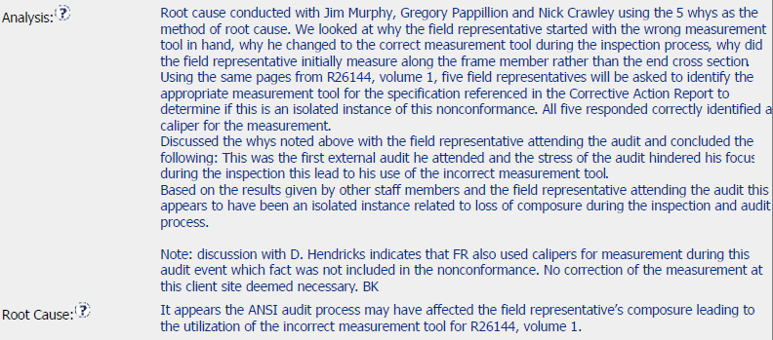
Root Cause Example, cont.
Assess the Root Cause given for this CAR:

Slide 6

Root Cause Example, cont.
Concerns:
Unless there was something done improperly by the auditor or during the audit process, this is not acceptable
Being nervous is not an acceptable root cause
More analysis is needed to determine why the nonconformance occurred
Be aware of similar Root Causes and request that the CAR Owner investigate further

Slide 7
Update for 2012: CAR Admin Responsibility

Slide 8
CAR Admin Responsibility: Update for 2012
The following change for CAR Admin responsibility will be effective January 1, 2012:
For all IQA Audits
The IQA auditor will be the CAR Admin for all Finding CARs they write for an audit
Observation CARs will continue to be administered per the CAR Admin Responsibility Matrix
Finding CARs not written by an IQA auditor will continue to be administered per the CAR Admin Responsibility Matrix

Slide 9
CAR Admin Responsibility: Update for 2012
Effective January 1, 2012:
Auditor | CAR Admin
 | Finding | Observation
IQA | IQA | No change. Per the CAR Admin Responsibility Matrix
Other than IQA | No change. Per the CAR Admin Responsibility Matrix | No change. Per the CAR Admin Responsibility Matrix

Slide 10
Update for 2012: CAR Reviews

Slide 11
CAR Reviews
Each CAR Admin will receive between 1-4 CAR Reviews
Part of our continuing effort to ensure consistency and proficiency with CAR Admin duties
This is a corrective action for a CAR received for the CAR process for CAR Admin inconsistency
Requested by CAR Admins from the CAR process assessment
To be coordinated by Cheryl Allison
Example of items to be reviewed included in FAQ 32 on the CAR website

Slide 12
Results: Assessment of CAR Admin Process/Activities

Slide 13
Results: Assessment of CAR Admin Process/ Activities
Thanks for your feedback!
We will individually contact those who had specific concerns.
34 of 45 (75%) CAR Admins solicited provided responses
The following summary charts show responses where two or more people responded similarly. The “#” column indicates the number of people having that response
Actions for feedback follow the summary charts

Slide 14
Results: Assessment of CAR Admin Process/ Activities
Communicating with CAR Admins
# | What has worked well? | # | What needs improvement? | # | What should be discontinued?
11 | Emails | 5 | KMS/Discussion forum/Phone tree |  | No suggestions
4 | FAQ's | 2 | Corporate QE Support
4 | Corporate QE Support | 2 | More examples of Good/Bad CARs
4 | Other CAR Admins
3 | Calibration Sessions
2 | IM's and Phone Calls

Slide 15
Results: Assessment of CAR Admin Process/ Activities
CAR Admin Calibration Sessions
# | What has worked well? | # | What needs improvement? | # | What should be discontinued?
11 | Common understanding/ consistency | 3 | Review common CAR Admin problems/ difficulties/ mistakes | 2 | Reading aloud the slides by the CAR Admins
6 | Relevant; well developed and presented | 2 | Earlier notification of sessions to fit schedules
5 | Sharing ideas and experiences | 2 | Make presentations available in KMS and to those unable to attend
5 | Presentation available before and after session | 2 | Merge sessions with other regions/ share concerns from other sessions
4 | Real examples | 2 | Interactive discussion to get CAR Admin input for value added/non-value added
4 | Discuss issues and changes

Slide 16
Results: Assessment of CAR Admin Process/ Activities
Training and Mentoring
# | What has worked well? | # | What needs improvement? | # | What should be discontinued?
16 | Having a mentor; other CAR Admins | 3 | Standard training material for CAR owners |  | No suggestions
3 | Training is systematic | 2 | CAR Admin qualification process is too long
2 | Locating mentors & trainees in same region

Slide 17
Results: Assessment of CAR Admin Process/ Activities
Other
# | What has worked well? | # | What needs improvement? | # | What should be discontinued?
3 | CAR reviews; Reviews by Corporate QE | 3 | More information on metrics use and metrics site |  | No suggestions
2 | FAQ's | 3 | Provide group CAR training by reviews; more reviews; best practices
 |  | 2 | Reach all possible CAR owners with training

Slide 18
Results: Assessment of CAR Admin Process/ Activities ACTIONS:
Communicating with CAR Admins
What needs improvement? | Action
KMS/Discussion forum/Phone tree | Will task those who suggested this with implementation
Corporate QE Support | Will address with the respondents
More examples of Good/Bad CARs | Will be an agenda item for calibrations and done by the CAR Admins

Slide 19
Results: Assessment of CAR Admin Process/ Activities ACTIONS:
CAR Admin Calibration Sessions
What needs improvement? | Action
Review common CAR Admin problems/ difficulties/ mistakes | Will continue to do this and include as a part of the Good/Bad CAR examples.
Earlier notification of sessions to fit schedules | Will check with RQMs for potential conflicts. CAR Admin must ensure their Outlook Calendar is current.
Make presentations available in KMS and to those unable to attend | Currently provided with meeting invitation and on the CAR website.
Merge sessions with other regions/ share concerns from other sessions | All CAR Admins will be invited to attend all calibration sessions (as an optional attendee for meetings not in your region).
Interactive discussion to get CAR Admin input for value added/non-value added | Will be done as a part of the KMS forum suggestion.
What should be discontinued? | Action
Reading aloud the slides by the CAR Admins | Will address with the respondents.

Slide 20
Results: Assessment of CAR Admin Process/ Activities ACTIONS:
Training and Mentoring
What needs improvement? | Action
Standard training material for CAR owners | Currently exists - see FAQ 15 on CAR website. Training CAR owners is a part of the CAR Admin responsibilities.
CAR Admin qualification process is too long | Timing depends on both the availability of CARs and trainee's progress.

Slide 21
Results: Assessment of CAR Admin Process/ Activities ACTIONS:
Other
What needs improvement? | Action
More information on metrics use and metrics site | Previously done during calibration sessions. Will be done as changes are made to the site. Contact us if you have specific questions.
Group CAR training by reviews; more reviews; best practices | Will implement CAR reviews for all CAR Admins.
Reach all possible CAR owners with training | Will be accomplished through the individual CAR Admin for CAR owners.

Slide 22
THANK YOU.

