Slide 1
CAR Administrator Calibration
IMPORTANT
During the call, DO NOT use HOLD because the music will interrupt the call. Use MUTE.
November 26, 2012
For questions or comments, please contact Cheryl Allison

Slide 2
Topics
Reminders
- Completing/Reviewing CAR fields
- Clearly state rationale for “containment not required”
Requirement Change: Program and Process Owners as Optional Recipients
New CAR Tool: Evaluation stage
Good CARs, Bad CARs

Slide 3
REMINDERS

Slide 4
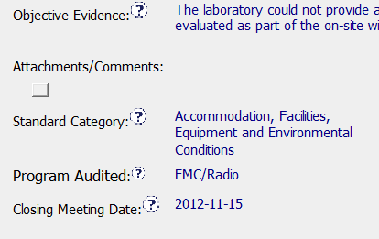
1. Completing/Reviewing CAR fields
Be mindful when completing and reviewing CAR fields
Several CARs have the “Standard Category” incorrectly identified. This field is completed by the CAR Originator. Review this prior to assigning the CAR to the CAR owner.

Slide 5
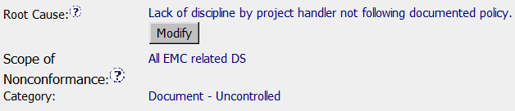
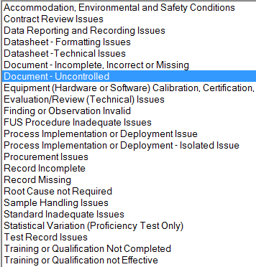
1. Completing/Reviewing CAR fields, cont.
Ensure that the “Category” – which means ‘Root Cause’ Category – reflects the root cause statement.

Slide 6
2. “Containment not required”
Containment is required for all Finding CARs. If there is an exception and containment is not required:
Clearly state the rationale for not having containment
Include the rationale in the “Corrective Action Plan” section
If containment is not required and the rationale has been stated in the Corrective Action Plan section, then a milestone for containment is not needed because there is no containment

Slide 7
REQUIREMENT CHANGE: Program and Process Owners as Optional Recipients

Slide 8
Requirement Change: Program and Process Owners as Optional Recipients
It is still preferred that Program and Process Owners are included as Optional Recipients for CARs. However:
Program/Process Owners are sometimes not defined
Some Program/Process Owners may ask to not be included as Optional Recipients
Include Program/Process owners as Optional Recipients:
When you can identify who they are
It is ok to take them off if they request to not be included as Optional Recipients
Note that GCAR Metrics provides them with useful data

Slide 9
NEW CAR TOOL: Evaluation Stage

Slide 10
New CAR Tool: Evaluation Stage
A potential new CAR tool is under evaluation – JumpStart.
UL Technology Services has selected JumpStart as a self-service application tool
If JumpStart is selected, it is anticipated that IT would develop the CAR application
No final decision has been made – this is still in the evaluation stage
Evaluation will continue for the next several weeks

Slide 11
Good CARs: Bad CARs

Slide 12
Good CARs: Bad CARs
Teams and CAR Numbers for review
Asia Team for meeting on November 30
Ronald Tse, Ravi V, Jacky Wu, Kila Yang, Motomu Kawano
CAR #s: 123911157, 123910338, 123910554, 123910354
NA Team for meeting on November 29
Mark Jessen, Michelle Lee
CAR #s: 123910809, 123910792, 123910360, 123910120
EULA and NA Team for meeting on November 29
Kyle Huang, Matthew Marotto, Alan Purvey
CAR #s: 123910307, 123910427, 123911101

Slide 13
THANK YOU.

