Slide 1
CAR Administrator Calibration
December 9, 2013
For questions or comments, please contact Cheryl Allison

Slide 2
Topics
Buy & Pay: Category for Observation CARs
Working With Remote CAR Owners
Champion Conversations
CAR Reviews
“CAR Stars”

Slide 3
Buy & Pay: Category for Observation CARs

Slide 4
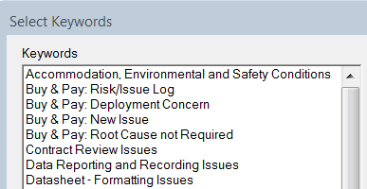
Buy & Pay: Category for Observation CARs
Root Cause Category for Observation CARs
“Buy & Pay: Root Cause not Required”
Processing for Buy & Pay observation CARs is the same as other observation CARs.

Slide 5
Working With Remote
CAR Owners

Slide 6
Working With Remote CAR Owners
CAR Owners may reside at a different location than yours. Among the challenges are:
Time zone differences
Means for communicating
Language differences
Cultural differences
What are strategies that you have used to overcome this challenge?
What have you tried that did not work well?

Slide 7
Working With Remote CAR Owners
Strategy:
Phone call to owner to introduce myself and let him/her know I’ll be scheduling a meeting
TIP:
Some work (stakeholder meetings, response development meetings, etc.) will need to be carried out remotely in the evening. While this sounds like no fun, it is far better than endless e-mail chains and needless CAR extensions.

Slide 8
Working With Remote CAR Owners
Strategy:
Schedule an on-line meeting with Lync, using the owner’s schedule availability in Outlook.
TIP:
Ask the CAR Owner their preference on how they want to work – telephone, email, Lync, real time meeting.
Telephone / Lync is useful for getting to know the other person - establishing an initial rapport.

Slide 9
Working With Remote CAR Owners
Strategy:
Probably the best proactive strategy is to enlist the help of the LQM from the very outset.
TIP:
This does not relieve the CAR Champion from leading the meetings, but is invaluable when Owners/Stakeholders need assistance and support.
Add the LQM as Optional Recipient. Send an email to the Owner recommending him/her to work with his/her LQM, copying the LQM, but always reminding him/her that you are available for support.

Slide 10
Working With Remote CAR Owners
Strategy:
Understanding that cultural differences are key and can play a significant role during meetings.
TIP:
Use LQM to clarify instructions if language is an issue (e.g., understanding).
My experience is that understanding is enhanced in written form where each person may better interpret writing and examples.

Slide 11
Working With Remote CAR Owners
Strategy – Other Situations:
New accreditor CARs with a defined due date (no time to waste)
TIP:
Typically, if a time zone problem, I send an email with pertinent details and CAR link to both the suggested owner and the LQM, or
Call the suggested Owner, leave message, follow-up with email.

Slide 12
Working With Remote CAR Owners
Strategy – Other Situations:
One week before response or milestone due date
TIP:
Send an email to CAR Owner when the notification of 1 week to answer is received offering my support, if needed.

Slide 13
Working With Remote CAR Owners
Strategy – Other Situations:
Something is not in compliance
TIP:
I look for the Owner or the LQM on Lync and discuss the issue.
If they are not available, I write an email explaining the findings and establish a final date to answer.

Slide 14
Report Tools to Assist
CAR Owners and CAR Champions

Slide 15
Report Tools to Assist CAR Owners and CAR Champions
There are two new report tools to assist with finding projects for use during owner and final verification activities
Test locations – CAR 123911039: Missing or incorrect test locations on the datasheet
Selects projects which have had in-house lab work or one of the DAP programs with the exception of some WTDP that is not covered by DAP.
ECD/TAT/PP Letters – CAR 123911191: ECD, TAT or PP letters missing from eComm

Slide 16
Report Tools to Assist CAR Owners and CAR Champions
The reports are a framework to identify projects that were completed after the corrective action was completed, thus giving the CAR owner or champion an opportunity to review work done to verify effectiveness
If problems still exist, the reports may help identify the scope of the ineffectiveness
Each report allows selection of a timeframe

Slide 17
Report Tools to Assist CAR Owners and CAR Champions
Access the reports from the Quality Dashboard

Slide 18
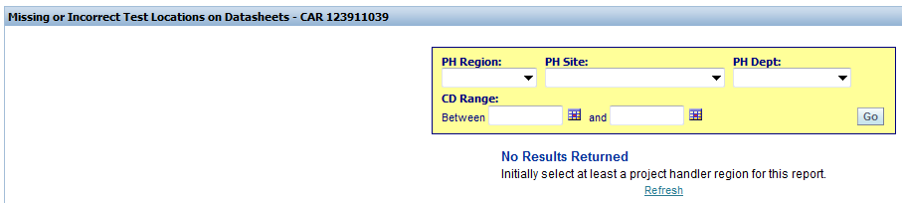
Report Tools to Assist CAR Owners and CAR Champions
For both Test Locations and ECD/TAT/PP Reports:
Select:
Required: PH Region
Optional: PH Site, PH Dept – Project Handler Region, Site, Department
Optional: CD Range – Completion Date Range. If dates are not selected, everything posted in the region after July 1 will be returned (not a good idea)

Slide 19
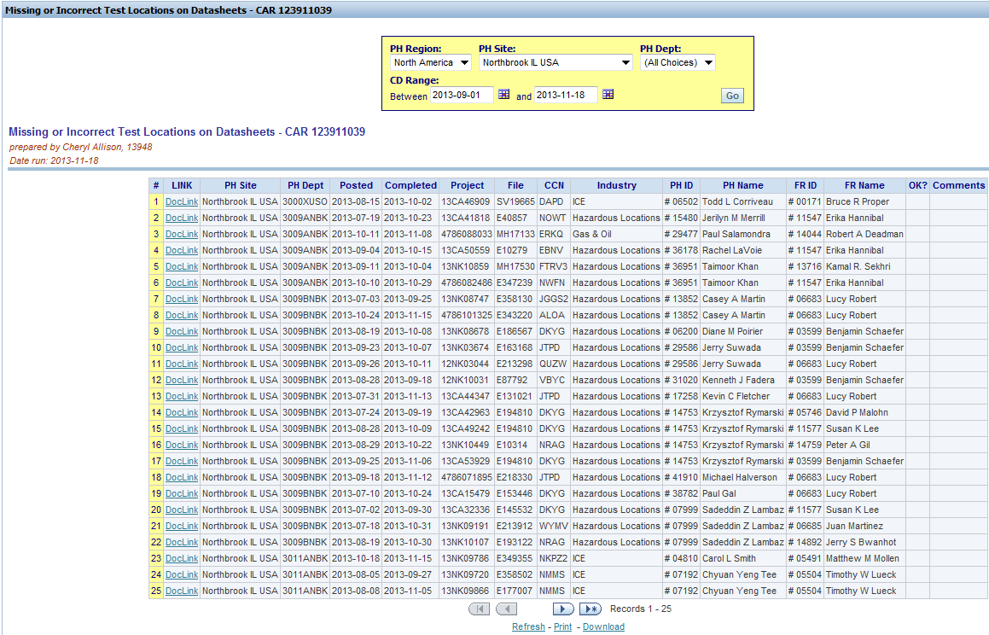
Report Tools to Assist CAR Owners and CAR Champions
Sort Order
1st
2nd
3rd

Slide 20
Report Tools to Assist CAR Owners and CAR Champions
Additional CAR Analysis Tools
Departments Servicing CCN’s – Searches for activity in eProduction based on the CCN. Return is location/department based rather than on projects conducted.
CCN’s for PDE’s – Selecting PDE(s) will return all CCN's they are responsible for in the CTR.
CCNs for Standard(s) – Selected standard(s) will return all CCN's referencing the standard(s) according to the CTR. Results include the full CCN description, the name of the PDE involved and the full standard name.
Standards for CCN(s) – Selecting "base" CCN(s) to search by will return all standards referenced by the CCN(s) in the CTR.

Slide 21
Champion Conversations

Slide 22
Champion Conversations
What are “Champion Conversations”?
Fellow CAR Champions sometimes share things regarding our role: items of interest, concern, or praise
Many of these items are worthy of discussion and sharing with the CAR Champion team as they may add value to our performance.
“Champion Conversations” is one forum that will be used for sharing and discussing these items.
Time permitting, the calibration meetings will include “Champion Conversations”.

Slide 23
Champion Conversations
“Cool” Tool
CAR Champion provides a tool to assist with extending CARs for 30 days or less!
It takes into consideration and adjusts for:
Weekends
# of days in the month
Tool is located on the Quality Dashboard

Slide 24
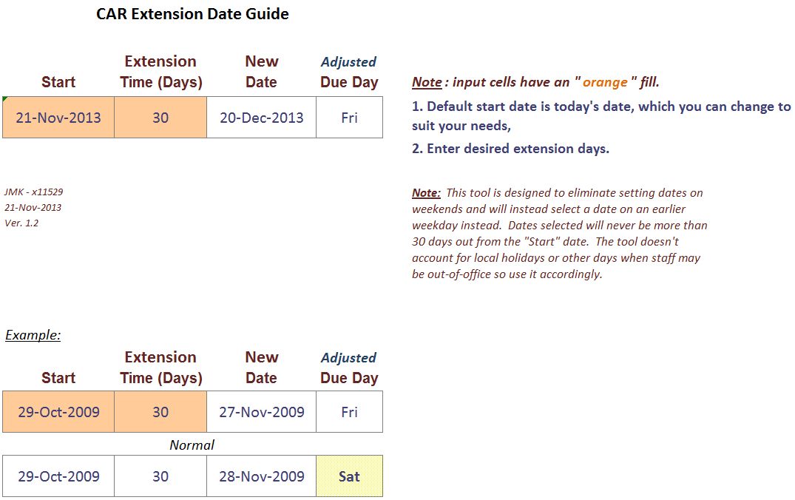
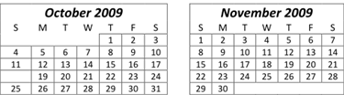
Champion Conversations

Slide 25
Champion Conversations
Tips for extending 30 days
Make date for the next month, one day less than today’s date, e.g.,
If today is Dec. 23, make the due date Jan. 22
If you made it Jan. 23, it would be 31 days
Avoid due dates that fall on:
Weekends
Holidays

Slide 26
Champion Conversations
Other Tips
Extending after overdue and escalation
The original date has passed and the new date must be in the future
Extend the date no more than 30 days from today’s date
If an extension of greater than 30 days from today’s date is desired, it must be approved by the CAR process owner (per our usual requirements)

Slide 27
Champion Conversations
Other Tips
Adding New Milestones
Existing milestone dates may need to be changed to accommodate actions required by a new milestone
Extend existing milestone dates by no more than 30 days from their current due date
If an extension of greater than 30 days from today’s date is desired, it must be approved by the CAR process owner (per our usual requirements)

Slide 28
Champion Conversations
Discussion
Force Close, Delete, or Verify?
When is it appropriate to
Force Close a CAR?

Slide 29
Champion Conversations
Discussion
Delete a CAR only if the following is true:
The CAR does not have a CAR number and was either created in error or is invalid.
If the CAR has a CAR number, the CAR must never be deleted. All CAR numbers should be traceable and no CAR numbers should be missing from GCAR.
The CAR may possibly be force closed.
One example of a CAR being created in error would be a duplicate CAR for the same issue.
One example of an invalid CAR would be that there is no requirement for the nonconformance cited.

Slide 30
Champion Conversations
Discussion
Force Close a CAR only if one of the following is true:
The CAR does have a CAR number and was either created in error or is invalid.
The CAR is an “Opportunity for Improvement” observation CAR and the CAR owner chooses to not act on the opportunity.
A company initiative exists that will address the nonconformance and no action is required within the CAR, i.e., no containment, no fixing of the objective evidence, etc.

Slide 31
Champion Conversations
Discussion
Force Close a CAR only if one of the following is true, continued:
The CAR process owner requests that a CAR be force closed due to a special situation.
Always include an explanation as to why the CAR is being force closed in either the analysis section or as a comment that goes in the CAR history.

Slide 32
Champion Conversations
Discussion
Never Force Close a CAR if:
Never force close an accreditor CAR that requires a response even if we think it is not a valid CAR.
Never force close an IQA CAR without approval in writing from the CAR process owner (Denise Echols), Cheryl Allison, or the auditor who wrote the CAR. Be sure to attach the approval to the CAR.

Slide 33
Champion Conversations
Discussion
Verify a CAR if:
Actions are taken within the CAR, e.g., containment actions, training, objective evidence fixes, etc.
These CARs should neither be deleted nor force closed.
Once the actions are complete, close the CAR and verify the CAR as effective noting special situations such as:
Long-term solutions being addressed by a different CAR
CAR process owner approval to close CAR due to management or other decisions

Slide 34
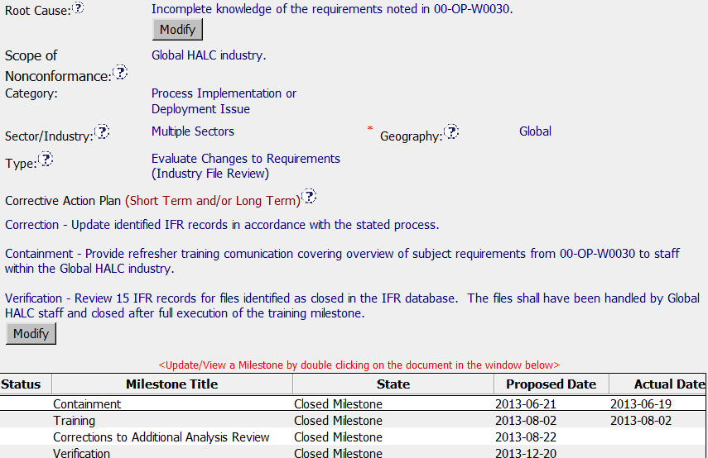
Can this CAR be deleted? Force Closed?

Slide 35
Champion Conversations
Discussion
Changing Accreditor CAR
Findings to Observations
Is it ever appropriate
to do this?

Slide 36
Champion Conversations
Discussion
Changing an Accreditor Finding CAR to an Observation:
If the Accreditor issues a Finding, the CAR must be addressed as a Finding.
Discussions of CAR classification should be addressed with the Accreditor prior to CAR issuance whenever possible.
If the Accreditor issues an Observation, we may go beyond the Accreditor requirement and issue the CAR as a finding if we have reason to believe there is a greater concern.

Slide 37
CAR Reviews

Slide 38
CAR Reviews
Teams and CAR Numbers for review
Asia Team for meeting on December 10
Tony Hsu, Simy Li, Samantha Bang, Catherine Qiu, Motomu Kawano
CAR #s: 133911950, 133912143, 133911586, 133911755, 133911765
NA Team for meeting on December 12
Tovia Bat-Leah, Jim Oates, Jeff Lietz
CAR #s: 133911731, 133911833, 133911586, 133912110
EULA and NA Team for meeting on December 11
Matthew Marotto, Rebeca Navarrete, Jim Kurtz
CAR #s: 133912537, 133911833, 133911755, 133911497

Slide 39
THANK YOU

