Slide 1
CAR Champion Calibration
December 11, 2014
For questions or comments, please contact Cheryl Allison Adams

Slide 2
Topics
Global CARs
CAR Surveys
Champion Conversations
CAR Reviews
“2014 CAR Stars”

Slide 3
Global CARs

Slide 4
Global CARs
What is a Global CAR?
One whose nonconformance:
Involves more than one function, business unit, and/or location
Has repeat issues that have not been fully addressed
Would benefit from an investigation and resolution provided by a cross-functional team of business and quality experts

Slide 5
Global CARs
What qualifies as a Global CAR?
Previous CARs attempted to address the issue but the resolutions were not effective or only partially effective. This may be indicated by a CAR being verified as ineffective.
The impact is significant for UL and widespread throughout the company. It may impact UL customers, accreditations or business effectiveness.
Multiple CARs may exist that cover various aspects of one process. The concerns may be more completely and effectively addressed by one comprehensive CAR that includes representation for all stakeholders and functions.

Slide 6
Global CARs
The CAR Process Owner:
Decides what will become a Global CAR.
Approves the direction of the global CAR team and empowers them to conduct a detailed analysis and provide recommendations for nonconformance resolution.
Ensures that the team is composed of the various subject matter and quality experts needed.

Slide 7
Global CARs
Global CAR Process
The CAR team performs detailed data analysis.
The true root cause(s) and the scope of the concern are determined
Corrective actions are established
The CAR may be created as the result of a previous CAR that was verified as ineffective or may be created as a new CAR

Slide 8
Global CARs
Global CAR Process, cont.
There may be new or existing CARs that fall within the scope of the Global CAR.
The CAR owner must perform an analysis that indicates the CAR is a part of the scope of the global CAR. If the concern fits within the scope of the global CAR, the analytical information is presented to Quality Engineering (Chris Nicastro) for approval to be treated as a part of the global CAR.
NOTE: There must be evidence provided that clearly shows the CAR is within the scope of the global CAR. No CAR will be accepted without this evidence being provided.

Slide 9
Global CARs
Global CAR Process, cont.
CARs that are within the scope of the global CAR are treated as observations and point to the global CAR for the long-term resolution.
NOTE: This does not mean that the classification of the CAR is changed from “Finding” to “Observation”. It means that a Finding CAR is treated as an observation and includes an explanation providing the rationale.

Slide 10
Global CARs
Global CAR Process, cont.
A thorough final verification of the effectiveness of the corrective actions is performed by members of the CAR team.
The verification must include data covering the entire scope of the concern – all functions, business units, locations, etc. that were identified.
The verification must also include evidence that each root cause was effectively addressed.

Slide 11
Global CARs
Projects currently under review
Standard, Edition and Date
Determine use of Standard/Edition/Date within the project handling process and where inconsistencies are currently found that result in non-compliances with the requirements of 17065 and 17025. Propose and implement process revisions to address inconsistencies.
Communication of Scope
To reduce or eliminate findings regarding missing communications of scope of investigation to customers.
DAP Client Scope
Reduce the number of DAP projects we accept with tests that are not within the client’s scope.

Slide 12
Global CARs
See CAR website revised FAQ #25 for updates:
New Global CARS
Updates to existing Global CARs
Instructions for new CARs that are within the scope of the existing Global CARs

Slide 13
CAR Surveys

Slide 14
CAR Surveys
CAR Surveys were distributed two ways:
Manually sent to a group of CAR owners who had CARs close in the 2nd and 3rd quarters 2014
A survey link is included in the email when a CAR becomes “Closed – Awaiting Verification”
Following are CAR survey metrics and specific comments for higher and lower ratings for each survey question (as of November 14, 2014)

Slide 15
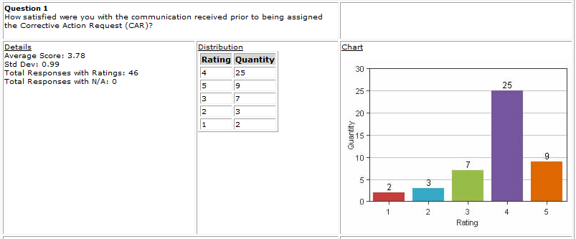
CAR Surveys
Rating: 1 or 2 | Rating: 5
i needed to find myself someone to understand what the CAR was about I manage staff in multiple offices. In my local office I am very aware of CARs but not so much when I am assigned a CAR from an office where I am not present. The issues noted in the CAR could have been addressed prior to being issued saving a lot of wasted time and resources. CAR should have never been issued to begin with. One of my CAR's would have made more sense to go to the PDE. | It is always helpful to have direct communication from the auditor to fully understand the finding of the CAR. An explanation of CAR and the relevant requirement was provided. I have had excellent communication with our Quality team throughout all my CAR processes. Jennifer Murrill and Julie Heinzinger created the last few I have addressed. They communicated the issue clearly, listened to my feedback and worked with me all along the way.

Slide 16
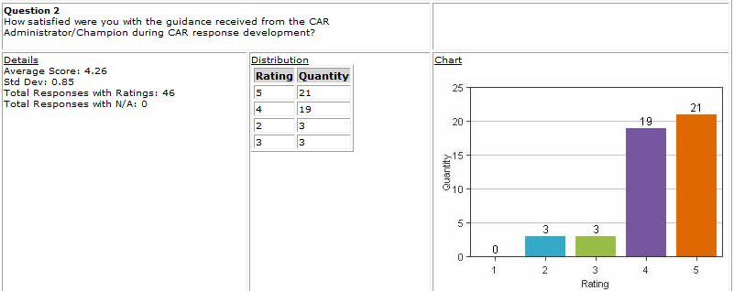
Rating: 1 or 2 | Rating: 5
attitude of Police and follow a procedure instead of using common sense | I use Michelle Lee from the Camas Office Quality as my Owners Assistant on most CARS assigned. She helps guide me through the process from start to finish. Her ability to objectively look at the situation and help with the resolution and milestone development is outstanding. Jenni Murrill is awesome! Jim (Carlisle) helped me throughout the process I have found that all the CAR Admin are helpful, you just have to ask they are more then willing to help you document your CAR in the best manner. Julie Heinzinger has is very knowledgeable in the process and provided a great supports to me in analyzing the finding, thus leading to a very thorough action plan. I consulted with Mark several times. He was very responsive and consultative; and helped make the response development not a big deal. I also like his attitude that this was about improving UL's business quality rather than fixing a broken process. Depends on the champion. Some are very active and helpful, others you never here from them. Jim Oates is very helpful. Again this was my first and it had escalated, but everyone was very helpful in explaining process and procedures

Slide 17
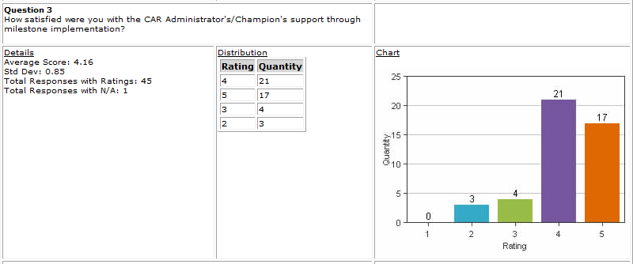
Rating: 1 or 2 | Rating: 5
There is often a disagreement on what is required for each milestone. A large amount of time is spent discussing and coming to agreement, which results in delays in completing the CAR. In some cases the CAR Administrator will hold the CAR hostage (which is typically tied to a critical accreditation) making it very difficult to work together for the best interest of all parties | Encouragement and direction was received through the implementation process. Jennifer Murrill is awesome ! I received good feedback and constructive advice on the Milestones. When Jennifer did not feel that the Milestone met the objectives, she met with me to discuss and refine them as we progressed. When events occurred that resulted in my needing to change or reevaluate Milestones, Jenni was very cooperative and understanding. Both Jim Carlise and Julie Heinzinger are very wiling to have calls with me to support me through the milestone implemenations. This is highly appreciated. Again, Mark was responsive and consultative. I felt like he was partnering with me to make things better.

Slide 18
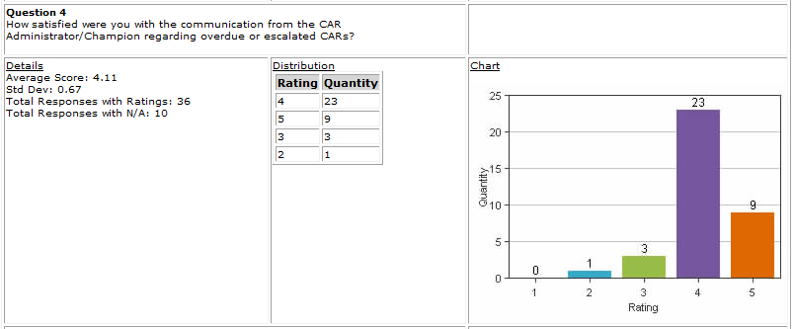
Rating: 1 or 2 | Rating: 4
No comments | I am always made aware when a CAR is overdue or escalated. Support was offered if needed I did not have any CAR's go to overdue or get escalated. Michelle meets with me weekly to review all CAR's in progress and keep them on track. This is an invaluable service she provides. When I do not have active CAR's we use this time to discuss upcoming Quality events or areas for improvement within the lab.

Slide 19
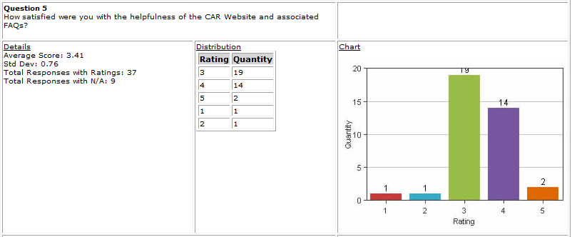
Rating: 1 or 2 | Rating: 3 or 4
No comments | Its really not geared to help you get through a CAR There are too much content to digest. Following the steps, it will take much time to understand those requirements. I did not need to reference the FAQs this time but know they are there to help.

Slide 20
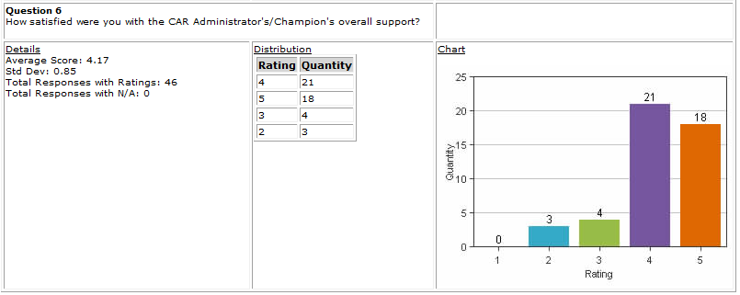
Rating: 1 or 2 | Rating: 5
Same as previous comments | They made the process as painless as possible. Chris is very helpful throughout the entire process of the CAR. It was great working with Mark, and getting advice from Julie. I felt supported, and that we were all on the same team working to make UL better. As mentioned in my comments above, the CAR Administrators are helpful and willing to work & supports me to get the CAR resolve. Special thanks to Dale Hendrick for the great support and guidance. I can't speak highly enough about the partnership that we have developed in the WCD with our Quality Team. Kathy Lindstrom, Jenni, Michelle, and Julie are dedicated to increasing the quality and overall processes in our labs. Having them available as a resource and their willingness to provide guidance and insight whenever requested is paramount to our sucsess. Jennifer Murrill is awesome ! Jim is great. He helps me through any problems I have throughout the process and will work with me to get everything in.

Slide 21
CAR Surveys
Actions based upon Survey results
CAR Champions receive a “CAR Survey Kudos” email that shares with them survey comments that specifically mention their name. Their managers are copied on the email.
The CAR FAQs are being updated to be more user friendly, logically grouped, and more helpful.
Champion Conversations will be used to discuss repeating concerns as well as specific good practices.
Other actions will be taken based upon the feedback provided as appropriate.

Slide 22
Champion Conversations

Slide 23
Champion Conversations
CAR Surveys – Opportunity
“I manage staff in multiple offices.
In my local office I am very aware of CARs
but not so much when I am assigned a
CAR from an office where I am not present”
How might we, as CAR Champions,
overcome this concern?

Slide 24
Champion Conversations
CAR Surveys – Opportunity
Communicating with remote CAR Owners
FAQ #1
Strategies for working with a CAR owner who is remote from your location
• Consider placing a phone call to the owner to introduce yourself and let them know you will be scheduling a meeting to discuss the CAR. This is helpful for establishing initial rapport with the owner.

Slide 25
Champion Conversations
CAR Surveys – Discussion
“The issues noted in the CAR could have
been addressed prior to being issued
saving a lot of wasted time and resources.
CAR should have never been issued
to begin with.”
How might we, as CAR Champions,
address this concern?

Slide 26
Champion Conversations
CAR Surveys:
Great Practices
“When Jennifer did not feel that the milestone met the objectives, she met with me to discuss and refine them as we progressed.”
“Mark was responsive and consultative. I felt like he was partnering with me to make things better.”
“Michelle meets with me weekly to review all CARs in progress and keep them on track. This is an invaluable service she provides.”

Slide 27
Champion Conversations
CAR Surveys:
Great Practices
“Excellent communication”
“Listened to my feedback”
“Worked with me all along the way”
“Helps guide me through the process”
“More than willing to help”
“Very responsive & consultative”
“Encouragement and direction was received”
“Like his attitude”
“Very willing to have calls with me”
“Partnering with me”
“Support was offered”

Slide 28

Champion Conversations
Where did I hear that?
“I know I read that somewhere. I remember we discussed it. But I just cannot find it now!”
Where can I find it?

Slide 29
Champion Conversations
Where did I hear that?
A cross-reference will soon be available to assist with finding topics that have been presented.
CAR FAQ #32 will be updated to include this cross-reference.
Example:
Topic | Locations
Changing an accreditor CAR classification | Calibration meeting Dec 2013 FAQ #2 00-QA-S0006
Extension request considerations | Calibration meeting Oct 2011 FAQ #7 and #8 00-QA-S0006

Slide 30
CAR Reviews

Slide 31
CAR Reviews
Teams and CAR Numbers for review
Asia Team for meeting on December 12
Jacky Wu, Catherine Qiu, Thomas Kestner
CAR #s: 143913625, 143913608, 143913806, 143913651
NA Team for meeting on December 11
Dale Hendricks, Chris Nicastro, Jenni Murrill
CAR #s: 143913608, 143913105, 143913946, 143913176
EULA and NA Team for meeting on December 11
Karl Harland, Jim Kurtz, Kyle Huang
CAR #s: 143913625, 143913105, 143913636, 133912839

Slide 32
2014 CAR Stars

Slide 33
THANK YOU

