Slide 1
Introduction of Agile
January 3, 2010 V 1.0
For questions or comments on the content, please contact Kyle Huang or Denise Echols

Slide 2
Agenda
What is Agile
  Agile Product Lifecycle Management (Agile)
  Introduction of Agile Product Portfolio Management (Agile PPM/PPM)
  Agile Import and Export Format
Current Agile Application in ULE
New Agile Application Being Deployed in Certification Office

Slide 3
Overview of Agile Product Lifecycle Management
Agile was purchased by Oracle. The following is from Oracle web site:
Agile Product Lifecycle Management (Agile PLM) manages the enterprise product record, the single system of record for product information required to maximize profitability throughout the lifecycle. Containing the rich information that uniquely defines all aspects of a product at each stage in its lifecycle, the product record includes all of the information required by the across a global product network to conceptualize, design, source, build, sell, service and dispose of products.
Through a broad suite of best practice, business-ready solutions, Agile PLM provides secure, timely, visibility and control of product information for PLM processes and for stakeholders across a global product network. Agile helps companies accelerate revenue, drive innovation, reduce costs, improve quality, and ensure regulatory compliance throughout the product lifecycle.

Slide 4
Introduction of Agile Product Portfolio Management
Agile product portfolio management (PPM) is a module in agile PLM. It is a web-based application that enables users to manage all aspects of a project or program. PPM is fully integrated with the complete agile PLM suite of products to maintain a centralized view of project records and associated product information within the organization.
Executives use the PPM dashboards to view portfolio data pertaining to all projects or programs. This includes risks such as schedule slips, lack of resources, and project cost that directly contribute to the overall status of the project.

Slide 5
Introduction of Agile Product Portfolio Management
Project or program managers use PPM to:
Create and manage project tasks, resources, and schedules
Assign projects, phases, tasks, and deliverables
Conduct project discussions
Oversee project status
Manage project budgets
Resource pool managers use PPM to:
Manage resource pools
Assigning resources to tasks
Project participants use PPM to:
Manage daily task assignments
Report the completion of tasks
Upload documents
Participate in project discussions

Slide 6
Agile Import Format
The agile import wizard is the tool used to import data into the agile PLM system. The supported formats are:
    Excel workbooks (XLS)
    ?Delimited text files (TXT)
    ?Product data exchange packages (PDX)
    ?Agile XML (or aXML) files

Slide 7
Agile Export Format
Agile PLM provides a simple export wizard to support extracting data from selected objects and export it to a Microsoft excel file, a comma-delimited (CSV) text file, an aXML file, or a PDX package. You can launch the export wizard from either web client or java client. Exporting data is an easy process. After downloading the export file to your desktop, you can either email or FTP it to a supply chain partner or import it into another application.

Slide 8
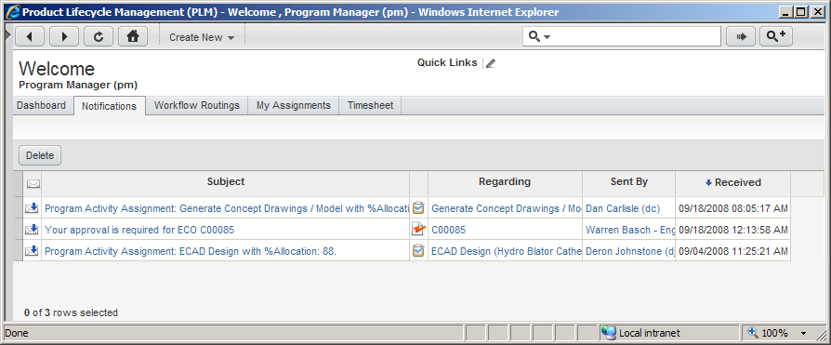
Agile Home Page

Slide 9
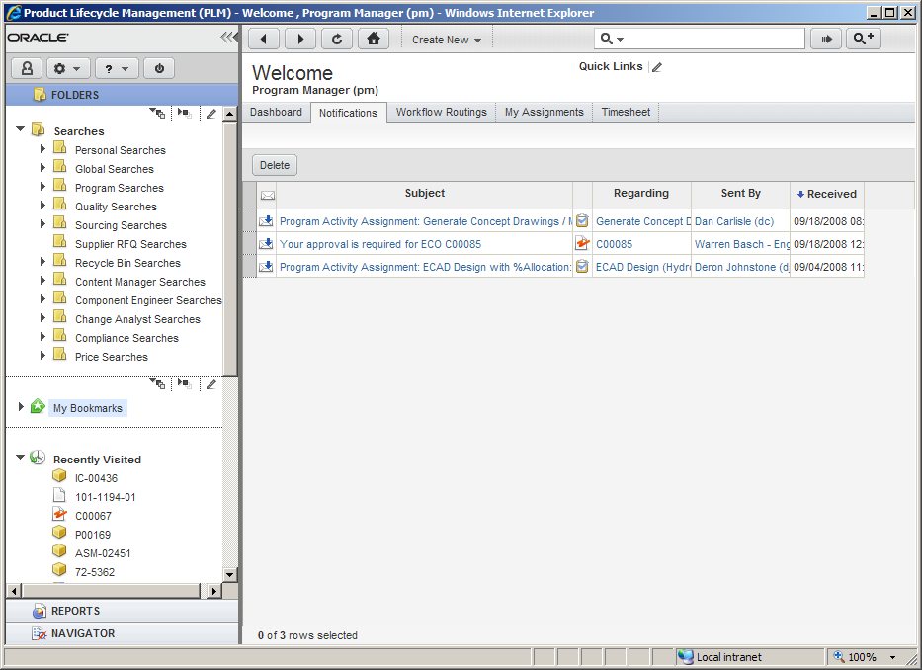
Agile Product Collaboration User Interface

Slide 10
Current Agile Application in ULE
ULE is using Agile for a Product Database and Project Management Tool.
Sales Process
Delivery Process
1.
Identify
2.
Qualify
3.
Bid
4.
Order
5.
Initiate
6.
Execute
7.
Complete
8.
Review
Agile for ULE is focused on the Service Delivery process, but begins with the customer’s Sales Order

Slide 11









Current Agile Application in ULE
ORDER
Release
Model
Change
Product Collaboration
Sales Order
CHANGE AS NEEDED
CIS,
Change Requests
INITIATE
Create Projects & Product Data
RELEASE PRODUCT
EXECUTE
Product Goes Live in Agile and on Website
Conduct Audit & Testing, Update Product Data
REVIEW
Cert.
Process
Change
COMPLETE
CO Review
Finalize Product Results and Make Recommendation

Slide 12
Current Agile Application in ULE
ULE | Agile | Owner
Oracle Sales Order | Sales Order | Commercial
Project (Job) | Master Project | EPM
Sub-Project | Sub-Project | EPM
Product | Model | EPM
ECV, SPC, or EEC | Certification | EPM
Standard | Standard & Results | EPM
Test Results
 | Release Model Change | EPM, Customer
 | Certification Process Change | EPM, CO

Slide 13
Current Agile Application in ULE
Order
Initiate
Execute
Complete
1. Create or Update Sales Order
(Comm.)
3. Update Master Project (EPM)
8. Complete Activities (EPM, Lab, Field Agent)
10. Recommend, Request CO Review (EPM)
4. Create Models (EPM, Customer)
2. Assign Sales Order to EPM
(EPM Owner)
9. Redline Results Data (EPM)
11. Approve or Reject (CO)
5. Model Release Change (EPM, Customer)
12. Complete Project (EPM)
6. Create & Update Sub-Projects (EPM)
7. Associate Model, Cert & Standard to Sub-Projects (EPM)

Slide 14
Current Agile Application in ULE
Model | The physical model from the customer; contains: Model #, Customer, Model Series Attributes (specific per Product Type)
Certification | The details specifying the certification; contains: Certification Listee, Manufacturer, Agents
Standard | The details specifying the standards tested; contains: Standard Information, Version
Results | Captures actual/measured test results about a given standard; contains: Attributes needed to determine if passed/failed for a given standard Example: Recycled Content and its three attributes UL CAS 168 and its ten attributes Pass / Fail Points / Awards

Slide 15
Current Agile Application in ULE
A customer job is a bundle of distinct services to be fulfilled and managed as a single “project” from the customers perspective.
Project (“Job”)
Customer
Order
for Services
Sub-Project 1
Sub-Project 2
Sub-Project 3

Slide 16
Current Agile Application in ULE
Order
Initiate
Execute
Complete
Master Project (“Job”)
Sub Project 1 - ECV Recycled Content for Product A
Sub Project 2 - ECV Volatile Organic for Product A
Sub Project 3 - SPC for Product B
A customer master project is set-up that is linked to the order. Three sub-projects are then set-up for each distinct service to be fulfilled, with linkage back to the master project.

Slide 17
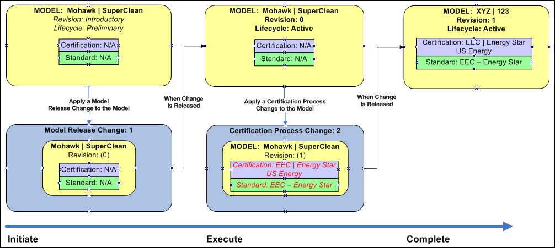
Current Agile Application in ULE

Slide 18
Current Agile Application in ULE
  A Sales Order is a type of Change with a workflow. It is related to the lifecycle of the project.
  A sales order’s information is organized and displayed in tabs containing attributes and fields that describe the change
Sales Order Tabs
Cover Page | Form data that captures all relevant data about the Sales Order
Affected Items | Not currently utilized
Workflow | Displays the Sales Order Workflow
Relationships | Captures the Relationships to other objects, such as the Master Project
Attachments | Stores files associated to the Sales Order, such as the customer’s quote letter
History | Captures the history of the Sales Order

Slide 19
Current Agile Application in ULE
Workflow States | Description | Processes
New Order | Recently created Sales Order | Commercial needs to update the order data (certification, product type, etc.)
Awaiting Assignment | Not yet assigned to an EPM | EPM Owner to assign an EPM
Not Started | Associated Project assigned, but Not Started | Process the Order
In Process | Associated Project in process | Execute the Project
Complete | Associated Project complete | Close Project in UL systems
Canceled | Sales Order canceled | Project cancellation activities
Hold | Sales Order placed on hold | Project hold activities

Slide 20
Current Agile Application in ULE
Assign Sales Order to EPM
What | New Sales Order are routed to the EPM Owner group (Service Delivery Manager) The EPM Owner group then assigns a Sales Order to an EPM
How | Receive email notification or see new Sales Order in Notifications tab Click hyperlink to navigate to Sales Order Click Edit Select Project Manager from list (internal/epm1) Click Save Click Next Status Click Finish
Why | Allows the EPM Owner group to determine who should receive ownership for a project, then notifies the assigned EPM.
Who | EPM Owner group (Service Delivery Manager)
Output | Master Project is created, assigned to the EPM and the Master Project and Sales Order are linked via a Relationship

Slide 21
Current Agile Application in ULE
When the EPM Owner assigns a Sales Order to an EPM, he/she then changes the status of the Sales Order to Not Started
When the Sales Order moves to Not Started, the Master Project is automatically created by the system.
  Note: If the EPM is not assigned, the system will return an error.
The Master Project will be assigned to the selected EPM
Number, Customer and Certifications are also copied to the Master Project.
The Sales Order and the Master Project relationships are established.
  Note: Only one Master Project can be created for a Sales Order

Slide 22
Current Agile Application in ULE
Update Master Project
What | The Master Project represents all of the activity to deliver a customer’s order for services, and can include multiple products and certifications. The project remains in Not Started status until at least one of the activities moves to >0% complete.
How | Receive email notification or see new Master Project in Notifications tab Click Details tab of the project Click Gantt Chart Edit schedule, dependencies, and tasks as needed Click File > Exit, and then Save to keep your changes
Why | Defining the schedule and adding the necessary resources will enable the EPM to properly manage and execute the project.
Who | EPM

Slide 23
Current Agile Application in ULE
  The Master Project houses the Sub Projects and provides the ability to have many Sub Projects associated to a Sales Order
  The Master Projects tabs are:
Project Tabs
General Info | Form data that captures all relevant data about the Master Project
Schedule | Listing of the Project’s Schedule; all activities, milestones and gates related to the full project
Dependencies | For a given Activity, this defines its dependencies to other Activities
Team | Defines who has capability to interact with/edit this Project
Content | Stores the relationships for Projects (to Sales Order, Model Release Change, etc)
Workflow | Details the Workflow for the Master Project (Not Started, In Process, Complete)
Collaboration | Stores any Discussion against the Master Project or its children
Attachments | Stores files associated to the Master Project
History | Captures the actions performed against the Master Project

Slide 24
Current Agile Application in ULE
Sales Order Field | Description
Number | Same as the Sales Order Number
Description | Description of the Master Project
Project State | Defines if the project is Active (available for use) or Proposed (not yet available)
Customer, Customer Sites, Access Groups | Customer associated with order, the locations for this order, and the groups able to see this project
PLM Reference | Field to place Model data related to the Master Project for reporting and searching
Project Manager | Overall owner of the project – defaulted from Sales Order assignment; the PM on the Project

Slide 25
Current Agile Application in ULE
Create a Model
What | The model is the product that ULE analyzes, and is associated to the Master Project.
How | Create new Model: Click Create New > Items > Models Select Product Type from list Enter Model Number and Customer , and click Save (Note that Customer | Model Number is generated automatically) Update the Attribute values at the bottom of the Title Block, and click Save Relate Model to Master Project: Click hyperlink to Master Project in the “Recently Visited” area of the Navigator Click Details View Click Edit From the “Recently Visited” area of the Navigator, drag and drop the Model just created to the PLM Reference field on the Master Project General Info tab Click Save Click the Content tab to verify that the Model appears in the Content tab, along with the Sales Order
Why | Generating the Model during the Master Project will enable the EPM of the Sub-Projects to utilize those Models on their projects.
Who | EPM

Slide 26
Current Agile Application in ULE
Optional
What | The model series relates a set of similar models.
How | Click Edit Click Create New button next to Customer | Model Series field Enter Customer | Model Series and Customer , then click Save
Why | Enables ULE to manage families of products more efficiently over time.
Who | EPM

Slide 27
Current Agile Application in ULE
  An Item’s information is organized and displayed on tabs
    Models have different tabs than Standards
Model Tabs
Title Block | Form data that captures all attribute data about the Model
Changes | Listing of all Pending and Released changes against the Model
Models | Listing of critical components in the Model’s Bill of Material
Certifications | Listing of associated certifications for the Model
Relationships | Stores the relationships to other objects, such as Standards and Projects
Where Used | Lists all Models this current Model is a Critical Component of
Attachments | Stores files associated to the Master Project
History | Captures the actions performed against the Master Project

Slide 28
Current Agile Application in ULE
  An Item’s status is indicated in the header section of the Item
Status | Where Applicable | When its used | Details
Preliminary | Model, Standard | Initial creation of a Model or Standard; Not valid for certification | Requires a release via a Change before becoming Active
Active | Model, Standard | Once released and validated | These can now be used in the certification process
Obsolete | Model | To be used when the customer no longer wishes to maintain this data

Slide 29
Current Agile Application in ULE
Model Release Change, Step 1
What | The Model Release Change controls the release of a new Model, giving the EPM & customer the ability to decide if all of the Model information is complete. A Model is in Preliminary status and has an Introductory revision until this change is complete.
How | Look for the Model Release Change on the bottom of the General Info tab of the Master Project If Model Release Change does not exist, create the Change Click Create New > Sales/Change Orders > Change Orders Select the Type Release Change from the list. Select the Operating Unit, then click Save Enter the Description of Change, Customer and Master Project, then click Save Click the Affected Items tab of the Model Release Change Add the Model to the Change Drag the Model into the Affected Items area or; Click Add then type the first few characters of the Item Number to select the Model Set the end-state Rev and Lifecycle Phase Double-click in the row to enter ‘0’ for the New Rev and Active for the Lifecycle Phase, then click Save
Why | Supports the creation of a Model that is in Preliminary status before the product information is confirmed (and the first Rev is Live).
Who | EPM
Slide <number>

Slide 30
Current Agile Application in ULE
Model Release Change, Step 2
What | The Model is released once the information/attributes are confirmed as correct.
How | To immediately release the Model, click on the Workflow tab of the Model Release Change, then click the Release box. Select Finish. To release the Model through a controlled workflow (e.g., when validating Model info with customer: Change Model to Submit status: Click Next Status Select the Project Manager from the list and click Finish Change Model to Validation status (when being validated by customer): Click Next Status Select the Project Manager from the list and click Finish Release the Model: Click Next Status Select the Project Manager from the list and click Finish Note: Model is now released at Rev 0 an Lifecycle of Active.
Why | Changes the Model status from Preliminary to Active and manages Model information approval process. Also baselines the Model to be used by others during the Certification process
Who | EPM

Slide 31
Current Agile Application in ULE
Model Release Change, Step 3
What | This activity confirms that the EPM has entered all vital information for a product before it is released.
How | Click the hyperlink to navigate to the Master Project Click the hyperlink for the Set up Product data activity Click Actions > Complete Note that the status of the activity is now Complete
Why | This informs the project team that the task is complete and all Model data is ready for use.
Who | EPM

Slide 32
Current Agile Application in ULE
Create & Update Sub-project
What | Sub-Projects are the unique set of tasks to assess a product for a certification (i.e., analyze a TV for Energy Efficiency Certification)
How | Create a Sub-Project: Optional: Update status of Create Sub Projects task in Master Project Click the Create Sub Projects task Click Change Status > In Process, then Finish Navigate to the Master Project General Info tab Click Actions > Create Sub Project for ECV (or other Certification Type) Allow processing to complete, then click Refresh, then Expand All in the Navigator pane Update and Initiate the Sub-Project: Click on the Sub Project in the Navigator pane Optional: Update tasks Optional: Add Team Members – Click on the Team tab, Click Add, Enter the team members, % allocation, and roles, then click Add Add Report Document to Attachments tab To Activate the Sub-Project, click the General Info tab, click Edit, select the Project State Active from the list, and click Save
Why | Individual Sub-Projects are tailored to the needs of the Certification type. Allows for one Certification process to finish before another.
Who | EPM
Slide <number>

Slide 33
Current Agile Application in ULE
  A Certification Process Change is a type of Change because it has a workflow – sequence of statuses - associated with it that governs the change control process
  A Certification Process Change’s information is organized and displayed in tabs containing attributes and fields that describe the change
Sales Order Tabs
Cover Page | Form data that captures all relevant data about the Certification Process Change
Affected Items | The Models and Standards that are being modified and released during the Certification Process
Workflow | Displays the Certification Release Change Workflow
Relationships | Captures the Relationships to other objects, such as the Sub Project
Attachments | Stores files associated to the Sales Order
History | Captures the history against the Sales Order

Slide 34
Current Agile Application in ULE
Workflow States | Description | Processes
Pending | Newly created change | Add Model and Change data
Submitted | Change submitted | EPM validates data is complete/accurate
In Process | Change is in process; Associated Project is being completed | Model/Result data is updated
In Review | Cert Officer is reviewing the data; data is locked down | Cert Officer approves or rejects the submission
Released | Change is released; Model/Standard/Cert data is released | None; data is now “Live”
Canceled | Change is canceled; Updated data is canceled | Determine next steps and data back-out processes
Hold | Change is put on hold | Model data changes are put on hold

Slide 35


Current Agile Application in ULE
Certification Process Change
In Process → Open
Sub Project Execute Gate
Released ← Open
In Review ← In Review
When… | Moves To … | Then ... | Moves To…
Certification Process Change | In Process | Sub Project Initiate Gate | Open
Sub Project CO Review | In Review | Certification Process Change | In Review
Sub Project CO Review | Open | Certification Process Change | Released
At this point, the Certification Process Change and its workflow are related to the Sub Project.

Slide 36
Current Agile Application in ULE
Associate Model, Standard &Certification with Sub-Project, step 1
What | The Model and its planned Certifications and Standards/Results must be associated to the Sub-Project.
How | Add the Model to the Sub-Project Navigate to the Sub-Project, and click Content tab, Add Product by either: Dragging and dropping the Model into the Content tab Click Add by Search; Enter Model Number in Search dialog and select the Model, then click Close
Why | Supports an automated activity to add certifications and standards to the Model in Agile. Also supports reporting on sub-project progress across the portfolio of projects.
Who | EPM

Slide 37
Current Agile Application in ULE
Associate Model, Standard &Certification with Sub-Project, step 2
What | The Model and its planned Certifications and Standards/Results must be associated to the Sub-Project.
How | Add the Certifications/Standards to the Sub-Project Navigate to the Sub-Project and click General Info tab, then click Edit Enter Requested Certification(s) and Applicable Standard(s) at the bottom of the General info tab, then click Save Complete the appropriate tasks under Checklist: Initiation Phase
Why | Supports an automated activity to add certifications and standards to the Model in Agile. Also supports reporting on sub-project progress across the portfolio of projects.
Who | EPM
Output | Data on the Sub Project is added to the Certification Process Change

Slide 38
Current Agile Application in ULE
Associate Model, Standard &Certification with Sub-Project, step 3
Expected Output | Certification Process Change is updated to include: Models from the Sub Project Certifications added to the Models as redlines Results: Created for each Applicable Standard and Added to Model’s Relationship Tab Added to Certification Process Change Moved to In Process state Sub Project is updated: *Sub Project Execution – Status field updated with results. History tab records actual results and errors Gate: Initiate to Execution moves to Open status if all dependencies are met.
If Errors Occur | Review the *Sub Project Execution – Status field: Update the Sub Project as appropriate From the Sub Project, select Actions → Re-run Initiate Checklist Allow Processing to complete and review message returned to screen

Slide 39
Current Agile Application in ULE
Complete Activities, Step 1
What | The day-to-day effort of managing a project is represented by activities in the project
How | Activities may be completed in 1 of 3 ways: In the Gantt chart, make the task 100% complete From the task, click Actions > Complete From a Quick View, edit the % Complete field and click Save Note: If an Activity cannot move to Complete status, please review the Content tab for any pending deliverables. Pending icon is indicated as:
Why | Completing Activities will enable the Project to move forward as well as provide a general status to both ULE and the Customer.
Who | EPM

Slide 40
Current Agile Application in ULE
Compete Activities, Step 2- Update Attachment
What | Standard attachments that are part of the certification process are available to be updated and completed in the Sub Project
How | Updating Attachments Open Activity and select Content tab. Select the File Name to be updated – this will open a File Folder. Select Check Out button; Save the attachment to your desktop. Modify and Save the content in Microsoft Word, as an example. Select the Replace File icon for the Attachment: Select your updated attachment from your desktop. Select Replace. This will upload the new file to Agile. Select the Check In button. Navigate to the Title Block tab. Select Edit and set the Lifecycle Phase to Complete. Select Save. Note: For Activities dependent upon attachments, this will move the Activity to Complete.
Why | Completing Activities will enable the Project to move forward as well as provide a general status to both ULE and the Customer.
Who | EPM

Slide 41





Current Agile Application in ULE
Execute Sub Project
Certification Process Change
Sub Project
Redline Results On Change
Results
Certification Process Change
Redline Certifications on Change
“Recommendation”
Models
CO Review
Set Execute Gate to In Review
User Executed Tasks
System Executed Tasks

Slide 42
Current Agile Application in ULE
Change as Needed
Order
PC
Create Change
Initiate
Change Control
Execute
Release
Recom.
Review
Add Affected Models
Release Change
Add Affected Results
Approve Change
Redline

Slide 43
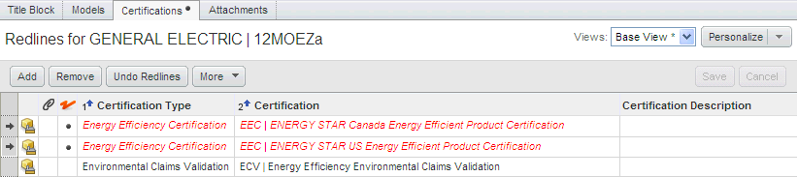
Current Agile Application in ULE
Redlining is used to make a modification to a released item
Changes to the Critical Components, Certifications or attribute data appear in red

Slide 44
Current Agile Application in ULE
Redline Results Data, Step 1
What | The results from an audit or test are Redlined during the course of the project.
How | Redline the Results Navigate to the Sub-Project and open Certification Process Change From General Info tab, OR From Content tab Select the Affected Items tab Highlight the row of the Result to modify Edit the Title Block tab of the Redline (shown in bottom half of screen) Modify the Results Select Save
Why | Supports capture of historical data against the results data. Provides the company and the customer the ability to see past and current results data.
Who | EPM or Lab

Slide 45
Current Agile Application in ULE
Redline Results Data. Step2
What | The Certification Process Change is ready for review and must be finalized prior to submittal to the CO
How | Finalize Certification Process Change Navigate to the Sub-Project and open Certification Process Change from the General Info tab Select the Affected Items tab Highlight the row of the Model Select the Certification tab in the Redline section Add or Remove Certification data as appropriate, including Locations. Select Save. Update the Revision (to 1, etc.) and Lifecycle (to Active) of each Model and Standard. Note: If any errors or warnings appear, click on Actions > Audit Release
Why | Finalizing of the Certification Process Change is required prior to CO recommendation and exiting the Execution phase of the Project
Who | EPM

Slide 46
Current Agile Application in ULE
Within Agile, the following information is revision controlled:
Item | Revision-Controlled Data
Models | Certifications Product Attributes Critical Components
Standards | Result Data
This data must be changed via a formal change process known as redlining
Note that the relationship between Model and Standard is not revision controlled

Slide 47
Current Agile Application in ULE
Recommend, Request CO review
What | The EPM recommends a certification decisions, then routes it to the Certification Office (CO), who must make the final decision.
How | Pre-Requisite: Complete all Activities in the Execution phase of Sub Project Request CO Review Navigate to the Certification Process Change Validate all required information has been completed: Actions → Audit Release Select the Next Status button Add any details for the CO in the Comments Box Select Finish button. Results: Certification Process Change is In Review and Gate: Execution to Completion (CO Approval) is In Review if all dependencies are met. Note: Certification Process Change data is now locked.
Why | Supports the controls to ensure ULE follows Guide 65
Who | EPM
Slide <number>

Slide 48
Current Agile Application in ULE
Approve or Reject
What | The CO makes a final decision on certifications to be added to a Model.
How | Click the hyperlink to navigate to the Sub Project from the Notification Review the Sub Project details and documents. Navigate to the Certification Process Change and review the Redlines Select Next Status button. Add any details for the CO in the Comments Box Select Finish button; Certification Process Change is now Released Return to the Sub Project Select the Gate: Execution to Completion Select Change Status Select Open Note: Once the Gate is opened and the Certification Process Change is released then the data is considered live in the system All Certifications and Results are now applied to the Model
Why | Supports the controls to ensure ULE follows Guide 65; applies certifications and results to the Model after CO approval only
Who | CO

Slide 49



Current Agile Application in ULE
Set to In Review
Certification Process Change
Changes are Locked
Execute Gate on Sub Project
Results
Models
CO Approves the Gate
Execute Gate on Sub Project
Certification Data is Live and Applied to the Model
Change is Released
User Executed Tasks
System Executed Tasks

Slide 50
Current Agile Application in ULE
Complete Project
What | Project and Model documentation is completed before the project is finalized.
How | Open the Sub Project Execute and mark Complete all remaining Activities Note: Sub Project will moved to a Complete state If all Sub Projects are complete: Navigate to the Master Project Execute and mark Complete all remaining Activities Note: Master Project will moved to a Complete state and Sales Order will move to a Complete state.
Why | The standard operating procedures for a ULE project require activities after the certification is complete, such as the certification letter and customer follow-up.
Who | EPM

Slide 51
Current Agile Application in ULE
Complete Project, Step 2
What | When a project completes, the Commercial team will be notified. The PCS project should be completed when the notification is received.
How | An email message will be delivered to your Inbox. The notification can also be found on the Notifications tab in Agile immediately after login.
Why | Enables the commercial team to receive automatic notification of a completed project, ensuring that ULE invoices on time.
Who | Commercial

Slide 52



Current Agile Application in ULE
Close Sub Project
Sub Project
Close
Master Project
Master Project
Close Sales Order
Sales Order
User Executed Tasks
System Executed Tasks

Slide 53
New Agile Application Being Deployed in Certification Office
Concord was the name of this project to develop this agile application in UL as project management tool. It has other name – project one.
Agile PLM is going to be deployed at certification office at phase 1 in product safety business. (Staff under Mette Pedersen).
It is used to manage non-UL mark projects.(GMA projects).
If it is successful, it might be used to replace e-production.

Slide 54
New Agile Application Being Deployed in Certification Office
GMA staff
    Create a master project
    Create a sub project (by mark) and attach the model info
    Add, delete, delegate project tasks/activities
    Complete a project and confirm objects and attachments are finalized

Slide 55
New Agile Application Being Deployed in Certification Office
Certification office staff
Create a CO certification request (change order)
Create A test report (object) and attach to certificate request
Create a certificate (object) and attach to certificate request
CO reviewer approves certificate request
Generate (print) a certificate and attach PDF to certificate (object)
Complete a CO request and confirm objects and attachments are finalized

Slide 56
New Agile Application Being Deployed in Certification Office
Field service staff
Obtain FI work requests
Create a FI inspection request (change order)
Create a FI inspection report (object) and attach to FI inspection request
Generate FI package and report and attach to FI inspection report (object)
Complete a FI request and confirm objects and attachments are finalized

Slide 57
Link of Training Material
All the material is under the Shared Directories listed below.
ULE Environment
\\usnbkd201p\gnk5238\IT Project Information\Project Detail Information\Business Initiatives\Project Concord - UL Environment\User Training Documents\Actual Training Materials Used
Project One = First Draft
\\usnbkd201p\gnk5238\IT Project Information\Project Detail Information\Business Initiatives\Project One\Change Management\Training
Basic Agile Documentation
\\usnbkd201p\gnk5238\IT Project Information\Project Detail Information\Business Initiatives\Project One\Agile Documentation

Slide 58
BI With Agile to Deliver Certificate
Oracle describes BI Publisher as
"...an enterprise reporting solution to author, manage, and deliver all types of highly formatted documents."
"Built on open standard, IT staff and developers can create data models against practically any data source.“
"End users can easily design report layouts using familiar desktop tools , dramatically reducing the time and cost needed to develop and maintain reports.“
Basically, BI Publisher is a software solution that allows a company to create , manage and deliver just about any corporate report. The software sits on its own server and can be connected to any database in the organization.
The Project One team is looking at having BI Publisher integrated with Oracle Agile . The idea being that when all the conditions of a certification are met , the Agile workflow will launch a BI Publisher report . The report is the final GMA/CO certificate. BI Publisher will pull the necessary information out of Agile to build the report (certificate).

