Slide 1
Effectiveness of Internal Audit
V 1.0

Slide 2

Effectiveness

Slide 3
ISO/IEC 17025:2005
Purpose of Internal Audit:
“to verify that its operations continue to comply with the requirements of
the management system and this International Standard.”
Scope of Internal Audit:
“The internal audit programme shall address all elements of the management system, including the testing and/or calibration activities.”

Slide 4
ISO/IEC 17065:2012
Purpose of Internal Audit:
“to verify that it fulfils the requirements of this International Standard and that the management system is effectively implemented and maintained.”
Scope of Internal Audit:
“An audit programme shall be planned, taking into consideration the importance of the processes and areas to be audited, as well as the results of previous audits.”

Slide 5
Effectiveness of Internal Audit
IQA Website Definition:
Effectiveness: Compare internal findings with the findings identified in external audits. The process is not effective if external audits are uncovering business/compliance impacting areas not identified internally.

Slide 6
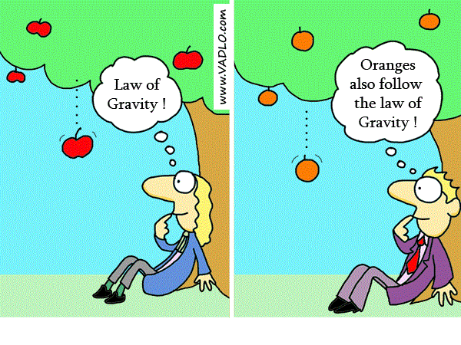
Effectiveness of Internal Audit

Slide 7
Rationale
The purpose of external audit is to assess if UL complies with accreditation/ regulation/ scheme requirement, which normally references to international standards. ( 17025, 17065 and etc.)
The management system of UL is to assure that UL complies with accreditation/ regulation/ scheme requirement and international standards.
Therefore, our internal audit has the same purpose and scope of external audit in general.
If internal audit is effective, there should be no surprise from external audit. Though due to sampling, maybe internal audit does not reveal the particular issues external auditors identified. Internal audit should uncover all the systematic issues before external audit.

Slide 8
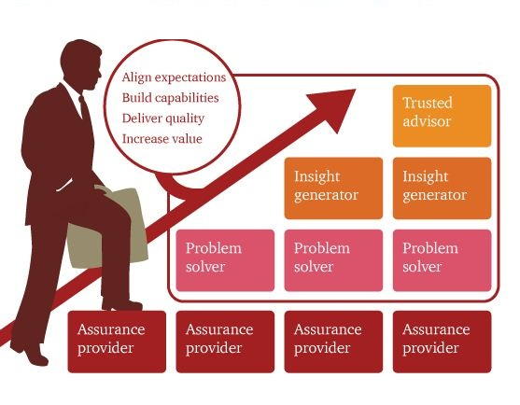
Increased Value of Internal Audit

