Slide 1
Review CB Test Equipment during IQA in 2015
December 8, 2014 V 1.0
For questions or comments on the content, please contact Kyle Huang or Denise Echols

Slide 2
Agenda
Background
General
Review of Test Equipment under IEC 60950-1
Review of Test Equipment under IEC 60601-1
Review of Test Equipment under IEC 60335-2-14
Review of Test Equipment under IEC 60598-1
Records of Audit

Slide 3
Background
Lab test capability is part of an IECEE CBTL Assessment. Some CARs generated from IECEE CBTL assessments focused on lab test capability, specifically equipment, critical consumables, or test methods not in compliance with the IEC standard requirements.
Though some UL standards for final products have been harmonized with IEC standards, they still have differences in small details, due to the structure of IEC standards, CTL Decision Sheets published by IECEE CB Scheme and the traditional approach of UL that includes the use of Certification Requirement Decisions and PAGs developed by UL PDE’s.

Slide 4
General
Following tests are selected by CB program owner for review of test equipment in 2015.
1) Test under IEC 60950-1
a. Direct Plug-in Equipment
2) Test under IEC 60601-1
a. Dynamic forces due to loading from persons
b. Measurement of CREEPAGE DISTANCES AND AIR CLEARANCES
3) Tests under IEC 60335-2-14
a. Stability and mechanical hazards
4) Tests under IEC 60598-1
a. Thermal test (normal operation)
If a CBTL has capability in several above categories, all equipment applicable need to be reviewed.

Slide 5
General
Corporate Internal Quality Audits will focus on lab testing capability during on-site audits of UL labs based on their existing CBTL scopes.
A group of tests selected will be reviewed by IQA auditors. Nonconformance will be documented in the GCAR Database. The list of tests assessed will be included in the audit records.
The corrective action will be handled according to the Global Corrective Action Procedure. If a systemic issue is found, the corrective action may be escalated for effective resolution across UL.
Corporate Quality Manager will maintain a list of tests selected in an ongoing CBTL Audit Plan. There is no intent to cover every test in every standard. However, assessments will cover various types of testing activities under CBTL scopes in a period of time obtained from program management input.

Slide 6
General
The list of tests need to be included in Attachment A of the Scope letter and communicated to local contact before the audit so the site can arrange the staff for interview.

Slide 7
1) a. Direct Plug-in Equipment
IEC 60950-1: 2005 +A1+A2, Clause 4.3.6
CTL Equipment list:
http://iecee.org/ctl/equipment/pdf/off/Equipment_list_60950_1_2nd_ed_A1_A2_2014_06_17.doc
4.3.6 Direct plug-in equipment Test equipment (see Fig. 11 of IEC 60065)
Required Basic - test and measurement equipment required for all apparatus

Slide 8
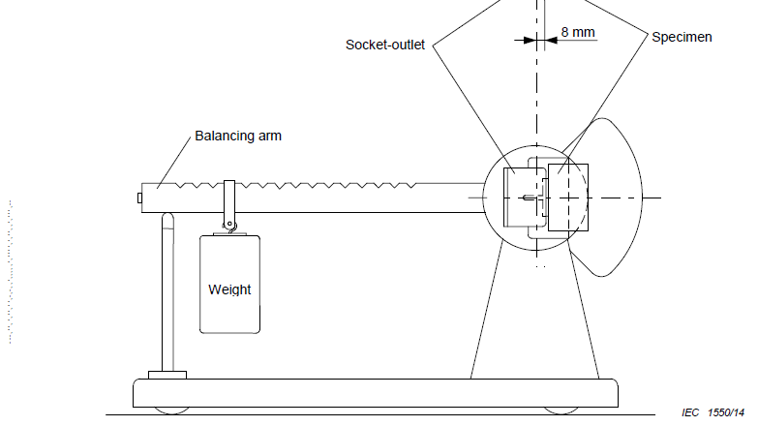
1) a. Direct Plug-in Equipment
Front view of equipment

Slide 9
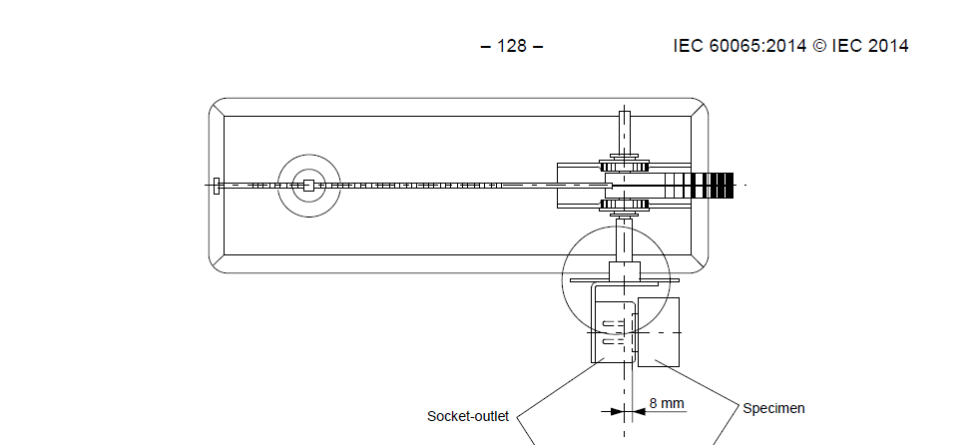
1) a. Direct Plug-in Equipment
Top View of the test equipment

Slide 10
1) a. Direct Plug-in Equipment
Calibration:
1. Distance: 8 mm (the center lines of the contacts at a distance of 8 mm behind the engagement face of the socket outlet).
2. Torque: May be calibrated by Weight Mass and Balance Arm Length.

Slide 11
2) a. Dynamic forces due to loading from persons
IEC 60601-1: 2005 +A1 Clause 9.8.3.3
CTL Equipment list:
http://iecee.org/ctl/equipment/pdf/med/IECEE-CTL%20PEQL%2060601-1%20Ed30_20140327.pdf
9.8 Hazards associated with support systems Weights or load cell, 0.1 m2 test surface, stop watch / timer, human body test mass (Figure 33)
Required
We only verify Human Body Test Mass Setup for Clause 9.8.3.3

Slide 12
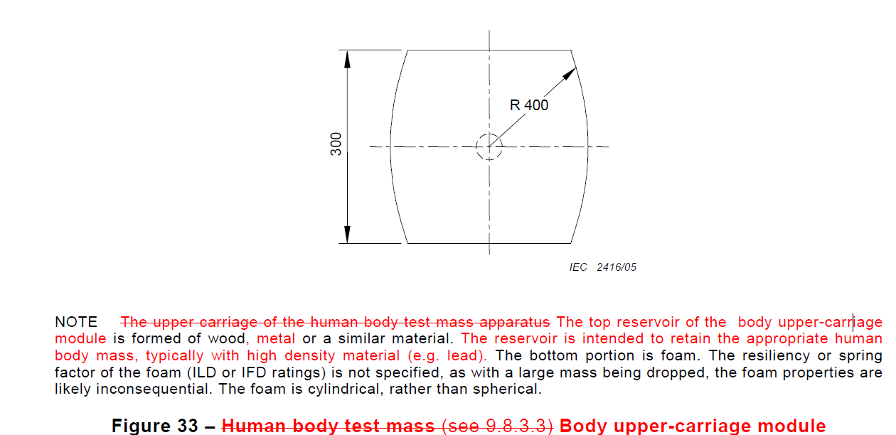
2) a. Dynamic forces due to loading from persons
Human body Test Surface(Body upper-carriage module Figure 33)
Top view

Slide 13
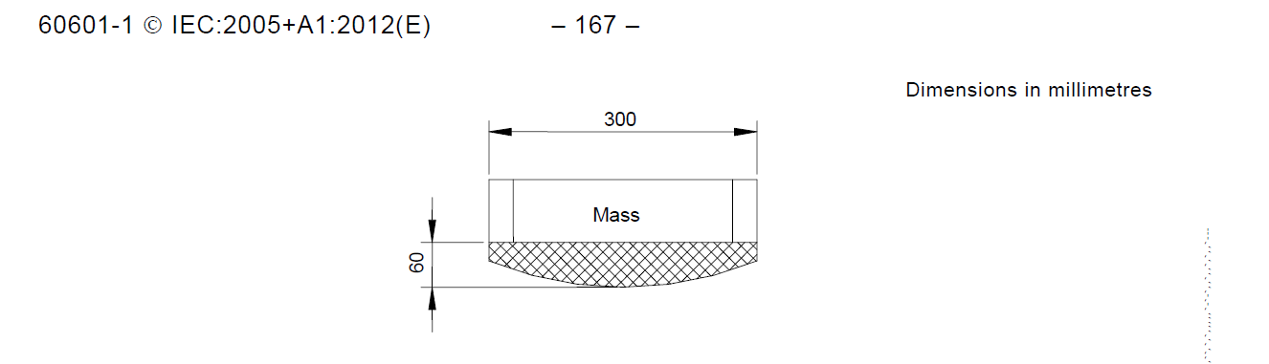
2) a. Dynamic forces due to loading from persons
Human body Test Surface(Body upper-carriage module Figure 33)
Front view

Slide 14
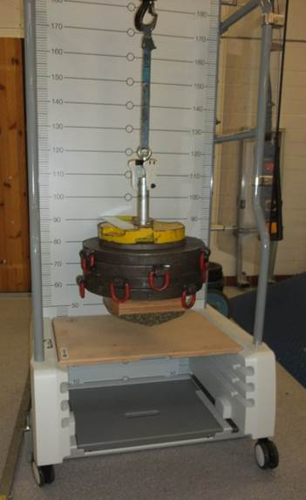
2) a. Dynamic forces due to loading from persons
Whole Test Apparatus Set Up
Simulated Body Weight
Top part of upper- Carriage
foam

Slide 15
2) a. Dynamic forces due to loading from persons
Calibration:
Dimension of Body Upper-Carriage Module
Weights, Load Cell, or Scale
Ruler, Tape Measure, or Caliper ( to measure 150 mm)

Slide 16
2) a. Dynamic forces due to loading from persons
Calibration:
Dimension of Body Upper-Carriage Module
Weights, Load Cell, or Scale
Ruler, Tape Measure, or Caliper ( to measure 150 mm)

Slide 17
2) b. Measurement of CREEPAGE DISTANCES AND AIR CLEARANCES
IEC 60601-1: 2005 +A1 Clause 8.9.4
CTL Equipment list:
http://iecee.org/ctl/equipment/pdf/med/IECEE-CTL%20PEQL%2060601-1%20Ed30_20140327.pdf
8.9 Creepage distances and air clearances Oscilloscope, oscilloscope leads, callipers, micrometer, spacing gauges, force gauge (2 N & 30 N), standard test finger (figure 6)
Required
We only verify Force Gauge, 2 N for clause 8.9.4

Slide 18
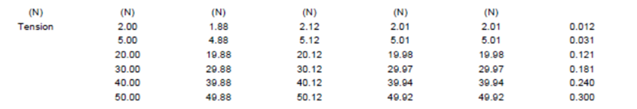
2) b. Measurement of CREEPAGE DISTANCES AND AIR CLEARANCES
Calibration
Force Gauge: The calibration records need to demonstrate that the measurement range covers 2N.
( Per Jola’s email dated Oct. 8, 2014, if the calibration data only show minimum force calibrated is 10N, it is not acceptable)
Here is a good example of calibration report.

Slide 19
3) a. Stability and mechanical hazards
IEC 60335-2-14:2006 +A1 +A2 Clause 20.2
CTL Decision Sheet 1075:
http://decisions.iecee.org/iecee/SearchCMC.nsf/de_home.xsp?xview=ctl#
Test probe to check the protection for moving parts of blenders according to
clause 20.2

Slide 20
3) a. Stability and mechanical hazards
The test probe is identical to test probe B of IEC 61032 except that the diameter of a circular stop face is 125 mm and a distance between the tip of the test finger and the stop face is 100 mm as follows

Slide 21
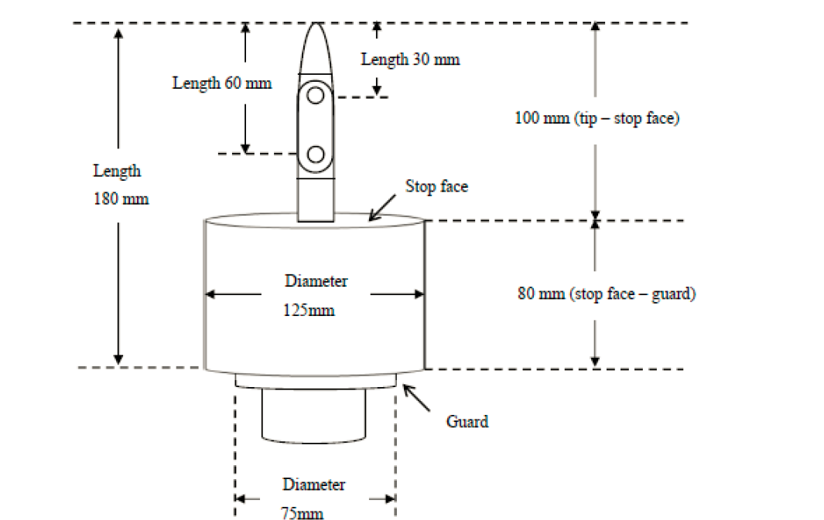
3) a. Stability and mechanical hazards
Overall Probe Figure

Slide 22
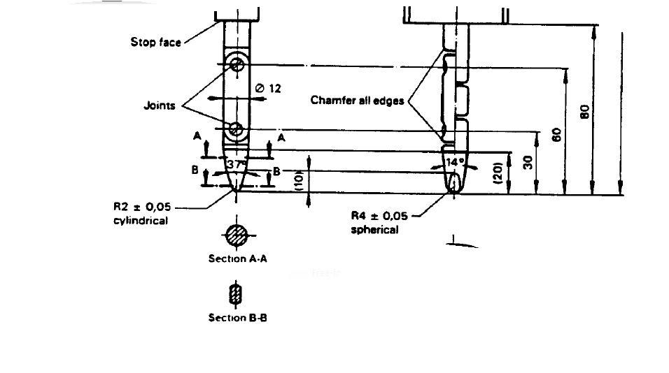
3) a. Stability and mechanical hazards
Top part of Probe B of 61032

Slide 23
3) a. Stability and mechanical hazards
Calibration:
Dimensions according to figures in CTL DSH 1075.
Finger Tip dimension according to test probe B of IEC 61032

Slide 24
4) a. Thermal test (normal operation)
IEC 60598-1: 2008 Clause 12.4.1
CTL Equipment list:
http://iecee.org/ctl/equipment/pdf/lite/LITE_60598-1_2008%202009_05_18.PDF
12.4.1 Thermal tests
Draught-Proof Enclosure (25 C)/ Thermometer/ Thermocouples/ Voltage Stabilizer/ Multimeter/ Wattmeter
Required
We only verify Voltage Stabilizer for Clause 12.4.1

Slide 25
4) a. Thermal test (normal operation)
IEC 60598-1: 2008 Clause 12.4.1
e) During and immediately before a measurement, the supply voltage shall be held within ±1 % and preferably within ± 0,5 % of the test voltage. The supply voltage shall be held within ±1 % of the test voltage during such preceding period as may affect the measurement; this period shall be not less than 10 min.

Slide 26
4) a. Thermal test (normal operation)
Equipment Verification:
The evidence that the test voltage meets above requirement:
The evidences need to demonstrate that verification was done at normal testing load of lighting product.
It is recommended to use the approach of Power Quality Analysis, but it is not required.
The equipment used during the verification (Voltage meter, Current Meter, Timer) need to be calibrated and meet the CTL requirement.
The equipment used for Voltage measurement during the verification is recommended to have proper Test Accuracy Ratio to ensure +/- 1%.

Slide 27

CTL Decision Sheet 251
CTL DSH 251B
CTL PDSH 251E

Slide 28

Records of Audit
00-QA-F0407, V3.0 is used to record the audit results.
Audit Report Number |  | Page # | of
Facility/Lab Audited |  | Test Audit Plan Rev | 4.0
Auditor Name |  | Date
Test Field/Program | IECEE CB scheme

Slide 29
Revision History
1.0 Initial Release

