Slide 1
SMT/CTF Update
LA Teleconference on 2014-04-14

Slide 2
SMT/CTF Assessment after 2/15/2014
Batch conversion of all SMTLs to CTF Stage 3 after February 15, 2014.
All SMTLs will be withdrawn on December 31, 2014.
No requirements are changed for CTF conversion, currently.
Slide <number>

Slide 3
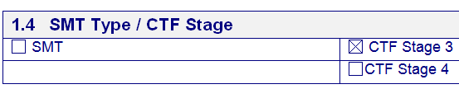
OD-2025 after 2014-02-15
Slide <number>

Slide 4
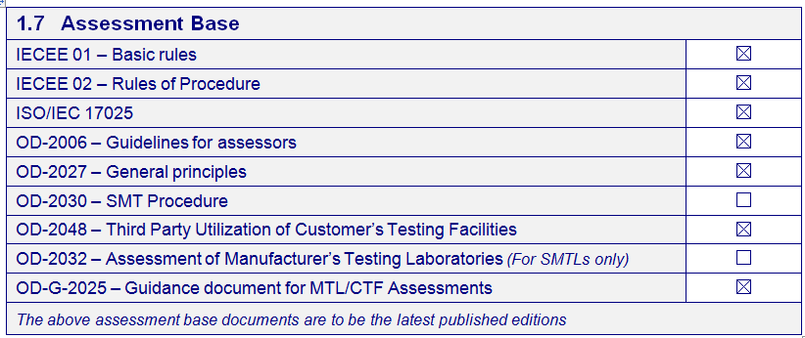
OD-2025 after 2014-2-15
Slide <number>

Slide 5
NCR Writing – Continuous Improvement
Lean good practice from good NCR writing.
Audit comments will help a reviewer and a lead assessor at the next re-assessment.
Needs to verify implementation of corrective actions:
- What documents need to be reviewed at the next annual reassessment?
- What documents did a Lead Assessor review at the next reassessment?
- Implementation verified?
- Closed?
Slide <number>

Slide 6
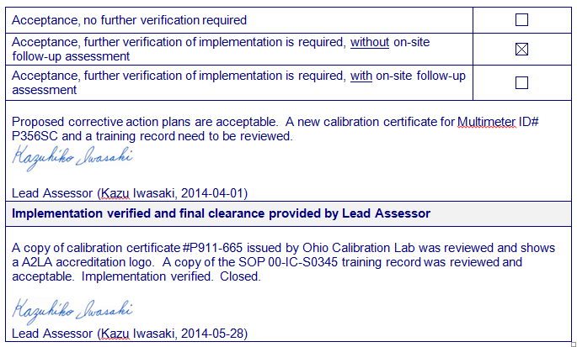
Good Practice
Slide <number>

Slide 7
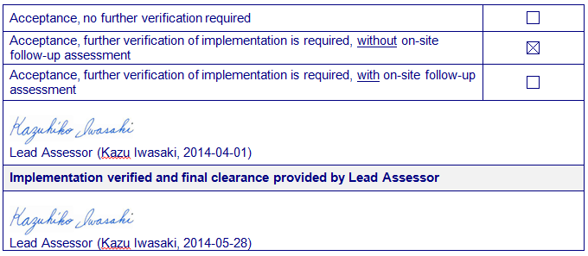
Acceptable Practice
Slide <number>

Slide 8
Initial Assessments
All NCRs shall be resolved.
Implementation shall be verified before acceptance.
Slide <number>

Slide 9
Thank you

