Slide 1
CARs That Reference Other CARs
November 17, 2015, Rev. 3; For questions, contact Cheryl Adams

Slide 2
CARs That Reference Other CARs
A few reasons that CARs reference other CARs:
An Observation CAR may reference a Finding CAR that addresses the root cause analysis and corrective actions for the issue
A CAR may reference a different CAR that provides for part of the resolution of the nonconformance
A new CAR that is opened as a result of an ineffective CAR references that original ineffective CAR

Slide 3
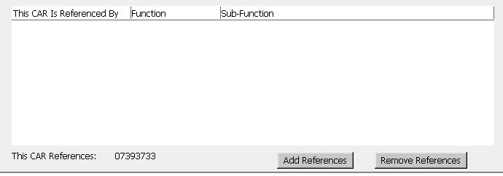
Things You Must Do
Whenever another CAR is referenced, you must put the referenced CAR number in the “This CAR References” field:

Slide 4
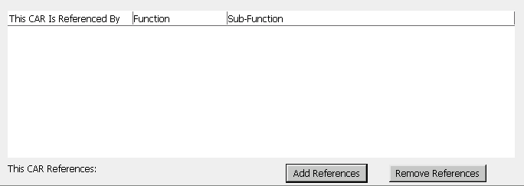
Steps to Follow: Add References
Open the CAR and select “Edit”.
Select “Add References”.

Slide 5
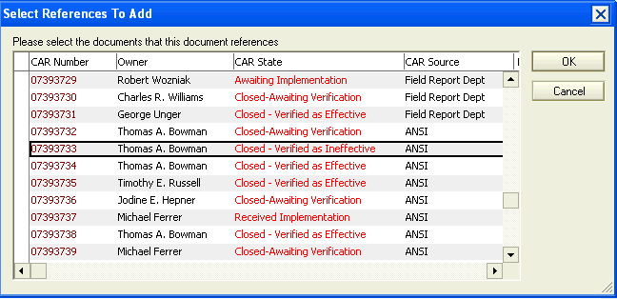
Steps to Follow: Add References
Select the CAR that is to be referenced from the list and select “OK”.

Slide 6
Steps to Follow: Add References
The selected CAR number now appears as a referenced CAR.
Repeat Step 3 until all referenced CARs have been added.

Slide 7
Steps to Follow: Remove References
Select “Remove References”.

Slide 8
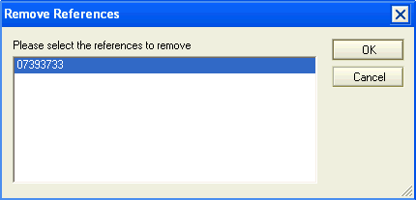
Steps to Follow: Remove References
Select the CAR that is to be removed and select “OK”.

Slide 9
Steps to Follow: Remove References
The referenced CAR is removed.
Repeat Step 2 until all desired referenced CARs have been removed.

Slide 10
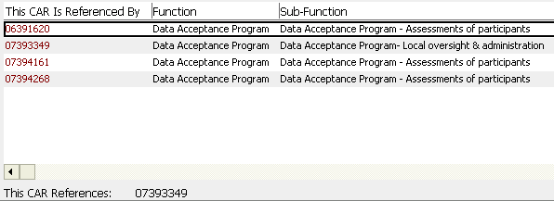
CARs That Reference Your CAR
Note that once you reference a CAR, the referenced CAR is automatically updated to show that it has been referenced in the “This CAR is Referenced By” field.

Slide 11
CARs That Reference Other CARs
For questions or further information, contact Cheryl Allison

Slide 12
Revision History
Revision 2, April 27, 2011
2 year review, added revision history page; no other updates
Revision 3, November 17, 2015
2 year review
Cover slide
Changed name from Cheryl Allison to Cheryl Adams
Removed “CAR Administration” from title

