Slide 1
Witness CB Test during IQA in 2013
February 2, 2013 V 2.0
For questions or comments on the content, please contact Kyle Huang or Denise Echols

Slide 2
Agenda
Background
General
Witness Tests under IEC 60950-1
Witness Tests under IEC 60065
Witness Tests under IEC 60598-1
Witness Tests under IEC 60335-1
Records of Audit
Additional review for CB Projects

Slide 3
Background
Lab test capability is part of an IECEE CBTL Assessment. Some CARs generated from IECEE CBTL assessments focused on lab test capability, specifically equipment, critical consumables, or test methods not in compliance with the IEC standard requirements.
Though some UL standards for final products have been harmonized with IEC standards, they still have differences in small details, due to the structure of IEC standards, CTL Decision Sheets published by IECEE CB Scheme and the traditional approach of UL that includes the use of Certification Requirement Decisions and PAGs developed by UL PDE’s.

Slide 4
General
Corporate Internal Quality Audits will focus on lab testing capability during on-site audits of UL labs based on their existing CBTL scopes.
A group of tests selected will be witnessed by the auditor. (Part of the test method might be examined by the auditor instead, which has been indicated in this presentation). Nonconformance will be documented in the GCAR Database. The list of tests assessed will be included in the audit records.
The corrective action will be handled according to the Global Corrective Action Procedure. If a systemic issue is found, the corrective action may be escalated for effective resolution across UL.
Corporate Quality Engineering Manager will maintain a list of tests selected in an ongoing CBTL Audit Plan. There is no intent to cover every test in every standard. However, assessments will cover various types of testing activities under CBTL scopes in a period of time obtained from program management input.

Slide 5
General
Following tests are selected by CB program owner for witness in 2013.
1) Tests under IEC 60950-1
a. Humidity Treatment
b. Discharge Test
2) Tests under IEC 60065
a. Humidity Treatment
b. Determination of Accessible Parts
c. Dielectric Strength Test
d. Withdraw of Mains Plug Test
3) Tests under IEC 60598-1
a. Earthing Test
b. Rain Test
4) Tests under IEC 60335-1
a. Humidity Treatment
b. Electric Strength Test
If a CBTL has capability in several above categories , only tests under IEC 60065 will be witnessed. The tests under IEC60950-1 are covered due to the similarity to the tests under IEC60065.

Slide 6
General
The list of tests need to be included in Attachment A of the Scope letter and communicated to local contact before the audit so the site can arrange for samples, equipment and personnel in advance.
Before witnessing each test, make sure staff know that the test being demonstrated must be conducted in the same manner as testing for an actual certification project. The test shall be completed step by step as per the requirement.
“can’t accept tests being demonstrated just half way through.” IF “staff takes these demonstrations very lightly instead of doing it as if they were really running the test they cut corners.”, “The result of this approach is an NCR. ”( from Jola Wroblewska’s email dated 6/4/2012)

Slide 7
1a Humidity Treatment
IEC 60950-1: 2005 +A1:2012, Clause 2.9.2
Method:
Cable entries, if any, are left open. If knock-outs are provided, they are opened. Electrical components, covers and other parts which can be removed BY HAND are removed and subjected, if necessary, to the humidity treatment with the main part.
Before being placed in the chamber, the apparatus is brought to a temperature between the specified temperature and a 4 K (degree C) higher temperature.
The chamber is to be set at 93% RH, with +/- 3% RH tolerance, at a convenient temperature between 20 degree C and 30 degree C, but the chosen temperature to be kept within +/- 2 degree C during the test. (CTL DSH 624_07_WG4)
The apparatus is kept in the chamber for 2 days (48 h)(We do not need to wait until the end of test)

Slide 8
1a Humidity Treatment
Equipment:
A. Humidity chambers
Requirement:
1) Calibration points: (IEC 60068-3-5:2001, Clause 4.4)
Temperature measuring sensors are located in each corner and in the center of the working space (see figure 3, minimum 9 sensors). For temperature chambers over 2 000 liter, additional sensors should be located in front of the center of each wall (see figure 4, minimum 15 sensors). The measuring system is to be arranged in such a way that the temperature distribution of the empty test chamber will not be affected.
(IEC 60068-3-6:2001, Clause 4.4)
A single humidity sensor should be positioned at the center of the working space. The relative humidity is then calculated at each point in the working space where a temperature sensor is located by using the temperature difference. This assumes that the absolute humidity remains the same throughout the working space.
2) Acceptance Tolerance of Calibration data: (CTL DSH 624_07_WG4)
a) The standard specifications for the humidity are to be met at the reference/measuring point, where the controlling humidity sensor is located. The tolerances permitted in CTL DSH 251A (+/- 6% RH) are allowed in other parts of the humidity chamber, away from the reference points.
b) Temperature: +/- 2 degree C. (CTL 251B, not include thermocouple)

Slide 9
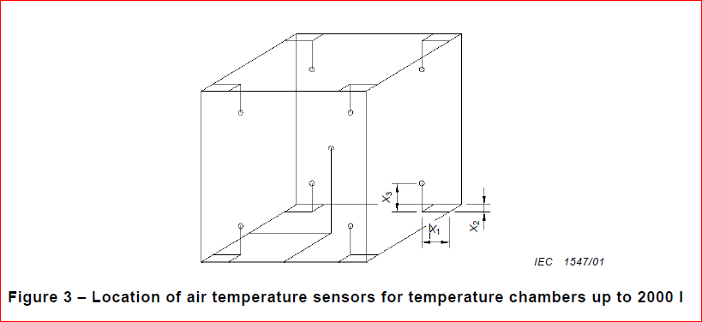
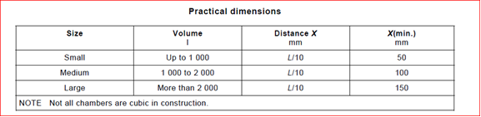
1a Humidity Treatment

Slide 10
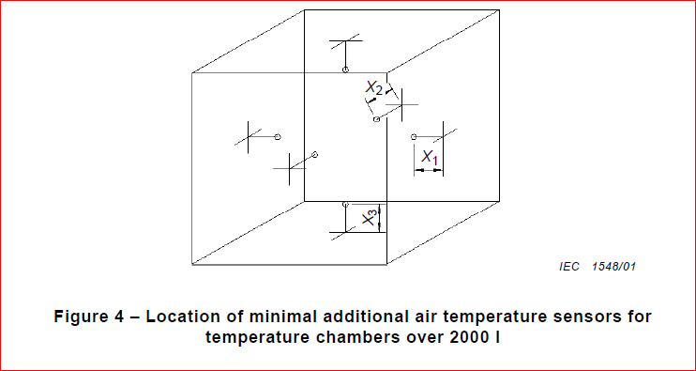
1a Humidity Treatment

Slide 11
1a Humidity Treatment
Equipment:
B. Timer
Calibration Tolerance: +/- 1% (CTL 251B)

Slide 12
1a Humidity Treatment
Environment (Recommendation only, IEC 60068-3-5:2001, Clause 4.1)
The following items should be taken into consideration:
the ambient conditions described in IEC 60068-1 should be satisfied in principle; (15-35 degree C, 75% RH maximum)
the chamber should not be exposed to direct solar radiation;
the chamber should not be exposed to electromagnetic interference;
the chamber should be leveled;
the chamber should be fixed in a location free from any mechanical and acoustic vibration interference
(If the environment conditions are not in compliance with above items, OFI could be written. If the environment conditions affect the final test results, CAR shall be written.)

Slide 13
1b Discharge Test
IEC 60950-1:2005+A1:2012, clause 2.1.1.7
Method:
EUT is connected to the power source and under normal operation.
The voltage (instant value) between the terminals of EUT plug is measured, when EUT is disconnected to the power source. (It may not be necessary to disconnect at exactly the peak of the voltage curve, as long as the value is not 0 V)
The voltage (instant value) between the terminals of EUT plug is measured, when EUT is disconnected to the power source after 1s. ( non-industrial plug equipment)
The voltage (instant value) between the terminals of EUT plug is measured, when EUT is disconnected to the power source after 10s. (industrial plug equipment)

Slide 14
1b Discharge Test
Equipment:
Oscilloscope with the probe used:
1) Having equipment records to demonstrate that an input impedance consisting of a resistance of 100 MΩ ± 5 MΩ in parallel with an input capacitance of 25 pF or less.
(Capacitance was 20+/-5 pF before A1:2012)
2) Calibration:
Timing function: +/- 10 ms (CTL 251 B)
Voltage: 0-1000V, DC to 1 KHz, +/- 1.5% (CTL 251 B)

Slide 15
1b Discharge Test
Acceptance Criteria:
The voltage measured after 1 s (10 s) has decayed to 37 % or less than the value measured at disconnection.

Slide 16
2a Humidity Treatment
IEC 60065:2001 +A1:2005 +A2:2010, Clause 10.2, not tropical climates
The same as IEC 60950-1: 2005 +A1:2012, Clause 2.9.2. (CTL DSH 624_07_WG4)

Slide 17
2b Determination of Accessible Parts
IEC 60065:2001 +A1:2005 +A2:2010, Clause 9.1.1.2, not include additional requirement for Class II products
Method
Through openings, the test finger is applied to any depth that the finger will permit and is rotated or angled before, during and after insertion to any position.
If the opening does not allow the entry of the finger, the force on the finger in the straight position is increased to 20 N ± 2 N and the test repeated with the finger in angled position.
The test is repeated using small finger probes according to test probes 18 of IEC 61032. This does not apply if the intended conditions of use prevent the apparatus from being accessed by children
The test is repeated using small finger probes according to test probes 19 of IEC 61032. This does not apply if the intended conditions of use prevent the apparatus from being accessed by children

Slide 18
2b Determination of Accessible Parts
Equipment
A. Force Gage: Calibration Tolerance (+/- 6%, CTL 251B)
B. The following test fingers and probes are available and calibrated to the dimensions specified.
Tolerance specified in the drawing shall be observed. The tolerance in CTL 251B can be used, if tolerance is not specified in the drawing.

Slide 19
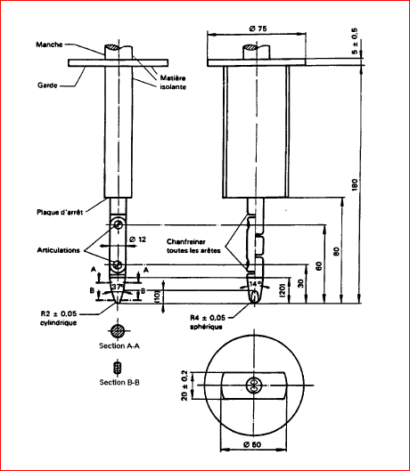
2b Determination of Accessible Parts
Test Finger

Slide 20
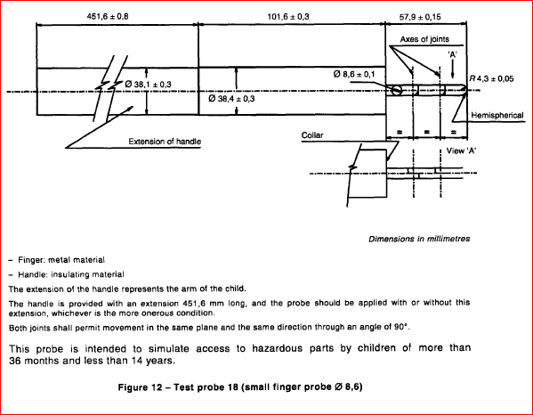
2b Determination of Accessible Parts

Slide 21
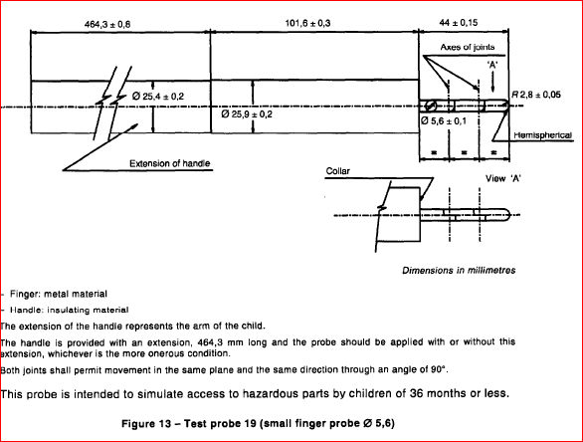
2b Determination of Accessible Parts

Slide 22
2b Determination of Accessible Parts
Environment: (IEC 60065:2001 +A1:2005 +A2:2010, Clause 4.1.3)
15-35 degree C, 75% RH maximum
Acceptance Criteria:
Conductive parts, covered only by lacquer, solvent-based enamel, ordinary paper, untreated textile, oxide films or beads are considered to be bare.
Moving parts of loudspeaker systems, such as dust caps or cones of drivers or passive radiators, are not regarded as preventing accessibility.

Slide 23
2c Dielectric Strength Test
IEC 60065: 2001+A1:2005+A2:2010, 10.3.2
Method
Initially, not more than half of the prescribed test voltage is applied.
Then it is raised rapidly to the full value which is held for 1 min. Value of the test voltage applied is measured within ±3 %.

Slide 24
2c Dielectric Strength Test
Equipment
Dielectric Tester
1.1) Capacity Verification:
a) The test voltages shall be obtained from a suitable source so designed that, when the output TERMINALS are short-circuited after the test voltage has been adjusted to the appropriate level, the output current is at least 200 mA.
  For example, If the dielectric voltage is 1000V, the record should show that the short-circuited current between equipment’s two high voltage terminals were measured, after the open circuit voltage was measured at 1000V. The short-circuited current should be over 200 mA. (Short period )
b) An over-current device shall not trip when the output current is less than 100 mA

Slide 25
2c Dielectric Strength Test
Equipment
Dielectric Tester
1.2) Calibration: (CTL 251B)
Voltage: 0-1000V, DC to 1KHz, +/- 1.5% ;
Voltage 1000V and above, DC to 1KHz, +/- 3%
2) Timer or Timing Function on Dielectric Tester
Calibration: +/- 1%

Slide 26
2c Dielectric Strength Test
Environment
The dielectric strength tests are made in the humidity chamber, or in the room in which the apparatus was brought to the prescribed temperature.

Slide 27
2d Withdrawal of Mains Plug Test
IEC 60065: 2001+A1:2005+A2:2010, clause 9.1.6 and 9.1.1.1
Method:
EUT is connected to the power source and under normal operation.
The voltage (instant value) between the terminals of EUT plug is measured. EUT is disconnected to the power source, when the voltage is close to the peak value.
The voltage (instant value) of the pins or contacts of the plug is measured, when EUT is disconnected to the power source after 2s.
The test may be repeated up to 10 times to obtain the most unfavorable situation.

Slide 28
2d Withdrawal of Mains Plug Test
5. IF the voltage measured after 2s exceeds:
– 35 V (peak) a.c. or 60 V d.c.,
– for audio signals of PROFESSIONAL APPARATUS, 120 V r.m.s.,
– for audio signals of other than PROFESSIONAL APPARATUS, 71 V r.m.s.;
(If the voltage measured does not exceed above value, the test is completed and results complies with the requirement)
a) The stored charges is calculated if voltage is between 60V d.c. and 15KV d.c. (C = cV) ( Charge is equal to capacitance times Voltage)
b) The energy of discharge is calculated if voltage is exceeding 15KV d.c. (E= ½ CV*V) (Energy is equal to 0.5 times capacitance time voltage square)
6. If stored charges exceeds 45 uC or energy of discharge exceeds 350 mJ, the touch current is to be measured, expressed as the corresponding voltages U1 and U2, and measured in accordance with IEC 60990, with the measuring network described in annex D of IEC 60065: 2001+A1:2005+A2:2010.

Slide 29
2d Withdrawal of Mains Plug Test
Equipment:
Oscilloscope with the probe used:
1) Having equipment records to demonstrate that an input impedance consisting of a resistance of 100 MΩ ± 5 MΩ in parallel with an input capacitance of 25 pF or less.
2) Calibration:
Timing function: +/- 10 ms (CTL 251 B)
Voltage: 0-1000V, DC to 1 KHz, +/- 1.5% (CTL 251 B)

Slide 30
2d Withdrawal of Mains Plug Test
Acceptance Criteria:
a) The voltage measured after 2s has less than:
– 35 V (peak) a.c. or 60 V d.c.,
– for audio signals of PROFESSIONAL APPARATUS, 120 V r.m.s.,
– for audio signals of other than PROFESSIONAL APPARATUS, 71 V r.m.s.;
b) OR The stored charges is less than 45 uC if voltage is between 60V d.c. and 15KV d.c., or the energy of discharge is less than 130 mJ if voltage is exceeding 15KV d.c.
c) OR The touch current measured does not exceed.
– for a.c.: U1 = 35 V (peak) and U2 = 0,35 V (peak);
– for d.c.: U1 = 1,0 V.

Slide 31
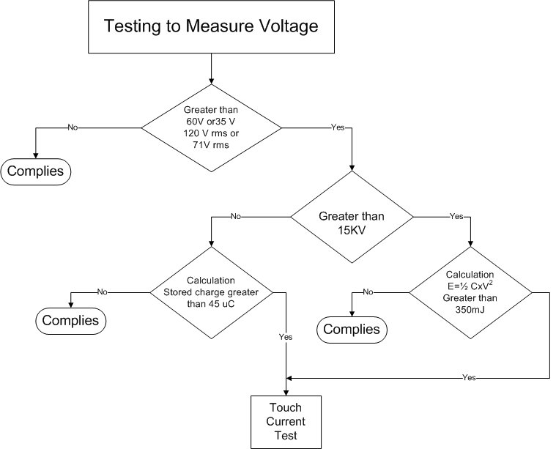
2d Withdrawal of Mains Plug Test

Slide 32
3a Earthing Test
IEC 60598-1:2009, Clause 7.2.3
Method
A current of at least 10 A, derived from a source with a no-load voltage not exceeding 12 V, shall be passed between the earthing terminal or earthing contact and each of the accessible metal parts in turn. The voltage drop between the earthing terminal or earthing contact and the accessible metal part shall be measured and the resistance calculated from the current and the voltage drop. In no case shall the resistance exceed 0,5 Ω. When type testing, the current shall be applied for a period of at least 1 min.
NOTE In the case of a luminaire with a supply cord, the earthing contact is at the plug or supply end of the flexible cable or cord.

Slide 33
3a Earthing Test
IEC 60598-1:2009, Clause 7.2.3
Equipment
Current Meter: Accuracy (CTL 251B) 5A and above, DC to 1 KHz, +/- 2.5%
Voltage Meter: Accuracy (CTL 251B) under 1000V, DC to 60Hz, +/- 1.5%
Timing Device: Accuracy (CTL 251B) 1s and above, +/- 1%

Slide 34
3a Earthing Test
IEC 60598-1:2009, Clause 7.2.3
Data Recording
a) Current, Voltage of Source, Voltage of Drop and Applied Time shall be recorded.
b) The calculation of Earthing Resistance shall be recorded.

Slide 35
3b Rain Test
IEC 60598-1:2009, Clause 9.2.4
Pre-Test Preparation (clause 9.2) :
The luminaire complete with lamp(s) shall be switched on and brought to a stable operating temperature at rated voltage.
The water for the tests shall be at a temperature of 15 °C ± 10 °C.
Luminaires shall be mounted and wired as in normal use and placed in the most unfavorable position, complete with their protective translucent covers. Where connection is made by a plug or a similar device, then this shall be regarded as part of the complete luminaire and shall be included in the tests and similarly for any separate control gear.
A fixed luminaire intended for mounting with its body in contact with a surface shall be tested with an expanded metal spacer interposed between the luminaire and the mounting surface. The spacer shall be at least equal in overall size to the projection of the luminaire.
Luminaires having provision for draining water by means of drain holes shall be mounted with the lowest drain hole open unless otherwise specified in the manufacturer's installation Instructions.

Slide 36
3b Rain Test
IEC 60598-1:2009, Clause 9.2.4
Pre-Test Preparation(continue):
For recessed luminaires, the parts in the recess and the parts protruding from the recess shall each be tested according to their IP classification as indicated in the manufacturer's mounting instructions.
Portable luminaires, wired as in normal use, shall be placed in the most unfavorable position of normal use.
Glands, if any, shall be tightened with a torque equal to two-thirds of that applied to glands in the test of 4.12.5.
Fixing screws of covers, other than hand-operated fixing screws of glass covers, shall be tightened with a torque equal to two-thirds of that specified in Table 4.1.
Screwed lids shall be tightened with a torque having a value in newton meters numerically equal to one-tenth of the nominal diameter of the screw thread in millimeters. Screws fixing other caps shall be tightened with a torque equal to two-thirds of that specified in Table 4.1.

Slide 37
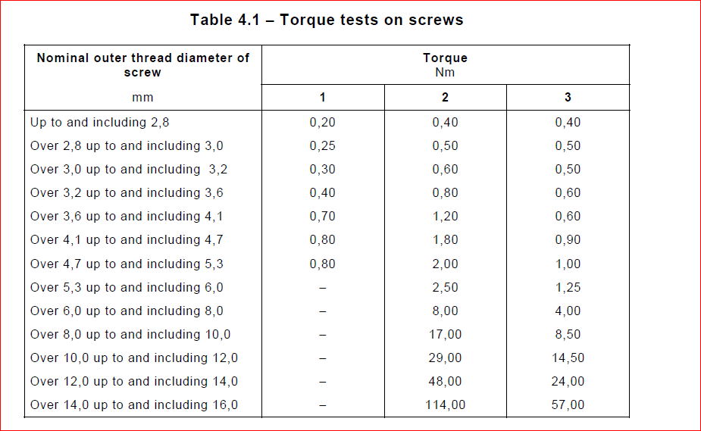
3b Rain Test

Slide 38
3b Rain Test
IEC 60598-1:2009, Clause 4.12.1
Column 1 of Table 4.1 applies to metal screws without heads if the tightened screw does not
protrude from the hole;
Column 2 applies to:
– other metal screws and to nuts;
– screws of insulating material
• having a hexagonal head with the dimensions across flats exceeding the overall thread
diameter;
• having a cylindrical head and a key socket with a cross-corner dimension exceeding the
overall thread diameter;
• having a head with a slot or cross slots, the length of which exceeds 1,5 times the
overall thread diameter.
Column 3 applies to other screws of insulation material

Slide 39
3b Rain Test
IEC 60598-1:2009, Clause 9.2.4
Method:
Rain-proof luminaires (second characteristic IP numeral 3) are sprayed with water for 10 min by means of a spray apparatus as shown in Figure 7. The radius of the semicircular tube shall be as small as possible and compatible with the size and position of the luminaire.
The tube shall be perforated so that jets of water are directed towards the center of the circle and the water pressure at the inlet of the apparatus shall be approximately 80 kN/m2. The tube shall be caused to oscillate through an angle of 120°, 60° on either side of the vertical, the time for one complete oscillation (2 × 120°) being about 4 s. The luminaire shall be mounted above the pivot line of the tube so that the ends of the luminaire receive adequate coverage from the jets. The luminaire shall be turned about its vertical axis during the test at a rate of 1 r/min. After this 10 min period, the luminaire shall be switched off and allowed to cool naturally whilst the water spray is continued for a further 10 min.

Slide 40
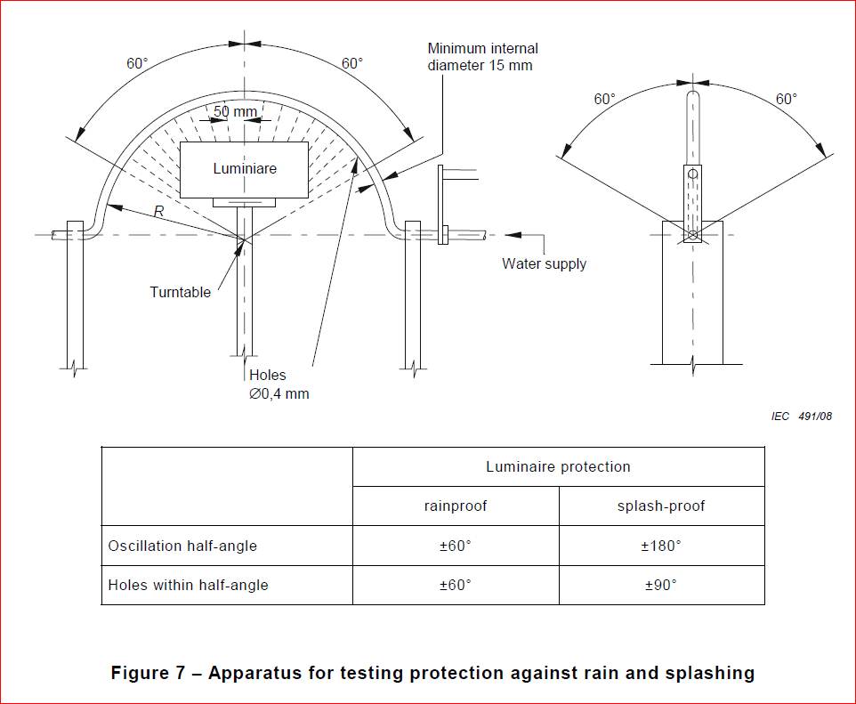
3b Rain Test
IEC 60598-1:2009, Clause 9.2.4

Slide 41
3b Rain Test
IEC 60598-1:2009, Clause 9.2.4
Equipment
Rain Test Apparatus
  Verification of Oscillation Speed and Rotation Speed
  Verification of Dimension:
    Tube internal diameter
    Hole diameter
    Distance between holes
C) Verification of Oscillation angles
D) Verification of Water Pressure
2) Timing Devices

Slide 42
3b Rain Test
IEC 60598-1:2009, Clause 9.2.4
Equipment
3) Other Equipment used during the preparation
Voltage Meter
Temperature Measuring System
Torque Meter
Water Temperature Meter

Slide 43
3b Rain Test
IEC 60598-1:2009, Clause 9.2
Compliance Criteria
After completion of the tests, the luminaire shall withstand the electric strength test specified in Section 10, and inspection shall show:
A) no trace of water on current-carrying parts or SELV parts where the voltage under load exceeds 12 V r.m.s. or 30 V ripple-free d.c. or on insulation where it could become a hazard for the user or surroundings, for example, where it could reduce the creepage distances below the values specified in Section 11;
B) 1) For luminaires without drain holes, there shall be no water entry.
2) For luminaires with drain holes, water entry including condensation is allowed during the tests if it can drain out effectively and provided it does not reduce the creepage and clearance distances below the minimum levels specified in the standard;
C) no damage, for example, cracking or breakage of a protective shield or glass envelope, such that safety or protection against the ingress of moisture is impaired.

Slide 44
4a Humidity Treatment
IEC 60335-1:2010, Clause 15.3
The same as IEC 60950-1: 2005 +A1:2012, Clause 2.9.2. (CTL DSH 624_07_WG4)

Slide 45
4b Electric Strength Test
IEC 60335-1:2010, Clause 13.3
Method
The appliance is disconnected from the supply and the insulation is immediately subjected to a voltage having a frequency of 50 Hz or 60 Hz for 1 min, in accordance with IEC 61180-1.
CTL DSH009A:
The following tests procedure has to be adopted: “Initially, not more than half the prescribed voltage is applied, then it is raised rapidly to the full value”
(IEC 60118-1: 1992. Clause 5.3.1)
The voltage shall be applied to the test object starting at a value sufficiently low to prevent any effect of overvoltage due to switching transients. It should be raised sufficiently slowly as to permit reading of the instruments, but not so slowly as to cause unnecessary prolongation of stressing of the test object near to the test voltage.
(Recommendation)
For type tests, these requirements are, in general, met if the rate of the rise is about 5 % of the estimated final test voltage per second, when the applied voltage is above 75 % of this voltage. It shall be maintained for the specified time and then rapidly decreased, but not suddenly interrupted, as this may generate switching transients which could cause damage or erratic test results.

Slide 46
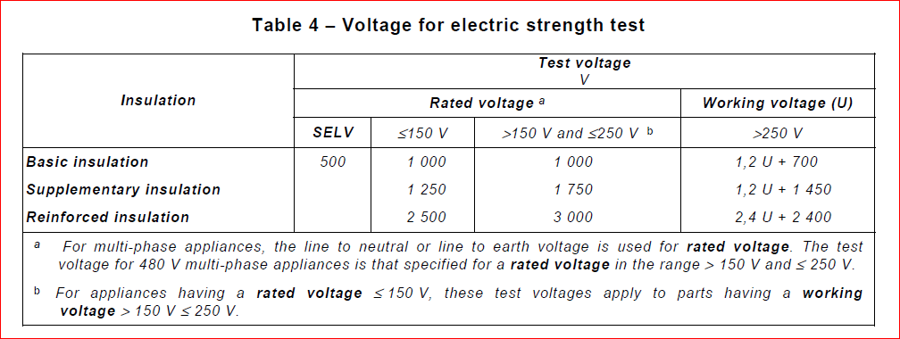
4b Electric Strength Test
IEC 60335-1:2010, Clause 13.3

Slide 47
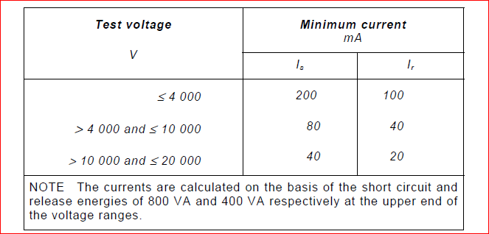
4b Electric Strength Test
Equipment
Dielectric Tester
Capacity Verification: The high-voltage source used for the test is to be capable of supplying a short circuit current is between the output terminals after the output voltage has been adjusted to the appropriate test voltage. The overload release of the circuit is not to be operated by any current below the tripping current Ir. The values of Is and Ir are given in Table 5 for various high-voltage sources.

Slide 48
4b Electric Strength Test
Equipment
Short Circuit Current/ Minimum Testing Voltage Verification method (IEC 60118-2:1994, clause 6.3)
An ammeter shall be connected across the output terminals of the test equipment. The control setting of the test equipment shall be adjusted until the ammeter reads THE SHORT CIRCUIT CURRENT and this control setting noted. The ammeter shall be removed and the open-circuit voltage of the test equipment measured at this control setting. This open-circuit voltage is the minimum test voltage for tests complying with the requirements of this standard.
.

Slide 49
4b Electric Strength Test
Equipment
Wave-form Verification method (IEC 60118-2:1994, clause 6.1)
Voltage wave-form
The output voltage of the test equipment shall be measured simultaneously with two reference measuring systems connected in parallel, one of which shall be a peak reading system and the other a true r.m.s. reading system. The ratio of peak to r.m.s. values shall be equal to a SQRT (2) +/- 5 % .

Slide 50
4b Electric Strength Test
Equipment
Dielectric Tester
1.2) Calibration: (CTL 251B)
Voltage 1000V and above, DC to 1KHz, +/- 3%
2) Timer or Timing Function on Dielectric Tester
Calibration: +/- 1%

Slide 51
4b Electric Strength Test
Environment
The test report shall always contain a record of the actual atmospheric conditions (temperature, pressure and relative humidity) during the test.
When the relative humidity exceeds about 75 %, the disruptive discharge voltage becomes irregular, especially when the disruptive discharge occurs across an insulating surface.
(IEC 61180-1, clause 3.3.2)
Unless it is required by the test standard, the relative humidity shall not exceed 75%. When temperature or barometric pressure is out of the following range, correction factor shall be considered to adjust testing voltage, especially when the disruptive discharge occurs across an insulating surface.
Temperature: 15 C to 35 C
Barometric Pressure: 92 kPa to 104 kPa

Slide 52
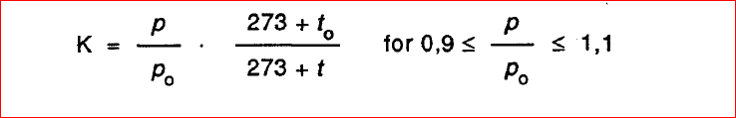
4b Electric Strength Test
Environment
Temperature to = 20 C
Barometric pressure Po = 101,3 kPa (1 013 mbar)
Voltage required by the standard Uo
Voltage Adjusted U= Uo x K

Slide 53

Records of Audit
00-QA-F0407, V2.0 is used to record the audit results.
Audit Report Number |  | Page # | of
Facility/Lab Audited |  | Test Audit Plan Rev
Auditor Name |  | Date
Test Field/Program | Electrical/ CBTL

Slide 54
Additional review for CB Projects
1) Select CB Test Report to IEC 60950-1. Review the Critical Component Table in the report.
2) Look for the following in the table:
a. Do the critical components (e.g. Power Supply) have an IEC certificate indicated? Do not accept CE-Marking!!! Since this is self-declaration.
b. Have they been investigated to the latest edition of the IEC standard?
c. Does the table include components and sub-assemblies certified to previous editions of the standard?
d. If yes, was an additional evaluation done, potentially additional testing or is there clarification why no additional investigation was required? (This is critical for power supply which is also evaluated to the IEC 60950-1 standard)

Slide 55
Revision History
1.0 Initial Release
2.0 Add two tests under IEC 60598-1 and two tests under IEC 60335-1, per the request from the program manager. Also revise a few pages for clarification. (Page 3, 4, and 16)

