Slide 1
Witness IECEx/ATEX Test during IQA in 2013
January 24, 2013 V 1.0
For questions or comments on the content, please contact Kyle Huang or Denise Echols

Slide 2
Agenda
Background
General
3. Witness Test under EN/IEC 60079-0
Thermal endurance to heat
4. Witness Test under EN/IEC 60079-11
Dielectric Strength Test
5. Records of Audit

Slide 3
Background
Lab testing capability is part of an IECEx TL Assessment. UL labs also perform similar tests under the ATEX certification program.
IECEx Scheme provides ExTAG Decision Sheets, which includes the clarification, guidance and interpretation of IEC standards under the IECEx scheme.
ATEX Notified Body Group (ExNB) provides ExNB Clarification Sheets, which include the clarification, guidance and interpretation of EN standards and other Notified Body related aspects under the ATEX Directive.
Per certification program owner and certification program manager’s request, Corporate IQA will conduct a review of lab testing capability in the Hazloc area during corporate internal quality audits.

Slide 4
General
Corporate Internal Quality Audits will focus on lab testing capability during on-site audits of UL labs based on their existing IECEx/ATEX TL scopes.
A group of tests selected will be witnessed or examined by the auditor. Nonconformance will be documented in the GCAR Database. The list of tests assessed will be included in the audit records.
Corrective actions will be handled according to the Global Corrective Action Procedure. If a systemic issue is found, the corrective action may be escalated for effective resolution across UL.
The Corporate Quality Engineering Manager will maintain a list of tests selected in an ongoing IECEx/ATEX TL Audit Plan. There is no intent to cover every test in every standard. However, assessments will cover various types of testing activities under IECEx/ATEX TL scopes in a period of time obtained from program management input.

Slide 5
General
Following tests are selected by IECEx program owner for 2013.
1. Test under EN/IEC 60079-0
Thermal endurance to heat
2. Witness Test under EN/IEC 60079-11
Dielectric Strength Test

Slide 6
General
The list of tests will be included in Attachment A of audit scope letter and communicated to the local contact before the audit, so the site can arrange samples, equipment and personnel in advance.
Before witnessing each test, make sure the testing staff know that the test being demonstrated must be conducted in the same manner as testing for an actual certification project. The test shall be completed step by step as per the requirement.

Slide 7
Thermal Endurance To Heat
IEC 60079-0: 2011, Clause 26.8 (EN 60079-0, August 2012, Clause 26.8)
Method:
Thermal endurance to heat shall be determined by submitting the enclosures or parts of enclosures in non-metallic materials, on which the integrity of the type of protection depends, to tests according to Table 15.
At the conclusion of the test according to Table 15(We do not need to wait for the end of the test), the enclosures or parts of enclosures in non-metallic materials that were tested shall be subjected to (20 ± 5) °C at (50 ± 10) % relative humidity for 24 0+48 h, and then immediately followed by the thermal endurance to cold test (26.9).
NOTE The test values given in Table 15 include two test conditions. The conditions shown in the 2nd column were used in previous editions of this standard and allow previously obtained test results to remain valid for this edition.
The conditions shown in the 3rd column have been added to allow testing at temperature/humidity conditions that are more readily achieved, although at an increased test time.

Slide 8
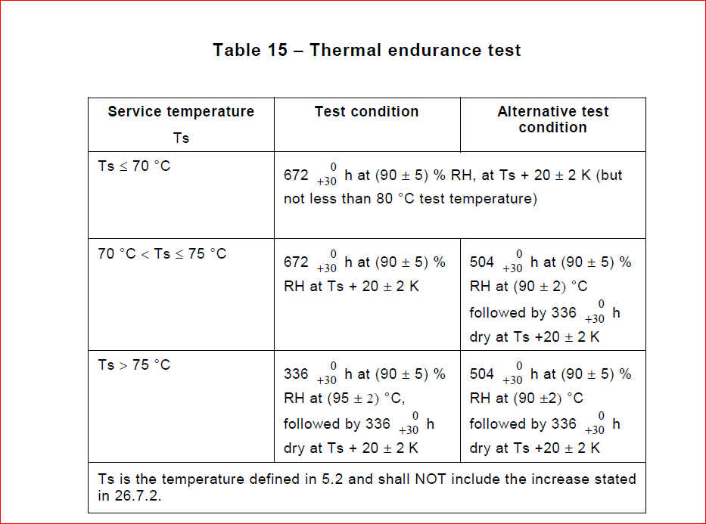
Thermal Endurance To Heat

Slide 9
Thermal Endurance To Heat
Equipment:
A. Humidity chambers
Requirement:
Calibration points: “Therefore my understanding is that one point calibration is OK “ ( email dated 1/24/2013 from Jasmin Omerovic, ATEX Program Manager)
Temperature/ Humidity : at least 90 degree C with 90% RH. May require 95 degree C with 90% humidity, if the column 2 method was used in the lab.

Slide 10
Thermal Endurance To Heat
Equipment:
B. Timer:
May not need a stop watch, since the unit of time in the requirement is hours, instead of minutes or seconds. However, traceability is still required.

Slide 11
Dielectric strength tests
IEC 60079-11:2011, clause 10.3(EN 60079-11, 2012-02-03, clause 10.3)
Method:
The test shall be performed either with an alternating voltage of substantially sinusoidal waveform at a power frequency between 48 Hz and 62 Hz or with a d.c. voltage having no more than 3 % peak-to peak ripple at a level 1,4 times the specified a.c. voltage.
The voltage shall be increased steadily to the specified value in a period of not less than 10 s and then maintained for at least 60 s.
The applied voltage shall remain constant during the test. The current flowing during the test shall not exceed 5 mA r.m.s. at any time.

Slide 12
Dielectric strength tests
Equipment
Dielectric Tester
1.1) Capacity Verification:
The supply shall have sufficient volt-ampere capacity to maintain the test voltage, taking into account any leakage current which may occur. The applied voltage shall remain constant during the test. The current flowing during the test shall not exceed 5 mA r.m.s. at any time. (Testing Voltage x 5 mA is the minimum VA required)
An alternating voltage of substantially sinusoidal waveform at a power frequency between 48 Hz and 62 Hz or with a d.c. voltage having no more than 3 % peak-to peak ripple at a level 1,4 times the specified a.c. voltage. (Verification of output AC or DC waveform is required)
1.2) Trip Current Verification: The current flowing during the test shall not exceed 5 mA r.m.s. at any time. (Need the ability to set up trip current at 5 mA and Calibrated)

Slide 13
Dielectric strength tests
Equipment
2) Timer or Timing Function on Dielectric Tester
Needs to be calibrated.

Slide 14

Records of Audit
00-QA-F0407, V2.0 is used to record the audit results.
Audit Report Number |  | Page # | of
Facility/Lab Audited |  | Test Audit Plan Rev
Auditor Name |  | Date
Test Field/Program | Hazloc/ IECEx

