Slide 1
Witness CB Test during IQA in 2014
Oct. 24, 2013 V 1.0
For questions or comments on the content, please contact Kyle Huang or Denise Echols

Slide 2
Agenda
Background
General
Associated IECEE CB Documents
Witness Tests under IEC 60950-1
Witness Tests under IEC 60335-1
Witness Tests under IEC 60598-1
Records of Audit

Slide 3
Background
Lab test capability is part of an IECEE CBTL Assessment. Some CARs generated from IECEE CBTL assessments focused on lab test capability, specifically equipment, critical consumables, or test methods not in compliance with the IEC standard requirements.
Though some UL standards for final products have been harmonized with IEC standards, they still have differences in small details, due to the structure of IEC standards, CTL Decision Sheets published by IECEE CB Scheme and the traditional approach of UL that includes the use of Certification Requirement Decisions and PAGs developed by UL PDE’s.

Slide 4
General
Following tests are selected by CB program owner for witness in 2014.
1) Test under IEC 60950-1
a. Touch Current Test (single-phase star TN or TT power distribution system only)
2) Tests under IEC 60335-1
a. Leakage Current Test (single-phase Class II appliance only)
3) Tests under IEC 60598-1
a. Touch Current Test(single-phase Class II luminaire only)
If a CBTL has capability in several above categories, only tests under IEC 60950-1 will be witnessed.

Slide 5
General
Corporate Internal Quality Audits will focus on lab testing capability during on-site audits of UL labs based on their existing CBTL scopes.
A group of tests selected will be witnessed by the auditor. (Part of the test method might be examined by the auditor instead, which has been indicated in this presentation). Nonconformance will be documented in the GCAR Database. The list of tests assessed will be included in the audit records.
The corrective action will be handled according to the Global Corrective Action Procedure. If a systemic issue is found, the corrective action may be escalated for effective resolution across UL.
Corporate Quality Manager will maintain a list of tests selected in an ongoing CBTL Audit Plan. There is no intent to cover every test in every standard. However, assessments will cover various types of testing activities under CBTL scopes in a period of time obtained from program management input.

Slide 6
General
The list of tests need to be included in Attachment A of the Scope letter and communicated to local contact before the audit so the site can arrange for datasheet, samples, equipment and personnel in advance.
Before witnessing each test, make sure staff know that the test being demonstrated must be conducted in the same manner as testing for an actual certification project. The test shall be completed step by step as per the requirement.
“can’t accept tests being demonstrated just half way through.” IF “staff takes these demonstrations very lightly instead of doing it as if they were really running the test they cut corners.”, “The result of this approach is an NCR. ”( from Jola Wroblewska’s email dated 6/4/2012)

Slide 7
Associated IECEE CB Documents
Following IECEE CB Documents are related to Touch/Leakage Current Test:
CTL PDSH 251C ( Instrument Accuracy Limit, published in 2013)
CTL – OP113 V 1.1( Leakage/Touch Current Measurement Instruments, published in 2013)
CTL PDSH 651A ( IEC 60335-1: 2010 Regarding to VDR )
CTL 482 (IEC 60335-1 Regarding to 3 phase Heating element with 1 phase motor)
CTL 472 (IEC 60335-1 Regarding to RFI fillers, the requirement has been included current version of standard)
CTL 394A (IEC 60950-1 Regarding to Devices with multiple supplies, the requirement has been included in current version of standard)
Note: Some existing CTL Decisions may be not applicable to the requested test demonstration.
It is important, however that CBTL staff looks at the existing decisions before test demonstration and remembers to explain it to the assessor.

Slide 8
1a Touch Current Test (Single Phase TN/TT)
IEC 60950-1: 2005 +A1:2012, Clause 5.1
Test Circuit:
Equipment is tested using the test circuit in Figure 5A (for single-phase equipment to be connected only to a star TN or TT power distribution system).
The use of a test transformer for isolation is optional. For maximum protection, a test transformer for isolation (T in Figures 5A ) is used and the main protective earthing terminal of the EUT is earthed. Any capacitive leakage in the transformer shall then be taken into account. As an alternative to earthing the EUT, the test transformer secondary and the EUT are left floating (not earthed) in which case capacitive leakage in the transformer need not be taken into account.
If transformer T is not used, the EUT and the test circuitry shall not be earthed. The EUT is mounted on an insulating stand, and appropriate safety precautions are taken in view of the possibility of the BODY of the equipment being at a HAZARDOUS VOLTAGE.
If it is inconvenient to test equipment at the most unfavorable supply voltage (see 1.4.5), it is permitted to test the equipment at any available voltage within the tolerance of RATED VOLTAGE or within the RATED VOLTAGE RANGE, and then calculate the results.

Slide 9
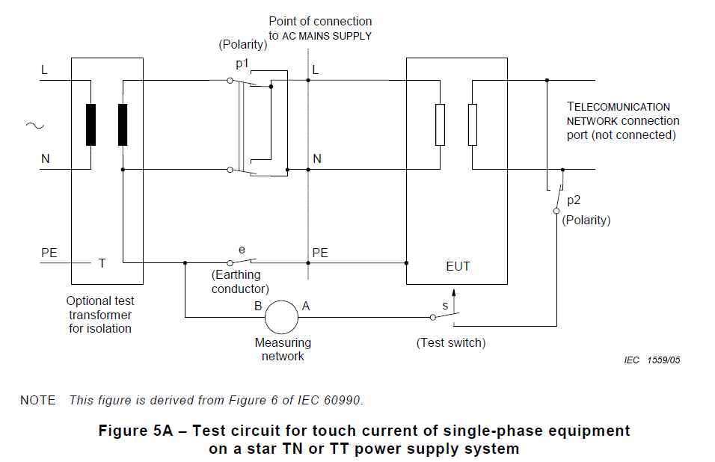
1a Touch Current Test (Single Phase TN/TT)
IEC 60950-1: 2005 +A1:2012, Clause 5.1

Slide 10
1a Touch Current Test (Single Phase TN/TT)
Test Preparation:
Tests are conducted using one of the measuring instruments in Annex D, or any other circuit
giving the same results. Terminal B of the measuring instrument is connected to the earthed (neutral) conductor of the supply (see Figure 5A ). Terminal A of the measuring instrument is connected as specified in Test Procedure.
For an accessible non-conductive part, the test is made to metal foil having dimensions of
100 mm by 200 mm in contact with the part. If the area of the foil is smaller than the surface
under test, the foil is moved so as to test all parts of the surface. Where adhesive metal foil is
used, the adhesive shall be conductive. Precautions are taken to prevent the metal foil from
affecting the heat dissipation of the equipment.
NOTE 1 The foil test simulates hand contact.
Accessible conductive parts that are incidentally connected to other parts are tested both as
connected and disconnected parts.

Slide 11
1a Touch Current Test (Single Phase TN/TT)
IEC 60950-1: 2005 +A1:2012, Clause 5.1
Test Procedure:
For equipment having a protective earthing connection or a FUNCTIONAL EARTHING connection, terminal A of the measuring instrument is connected via measurement switch "s" to the main protective earthing terminal of the EUT, with the earthing conductor switch "e" open.
The test is also conducted, on all equipment, with terminal A of the measuring network connected via measurement switch "s" to each unearthed or non-conductive accessible part and each unearthed accessible circuit, in turn, with the earthing conductor switch "e" closed.
Additionally for single-phase equipment, the tests are repeated in reverse polarity (switch "p1");
For each placement of the measuring instrument, any switches in the PRIMARY CIRCUIT and likely to be operated in normal use are open and closed in all possible combinations.
After applying each test condition, the equipment is restored to its original condition, that is without fault or consequential damage.

Slide 12
1a Touch Current Test (Single Phase TN/TT)
IEC 60950-1: 2005 +A1:2012, Clause 5.1
Test Instrument Selection:
Either the r.m.s. value of the voltage, U2, is measured using the measuring instrument of
Figure D.1, or the r.m.s. value of the current is measured using the measuring instrument of
Figure D.2. The D.1 instrument gives a more accurate measurement than the D.2 instrument if the
waveform is non-sinusoidal and the fundamental frequency exceeds 100 Hz.
Alternatively, the peak value of the voltage, U2, is measured using the measuring instrument
described in Clause D.1.
If the voltage, U2, is measured using the measuring instrument described in Clause D.1, the following calculation is used:
TOUCH CURRENT (A) = U2 / 500
NOTE Although r.m.s. values of TOUCH CURRENT have traditionally been measured, peak values provide better correlation with the response of the human body to non-sinusoidal current waveforms

Slide 13
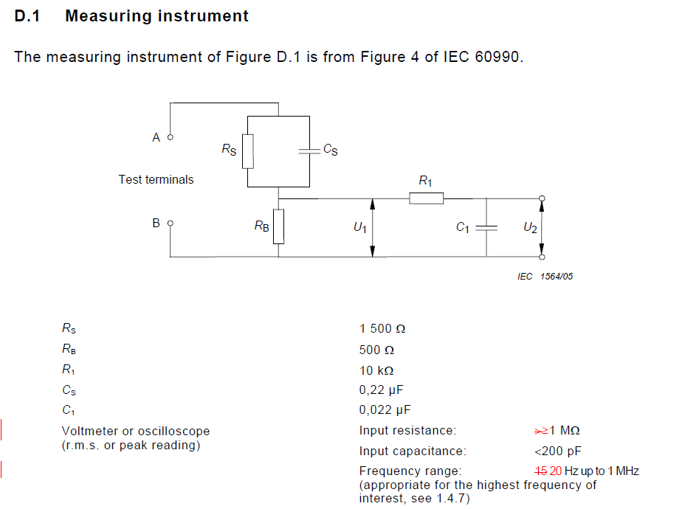
1a Touch Current Test (Single Phase TN/TT)
IEC 60950-1: 2005 +A1:2012, Clause 5.1
Test Instrument D.1:

Slide 14
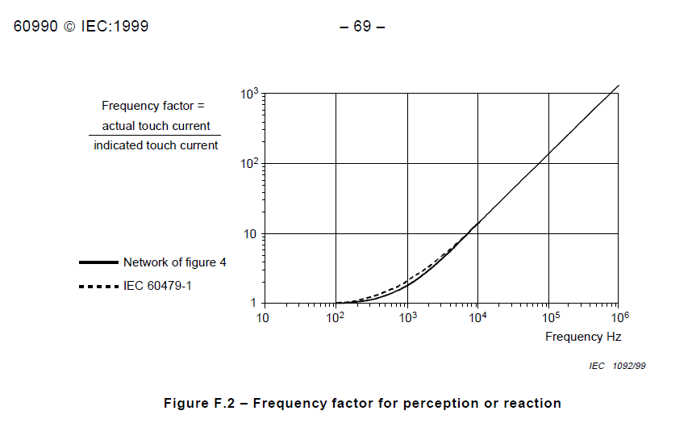
1a Touch Current Test (Single Phase TN/TT)
IEC 60950-1: 2005 +A1:2012, Clause 5.1
Test Instrument D.1:
The measuring instrument is calibrated by comparing the frequency factor of U2 with the solid line in Figure F.2 of IEC 60990 at various frequencies. A calibration curve is constructed showing the deviation of U2 from the ideal curve as a function of frequency.

Slide 15
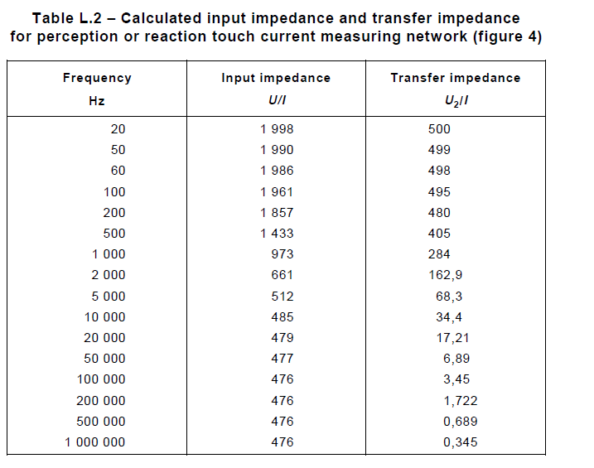
1a Touch Current Test (Single Phase TN/TT)
IEC 60950-1: 2005 +A1:2012, Clause 5.1
Test Instrument D.1:

Slide 16
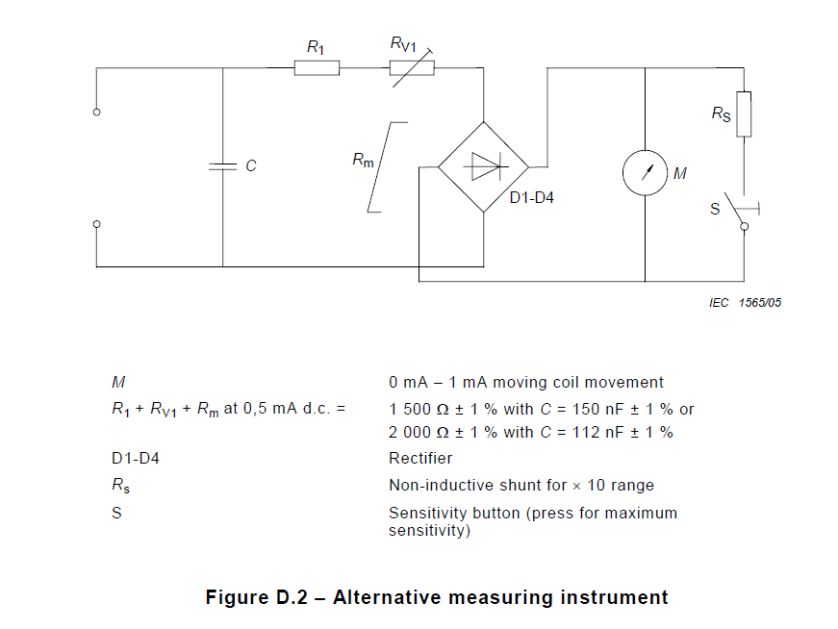
1a Touch Current Test (Single Phase TN/TT)
IEC 60950-1: 2005 +A1:2012, Clause 5.1
Test Instrument D.2:

Slide 17
1a Touch Current Test (Single Phase TN/TT)
IEC 60950-1: 2005 +A1:2012, Clause 5.1
Test Instrument D.2:
The instrument comprises a rectifier/moving coil meter with additional series resistance, the two being shunted by a capacitor, as shown in Figure D.2. The effect of the capacitor is to reduce the sensitivity to harmonics and other frequencies above the power frequency. The instrument should also include a × 10 range obtained by shunting the meter coil by a non-inductive resistor. It is also permitted to include overcurrent protection, provided that the method used does not affect the basic characteristics of the instrument.
RV1 is adjusted for the desired value of total resistance at 0,5 mA d.c.
The meter is calibrated at the following calibration points on the maximum sensitivity range at
50 Hz to 60 Hz sinusoidal: 0,25 mA, 0,5 mA, 0,75 mA.
The following response is checked at the 0,5 mA calibration point:
Sensitivity at 5 kHz sinusoidal: 3,6 mA ± 5 %.

Slide 18
1a Touch Current Test (Single Phase TN/TT)
IEC 60950-1: 2005 +A1:2012, Clause 5.1
Accuracy of Equipment: (CTL 251C/ OP 113 V 1.1)
1. Power Source Voltage Meter:
Voltage: 0-1000V, DC to 1 kHz, +/- 1.5%
2a. Meter D.2:
Current: 50/60 Hz +/- 3.5% ( 0.25 mA, 0.5 mA and 0.75 mA)
5 kHz +/- 5% (Display 0.5 mA, when the input current is 3.6 mA at 5 k Hz)
2b. Meter D.1:
  Voltage meter to measure U2: DC to 1 kHz, +/- 1.5%; 1 kHz to 5 kHz, +/- 2%;
5 kHz to 20 kHz, +/- 3%; 20 kHz and more, +/- 5%
Resistors and capacitors used in the network need to have a tolerance of +/- 1.0 % or Individually selected for correct value by measurement. (It is not calibration requirement, but design requirement)
  The complete circuit as one leakage current meter :
up to 30 mA: 20 Hz- 100 k Hz +/- 3.5%; 100 k Hz – 1M Hz +/- 30%
30 mA above: 50 Hz -1 M Hz +/- 5%
3. Caliper (Measure the metal foil dimension): +/- 0.5 %

Slide 19
2a Leakage Current Test (Single Phase, Class II )
IEC 60335-1:2010, Clause 13
Method:
The appliance is operated under normal operation for the duration specified in 11.7.
Heating appliances are operated at 1,15 times the rated power input.
Motor-operated appliances and combined appliances are supplied at 1,06 times rated voltage.
Protective impedance and radio interference filters are disconnected before carrying out the tests. (CTL 472)
For class II appliances, the leakage current is measured by means of the circuit described in Figure 4 of IEC 60990.
The leakage current is measured between any pole of the supply and accessible metal parts connected to metal foil having an area not exceeding 20 cm × 10 cm which is in contact with accessible surfaces of insulating materials.

Slide 20
2a Leakage Current Test (Single Phase, Class II )
IEC 60335-1:2010, Clause 13
Method (Continue):
The metal foil has the largest area possible on the surface under test without exceeding the dimensions specified. If its area is smaller than the surface under test, it is moved to test all parts of the surface. The heat dissipation of the appliance is not to be affected by the metal foil.
For single-phase appliances, the measuring circuit is shown in the following figures:
– if of class II, Figure 1;
The leakage current is measured with the selector switch in each of the positions a and b.

Slide 21
2a Leakage Current Test (Single Phase, Class II )
IEC 60335-1:2010, Clause 13
Results:
The leakage current shall not exceed the following values:
– for class II appliances 0,35 mA peak

Slide 22
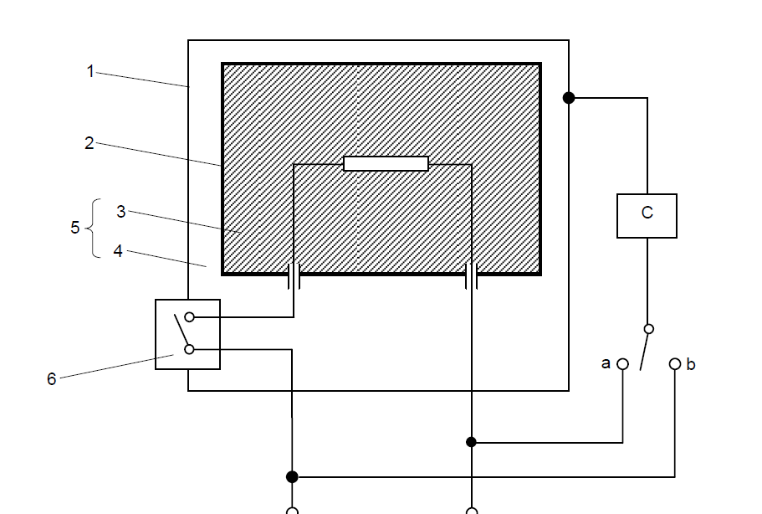
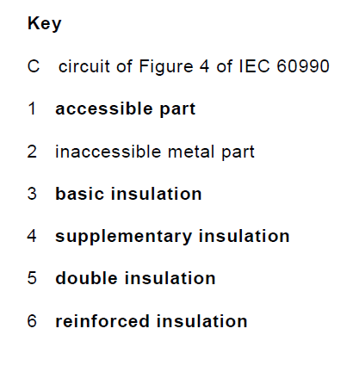
2a Leakage Current Test (Single Phase Class II)
IEC 60335-1: 2010, Figure 1

Slide 23
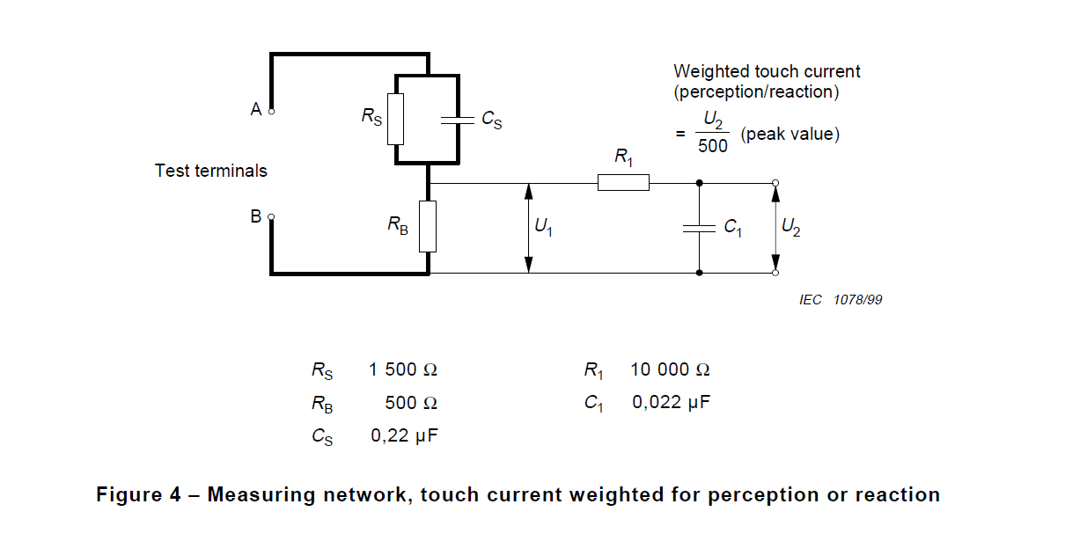
2a Leakage Current Test (Single Phase Class II)

Slide 24
2a Leakage Current Test (Single Phase Class II)
Test Instrument:
The measuring instrument is calibrated by comparing the frequency factor of U2 with the solid line in Figure F.2 of IEC 60990 at various frequencies. A calibration curve is constructed showing the deviation of U2 from the ideal curve as a function of frequency.

Slide 25
2a Leakage Current Test (Single Phase Class II)
Test Instrument:

Slide 26
2a Leakage Current Test (Single Phase Class II)
Accuracy of Equipment: (CTL 251C/ OP 113 V 1.1)
1. Power Source Voltage Meter:
Voltage: 0-1000V, DC to 1 kHz, +/- 1.5%
2 Leakage Current Meter :
  Voltage meter to measure U2: DC to 1 kHz, +/- 1.5%; 1 kHz to 5 kHz, +/- 2%;
5 kHz to 20 kHz, +/- 3%; 20 kHz and more, +/- 5%
an input impedance of at least 1 M ohm and an input capacitance no greater than
200 pfd. (This is not calibration requirement, but meter specification)
Resistors and capacitors used in the network need to have a tolerance of +/- 1.0 % or Individually selected for correct value by measurement. (It is not calibration requirement, but design requirement)
  The complete circuit as one leakage current meter :
up to 30 mA: 20 Hz- 100 k Hz +/- 3.5%; 100 k Hz – 1M Hz +/- 30%
30 mA above: 50 Hz -1 M Hz +/- 5%
3. Caliper (Measure the metal foil dimension): +/- 0.5 %

Slide 27
3a Touch Current Test (Single Phase, Class II )
IEC 60598-1:2008, Annex G
Method:
The luminaire is tested at an ambient temperature of 25 °C ± 5 °C and at rated supply voltage and frequency in the test circuit shown in Figure G.1.
The luminaire is operated with the lamp(s) of the type for which it is intended, such that, when stabilized at rated voltage, the lamp wattage and voltage of fluorescent and other discharge lamps are within ± 5 % of the rated values.
For the measurements of the touch current, the circuit specified in Figures G.1, and G.2 are used.
The test sequence shall be as detailed in Clause G.5. The standard test finger in accordance with IEC 60529 is used as the test probe and is applied to accessible metal parts, or accessible insulating parts wrapped in foil, 10 cm x 20 cm in size, of the luminaire body.
The voltage U2 in the measuring networks of Figure G.2 are peak voltages.

Slide 28
3a Touch Current Test (Single Phase, Class II )
IEC 60598-1:2008, Annex G
Method (Continue):
If frequencies above 30 kHz are involved, measurement of touch current shall include measurement with regard to electric burn effects in addition to measurement of Figure G.2. For the burn effects, the unweighted r.m.s. value of the touch-current is relevant. Unweighted touch-current is calculated from the r.m.s. voltage U1, measured across the 500 Ω resistor of Figure G.1
The terminal A electrode (standard test finger) shall be applied to each accessible part in turn.
For each application of the terminal A electrode, the terminal B electrode shall be applied to earth, then applied to each of the other accessible parts in turn.
For measurement on class II luminaires, the protective conductor is ignored.
The test circuit of Figure G.1 shall employ an isolating transformer.

Slide 29
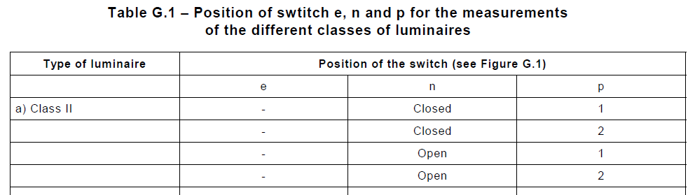
3a Touch Current Test (Single Phase, Class II )
IEC 60598-1:2008, Annex G
Test sequence:
The touch-current is measured as follows:
In the case of portable and adjustable luminaires incorporating a switch for use with fluorescent or other discharge lamps, the luminaire shall be switched off after the measurements. The luminaire is then switched on and before the lamp(s) restarts, the touch-current is measured again as stated in Table G.1.

Slide 30
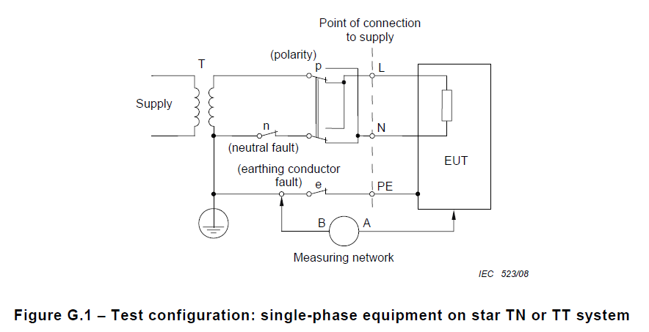
3a Touch Current Test (Single Phase, Class II )
IEC 60598-1:2008, Annex G

Slide 31
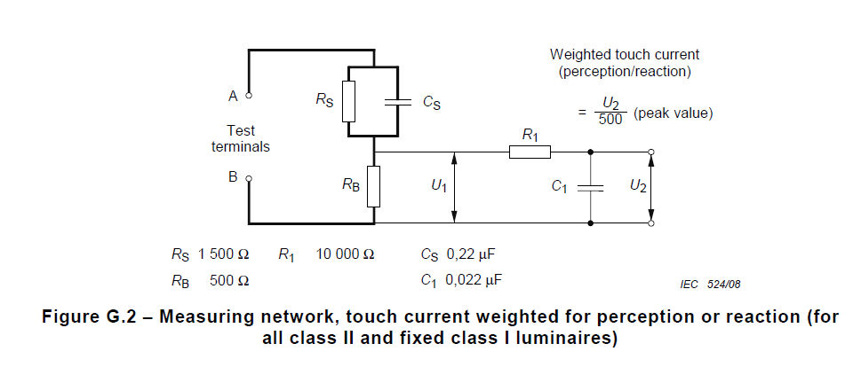
3a Touch Current Test (Single Phase, Class II )
IEC 60598-1:2008, Annex G

Slide 32
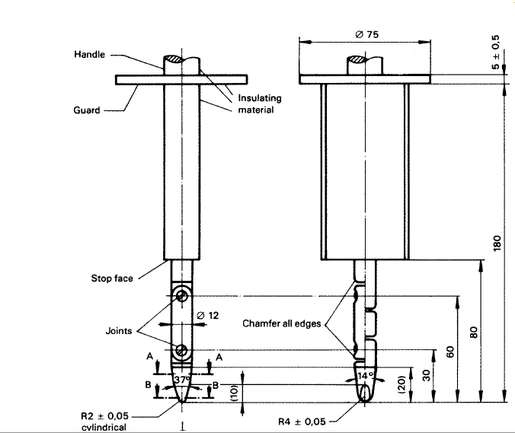
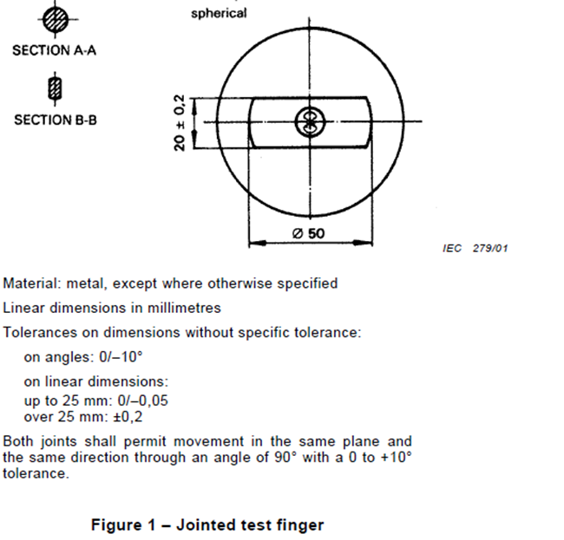
3a Touch Current Test (Single Phase, Class II )
IEC 60529, Standard Test Finger

Slide 33
3a Touch Current Test (Single Phase Class II)
Accuracy of Equipment: (CTL 251C/ OP 113 V 1.1)
1. Power Source Voltage Meter:
Voltage: 0-1000V, DC to 1 kHz, +/- 1.5%
2 Leakage Current Meter :
  Voltage meter to measure U2: DC to 1 kHz, +/- 1.5%; 1 kHz to 5 kHz, +/- 2%;
5 kHz to 20 kHz, +/- 3%; 20 kHz and more, +/- 5%
an input impedance of at least 1 M ohm and an input capacitance no greater than
200 pfd. (This is not calibration requirement, but meter specification)
Resistors and capacitors used in the network need to have a tolerance of +/- 1.0 % or Individually selected for correct value by measurement. (It is not calibration requirement, but design requirement)
  The complete circuit as one leakage current meter :
up to 30 mA: 20 Hz- 100 k Hz +/- 3.5%; 100 k Hz – 1M Hz +/- 30%
30 mA above: 50 Hz -1 M Hz +/- 5%
Caliper (Measure the metal foil dimension): +/- 0.5 %
Test Finger: See the figure for accuracy requirement
Temperature Measuring devices: +/- 2 degree C

Slide 34
3a Touch Current Test (Single Phase Class II)
Test Instrument:
The measuring instrument is calibrated by comparing the frequency factor of U2 with the solid line in Figure F.2 of IEC 60990 at various frequencies. A calibration curve is constructed showing the deviation of U2 from the ideal curve as a function of frequency.

Slide 35
3a Touch Current Test (Single Phase Class II)
Test Instrument:

Slide 36
Records of Audit
00-QA-F0407, V3.0 is used to record the audit results.
Audit Report Number |  | Page # | of
Facility/Lab Audited |  | Test Audit Plan Rev | 3.0
Auditor Name |  | Date
Test Field/Program | Electrical/ CBTL

Slide 37
Revision History
1.0 Initial Release

