Slide 1
How to find a contract in oracle r12
When you have a subscriber number
Prepared by Tovia Bat-Leah 4/16/15

Slide 2
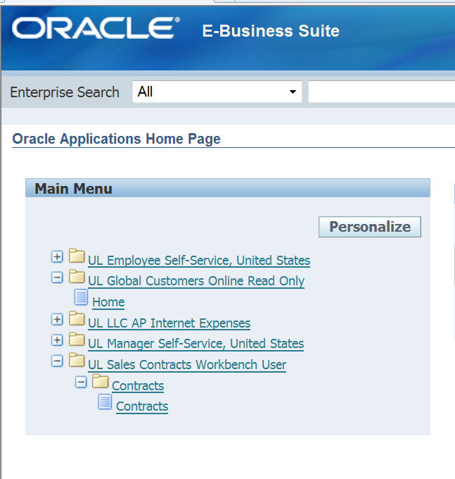
Notes:
Select home from UL global customer online read only

Slide 3
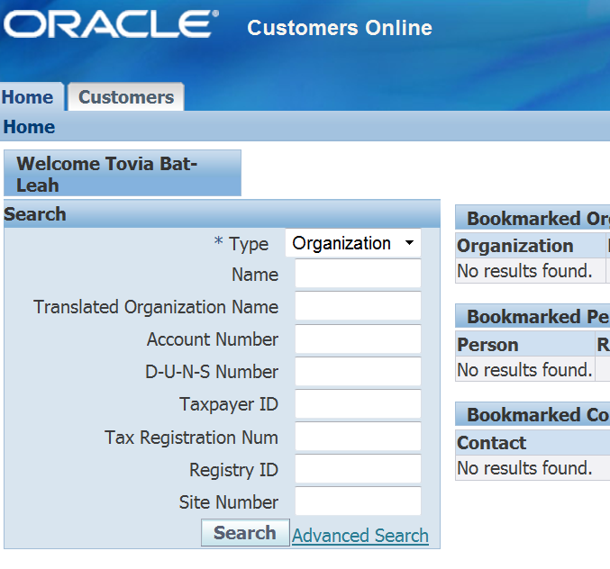
Notes:
Go to advanced search

Slide 4
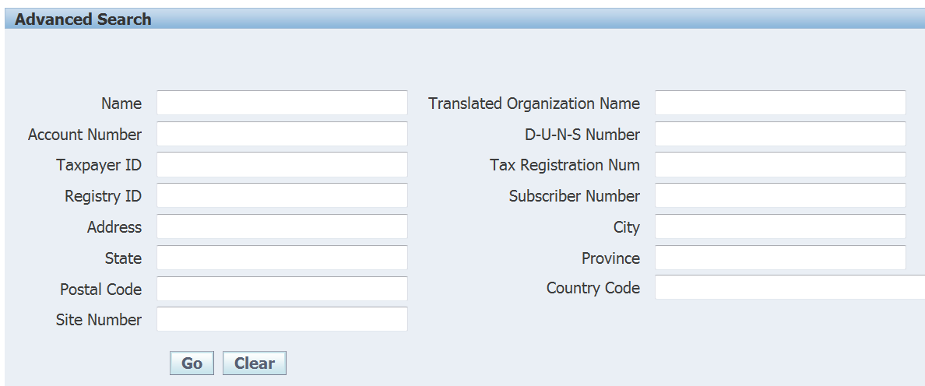
Notes:
Subscriber number 837288001 for example should be 837288-001

Slide 5
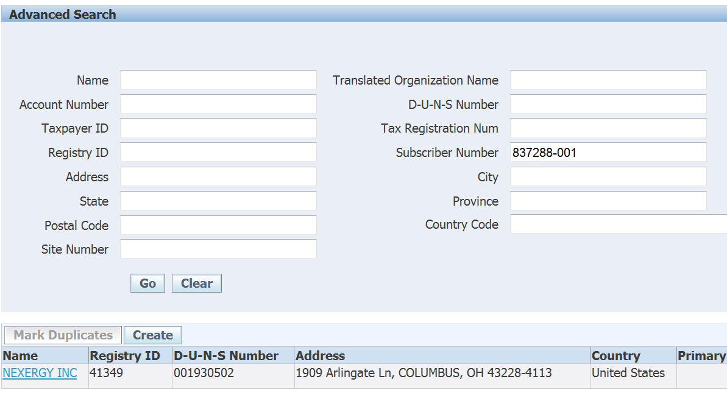
Notes:
Click on the name

Slide 6
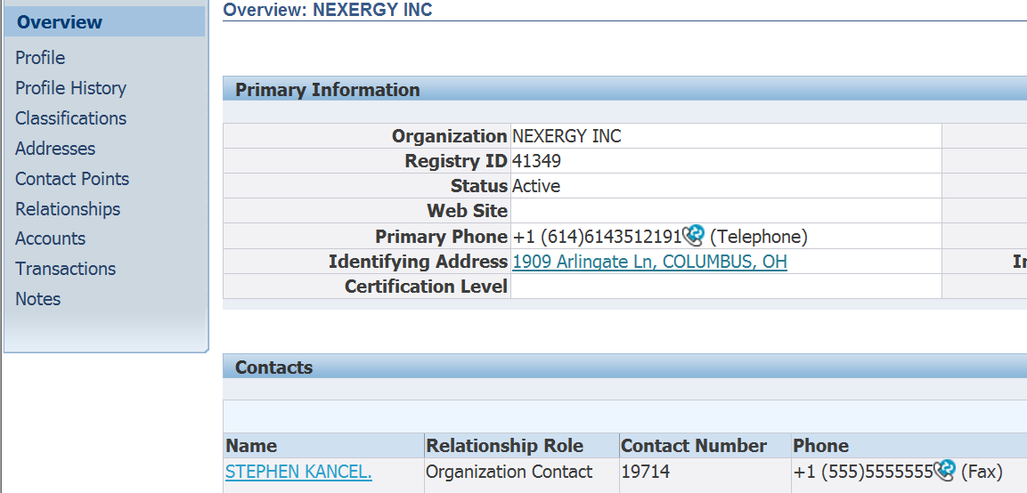
Notes:
Click on accounts

Slide 7
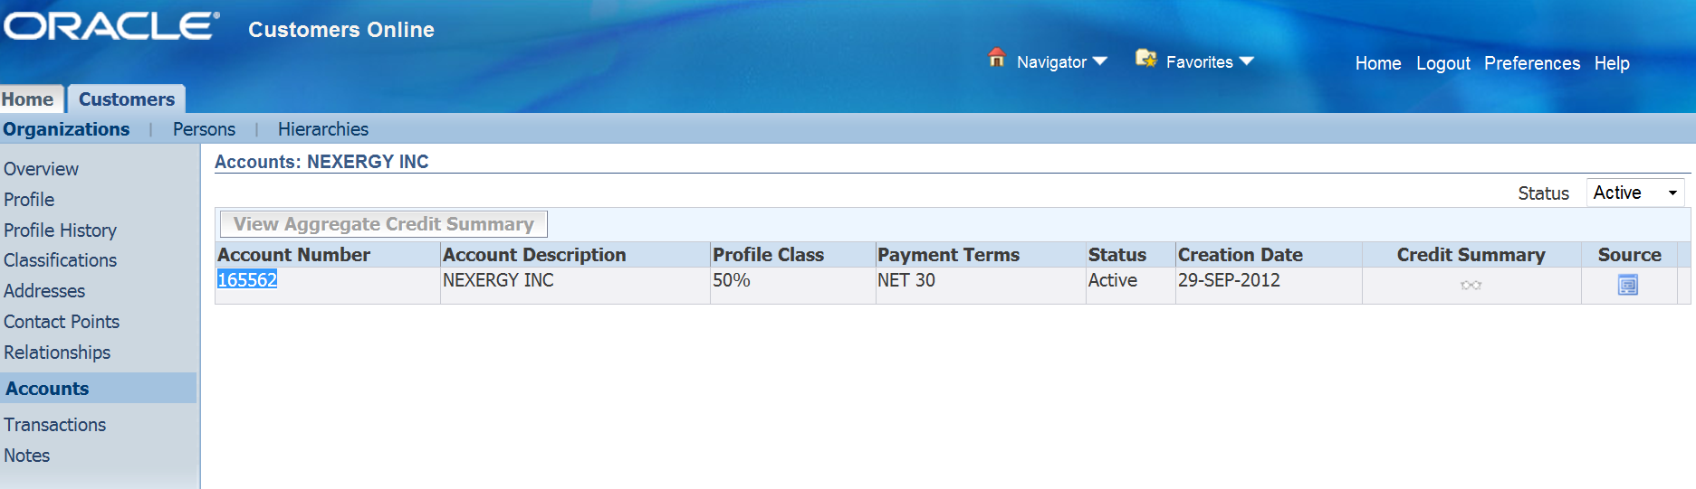
Notes:
Capture the account number which will be used as the customer number in the next search 165562 then click home on top

Slide 8
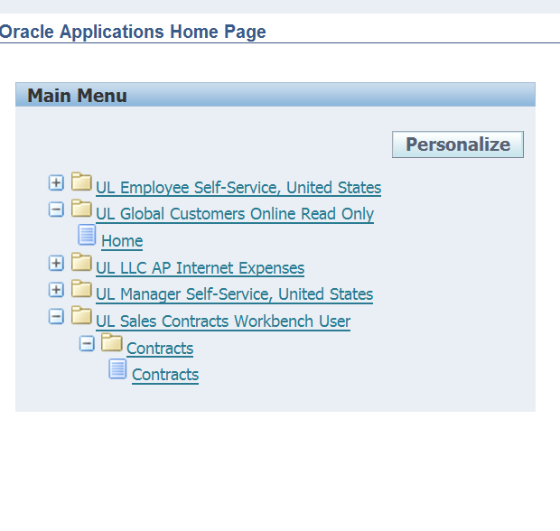
Notes:
Now go to the contract look up

Slide 9
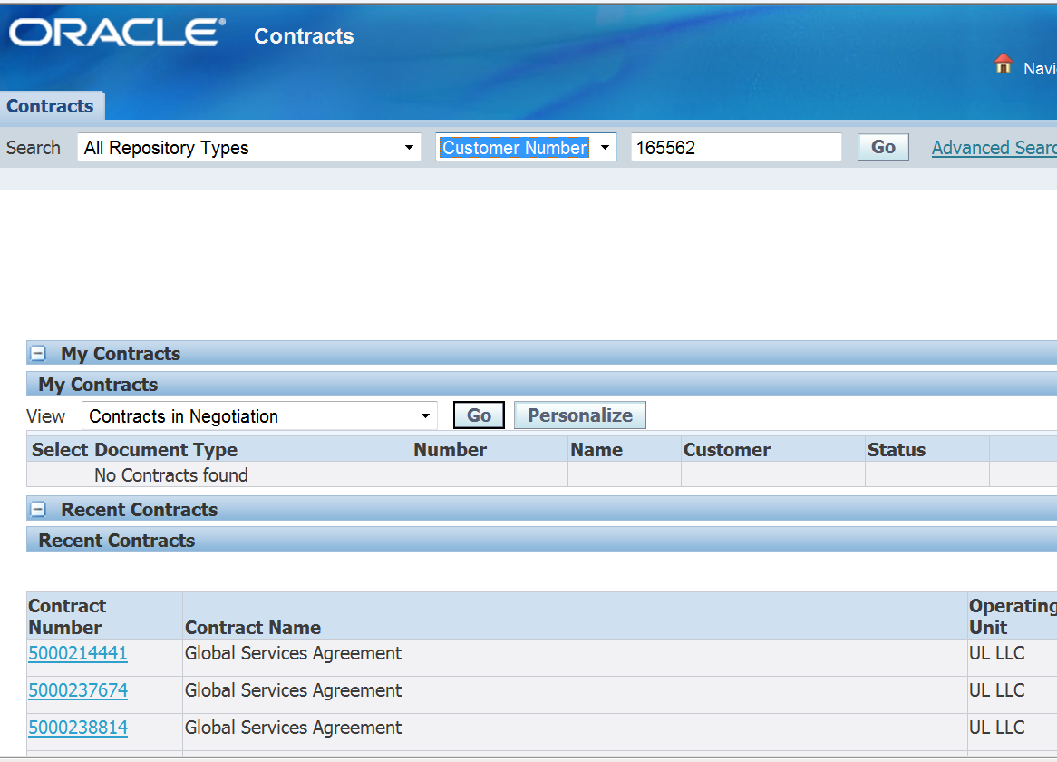
Notes:
Place the account number in the box and select customer number from the drop down menu and all repository types for all agreements, then click go

Slide 10
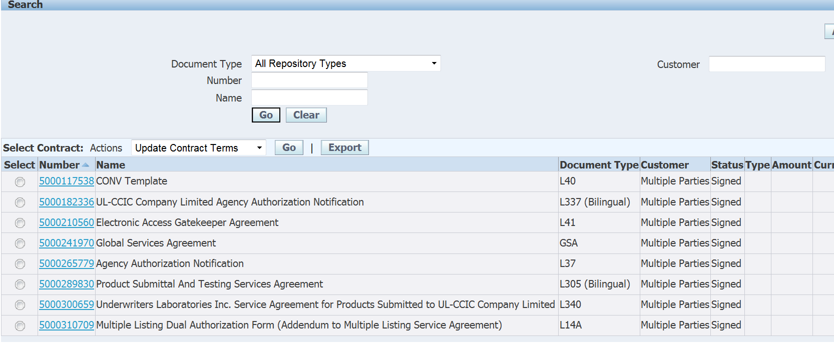
Notes:
Click the agreement you want to see

Slide 11
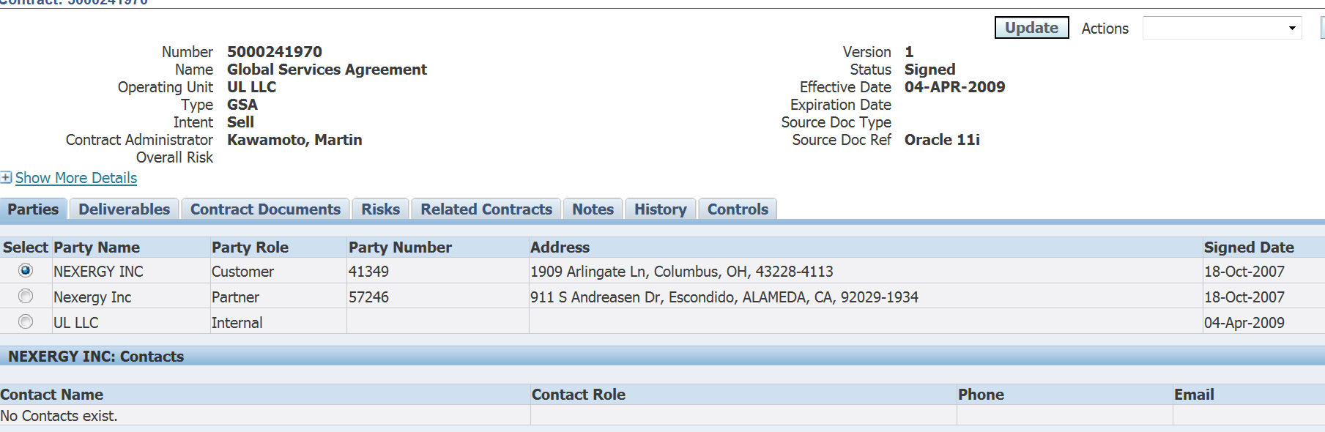
Notes:
Select contract documents

Slide 12
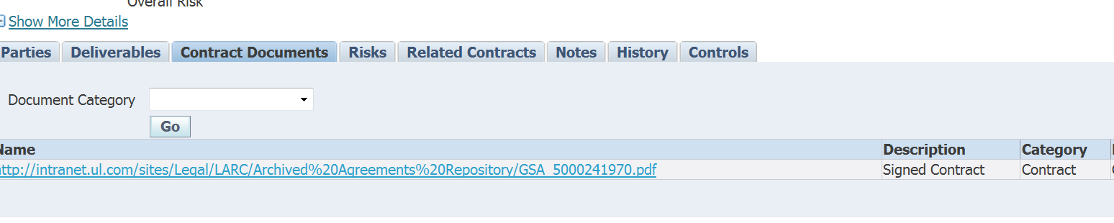
Notes:
Select the document

Slide 13
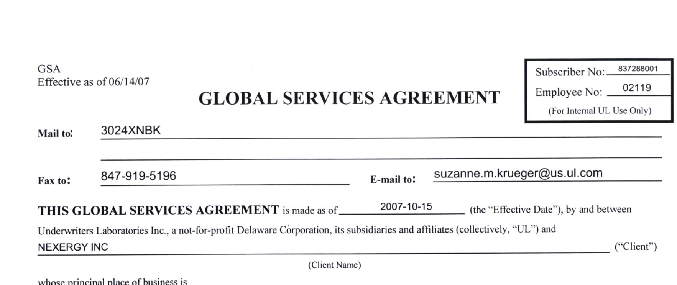
Notes:
See the contract !!

