Slide 1
IQA 2015 training
Jasmin Omerovic

Slide 2
Agenda
Schemes:
ATEX Directive - Equipment
ATEX Directive - Quality Audits
MID
IECEx System – Certified Equipment Scheme
UL Type Examination Certification

Slide 3
ATEX Directive – Eqipment Certification Scheme

Slide 4
ATEX Directive Equipment “Certification Scheme”
00-GC-P0869
Other than transition to EN ISO/IEC 17065 - no changes to the scheme as such.
UL’s ATEX Notified Body status is based on - EN ISO/IEC 17025 and EN ISO/IEC 17065 accreditations.
Accreditation body: DANAK – single appointed accreditation body in DK acc. to New Legislative Framework (from 2008)
Notified=Certification Body: UL International Demko A/S
Scheme owner(s) and regulator(s): Complexed picture, see next slide.

Slide 5
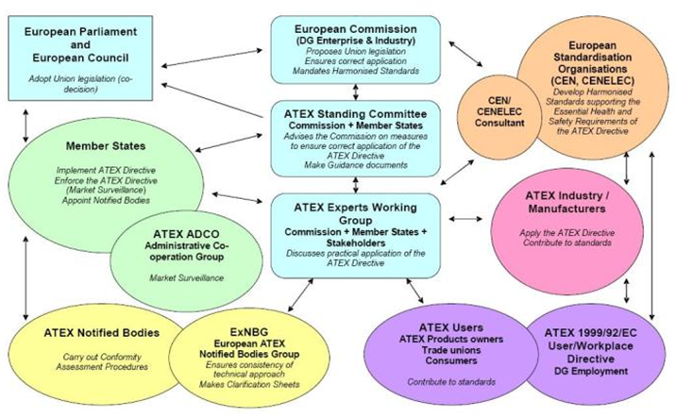
ATEX 94/9/EC – Overall Structure of stakeholders
Scheme Owner
Ministry
Country Scheme Owner
Notifying Authority
=
Regulator
Notified Bodies = Certification Bodies
http://ec.europa.eu/enterprise/sectors/mechanical/atex/directive-management/index_en.htm

Slide 6
ATEX Directive Equipment Certification Scheme – near future
Current ATEX directive will expire on April 19, 2016.
New 2014/34/EU directive applies from April 20, 2016.
- No technical changes.
- Same conformity assessment procedures.
- Changes affect economic operators, authorities, Notified Bodies.

Slide 7
ATEX Directive – Surveillance (Quality Audits)

Slide 8
ATEX Directive – Surveillance (Quality Audit ”Certification Scheme”) services
ATEXD Quality Audits are sold as a separate service – not a part of product certification services (i.e. EC-Type Examination Certificates).
Changes since last year:
Until now ATEX NB for QA modules (IV and VII) were based on product certification accreditation.
Now the requirement is:
- Either an accreditation mentioning specifically QA modules or
- Assessment directly by Notifying authorities (NA).
Consequence:
Assessment directly by NA to requirements of EA 2/17 i.e. compliance with product certification accreditation + cl. 9 of EN ISO/IEC 17021.

Slide 9
ATEX Directive – Surveillance (Quality Audit ”Certification Scheme”) services
The only exclusion of cl. 9 of ISO/IEC 17021 is the audit frequency – cl. 9.3.2.2 of ISO/IEC 17021 requires annual audits (max. 12 months)
BUT ExNB01/107 requires annual audits for non ISO9001 certified customers. Customers holding ISO 9001 certification require next audit to occur within max. 18 months.
Currently – no ATEX Q Audits Scheme Rules and Requirements (future 00-GC-P0868)
BUT
00-IC-S0053 (IECEx, ATEX and INMETRO Quality Audit Procedure) and related documents updated to align our processes and forms with ISO/IEC17021 (and other) requirements.

Slide 10
MID (Measuring Instruments Directive)

Slide 11
MID Equipment “Certification Scheme”
00-GC-P0873
Other than transition to EN ISO/IEC 17065 - no changes to the scheme as such.
UL’s ATEX Notified Body status is based on EN ISO/IEC 17065 accreditation
Accreditation body: DANAK – single appointed accreditation body in DK acc. to New Legislative Framework (from 2008)
Notified=Certification Body: UL International Demko A/S
Scheme owner(s) and regulator(s): Complexed picture, similar to ”ATEX landscape”. UL notified by Danish Safety Technology Authority.

Slide 12
IECEx System – Certified Equipment Scheme (incl. Conformity Mark Licensing Scheme) + Certified Service Facilities Scheme

Slide 13
IECEx System – Certified Equipment Scheme
00-GC-P0871
One of IEC CA Systems – voluntary scheme.
Type 5 scheme (according to ISO 17067) – product evaluation + surveillance (quality audit).
Other than transition to EN ISO/IEC 17065 - no significant changes to the scheme as such.
2 ExCBs (IECEx Certification Bodies): UL LLC and UL International Demko A/S
2 ExTLs (IECEx Testing Laboratories): UL LLC and UL International Demko A/S and
1 Affiliated ExTL: UL Taiwan (to be approved shortly).
Scheme owner: IEC / IECEx System.
Conformity Mark Licensing Scheme and Certified Service Facilities Scheme (only under UL LLC ExCB) – limited activity: No significant changes.

Slide 14
UL Type Examination Certification

Slide 15
UL Type Examination Certification Scheme
00-GC-P0867
Scope: Safety and EMC
Other than transition to EN ISO/IEC 17065 - no changes to the scheme as such.
Scheme owner: UL
Certification Body: UL International Demko A/S

Slide 16
Questions?

Slide 17
THANK YOU.

