Slide 1
IQA – ISO/IEC 17065 Training. UL Demko Certification body
May , 2015
Jan-Erik Storgaard

Slide 2
Agenda
Compliance Manual
Cl. 4.2 ”Management of Impartiality”
Cl. 5.2 ”Mechanism for Safeguarding Impartiality”
Cl. 6.1.2 , ”Management of competence for personel involved in the Certification Process
Cl. 8.0 ”Management System Requirements”
Cl. 8.5 Manegement review (Option A)
Transition audit from Guide 65(EN 45011) to ISO/IEC 17065.
Document Overview

Slide 3
Compliance Manual
Development of UL DEMKO Certification Body Compliance Manual, based on the ISO/IEC 17065, the manual shall be read in conjunction with Global Certification Compliance Manual.
00-CB-P0854, Global Certification Compliance Manual
00-CB-P0869, UL DEMKO Certification Body Compliance Manual

Slide 4
Cl. 4.2 ”Management of Impartiality”
Risk to Impartiality is identified by UL Demko CB to demonstrate how it mitigated, elimated or mimized such risk by using Risk assesment Management form(20-CB-F0850).
UL Demko CB top Management ensure to be in compliance with the Standard of Business Conduct(00-LE-P0001), Conflict of Interest(00-LE-P0026) and Impartiality Policy(00-CE-P0852).
The UL DEMKO, not part of Designer, Manufacturer, Installer etc.

Slide 5
Cl. 5.2 ”Mechanism for Safeguarding Impartiality”
Procedure 20-IC-S0038, ”Certification Commitee” was obsoleted.
New Procedure was published 20-CB-S0851, ” Certification Committee (MECHANISM) for UL International Demko A/S”
The Procedure describe the Roles, Responsibilitites and that the Commitee is allowed take independent action(e.g. accrediation bodies) if the UL Demko CB doesn´t follow the input.
Risk to Impartiality (Risk assesment Management form(20-CB-F0850)) which was identified by UL Demko CB is presented to the Commitee (Mechanism).
The Commitee provide input to the completed Risk Assesment analyze , the comments, recommendation etc. is captured in the meeting Minutes and Annual Management Review(AMR).

Slide 6
Cl. 6.1.2 , ”Management of competence for personel involved in the Certification Process.
Procedure 20-IC-S0041, ” Certification Personnel Qualification Program” was obsoleted.
Procedure 20-IC-S0420, ” Certification Personnel Qualification Program” was obsoleted.
New Procedure was published 20-IC-S0851, ” Training, Qualification and monitoring requirements for certification staff under UL Demko Certification body”.
The Procedure include the more detailed requirements for qualification, Monitoring etc.

Slide 7
Cl. 8.0 ”Management System Requirements”
8.1.2 Option A, The UL Demko CB has established and maintains a manegement system of achieving the consistent fulfilment of ISO/IEC 17065:2012 in accordance with option A.
8.2, The UL Demko CB Quality Manegement handbook and UL Global Quality Manual (20-QA-P0025 and 00-QA-P0001) describes the fulfillment of Manegement system documentation.

Slide 8
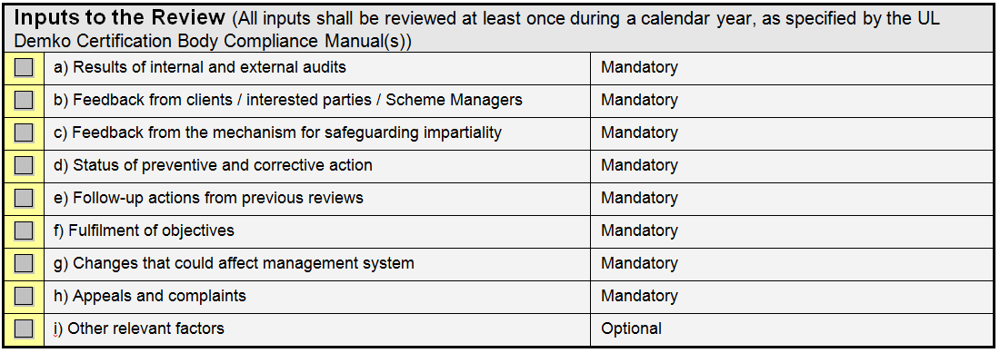
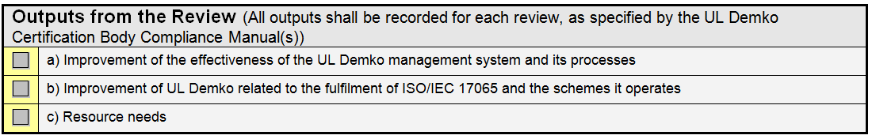
Cl. 8.5 Manegement review (Option A)
The Form 20-QA-S0026, ” Management Review 2010 of UL Demko’s Quality System” was obsoleted.
New Form was published 20-CB-F0851, ” UL Demko Management Review Report Form”, the form includes;

Slide 9
Guide 65 (EN45011) to ISO/IEC 17065 Transistion
UL International Demko A/S had a transition audit April 23, 2015.
The Result of the audit was 0 Findings.
It was agreed with DANAK that meeting with the new Mechanism(Certification Commitee) on May 26, 2015. The outcome of presented Risk assesment shall be send to DANAK.
Next step is to present the outcome/conclusion of the Certification Commitee discussion on the completed Risk Assesment to the DANAK Accrediation commitee.
Its expected that the Accrediation Commitee will complete the transistion to ISO/IEC 17065 by end June, 2015.

Slide 10
New QMS Document references
00-CB-P0854, Global Certification Compliance Manual
00-CB-P0869, UL DEMKO Certification Body Compliance Manual
00-CE-P0852, Impartiality Policy
20-CB-S0851, Certification Committee (MECHANISM) for UL International Demko A/S
20-CB-F0851, UL Demko Management Review Report Form
20-CB-F0850, Risk Assesment Manegement form
20-IC-S0851, Training, Qualification and monitoring requirements for certification staff under UL Demko Certification body

Slide 11
New QMS Document references
00-GC-P0866, GS Mark Scheme Policy
00-GC-P0865, D-Mark Scheme Policy
00-GC-P0864, ENEC Scheme Policy
00-GC-P0869, ATEX Scheme Policy
00-GC-P0871, IECEx Scheme Policy
00-GC-P0873, MID Scheme Policy
00-GC-P0861, UL-EU Scheme Policy
00-GC-P0878, CCA Scheme Policy

