Slide 1
Witness tests at CBTL during IQA in 2016
October 1, 2015 V 1.0
For questions or comments on the content, please contact Kyle Huang or Denise Echols

Slide 2
Agenda
Background
General
Witness Tests under IEC 60950-1
Witness Tests under IEC 60065
Witness Tests under IEC 60335-1
Witness tests under IEC 60598-1
Records of Audit

Slide 3
Background
Lab test capability is part of an IECEE CBTL Assessment. Some CARs generated from IECEE CBTL assessments focused on lab test capability, specifically equipment, critical consumables, or test methods not in compliance with the IEC standard requirements.
Though some UL standards for final products have been harmonized with IEC standards, they still have differences in small details, due to the structure of IEC standards, CTL Decision Sheets published by IECEE CB Scheme, IEC TC Interpretation Sheets and the traditional approach of UL that includes the use of Certification Requirement Decisions and PAGs developed by UL PDE’s.
Note: IEC TC Interpretation Sheets: http://decisions.iecee.org/iecee/SearchCMC.nsf/home?OpenForm&Start=1&Count=30&Expand=3&Seq=5

Slide 4
General
Following tests are selected by CB program owner for witness of test in 2016.
1) Test under IEC 60950-1
a. Resistance of Earthing Conductor
2) Test under IEC 60065
a. Bump Test
3) Tests under IEC 60335-1
a. Moisture Resistance (IPX3 only)
4) Tests under IEC 60598-1
a. Electrical Strength Test
If a CBTL has capability in several above categories, all tests applicable need to be witnessed.

Slide 5
General
Corporate Internal Quality Audits will focus on lab testing capability during on-site audits of UL labs based on their existing CBTL scopes.
A group of tests selected will be reviewed by IQA auditors. Nonconformance will be documented in the GCAR Database. The list of tests assessed will be included in the audit records.
The corrective action will be handled according to the Global Corrective Action Procedure. If a systemic issue is found, the corrective action may be escalated for effective resolution across UL.
Corporate Quality Manager will maintain a list of tests selected in an ongoing CBTL Audit Plan. There is no intent to cover every test in every standard. However, assessments will cover various types of testing activities under CBTL scopes in a period of time obtained from program management input.

Slide 6
General
The list of tests need to be included in Attachment A of the Scope letter and communicated to local contact before the audit so the site can arrange the resource for the audit.

Slide 7
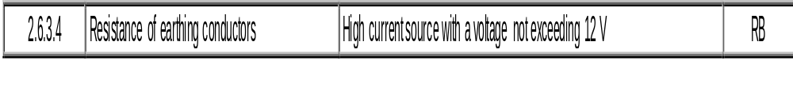
1) a. Resistance of Earthing Conductors
IEC 60950-1: 2005 +A1+A2, Clause 2.6.3.4
CTL Equipment list:
http://iecee.org/ctl/equipment/pdf/off/Equipment_list_60950_1_2nd_ed_A1_A2_2014_06_17.doc

Slide 8
1) a. Resistance of Earthing Conductor
Method:
The voltage drop in a PROTECTIVE BONDING CONDUCTOR is measured after applying the test current for the time period specified below. The test current can be either a.c. or d.c. and the test voltage shall not exceed 12 V. The measurement is made between the main protective earthing terminal and the point in the equipment that is required by 2.6.1 to be earthed. The
resistance of the PROTECTIVE EARTHING CONDUCTOR is not included in the measurement. However, if the PROTECTIVE EARTHING CONDUCTOR is supplied with the equipment, it is permitted to include the conductor in the test circuit but the measurement of the voltage drop is made only from the main protective earthing terminal to the part required to be earthed.
Note: Earthing in IEC standards is similar to Grouding in UL standards.

Slide 9
1) a. Resistance of Earthing Conductor
Method (Continued):
The test current, duration of the test and test results are as follows:
For equipment powered from a MAINS SUPPLY, if the PROTECTIVE CURRENT RATING of the circuit under test (see 2.6.3.3) is 16 A or less, the test current is 200 % of the PROTECTIVE CURRENT RATING applied for 120 s.
For equipment powered from an AC MAINS SUPPLY, if the PROTECTIVE CURRENT RATING of the circuit under test exceeds 16 A, the test current is 200 % of the PROTECTIVE CURRENT RATING and the duration of the test is as shown in Table 2E. (Note: For normal US product, it is 40A for 120 s)
The resistance of the PROTECTIVE BONDING CONDUCTOR, calculated from the voltage drop, shall not exceed 0.1 Ω . After the test, the PROTECTIVE BONDING CONDUCTOR shall not be damaged.
Definition of PROTECTIVE CURRENT RATING (1.2.13.17):
rating of an overcurrent protective device that is know or assumed to be in place to protect a circuit.

Slide 10
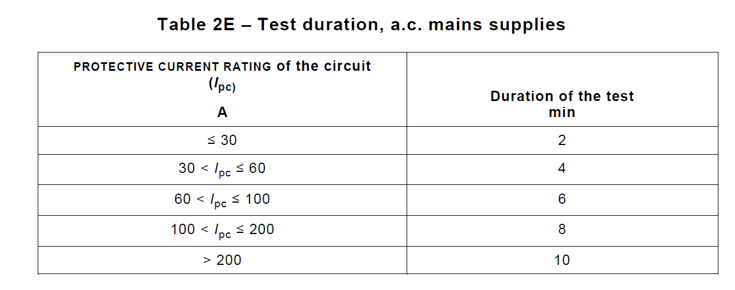
1) a. Resistance of Earthing Conductor

Slide 11
1) a. Resistance of Earthing Conductor
Method (Continued): (Clause 2.6.3.3)
The PROTECTIVE CURRENT RATING of the circuit depends on the provision and location of overcurrent protective devices. It shall be taken as the smallest of a) or b) or c), as applicable.
a) For PLUGGABLE EQUIPMENT TYPE A, the PROTECTIVE CURRENT RATING is the rating of an overcurrent protective device provided external to the equipment (for example, in the building wiring, in the mains plug or in an equipment rack) to protect the equipment, with a minimum of 16 A.
NOTE 1 In most countries, 16 A is considered to be suitable as the PROTECTIVE CURRENT RATING of the circuit.
NOTE 2 In Canada and the United States, the PROTECTIVE CURRENT RATING of the circuit is taken as 20 A.
NOTE 3 In the United Kingdom, the current rating of the circuit shall be taken as 13 A, not 16 A.
b) For PLUGGABLE EQUIPMENT TYPE B and PERMANENTLY CONNECTED EQUIPMENT (see 2.7.1), the PROTECTIVE CURRENT RATING is the maximum rating of the overcurrent protective device specified in the equipment installation instructions to be provided external to the equipment (see 1.7.2.3).
c) For any of the above equipment, the PROTECTIVE CURRENT RATING is the rating of an overcurrent protective device, if provided in or as part of the equipment, that protects the circuit or part required to be earthed.

Slide 12
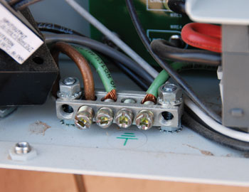
1) a. Resistance of Earthing Conductor
Bonding is the practice of connecting all accessible metalwork – whether associated with the electrical installation (known as exposed metalwork) or not (extraneous metalwork) – to the system earth.

Slide 13
1) a. Resistance of Earthing Conductor
Accuracy of the instrument verified through instrument specification and confirmed by recent calibration certificate:
1. Amp Meter : 1.5% ( up to 5 A); 2.5% ( above 5 A)
2. Voltage Meter : 1.5%
3. Timer: 1%
Note: Check the instrument specification first and ensure it meets the requirement above.

Slide 14
2) a. Bump Test
IEC 60065: 2010 +A1+ A2 Clause 12.1.2
Apparatus with a mass exceeding 7 kg are subjected to the following test.
The apparatus is placed on a horizontal wooden support, which is allowed to fall 50 times from a height of 5 cm onto a wooden table.
After the test, the apparatus shall show no damage in the sense of this standard.
Note: The fall of apparatus with the wooden support should be free fall. No damage is only related to Safety concerns, such as access of live parts, reduce of creepage and clearance and etc.

Slide 15
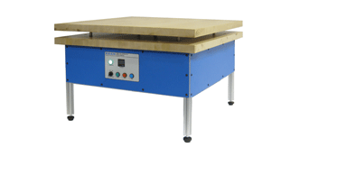
2) a. Bump Test
IEC 60065: 2010 +A1+ A2 Clause 12.1.2
Example of Bump Tester:

Slide 16
2) a. Bump Test
Accuracy of the instrument verified through instrument specification and confirmed by recent calibration certificate:
Mass Measurement: 5%
Ruler, Tape Measure, or Caliper ( to measure 5 cm) or Bump tester: 0.5%

Slide 17
3) a. Moisture Resistance
IEC 60335-1:2010 Clause 15.1.1
Appliances other than those classified IPX0 are subjected to the tests of IEC 60529 as follows:
– IPX3 appliances as described in Subclause 14.2.3a;
( Note: IPX3 appliances shall be able to withstand 60 degree spray water)
Compliance is checked as specified in 15.1.1 taking into account 15.1.2, the appliance not being connected to the supply mains.
The appliance shall then withstand the electric strength test of 16.3 and, after carefully wiping the external enclosure to remove any surplus water, an inspection shall show that there is no trace of water on insulation which could result in a reduction of clearances or creepage distances below the values specified in Clause 29.
For IPX3 appliances, the base of wall-mounted appliances is placed at the same level as the pivot axis of the oscillating tube.

Slide 18
3) a. Moisture Resistance
IEC 60529:1989 +A1 Clause 14.2.3 a (Amendment 2 shall not be included, because IEC 60335-1 does not reference Amendment 2.)
Conditions when using the test device as in figure 4 (oscillating tube):
The total flow rate is adjusted as specified in table 9 and is measured with a flow meter.
The oscillating tube is provided with spray holes over an arc of 60° either side of the centre point. The support is not perforated. The enclosure to be tested is placed at the centre point of the semicircle. The tube is caused to oscillate through an angle of 120°, 60° on either side of the vertical, the time for one complete oscillation (2 × 120°) being about 4 s and the test duration being 5 min.
The enclosure is then turned through an horizontal angle of 90° and the test is continued for a further 5 min.
The maximum acceptable radius of the oscillating tube is 1 600 mm.

Slide 19
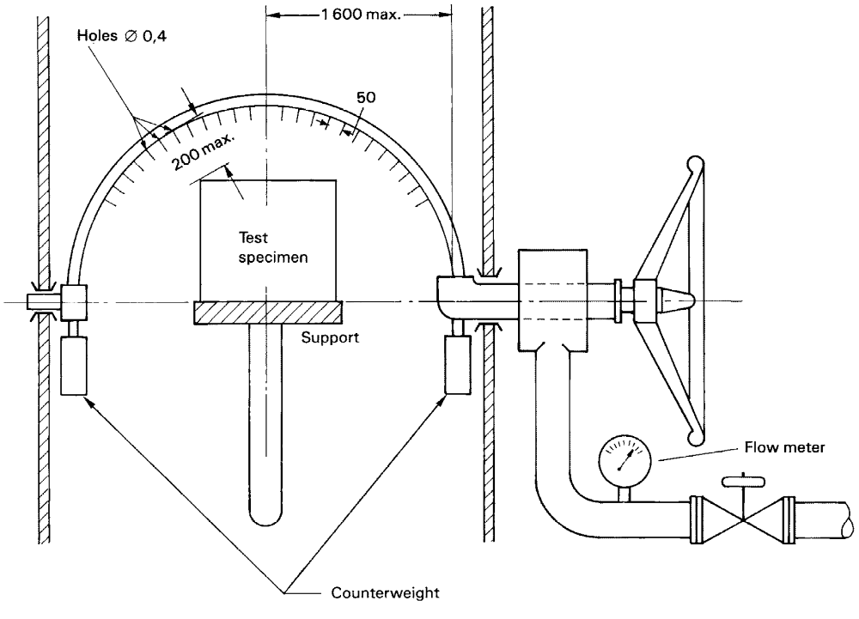
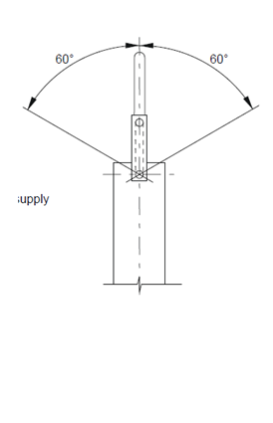
3) a. Moisture Resistance
Front View
Side View
Unit: mm

Slide 20
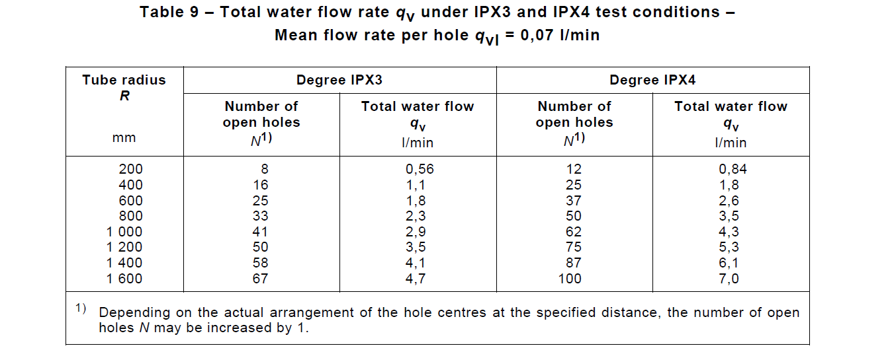
3) a. Moisture Resistance

Slide 21
3) a. Moisture Resistance
Equipment
Rain Test Apparatus
  Verification of Oscillation Speed, approximately 4 seconds
  Verification of Dimension:
    Hole diameter, 0.4 mm
    Distance between holes, 50 mm
    Distance between EUT and Oscillation Loop, 200 mm Max
  C) Verification of Oscillation angles, 60 degree
  D) Verification of Water flow rate per table 9
2) Timing Devices

Slide 22
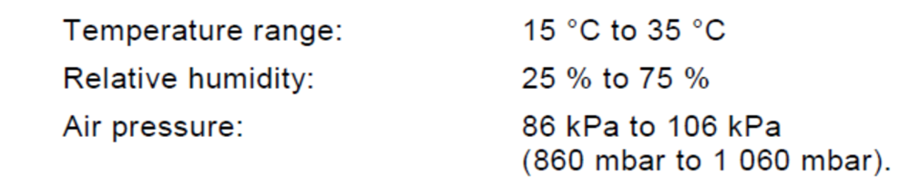
3) a. Moisture Resistance
Additional verification required but very often missed causing NCR
1. According to IEC 60529, test engineer should verify that
2. During the tests for IPX1 to IPX6 the water temperature should not differ by more than 5 K from the temperature of the specimen under test. If the water temperature is more than 5 K below the temperature of the specimen a pressure balance shall be provided for the enclosure

Slide 23
4) a. Electric Strength Test
IEC 60598-1:2014 Clause 10.2.2
A voltage of substantially sine-wave form, with a frequency of 50 Hz or 60 Hz and the value specified in Table 10.2, shall be applied for 1 min across the insulation shown in that table.
Initially, no more than half the prescribed voltage shall be applied, it is then raised gradually to the full value.
For the high-voltage transformer used for the test, when the output terminals are short-circuited after the output voltage has been adjusted to the appropriate test voltage, the output current shall be at least 200 mA.
The overcurrent relay shall not trip when the output current is less than 100 mA. (The overcurrent rely is protective device for the equipment, which is not used during the verification above)
Care shall be taken that the r.m.s. value of the test voltage applied is measured within ±3 %.

Slide 24
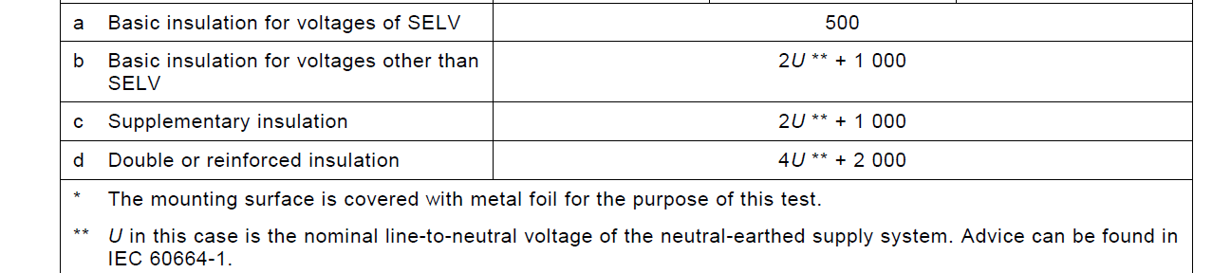
4) a. Electric Strength Test
IEC 60598-1:2014 Clause 10.2.2

Slide 25
4) a. Electric Strength Test
Equipment
Wave-form Verification method (IEC 60118-2:1994, clause 6.1)
Voltage wave-form
The output voltage of the test equipment shall be measured simultaneously with two reference measuring systems connected in parallel, one of which shall be a peak reading system and the other a true r.m.s. reading system. The ratio of peak to r.m.s. values shall be equal to a SQRT (2) +/- 5 % .

Slide 26
4) a. Electric Strength Test
Equipment
Dielectric Tester
1.2) Accuracy of the instrument verified through instrument specification and confirmed by recent calibration certificate
Voltage 1000 V and above, DC to 1KHz, +/- 3%
Voltage under 1000 V, DC to 1 K Hz, +/- 1.5%
2) Timer or Timing Function on Dielectric Tester: +/- 1%

Slide 27
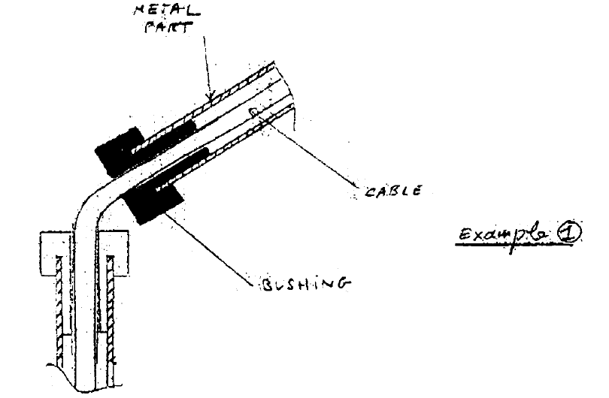
4) a. Electric Strength Test
If the product has bushing, the testing / evaluation staff should be able to reference CTL DSH 910 for the dielectric voltage value:
In IEC 60598-1 1999 there are no specific requirements for bushing in the Tables of clause 10. Two examples are presented (see the attached figures). What values are applicable for the dielectric strength test?
Decision:
Example 1: if the luminaire is class I, it is enough to use a double insulated cable and fulfil mechanical requirements. If the luminaire is class II, requirements for supplementary insulation apply to the bushing.

Slide 28
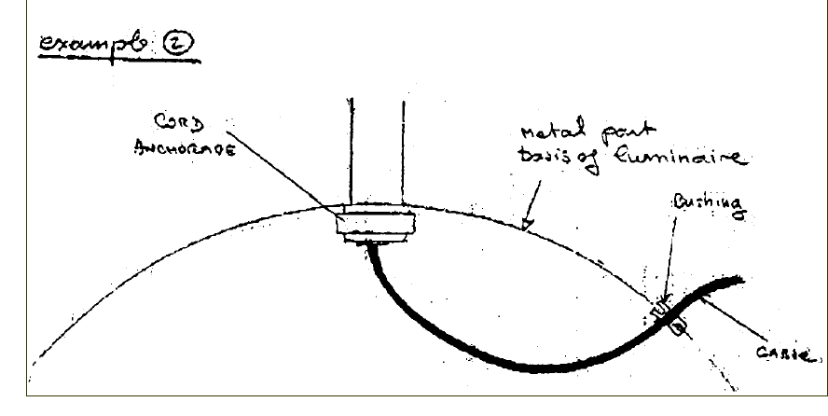
4) a. Electric Strength Test
CTL DSH 910
In IEC 60598-1 1999 there are no specific requirements for bushing in the Tables of clause 10. Two examples are presented (see the attached figures). What values are applicable for the dielectric strength test?
Decision:
Example 2: creepage distances and clearances on bushings must be measured only for the outside of the luminaire. It should be judged case by case.
.

Slide 29

CTL Decision Sheet 251
CTL DSH 251B is replaced by CTL DSH 251E in May 2015.

Slide 30

Records of Audit
00-QA-F0407, V3.0 is used to record the audit results.
Audit Report Number |  | Page # | of
Facility/Lab Audited |  | Test Audit Plan Rev | 5.0
Auditor Name |  | Date
Test Field/Program | IECEE CB scheme

Slide 31
Revision History
1.0 Initial Release
2.0 Add notes on Slide 3 and 13; Add slide 14 ( Bump Tester image); Add Unit of measurement on Slide 18; Delete Internal Tube Diameter in Slide 20.

