Slide 1
Estimation of uncertainty of measurement
For Internal Quality Auditor, UL

Slide 2
Introduction
This session is to help the internal quality auditor understand the basic information about Estimation of uncertainty of measurement.
It will not cover the details of calculation and statistics theory.

Slide 3
Content
Overview
Terminology I
General Uncertainty Components Considered
Terminology II
Basic Statistics
Basic Calculation Model
Requirements from ISO/IEC 17025
Typical Questions Used During The Audit At Testing Laboratory
Topics not covered

Slide 4
Overview
Estimation of uncertainty of measurement :
What: Estimate the possible difference between the measured value and the “True Value”.
Purpose: An effort to ensure traceability and comparability of the measurement.
Why: The requirement of ISO/IEC 17025 (Sec. 5.4.6)

Slide 5
Terminology I
True Value:
Definition: The attribute or parameter of measured subject.
Example: However, it is difficult to know, except some defined physical phenomena, such as the length of the path traveled by light in vacuum during a time interval of 1/299792458 of a second is one meter.
Uncertainty of Measurement:
Definition: A lack of confidence in the perceived value of an attribute or parameter determined through measurement.
Meaning: The data got from measurement may not be the true value, so we want to know how far it may be from the true value

Slide 6
General Uncertainty Components Considered (I)
The contributor of instrument from calibration
Meaning: The error passing along with the calibration. (Uncertainty of Measurement Statement from Calibration Certificate)
The contributor of instrument from long term stability
Meaning: The performance of the instrument fluctuates during the period of calibration. (The possibility that the instruments remains within the tolerance)
The contributor of instrument from specification
Meaning: The capability of the instrument, such as resolution, designed accuracy. Such as resolution: 0.001V, accuracy: 0.5% full scale+/- 0.002V from instrument instruction manual.

Slide 7
General Uncertainty Components Considered (II)
The contributor from test method
Example: 1) Different circuit to measure resistance using voltage meter and current meter will introduce the different error. 2) The Four Lead Method to measure resistance is better than the normal Two Lead Method, especially for low resistance.
The contributor from environment
Example: Temperature, Air pressure, Gravity, Humidity, if it is not specified by Test Method
The contributor from personnel
Example: 1) Measuring points if it is not specified by Test method;
2) The reading difference if the instrument is not digital.

Slide 8
Terminology II
Level of Confidence:
Definition: The possibility that the estimation is correct.
K:
Definition: The multiplier based on the sample size in T distribution. Meaning: It is the indicator for the possibility in T distribution. Example: “K=2” is similar to “ Level of Confidence = 95%”.
Type A Estimate:
Definition: Estimate obtained by data Sampling.
Type B Estimate:
Definition: Estimate obtained heuristically.
Meaning: A heuristic estimate is one based on recollected experience or engineering knowledge.

Slide 9
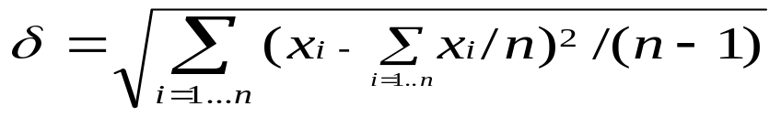
Terminology II (Continued)
Independent:
Two events are independent if the occurrence of one of the events gives us no information about whether or not the other event will occur; that is, the events have no influence on each other.
Distribution: (Statistical Distribution)
The quantity of deviation from the mean with respect to the relative probability of occurrence.
Standard Deviation:
The square root of the sum of the squared deviations from the mean divided by “n-1”.

Slide 10
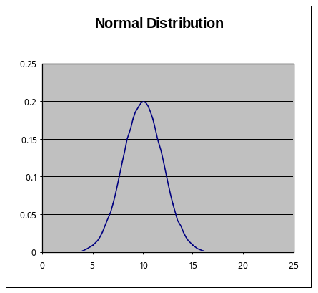
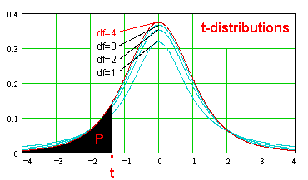
Basic Statistics Used
3 common types of distribution used during the estimation: Normal, T and Rectangular.
The overall estimation of the uncertainty of measurement uses Normal Distribution or T Distribution
The Type A Estimation uses Normal Distribution or T distribution
The Type B Estimation may use Normal Distribution or Rectangular Distribution.

Slide 11

Basic Calculation Model
Determine the type of Estimate and Distribution for individual contributions:
The contribution of Instrument: Type B Estimate
The contribution from Test Method: Type B Estimate
The contribution from Personnel: Type A Estimate
The contribution from Environment may use Type A or Type B.
Standard Deviation is calculated independently for all estimate.
Root Sum Square formula is used to combine the contributions from all the estimates and get the Standard Deviation of the total results, assuming that all sources estimated are independent. If some sources are not independent, the correlation of those errors shall be considered.
Based on Normal Distribution or Student T distribution, expend the Estimate from standard deviation to 95% of confidence level or K=2

Slide 12
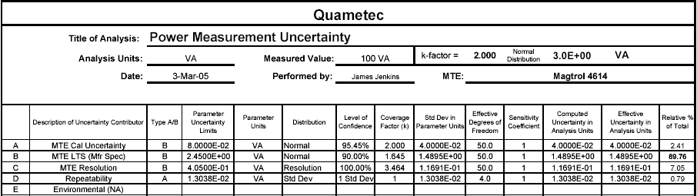
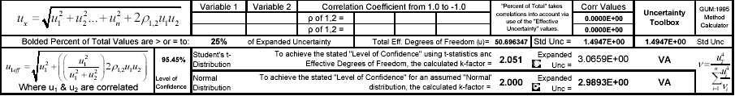
A Simple Example
This estimate of uncertainty is applicable to the measurement of power using the Magtrol 4614 Power Analyzer at the 5 Amp Range and the 125 VAC Range equaling a 750 VA Range.

Slide 13
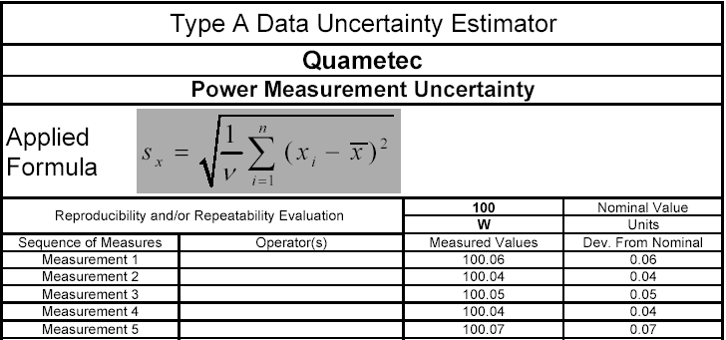
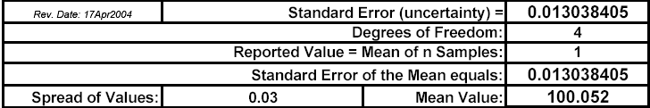
A Simple Example(Continued)

Slide 14
Requirements from ISO/IEC 17025
A calibration laboratory, or a testing laboratory performing its own calibrations, shall have and shall apply a procedure to estimate the uncertainty of measurement for all calibrations and types of calibrations. (5.4.6.1)
Note to auditor: All calibrations need to have a procedure and an estimation.

Slide 15
Requirements from ISO/IEC 17025 (continued)
Testing laboratories shall have and shall apply procedures for estimating uncertainty of measurement. In certain cases, the nature of the test method may preclude rigorous, metrologically and statistically valid calculation of uncertainty of measurement. In these case, the laboratory shall at least attempt to identify all the components of uncertainty and make a reasonable estimation, and all ensure that the form of reporting of the results does not give a wrong impression of the uncertainty. Reasonable estimation shall be based knowledge of the performance of the method and on the measurement scope and shall make use of , for example, previous experience and validation data.(5.4.6.2)
Note to auditor: 1) Testing laboratory shall have at least one procedure and one practice for estimating uncertainty of measurement. 2) The practice shall include all major contributors.
3) The calculation is not required during the estimation as long as it is reasonable.

Slide 16
Requirement from ISO/IEC17025 (continued)
When estimating the uncertainty of measurement, all uncertainty components which are of importance in the given situation shall be taken into account using appropriate methods of analysis. (5.4.6.3)
Note to auditor: If general uncertainty components are not included in the estimation, the lab need explain the reasons.

Slide 17
Requirements of ISO/IEC 17025 (continued)
For testing laboratories, the requirements given in 5.6.2.1 apply for measuring the test equipment with measuring functions used, unless it has been established that the associated contribution from the calibration contributes little to the total uncertainty of the test results. When situation arises, the laboratory shall ensure that the equipment used can provide the uncertainty of measurement needed. (5.6.2.2)
Note to auditor: When talking about estimation of uncertainty of measurement at the testing laboratory, we are looking for the estimate of uncertainty of the test results.

Slide 18
Requirements of ISO/IEC 17025 (continued)
Where applicable, a statement on the estimated uncertainty of measurement; information on uncertainty is needed in test reports when it is relevant to the validity or application of the test results, when a client’s instruction so requires, or when the uncertainty affects compliance to specification limit; (5.10.3.1 c)
Note to auditor: For testing laboratories, the estimate of uncertainty of the test results is required at above 3 conditions.

Slide 19
Typical Questions Used During the Audit At Testing Laboratory
Do you have a procedure for estimating uncertainty of measurement? (5.4.6.2)
Can we take a look at one of your estimation? (5.4.6.2)
How many uncertainty components do you include in your estimation? What are they? (5.4.6.3)
Why temperature is not considered in your estimation? Why test method is not considered as a contributor in your estimation? (5.4.6.3)
How do you analysis those contributors? What is the base on which you got this data for this contributor? (5.4.6.2)
Since the test data is very close to the limit of the standard, what is the uncertainty of measurement of this test data? Can you estimate the uncertainty of this measurement? (5.10.3.1 c)
The test method requires 100 lbs +/5 lbs for this force. Can you tell me if uncertainty of measuring this force affects the compliance to this limit? How do you get this estimation? (5.10.3.1 c)

Slide 20
Topics not covered
Statistics assumption for applying the distribution
Calculation of Standard Deviation based on the distribution
How to design the experiment, collecting the sampling data and conduct the Type A estimate (Design Of Experiment)
How to combine the contributors if they are not independent (Correlation Coefficient)
How to expand the Estimate from one measuring point to measuring range (Least Square Fit)

Slide 21
Summary
In this session we discussed the basic contributors, statistics model and calculation for Uncertainty of Measurement. We also discussed the requirements from ISO/IEC 17025 about the Estimate of Uncertainty of Measurement.

Slide 22
During an Audit, a Laboratory Must Show:
Appropriate resources and procedures for conducting measurement uncertainty calculations of UL-performed: a) calibrations (5.4.6.1) and b) testing (5.4.6.2).
Records of appropriate, comprehensive measurement uncertainty calculations for all UL-performed calibrations (5.4.6.1).
Records of an appropriate, comprehensive measurement uncertainty calculation for at least one UL-performed test (5.4.6.2). The calculation shall address uncertainty of test results (5.6.2.2).
That responsible laboratory staff can articulate when and why measurement uncertainty calculations are applicable or necessary and must be reported to the customer (CAS or client) (5.10.3.1c).

