Slide 1
CAR Administration:
Avoiding CAR Escalation Errors
March 8, 2011, Rev. 2; For questions or comments, contact Cheryl Allison

Slide 2
Avoiding CAR Escalation Errors
When a CAR response or milestone is overdue and you grant an extension:
  The CAR Administrator must do 4 things
  These 4 things must be done in sequence or the CAR may escalate in error

Slide 3
Avoiding CAR Escalation Errors
4 things that must be done in sequence:
  Place the CAR in “Quiet Mode”.
  Revert the CAR to a previous status.
  Change the due date.
  Take the CAR out of “Quiet Mode”.

Slide 4
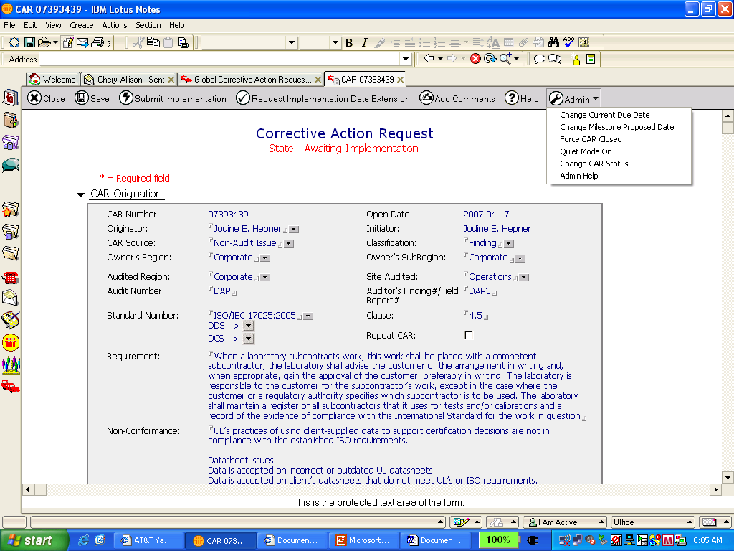
Avoiding CAR Escalation Errors
1. Place the CAR in “Quiet Mode”.
  This prevents unnecessary emails from being sent when you change the CAR status.

Slide 5
Avoiding CAR Escalation Errors
2. Revert the CAR to a previous status.
  Change the status until it is either:
    “Awaiting Response” if the response had become overdue
    “Awaiting Implementation” if a milestone had become overdue

Slide 6
Avoiding CAR Escalation Errors
2. Revert the CAR to a previous status.

Slide 7
Avoiding CAR Escalation Errors
3. Change the due date.
  Be sure to use the calendar function when changing the due date.
  Please keep in mind that the CAR Process Owner (Denise Echols) must approve:
    Extensions that extend a commitment by 30 days or more
    Extensions after 3 have been previously granted for a response or 3 for all milestones combined

Slide 8
Avoiding CAR Escalation Errors
3. Change the due date.
Change
Response
due date
Change
Milestone
due date

Slide 9
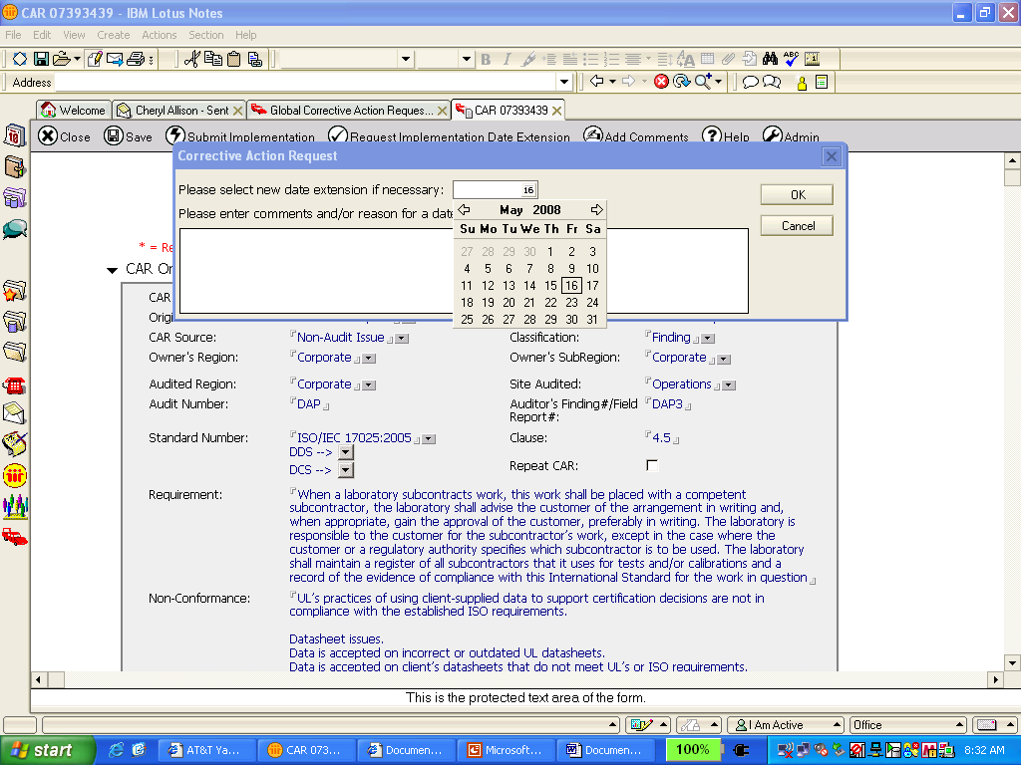
Avoiding CAR Escalation Errors
3. Change the due date.
  Be sure to use the calendar function:

Slide 10
Avoiding CAR Escalation Errors
4. Take the CAR out of “Quiet Mode”.
  You must remember to remove the CAR from “Quiet Mode” so that regular email reminders will continue.

Slide 11
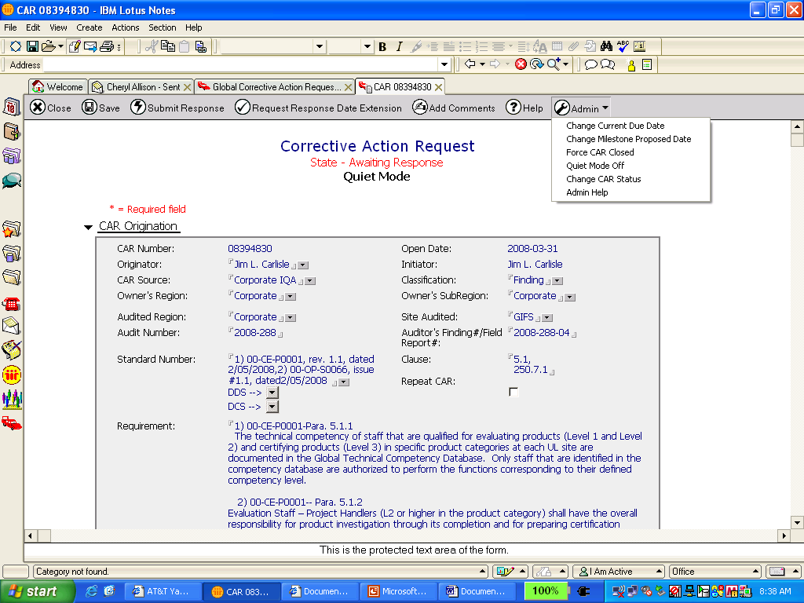
Avoiding CAR Escalation Errors
4. Take the CAR out of “Quiet Mode”.

Slide 12
Avoiding CAR Escalation Errors
For questions or further information, contact Cheryl Allison

Slide 13
Revision History
Revision 2, March 8, 2011
  2 year review, added revision history page
  Slide 5 – Removed the bullet stating that the CAR database changes one state at a time.
  Slide 7 – Clarified that the CAR Process Owner approves extensions if more than 3 for a combination of milestones and not for each milestone.

