Slide 1
Witness tests at CBTL during IQA in 2017
September 10, 2017 V 1.0
For questions or comments on the content, please contact Kyle Huang or Denise Echols

Slide 2
Agenda
Background
General
Witness Test under IEC 60950-1
Witness Test under IEC 61347-1
Witness Test under IEC 60745-1
Witness Test under IEC 60335-1
Records of Audit

Slide 3
Background
Lab test capability is part of an IECEE CBTL Assessment. Some CARs generated from IECEE CBTL assessments focused on lab test capability, specifically equipment, critical consumables, or test methods not in compliance with the IEC standard requirements.
Though some UL standards for final products have been harmonized with IEC standards, they still have differences in small details, due to the structure of IEC standards, CTL Decision Sheets published by IECEE CB Scheme, IEC TC Interpretation Sheets and the traditional approach of UL that includes the use of Certification Requirement Decisions and PAGs developed by UL PDE’s.
Note: IEC TC Interpretation Sheets: http://decisions.iecee.org/iecee/SearchCMC.nsf/home?OpenForm&Start=1&Count=30&Expand=3&Seq=5

Slide 4
General
Following tests are selected by CB program owner for witness of test in 2017.
1) Test under IEC 60950-1
a. Limited current circuits
2) Test under IEC 61347-1
a. Resistance to Tracking
3) Tests under IEC 60745-1
a. Abnormal- Overloading
4) Tests under IEC 60335-1
a. Power Cord Strain Relief Test
If a CBTL has capability in several above categories, all tests applicable need to be witnessed.

Slide 5
General
Corporate Internal Quality Audits will focus on lab testing capability during on-site audits of UL labs based on their existing CBTL scopes.
A group of tests selected will be reviewed by IQA auditors. Nonconformance will be documented in the GCAR Database. The list of tests assessed will be included in the audit records.
The corrective action will be handled according to the Global Corrective Action Procedure. If a systemic issue is found, the corrective action may be escalated for effective resolution across UL.
Corporate Quality Manager will maintain a list of tests selected in an ongoing CBTL Audit Plan. There is no intent to cover every test in every standard. However, assessments will cover various types of testing activities under CBTL scopes in a period of time obtained from program management and NCB inputs.

Slide 6
General
The list of tests need to be included in Attachment A of the Scope letter and communicated to local contact before the audit so the site can arrange the resource for the audit.

Slide 7
1) Limited Current Circuits
IEC 60950-1: 2005 +A1:2009+A2:2013, Clause 2.4.2.
CTL Equipment list:
http://www.iecee.org/get_fileID.php?file_id=181071
2.4.2 | Limited current circuits, limit values | Resistor 2 000 Ω ± 10%, Capacitance measuring device | RB

Slide 8
1) Limited Current Circuits
Method:
For frequencies not exceeding 1 kHz, the steady-state current drawn through a non-inductive resistor of 2 000 Ω ± 10 % connected between any two parts of a LIMITED CURRENT CIRCUIT, or between any such part and earth (see 1.4.9), shall not exceed 0,7 mA peak, or 2 mA d.c.
For frequencies above 1 kHz, the limit of 0,7 mA is multiplied by the value of the frequency in kilohertz but shall not exceed 70 mA peak.

Slide 9
1) Limited Current Circuits
Method: (Continued)
Alternatively, it is permitted to use the measuring instruments of Annex D instead of the non-inductive resistor of 2 000 Ω ± 10 % mentioned above.
When using the measuring instrument of Figure D.1, the voltage, U2, is measured and the current is calculated by dividing the measured voltage, U2, by 500. The calculated value shall not exceed 0,7 mA peak.
  NOTE 1 If one side of the LIMITED CURRENT CIRCUIT has a conductive connection to earth, point B of the measuring instrument of Figure D.1 should be connected to that side.
When using the measuring instrument of Figure D.2, the measured value of the current shall not exceed 0,7 mA peak.

Slide 10
1) Limited Current Circuits
Equipment:
2000 ohm no-inductive resistance. ( calibrated/verified with 10% tolerance) This is mandatory.
2a) Oscilloscope or similar Frequency Meter. ( tolerance: +/- 0.2% up to 10K Hz)
2b) Current meter ( tolerance as the following:
dc up to 60 Hz ± 1,5%
above 60 Hz up to 5 kHz ± 2,5%
5 kHz up to 20 kHz ± 3,5%
20 kHz and above ± 5%)
The laboratory can use D.1 or D.2 instead of equipment 2a and 2b.

Slide 11
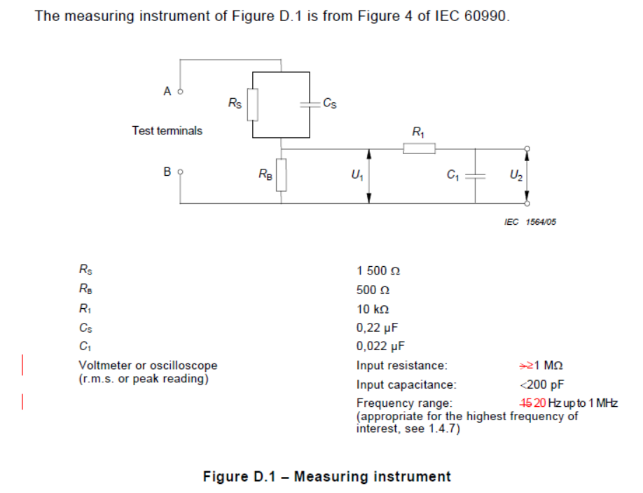
1) Limited Current Circuits

Slide 12
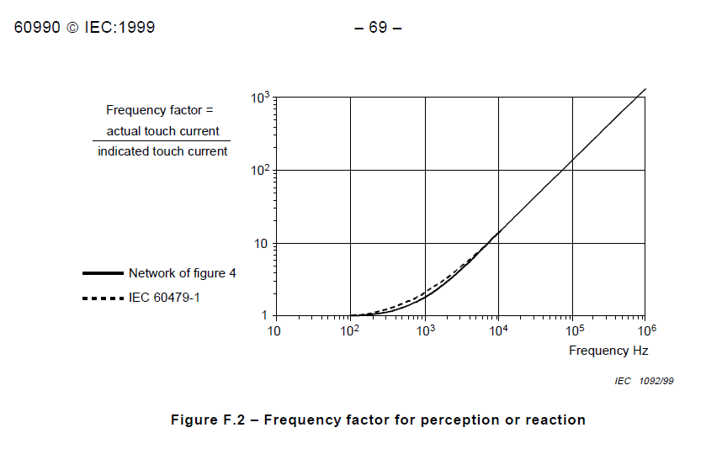
1) Limited Current Circuits
Test Instrument D.1: Reference to OD-5013 V1.0
The measuring instrument is calibrated by comparing the frequency factor of U2 with the solid line in Figure F.2 of IEC 60990 at various frequencies. A calibration curve is constructed showing the deviation of U2 from the ideal curve as a function of frequency.

Slide 13
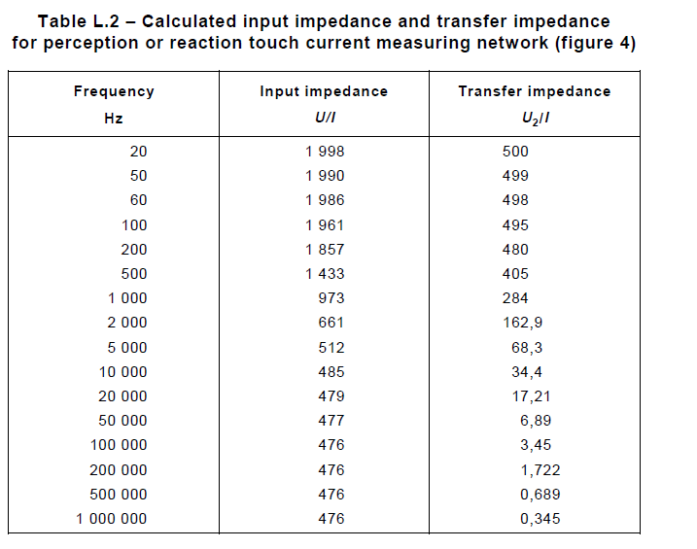
1) Limited Current Circuits
Test Instrument D.1:

Slide 14
1) Limited Current Circuits
Meter D.1:
  The complete circuit as one leakage current meter for the tolerance :
50 Hz up to 60 Hz ± 3,5%
greater 60 Hz up to 5 kHz ± 5%
greater 5 kHz up to 100 kHz ± 10%

Slide 15
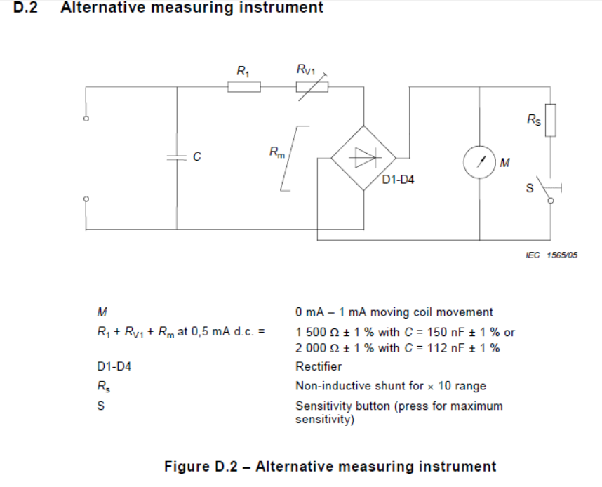
1) Limited Current Circuits

Slide 16
1) Limited Current Circuits
Test Instrument D.2:
The instrument comprises a rectifier/moving coil meter with additional series resistance, the two being shunted by a capacitor, as shown in Figure D.2. The effect of the capacitor is to reduce the sensitivity to harmonics and other frequencies above the power frequency. The instrument should also include a × 10 range obtained by shunting the meter coil by a non-inductive resistor. It is also permitted to include overcurrent protection, provided that the method used does not affect the basic characteristics of the instrument.
RV1 is adjusted for the desired value of total resistance at 0,5 mA d.c.
The meter is calibrated at the following calibration points on the maximum sensitivity range at
50 Hz to 60 Hz sinusoidal: 0,25 mA, 0,5 mA, 0,75 mA.
The following response is checked at the 0,5 mA calibration point:
Sensitivity at 5 kHz sinusoidal: 3,6 mA ± 5 %.

Slide 17
2) Resistance to Tracking
IEC 61347-1:2007+A1:2010+A2:2012, clause 18.5 ( This is not the latest edition of IEC 61347-1)
Lamp controlgear intended for building into luminaires other than ordinary, independent lamp controlgear, and lamp controlgear having insulation subject to starting voltages with a peak value higher than 1 500 V shall be resistant to tracking.
For materials other than ceramic, compliance is checked by subjecting the parts to the tracking test according to Section 13 of IEC 60598-1. ( The version of IEC60598 here is 2008 instead of last version 2014)
https://www.youtube.com/watch?v=zn9xpMTPVb4
https://www.youtube.com/watch?v=VQK_QLy-JBo

Slide 18
2) Resistance to Tracking
IEC 60598-1:2008 Clause 13.4 ( This is not the latest edition of IEC 60598-1)
Method:
For materials other than ceramic, compliance is checked by the proof tracking test in accordance with IEC 60112 subject to the following details.
– If the specimen has no flat surface of at least 15 mm × 15 mm, the test may be carried out on a flat surface with reduced dimensions provided drops of liquid do not flow off the specimen during the test. No artificial means should, however, be used to retain the liquid on the surface. In case of doubt, the test may be made on a separate strip of the same
material, having the required dimensions and manufactured by the same process.
– If the thickness of the specimen is less than 3 mm, two, or if necessary more, specimens should be stacked to obtain a thickness of at least 3 mm.

Slide 19
2) Resistance to Tracking
Method: ( Continued)
– The test shall be made at three places of the specimen or on three specimens.
– The electrodes (see Figure 11) shall be of platinum and test solution A, described in 7.3 of IEC 60112:2003, shall be used.
The specimen shall withstand 50 drops without failure at a test voltage of PTI 175. A failure has occurred if a current of 0,5 A or more flows for at least 2 s by a conducting path between the electrodes on the surface of the specimen, thus operating the overcurrent relay, or if the specimen burns without releasing the overcurrent relay.
Clause 9 of IEC 60112:2003 regarding determination of erosion does not apply. ( No erosion required)
The Note 3 of Clause 5 of IEC 60112:2003 regarding surface treatment does not apply. ( Test sample according to previously described)

Slide 20
2) Resistance to Tracking
IEC 60112:2003 + A1:2009
6 Test specimen conditioning
6.1 Environmental conditioning
Unless otherwise specified, the test specimens shall be conditioned for a minimum of 24 h at 23 °C ± 5 K, with (50 ± 10) % RH.(Only the review of records required)
6.2 Test specimen surface state
Unless otherwise specified,
a) tests shall be made on clean surfaces;
b) any cleaning procedure used shall be reported. Wherever possible, the details shall be agreed between supplier and customer.

Slide 21
2) Resistance to Tracking
7 Test apparatus
7.1 Electrodes
Two electrodes of platinum with a minimum purity of 99 % shall be used. The two electrodes shall have a rectangular cross-section of (5 ± 0,1) mm × (2 ± 0,1) mm, with one end chisel-edged with an angle of 30° ± 2° (see Figure 1). The sharp edge shall be removed to produce an approximately flat surface, 0,01 mm to 0,1 mm wide.
At the start of the test, the electrodes shall be symmetrically arranged in a vertical plane, the total angle between them being 60° ± 5° and with opposing electrode faces approximately vertical on a flat horizontal surface of the test specimen (see Figure 2 ). Their separation along the surface of the test specimen at the start of the test shall be 4,0 mm ± 0,1 mm.
( all dimensions are required to have calibration records or verification records)

Slide 22
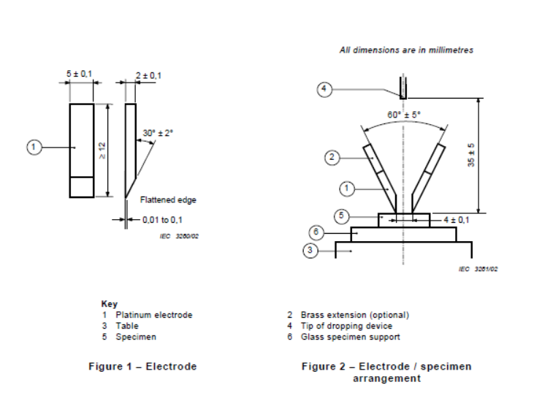
2) Resistance to Tracking

Slide 23
2) Resistance to Tracking
A thin metal rectangular slip gauge shall be used to check the electrode separation. The electrodes shall move freely and the force exerted by each electrode on the surface of the test specimen at the start of the test shall be 1,00 N ± 0,05 N. The design shall be such that the force can be expected to remain at the initial level during the test. ( Force need to be verified)
One typical type of arrangement for applying the electrodes to the test specimen is shown in Figure 3. The force shall be verified at appropriate intervals.
Where tests are made solely on those materials where the degree of electrode penetration is small, the electrode force may be generated by the use of springs. However, gravity should be used to generate the force on general purpose equipment (see Figure 3).

Slide 24
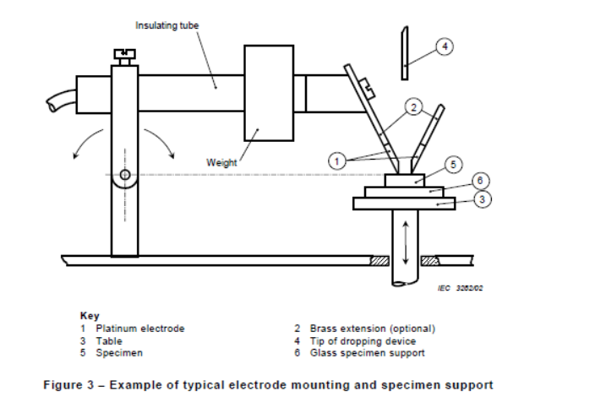
2) Resistance to Tracking

Slide 25
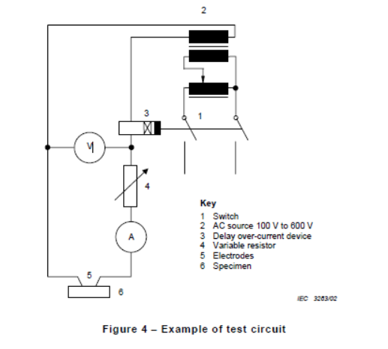
2) Resistance to Tracking

Slide 26
2) Resistance to Tracking
7.2 Test circuit
The electrodes shall be supplied with a substantially sinusoidal voltage, variable between 100 V and 600 V at a frequency of 48 Hz to 62 Hz. The voltage measuring device shall indicate a true r.m.s. value and shall have a maximum error of 1,5 %. The power of the source shall be not less than 0,6 kVA. An example of a suitable test circuit is shown in Figure 4.
A variable resistor shall be capable of adjusting the current between the short-circuited electrodes to (1,0 ± 0,1) A and the voltage indicated by the voltmeter shall not decrease by more than 10 % when this current flows (see Figure 4). The instrument used to measure the value of the short-circuit current shall have a maximum error of ±3 %. ( Use this value instead of CTL)
The input supply voltage to the apparatus shall be adequately stable.
The over-current device shall operate when a current with an r.m.s. value of 0,50 A with ha relative tolerance of ±10 %, has persisted for 2,00 s with a relative tolerance of ±10 %. ( Use this value instead of CTL)

Slide 27
2) Resistance to Tracking
7.3 Test solutions
Solution A:
Dissolve approximately 0,1 % by mass of analytical reagent grade anhydrous ammonium chloride (NH4Cl), of a purity of not less than 99,8 %, in de-ionized water, having a conductivity of not greater than 1 mS/m to give a resistivity of (3,95 ± 0,05) Ωm at (23 ± 1) °C.
(Purchasing records of NH4Cl and deionized water are required. The measurement for the resistivity of solution is required, but the solution 0.1% is not required for verification)
Solution B: ( Not allowed)

Slide 28
2) Resistance to Tracking
7.4 Dropping device
Drops of the test solution shall fall on to the specimen surface at intervals of 30 s ± 5 s. The drops shall fall more or less centrally between the electrodes from a height of 35 mm ± 5 mm.
The time for 50 drops to fall on to the specimen shall be (24,5 ± 2) min.
The mass of a sequence of 50 drops shall lie between 0,997 g and 1,147 g.
The mass of a sequence of 20 drops shall lie between 0,380 g and 0,480 g.
The mass of the drops shall be checked at appropriate time intervals.
( verification records are required for the mass of drops and the intervals)

Slide 29
2) Resistance to Tracking
7.5 Test specimen support platform
A glass plate or plates, having a total thickness of not less than 4 mm and of a suitable size shall be used to support the test specimen during the test.
disposable glass microscope slide be placed on the specimen support table immediately under the test specimen.
7.6 Electrode assembly installation
The specimen and its immediate electrodes shall be mounted in an essentially draught-free space in an enclosure.
A suitable fume extraction system shall be provided to allow safe venting of the enclosure after the test.

Slide 30
2) Resistance to Tracking
8 Basic test procedure
8.1 General
Where the material is substantially anisotropic, tests shall be made in the direction of the features and orthogonal to them. Results from the direction giving the lower values shall be used, unless otherwise specified.
Test shall be made at an ambient temperature of (23 ± 5) °C.
Tests shall be made on uncontaminated test specimens, unless otherwise specified. The result of a test where a hole is formed is considered to be valid, irrespective of the test specimen thickness, but the formation of the hole shall be reported together with the depth of the hole (the thickness of the test specimen or stack).

Slide 31
2) Resistance to Tracking
8.2 Preparation
After each test, clean the electrodes with an appropriate solvent and then rinse them with deionized water. If necessary, restore their shape and give a final rinse before the next test.
Immediately before the test ensure, if necessary by cooling the electrodes, that their temperature is sufficiently low so that they have no adverse effect on the specimen properties.
Ensure freedom from visual contamination and ensure that the solution to be used conforms to the conductivity requirements either by regular testing, or by measurement immediately before the test.
In case of dispute, the cleaning procedures used for the electrodes and dropper tube shall be agreed between purchaser and supplier

Slide 32
2) Resistance to Tracking
8.2 Preparation
Place the test specimen, with the test surface uppermost and horizontal on the specimen support table. Adjust the relative height of the test specimen and electrode mounting assembly, such that on lowering the electrodes on to the specimen, the correct orientation is achieved with a separation of 4,0 mm ± 0,1 mm. Ensure that the chisel edges make contact with the surface of the specimen with the required force and over their full width.
Set the test voltage to the required value which shall be an integer multiple of 25 V, and adjust the circuit parameters so that the short-circuit current is within the permitted tolerance.

Slide 33
2) Resistance to Tracking
8.3 Test procedure
Start the dropping system so that drops fall on to the test surface and continue the test until one of the following occurs:
a) the over-current device operates;
b) a persistent flame occurs;
c) at least 25 s have elapsed after the fiftieth drop has fallen without a) or b) occuring.
After completion of the test, vent the chamber of noxious fumes and remove the test specimen.

Slide 34
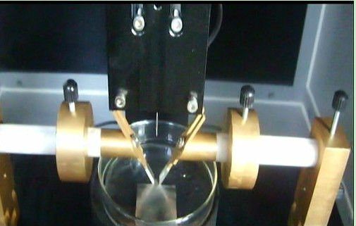
2) Resistance to Tracking

Slide 35
3) Overload Test
IEC 60745-1:2006, Clause 18.12
A class I tool employing class II construction (see 5.10) or a class II tool shall be able to operate under extreme overload conditions without impairing protection against electric shock.
Compliance is checked by the following test on a separate sample.
All fuses, thermal cut-outs, overload protectors and the like specified in 18.1 that are accessible to the user without the aid of a tool shall be shorted.
The sample is connected to a minimum 12 kVA circuit. The tool is loaded to 160 % of normal load current for either 15 min or until the tool open-circuits or flame appears. If the tool will not operate at 160 %, the tool is stalled for 15 min or until the tool open-circuits or flame appears. (12 KVA needs to be verified)

Slide 36
3) Overload Test
IEC 60745-1:2006, Clause 18.12
If either condition occurs, immediately de-energize the tool and, if flames appear, extinguish with CO2 extinguisher. The leakage current between live parts and accessible parts, measured in accordance with Clause 13, is monitored throughout the test and after the test until leakage
current has stabilized or decreases. Leakage current shall not exceed 2 mA.
After the tool is cooled to room temperature, an electric strength test per Clause 15 is performed between live parts and accessible parts as follows:
– If a tool does not operate after 15 min, apply a 1 500 V electric strength test.
– If a tool operates after 15 min, apply a 2 500 V electric strength test.

Slide 37
3) Overload Test
Clause 13 Leakage current
Protective impedance is disconnected from live parts before carrying out the tests. It is recommended that the tool be supplied through an isolating transformer; otherwise, it must be insulated from earth.
The leakage current is measured by means of the circuit of Figure 10 between any pole of the supply and accessible metal parts and metal foil with an area not exceeding 20 cm × 10 cm in contact with accessible surfaces of insulating material, connected together.
The metal foil has the largest area possible on the surface under test, without exceeding the dimensions specified. If its area is smaller than the surface under test, it is moved so as to test all parts of the surface. The heat dissipation of the tool shall, however, not be affected by the metal foil.

Slide 38
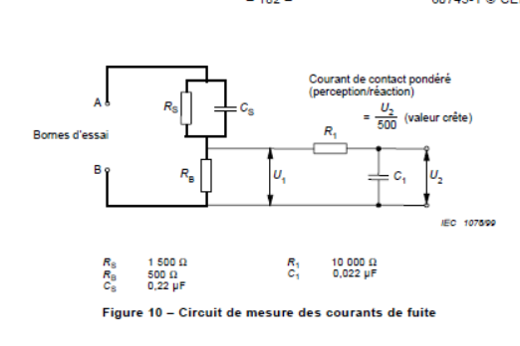
3) Overload Test
This is the same as D.1 circuit for IEC 60950-1

Slide 39
3) Overload Test
15.2 Electrical Strength Test
The insulation is subjected for 1 min to a voltage of substantially sinusoidal waveform, having a frequency of 50 Hz or 60 Hz. The value of the test voltage and the points of application are shown in Table 2, unless otherwise specified.
Accessible parts of insulated material are covered with metal foil.
Initially, not more than half the prescribed voltage is applied, then it is raised rapidly to the full value.
No flashover or breakdown shall occur during the test.
The high-voltage transformer used for the test must be so designed that, when the output terminals are short-circuited after the output voltage has been adjusted to the appropriate test voltage, the output current is at least 200 mA.

Slide 40
3) Overload Test
The overcurrent relay must not trip when the output current is less than 100 mA.
Care is taken that the r.m.s. value of the test voltage applied is measured within ±3 %.
Care is taken that the metal foil is so placed that no flashover occurs at its edges or the edges of the insulation.
When testing insulating coatings, the metal foil may be pressed against the insulation by means of a sandbag of such a size that the pressure is about 5 kPa (0,5 N/cm2). The test may be limited to places where the insulation is likely to be weak, for example where there are sharp metal edges under the insulation.

Slide 41
3) Overload Test
Equipment:
Timer ( +/- 1%)
Voltage Meter ( +/- 1.5%)
Current Meter ( <= 5A, 1.5% ; >5 A, 2.5%)
Leakage current Meter/Circuit ( See slide 24)
Dielectric Machine ( +/3 3%)

Slide 42
4) Power Cord Strain Relief Test
IEC 60335-1:2010 Clause 25.15
Method:
A mark is made on the cord while it is subjected to the pull force shown in Table 12, at a distance of approximately 20 mm from the cord anchorage or other suitable point.
The cord is then pulled, without jerking, for 1 s in the most unfavourable direction with the force specified. The test is carried out 25 times.
The cord, unless on an automatic cord reel, is then subjected to a torque that is applied as close as possible to the appliance. The torque is specified in Table 12 and is applied for 1 min.
During the tests, the cord shall not be damaged and shall show no appreciable strain at the terminals. The pull force is reapplied and the cord shall not be longitudinally displaced by more than 2 mm.

Slide 43
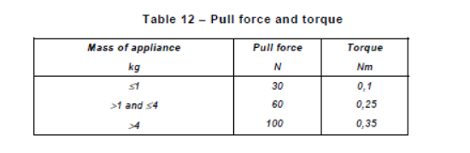
4) Power Cord Strain Relief Test

Slide 44
4) Power Cord Strain Relief Test
Equipment:
Timer ( +/- 1 %)
Torque Meter ( +/- 10%)
Force (+/- 6%)
Mass ( 100g - 5Kg +/- 2%)
Caliper ( +/- 0.1 mm)

Slide 45

Records of Audit
00-QA-F0407, V3.0 is used to record the audit results.
Audit Report Number |  | Page # | of
Facility/Lab Audited |  | Test Audit Plan Rev | 6.0
Auditor Name |  | Date
Test Field/Program | IECEE CB scheme

Slide 46
Revision History
1.0 Initial Release

