Slide 1
Witness CB Test during IQA in 2013
June 6, 2012 V 1.0
For questions or comments on the content, please contact Kyle Huang or Denise Echols

Slide 2
Agenda
Background
General
3. Witness Tests under IEC 60950-1
a. Humidity Treatment
b. Discharge Test
Witness Tests under IEC 60065
a. Humidity Treatment
b. Determination of Accessible Parts
c. Dielectric Strength Test
d. Withdraw of Mains Plug Test
5. Records of Audit
6. Additional review for CB Projects

Slide 3
Background
Lab testing capability is part of IECEE CBTL Assessment. Currently there were a few CARs from IECEE CBTL assessment focusing on the testing capability of UL labs, such as Equipment, Critical Consumables, or testing method not complying with IEC standards requirement. Though some UL standards for final products have been harmonized with IEC standards, they still have differences in small details, due to the structure of IEC standards and traditional approach of UL, such as Certification Requirement Decision/ PAG by PDE and CTL Decision Sheets published by IECEE CB Scheme.

Slide 4
General
Corporate Internal Quality Audits will focus on lab testing capability during on-site audits of UL labs based on their existing CBTL scopes.
A group of tests selected will be witnessed or examined by the auditor. Nonconformance will be documented in the GCAR Database. The list of tests assessed will be included in the audit records.
The corrective action will be handled according to the Global Corrective Action Procedure. If a systemic issue is found, the corrective action may be escalated to PDE, CO, CPO or laboratory managers for effective resolution across UL.
Corporate Quality Engineering Manager will maintain a list of tests selected in an ongoing CBTL Audit Plan. There is no intent to cover every test in every standard. However, assessments will cover various types of testing activities under CBTL scopes in a period of time obtained from program management input.

Slide 5
General
Following tests are selected by CB program owner for 2013.
1) Tests under IEC 60950-1
a. Humidity Treatment
b. Discharge Test
2) Tests under IEC 60065
a. Humidity Treatment
b. Determination of Accessible Parts
c. Dielectric Strength Test
d. Withdraw of Mains Plug Test
If a CBTL has capability in both categories, only tests under IEC 60065 will be witnessed.

Slide 6
General
The list of tests need to be included in Attachment A of Scope letter and communicated to local contact person before the audit, so the site can arrange the samples, equipment and personnel in advance.
Before witnessing each test, make sure the testing staff know that the test being demonstrated must be conducted in the same manner as testing for an actual certification project. The test shall be completed step by step as requirement.
“can’t accept tests being demonstrated just half way through.” IF “staff takes these demonstrations very lightly instead of doing it as if they were really running the test they cut corners.”, “The result of this approach is an NCR. ”( from Jola Wroblewska’s email dated 6/4/2012)

Slide 7
Humidity Treatment
IEC 60950-1: 2005 +A1:2012, Clause 2.9.2
Method:
Cable entries, if any, are left open. If knock-outs are provided, they are opened. Electrical components, covers and other parts which can be removed BY HAND are removed and subjected, if necessary, to the humidity treatment with the main part.
Before being placed in the chamber, the apparatus is brought to a temperature between the specified temperature and a 4 K (degree C) higher temperature.
The chamber is to be set at 93% RH, with +/- 3% RH tolerance, at a convenient temperature between 20 degree C and 30 degree C, but the chosen temperature to be kept within +/- 2 degree C during the test. (CTL DSH 624_07_WG4)
The apparatus is kept in the chamber for 2 days (48 h)(We do not need wait the end of test)

Slide 8
Humidity Treatment
Equipment:
A. Humidity chambers
Requirement:
1) Calibration points: (IEC 60068-3-5:2001, Clause 4.4)
Temperature measuring sensors are located in each corner and in the center of the working space (see figure 3, minimum 9 sensors). For temperature chambers over 2 000 liter, additional sensors should be located in front of the center of each wall (see figure 4, minimum 15 sensors). The measuring system is to be arranged in such a way that the temperature distribution of the empty test chamber will not be affected.
(IEC 60068-3-6:2001, Clause 4.4)
A single humidity sensor should be positioned at the center of the working space. The relative humidity is then calculated at each point in the working space where a temperature sensor is located by using the temperature difference. This assumes that the absolute humidity remains the same throughout the working space.
2) Acceptance Tolerance of Calibration data: (CTL DSH 624_07_WG4)
a) The standard specifications for the humidity are to be met at the reference/measuring point, where the controlling humidity sensor is located. The tolerances permitted in CTL DSH 251A (+/- 6% RH) are allowed in other parts of the humidity chamber, away from the reference points.
b) Temperature: +/- 2 degree C. (CTL 251B, not include thermocouple)

Slide 9
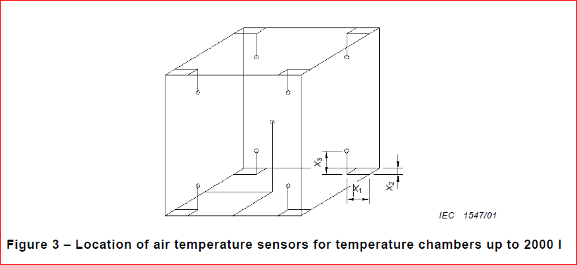
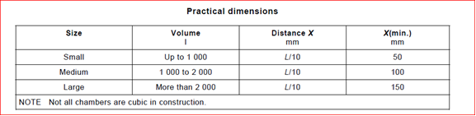
Humidity Treatment

Slide 10
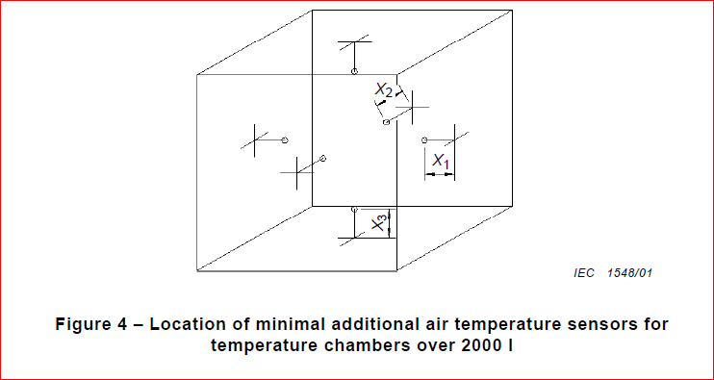
Humidity Treatment

Slide 11
Humidity Treatment
Equipment:
B. Timer
Calibration Tolerance: +/- 1% (CTL 251B)

Slide 12
Humidity Treatment
Environment (Recommendation only, IEC 60068-3-5:2001, Clause 4.1)
The following items should be taken into consideration:
the ambient conditions described in IEC 60068-1 should be satisfied in principle; (15-35 degree C, 75% RH maximum)
the chamber should not be exposed to direct solar radiation;
the chamber should not be exposed to electromagnetic interference;
the chamber should be leveled;
the chamber should be fixed in a location free from any mechanical and acoustic vibration interference

Slide 13
Discharge Test
IEC 60950-1:2005+A1:2012, clause 2.1.1.7
Method:
EUT is connected to the power source and under normal operation.
The voltage (instant value) between the terminals of EUT plug is measured, when EUT is disconnected to the power source. (It may not be necessary to disconnect at exactly the peak of the voltage curve, as long as the value is not 0 V)
The voltage (instant value) between the terminals of EUT plug is measured, when EUT is disconnected to the power source after 1s. ( non-industrial plug equipment)
The voltage (instant value) between the terminals of EUT plug is measured, when EUT is disconnected to the power source after 10s. (industrial plug equipment)

Slide 14
Discharge Test
Equipment:
Oscilloscope with the probe used:
1) Having equipment records to demonstrate that an input impedance consisting of a resistance of 100 MΩ ± 5 MΩ in parallel with an input capacitance of 25 pF or less.
(Capacitance was 20+/-5 pF before A1:2012)
2) Calibration:
Timing function: +/- 10 ms (CTL 251 B)
Voltage: 0-1000V, DC to 1 KHz, +/- 1.5% (CTL 251 B)

Slide 15
Discharge Test
Acceptance Criteria:
The voltage measured after 1 s (10 s) has decayed to 37 % or less than the value measured at disconnection.

Slide 16
Humidity Treatment
IEC 60065:2001 +A1:2005 +A2:2010, Clause 10.2, not tropical climates
The same as IEC 60950-1: 2005 +A1:2012, Clause 2.9.2. (CTL DSH 624_07_WG4)

Slide 17
Determination of Accessible Parts
IEC 60065:2001 +A1:2005 +A2:2010, Clause 9.1.1.2, not include additional requirement for Class II products
Method
Through openings, the test finger is applied to any depth that the finger will permit and is rotated or angled before, during and after insertion to any position.
If the opening does not allow the entry of the finger, the force on the finger in the straight position is increased to 20 N ± 2 N and the test repeated with the finger in angled position.
The test is repeated using small finger probes according to test probes 18 of IEC 61032. This does not apply if the intended conditions of use prevent the apparatus from being accessed by children
The test is repeated using small finger probes according to test probes 19 of IEC 61032. This does not apply if the intended conditions of use prevent the apparatus from being accessed by children

Slide 18
Determination of Accessible Parts
Equipment
A. Force Gage: Calibration Tolerance (+/- 6%, CTL 251B)
B. The following test fingers and probes are available and calibrated to the dimensions specified.
Tolerance specified in the drawing shall be observed. The tolerance in CTL 251B can be used, if tolerance is not specified in the drawing.

Slide 19
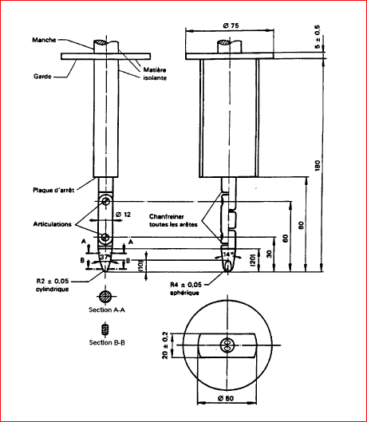
Determination of Accessible Parts
Test Finger

Slide 20
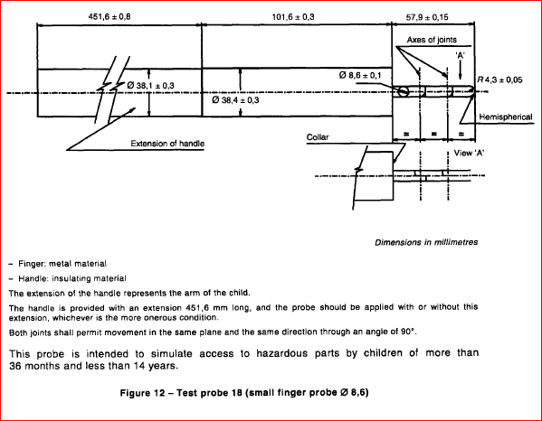
Determination of Accessible Parts

Slide 21
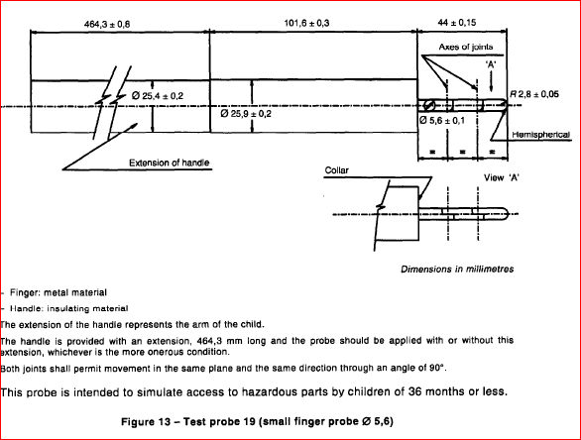
Determination of Accessible Parts

Slide 22
Determination of Accessible Parts
Environment: (IEC 60065:2001 +A1:2005 +A2:2010, Clause 4.1.3)
15-35 degree C, 75% RH maximum
Acceptance Criteria:
Conductive parts, covered only by lacquer, solvent-based enamel, ordinary paper, untreated textile, oxide films or beads are considered to be bare.
Moving parts of loudspeaker systems, such as dust caps or cones of drivers or passive radiators, are not regarded as preventing accessibility.

Slide 23
Dielectric Strength Test
IEC 60065: 2001+A1:2005+A2:2010, 10.3.2
Method
Initially, not more than half of the prescribed test voltage is applied.
Then it is raised rapidly to the full value which is held for 1 min. Value of the test voltage applied is measured within ±3 %.

Slide 24
Dielectric Strength Test
Equipment
Dielectric Tester
1.1) Capacity Verification:
a) The test voltages shall be obtained from a suitable source so designed that, when the output TERMINALS are short-circuited after the test voltage has been adjusted to the appropriate level, the output current is at least 200 mA.
  For example, If the dielectric voltage is 1000V, the record should show that the short-circuited current between equipment’s two high voltage terminals were measured, after the open circuit voltage was measured at 1000V. The short-circuited current should be over 200 mA. (Short period )
b) An over-current device shall not trip when the output current is less than 100 mA

Slide 25
Dielectric Strength Test
Equipment
Dielectric Tester
1.2) Calibration: (CTL 251B)
Voltage: 0-1000V, DC to 1KHz, +/- 1.5% ;
Voltage 1000V and above, DC to 1KHz, +/- 3%
2) Timer or Timing Function on Dielectric Tester
Calibration: +/- 1%

Slide 26
Dielectric Strength Test
Environment
The dielectric strength tests are made in the humidity chamber, or in the room in which the apparatus was brought to the prescribed temperature.

Slide 27
Withdrawal of Mains Plug Test
IEC 60065: 2001+A1:2005+A2:2010, clause 9.1.6 and 9.1.1.1
Method:
EUT is connected to the power source and under normal operation.
The voltage (instant value) between the terminals of EUT plug is measured. EUT is disconnected to the power source, when the voltage is close to the peak value.
The voltage (instant value) of the pins or contacts of the plug is measured, when EUT is disconnected to the power source after 2s.
The test may be repeated up to 10 times to obtain the most unfavorable situation.

Slide 28
Withdrawal of Mains Plug Test
5. IF the voltage measured after 2s exceeds:
– 35 V (peak) a.c. or 60 V d.c.,
– for audio signals of PROFESSIONAL APPARATUS, 120 V r.m.s.,
– for audio signals of other than PROFESSIONAL APPARATUS, 71 V r.m.s.;
(If the voltage measured does not exceed above value, the test is completed and results complies with the requirement)
a) The stored charges is calculated if voltage is between 60V d.c. and 15KV d.c. (C = cV) ( Charge is equal to capacitance times Voltage)
b) The energy of discharge is calculated if voltage is exceeding 15KV d.c. (E= ½ CV*V) (Energy is equal to 0.5 times capacitance time voltage square)
6. If stored charges exceeds 45 uC or energy of discharge exceeds 350 mJ, the touch current is to be measured, expressed as the corresponding voltages U1 and U2, and measured in accordance with IEC 60990, with the measuring network described in annex D of IEC 60065: 2001+A1:2005+A2:2010.

Slide 29
Withdrawal of Mains Plug Test
Equipment:
Oscilloscope with the probe used:
1) Having equipment records to demonstrate that an input impedance consisting of a resistance of 100 MΩ ± 5 MΩ in parallel with an input capacitance of 25 pF or less.
2) Calibration:
Timing function: +/- 10 ms (CTL 251 B)
Voltage: 0-1000V, DC to 1 KHz, +/- 1.5% (CTL 251 B)

Slide 30
Withdrawal of Mains Plug Test
Acceptance Criteria:
a) The voltage measured after 2s has less than:
– 35 V (peak) a.c. or 60 V d.c.,
– for audio signals of PROFESSIONAL APPARATUS, 120 V r.m.s.,
– for audio signals of other than PROFESSIONAL APPARATUS, 71 V r.m.s.;
b) OR The stored charges is less than 45 uC if voltage is between 60V d.c. and 15KV d.c., or the energy of discharge is less than 130 mJ if voltage is exceeding 15KV d.c.
c) OR The touch current measured does not exceed.
– for a.c.: U1 = 35 V (peak) and U2 = 0,35 V (peak);
– for d.c.: U1 = 1,0 V.

Slide 31
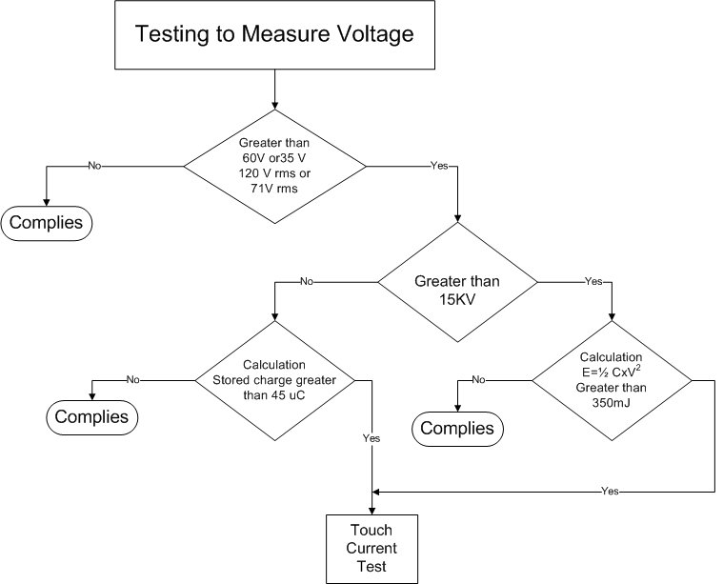
Withdrawal of Mains Plug Test

Slide 32

Records of Audit
00-QA-F0407, V2.0 is used to record the audit results.
Audit Report Number |  | Page # | of
Facility/Lab Audited |  | Test Audit Plan Rev
Auditor Name |  | Date
Test Field/Program | Electrical/ CBTL

Slide 33
Additional review for CB Projects
1) Select CB Test Report to IEC 60950-1. Review the Critical Component Table in the report.
2) Look for the following in the table:
a. Do the critical components (e.g. Power Supply) have an IEC certificate indicated? Do not accept CE-Marking!!! Since this is self-declaration.
b. Have they been investigated to the latest edition of the IEC standard?
c. Does the table include components and sub-assemblies certified to previous editions of the standard?
d. If yes, was an additional evaluation done, potentially additional testing or is there clarification why no additional investigation was required? (This is critical for power supply which is also evaluated to the IEC 60950-1 standard)

